Slide 1
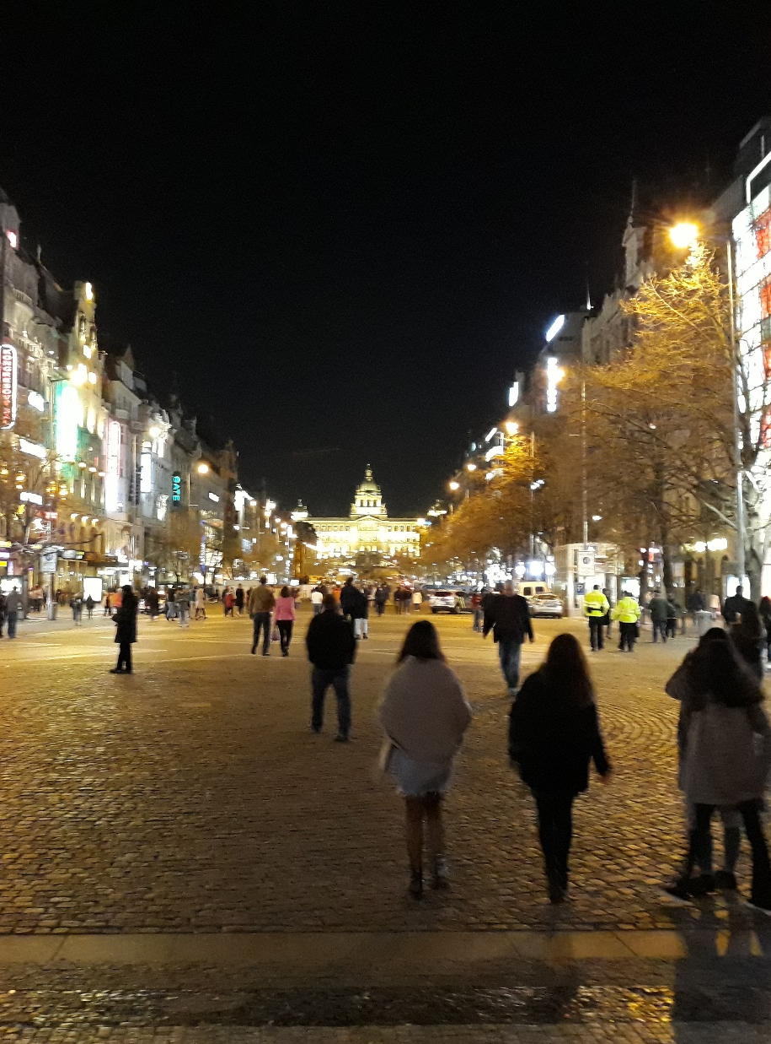
IETF Hackathon:
Network Time Security (NTS)
IETF 104
23-24 March, 2019
Prague

Slide 2
Hackathon Plan
Integration of NTS into different NTP implementations
Based on draft-ietf-ntp-using-nts-for-ntp-17
Verifying interoperability between various NTS implementations

Slide 3
What got done
IETF 104 Hackathon Results Overview |  |  | NTP NTS Servers
 |  |  | Ostfalia Server | Chrony Server | NTPSec Server | Netnod (Python) Server | Netnod (Golang) (Malmö) Server | NTF Server (*) | Cloudflare NTS Server
 |  | Implementation Status | Done | Done | Done | Done | In Progress | In Progress | In Progress
NTP NTS Clients | Ostfalia Client | Done | KE, NTP | KE, NTP | KE, NTP | KE, NTP
 | Chrony Client | Done | KE, NTP | KE, NTP | KE, NTP | KE, NTP
 | NTPSec Client | Done | KE, NTP | KE, NTP | KE, NTP | KE, NTP
 | Netnod (Python) client | Done | KE,NTP | KE,NTP | KE, NTP | KE, NTP
 | Netnod (Golang) (Malmö) client | Done | KE
 | NTF client (*) | In Progress
KE = Key Exchange worked NTP = authenticated NTP packets successfully exchanged
(*) NOTE: implementing draft-ietf-ntp-using-nts-for-ntp-11

Slide 4
What we did/learned
Several bug fixes in the implementations
Some issues with OpenSSL (bug in TLS key exporter function)
Interoperability test was very successful
No further problems in the NTS-draft discovered

Slide 5
Wrap Up
Team members:
Karen O'Donoghue (ISOC)
Dieter Sibold (PTB)
Richard Welty (NTF)
Martin Langer (Ostfalia University)
Christer Weinigel (Netnod)
Watson Ladd (Cloudfare)
Aanchal Malhotra (Boston University, Cloudflare)
Miroslav Lichvar (Red Hat) (remote)
Hal Murray (NTPSec) (remote)
Sanjeev Gupta (NTPSec) (remote)
Gary Miller (NTPSec) (remote)
Michael "MC" Cardell Widerkrantz (Malmö) (remote)
Martin "cos" Samuelsson (Malmö) (remote)
NTP working group:
https://datatracker.ietf.org/wg/ntp
Involved documents:
draft-ietf-ntp-using-nts-for-ntp-17
RFC 5905 (NTPv4)
RFC 5297 (AES-SIV)
RFC 7822 (NTP EF)
Repositories:
https://gitlab.com/MLanger/nts
​https://github.com/Netnod/nts-poc-python
https://github.com/wbl/nts-rust
​https://github.com/mlichvar/chrony-nts
​https://gitlab.com/NTPsec/ntpsec

