Slide 1
IETF Hackathon: OpenWSN Project
IETF 104
23-24 March, 2019
Prague

Slide 2

Hackathon Plan
Evaluating the performance of 6TiSCH
RFC/draft:
RFC8180
RFC8480
draft-ietf-6tisch-msf
Implementing the latest version msf draft
Implementing the continuous delivery benchmarking platform

Slide 3
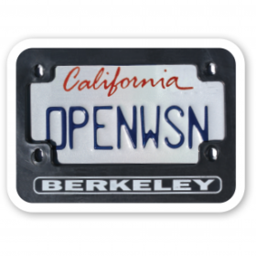

What we planned to do
OpenWSN Project
Open source
Implementation of 6TiSCH stack
Firmware: openwsn-fw
Software: openvisualizer, coap
OpenBenchmark Project
Open source
benchmark 6TiSCH stack in a reproducible manner
Front end : web interface to manage experiment
Back end : interact with mote over testbed
www.openwsn.org
https://benchmark.6tis.ch

Slide 4
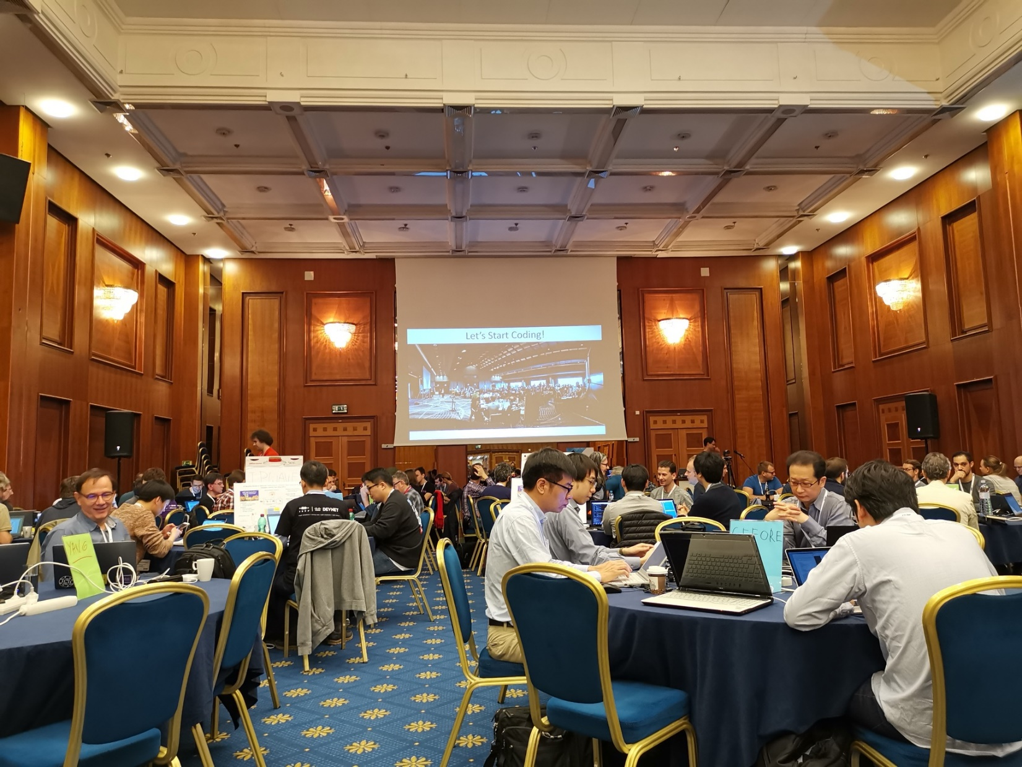

Slide 5
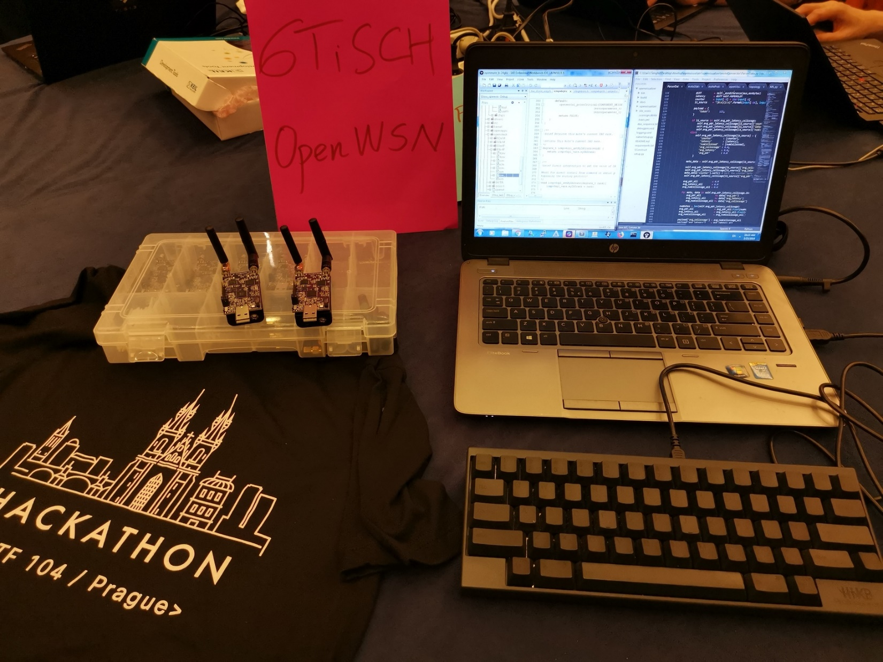

Slide 6
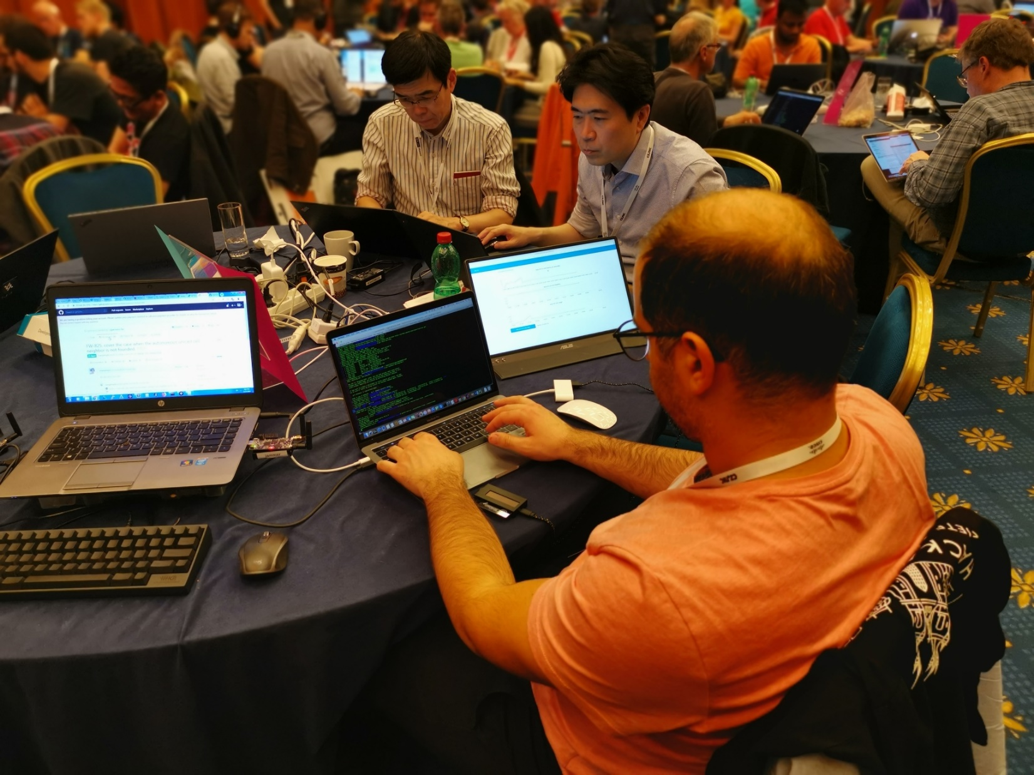

Slide 7
What got done
Outcome
draft-ietf-6tisch-msf version 02 is implemented
Benchmark CoAP application is implemented and integrated with the benchmarking service
Able to receive the signal from mote over Testbed
Code available at:
https://github.com/openwsn-berkeley/openwsn-fw/
https://github.com/openwsn-berkeley/openvisualizer
A live demo available at:
https://openwsn-dashboard.eu-gb.mybluemix.net/ui

Slide 8
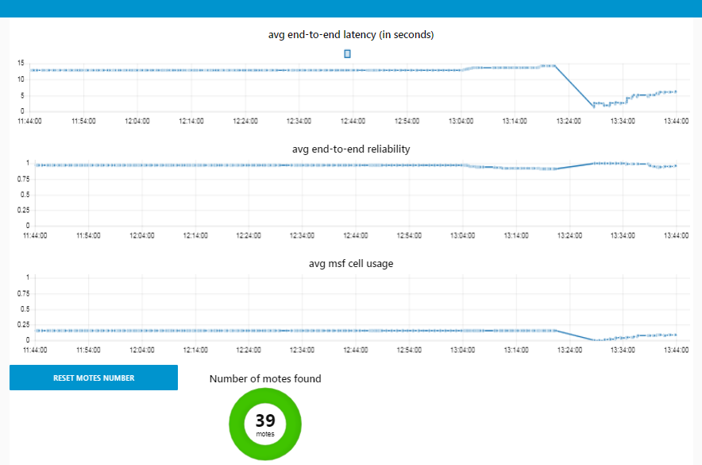

Slide 9
What we learned
the performance of MSF-02 version is improved compared to version -01
Network forming time
Efficient on cell allocation
End-to-end reliability
The synchronization takes long!

Slide 10
Wrap Up
Team members:
Tengfei Chang
Malisa Vucinic
Affiliation:
Inria-Paris, France
Email:
tengfei.chang@inria.fr
malisa.vucinic@inria.fr
Links:
https://datatracker.ietf.org/wg/6tisch/
www.openwsn.org
https://benchmark.6tis.ch/

