Slide 1
IETF Hackathon: SpinDump (QUIC Measurements)
IETF 104
23-24 March, 2019
Prague

Slide 2
Hackathon Plan
We were working on tools for network performance monitoring
Relevant drafts
draft-trammell-ippm-spin
draft-cfb-ippm-spinbit-new-measurements
The set of QUIC drafts
Improve the spindump analyzer tool, implement aggregation and visualisation tools

Slide 3
What got done
Added support for Google QUIC back to Q043
Added support for IETF QUIC draft 18
We updated the JSON reporting format
We fixed bugs
We started work on an aggregation server that collects data from multiple spindump instances.
We started work on a visualization tool that combines end to end performance data with data from network segments.
We discussed potential improvements to the spinbit based on:
draft-cfb-ippm-spinbit-new-measurements
Future candidate for spindump

Slide 4
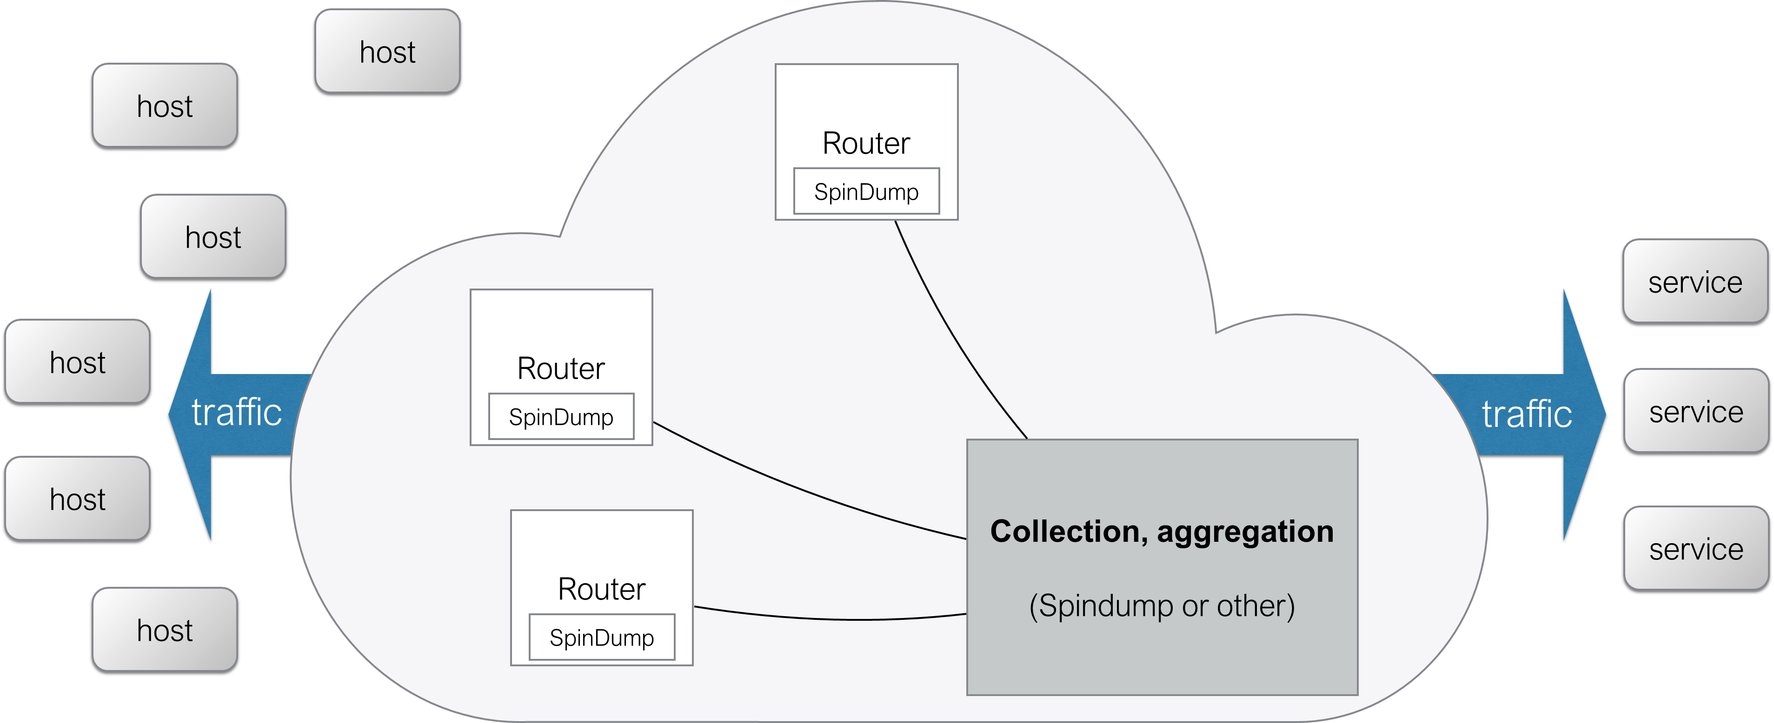
Preparing a Demo for Monday

Slide 5
Wrap Up
Team members:
Jari Arkko
Szilvester Nadas
Marcus Ihlar
Roni Even
Mauro Cociglio
https://github.com/EricssonResearch/spindump

