Slide 1

IETF Hackathon: <http 451>
IETF 104
23-24 March, 2019
Prague
Notes:
<number>

Slide 2
Hackathon Plan
Develop a http451 module for drupal
Drupal Is used by 3% of all websites of the world.
Working from Mauritius
1

Slide 3
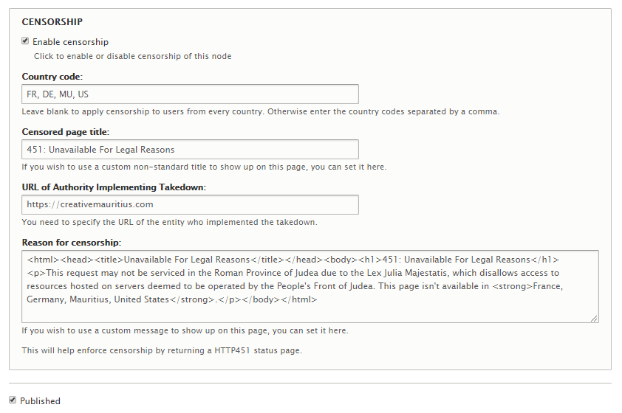
What got done
Http 451 is now in the review queue by drupal developers
Geoip
Live demo: https://creativemauritius.com
1

Slide 4
What we learned
Listening to drupal review team
Small implementation issues
Hopefully it will become official
1

Slide 5

Wrap Up
Team members:
Veegish Ramdani
Kifah Meeran
1

