Slide 1


I2RS Building the NG routing interface
Not the Pizza box CLI
I2RS built for High performance
Sue Hares, Jie Dong

Slide 2



I2RS
New concepts
Ephemeral state
High Speed Publication/subscription stream
Tracing
High speed
Via RESTCONF
NETCONF

Slide 3
I2RS Interim
Challenge: Can all the I2RS modules be integrated into ODL environment?
Steps:
Load into I2RS into I2rs repository
Validate
Build I2RS Yang modules into ubuntu-14 + Lithium
Send via NETCONF v4 route to RIB and I2RS RIB
Code
Ubuntu 14.3 ODL Lithium + I2RS Modules

Slide 4
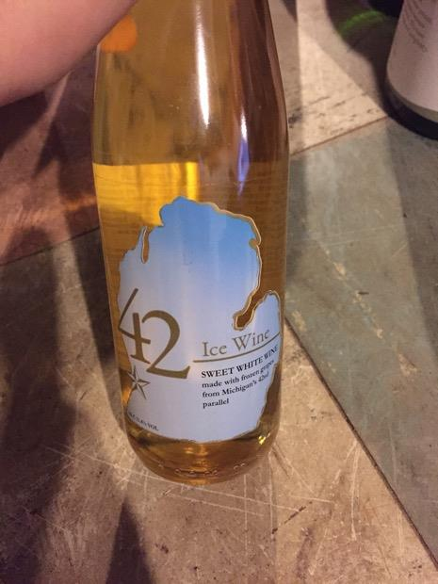

Prize to those who join I2RS hackers
Code here
Wine sent to you
ICE Wine – sweet wine harvested when the snow falls

