Slide 1

DNS / DNSSEC / DANE / DPRIVE
Platforms Used
dnspython
DEMOS
AVAILABLE
Team Affiliations
ACLU, CZ.nic,
NLnet Labs, Sinodun,
Verisign Labs, W3C
Winner of
Best Internet
Security
Improvement
Projects Developed
Privacy padding for DNS-over-TLS
Privacy election for client-subnet option
Privacy: Check TLS at Recursive
Return of privacy/transport results
DNSSEC Roadblock Avoidance
DNSSEC CDS/CDSKey

Slide 2

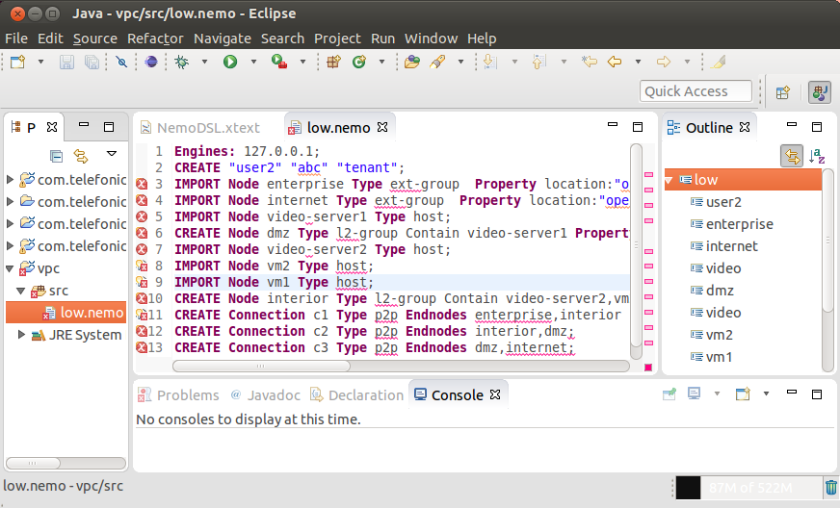

A Language for Intent Based Network Modeling
A language editor in Eclipse with Syntax highlighting and auto completion.
The virtual private cloud use case described by NEMO language
Intent execution
Low bandwidth
What I want
internet
High bandwidth
DMZ
interior
BoD
Enterprise
site

Slide 3

DHCP Hackathon
DHCP4o6 (RFC7341) implementations
Kea (server)
wide-dhcpv6 (client)
Deutsche Telecom (client, remote)
7 people participated
Rough consensus and Running Code!
Kea (kea.isc.org/wiki/Dhcp4o6Design, github.com/isc-projects/kea, hackathon94 branch)
WIDE DHCPv6 (github.com/jinmei/wide-dhcpv6, dhcp4o6 branch)
ISC DHCP prototype (kea.isc.org/wiki/DHCP4o6-Use)
No spec issues
Interop!
2 independent server and client implementations interoperating
Testing interop of another server-client pair caused problems due to the client being remote recommendation: client and server SHOULD be on the same continent.
Looking forward to the next hackathon (YANG, Secure DHCPv6)

Slide 4
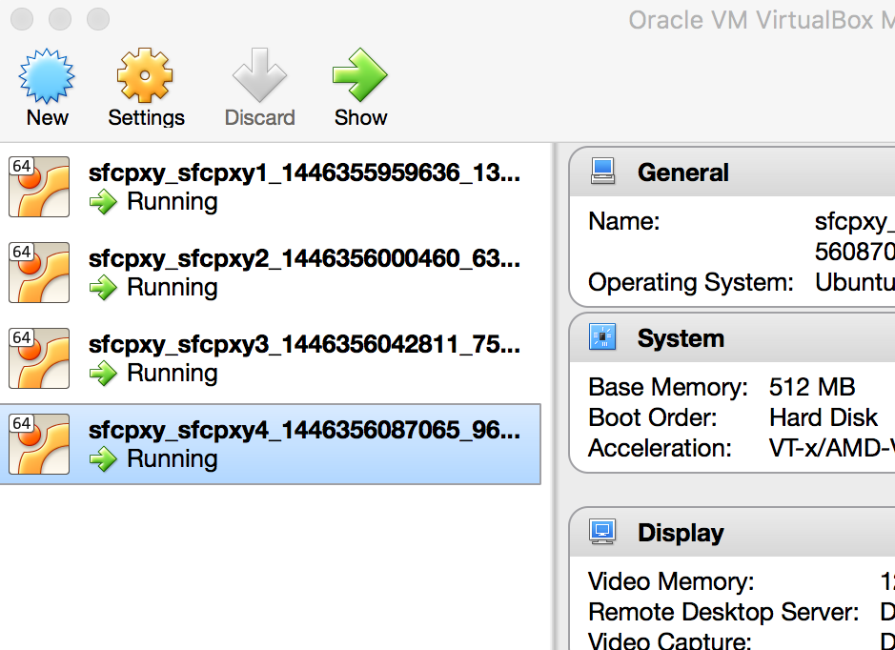


SFC Hackathon
Developed SFC Proxy and Test Environment
How to remove/re-attach NSH with SFC Proxy (OVS)
How to test SFC Proxy + VNFs with open source
Present SFC Proxy
Function
DEMOS
AVAILABLE
Test Environment
<We will share this code!>
SF
All components are in
vagrant + VirtualBox
Data
SFC Proxy
Classifier
SFF
NSH
Data
Data
VXLAN
NSH
Data
Data

