Slide 1
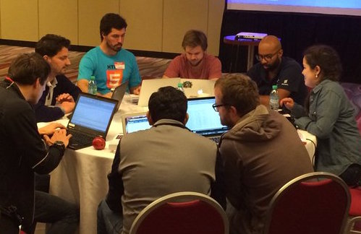
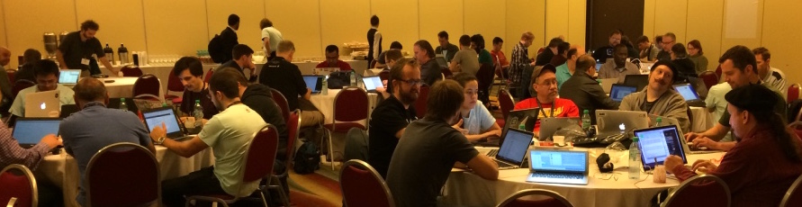
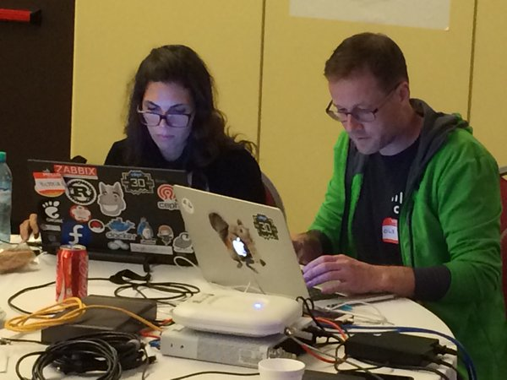

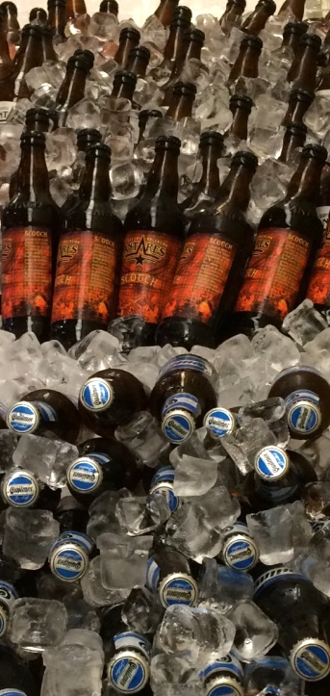
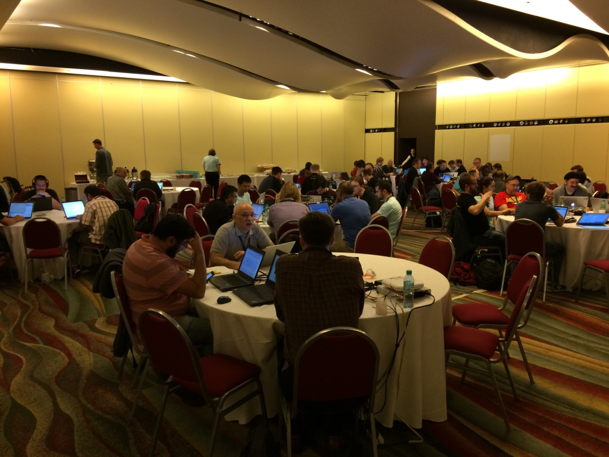
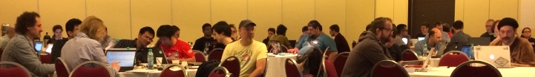

Slide 2

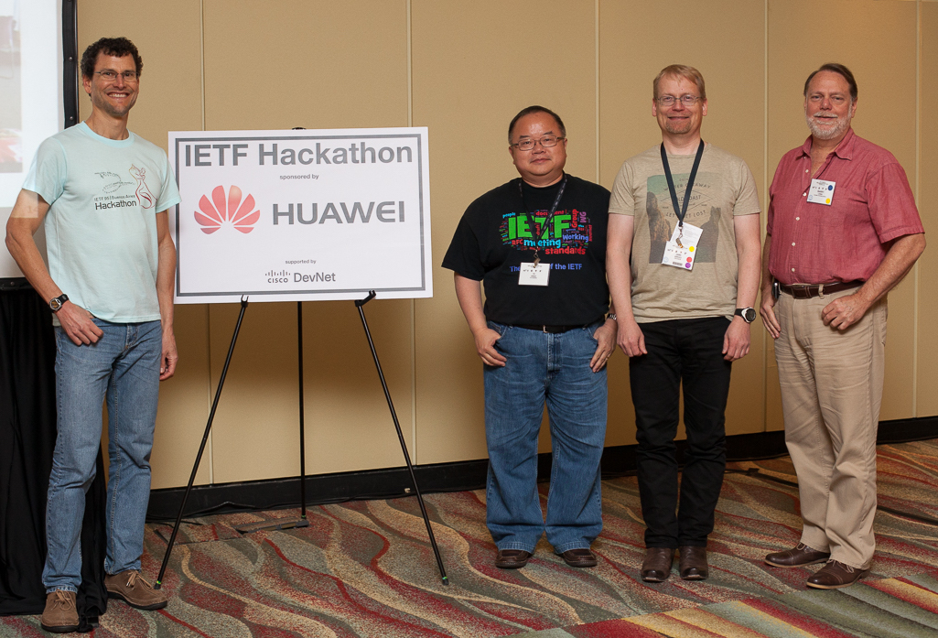
Why?
Increase pace and relevance of IETF standards
Bring speed, collaborative spirit of open source to IETF
Test ideas, experiment, feed results into WGs
Create sample code, reference implementations
Attract developers, young people to IETF
There’s cool shit at IETF
Supported by:
Supported by:

Slide 3
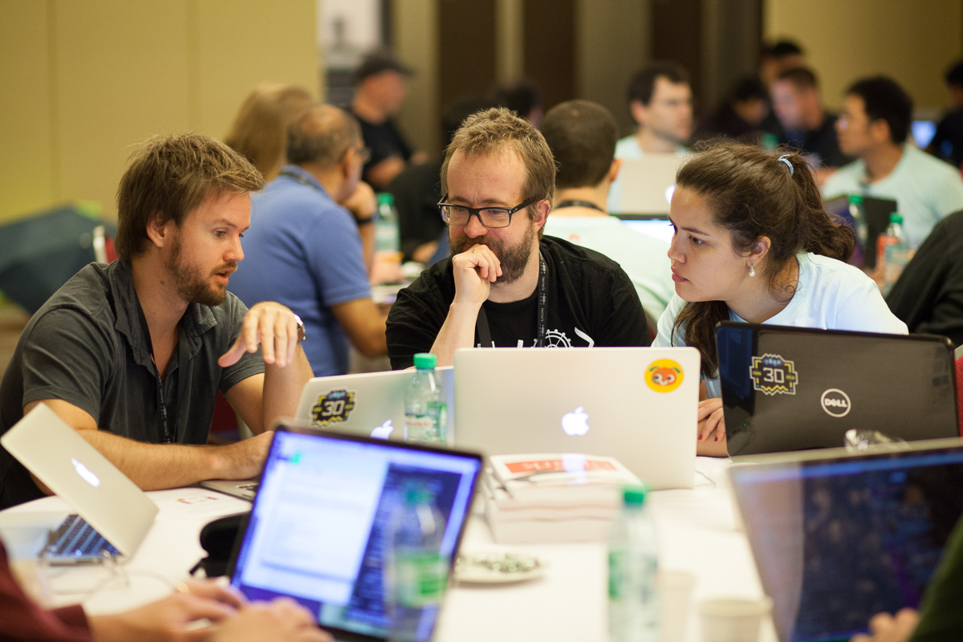
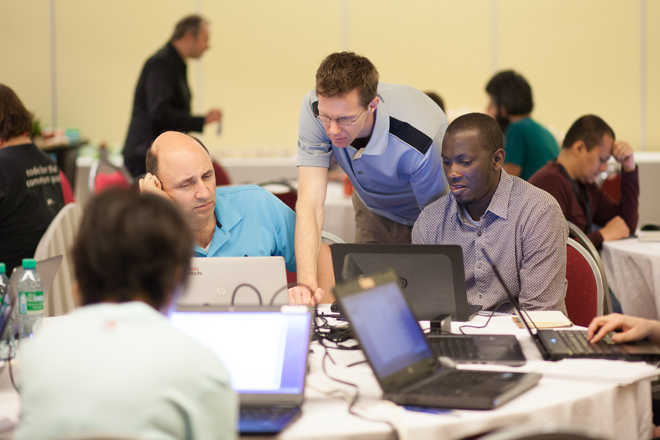
Highlights
100+ participants, 30+ new
10+ new IETFers
From Argentina, Africa
New projects
TLS 1.3, VPP, Big Data
Huawei sponsoring entire year
Cisco DevNet supporting
CodeSprint/Hackathon interworking
Pyang improved, in draft submit tool
YANG Pub/Sub client extended
Contribute to OpenDaylight
I2RS findings discussed in WG
Projects on display at Bits-n-Bites
Hackathon Proceedings in datatracker

