Slide 1

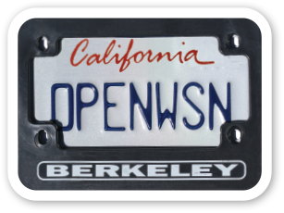
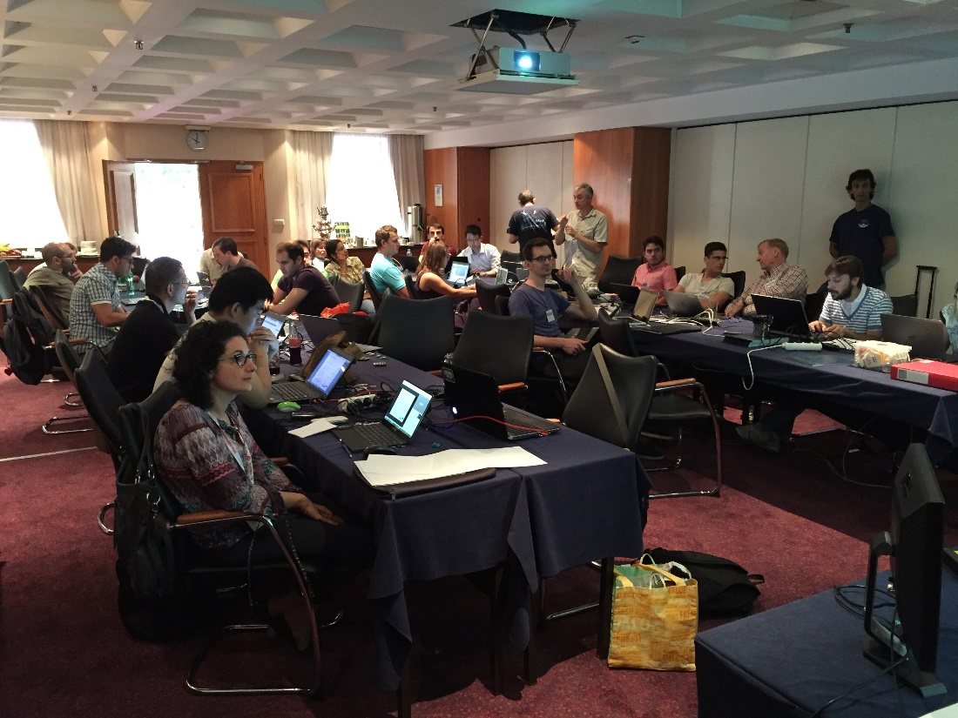
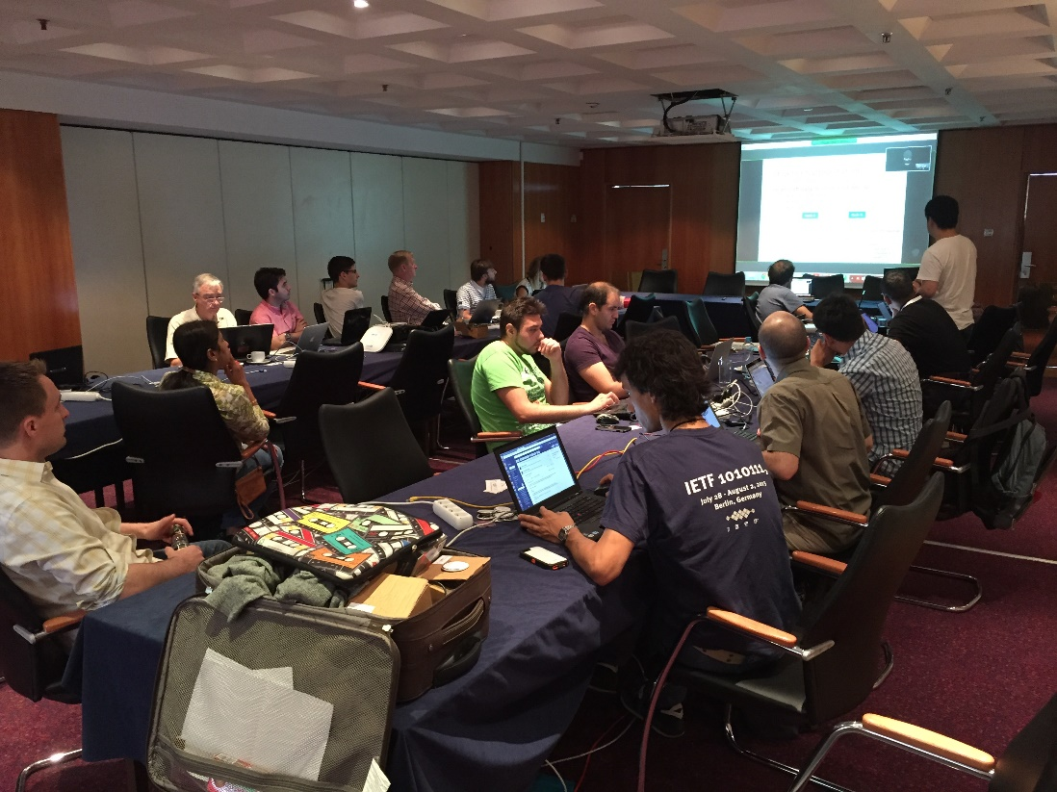



6TiSCH/OpenWSN
Hackathon
11 presented projects!
“Best of” winners:
  Tengfei Chang
  “FreeRTOS/OpenWSN integration”
  Savio Sciancalepore
  “Link-layer security OpenMote-CC2530 / TelosB interop”
  Dominique Barthel, Quentin Lampin
  “Node Monitoring framework”

Slide 2
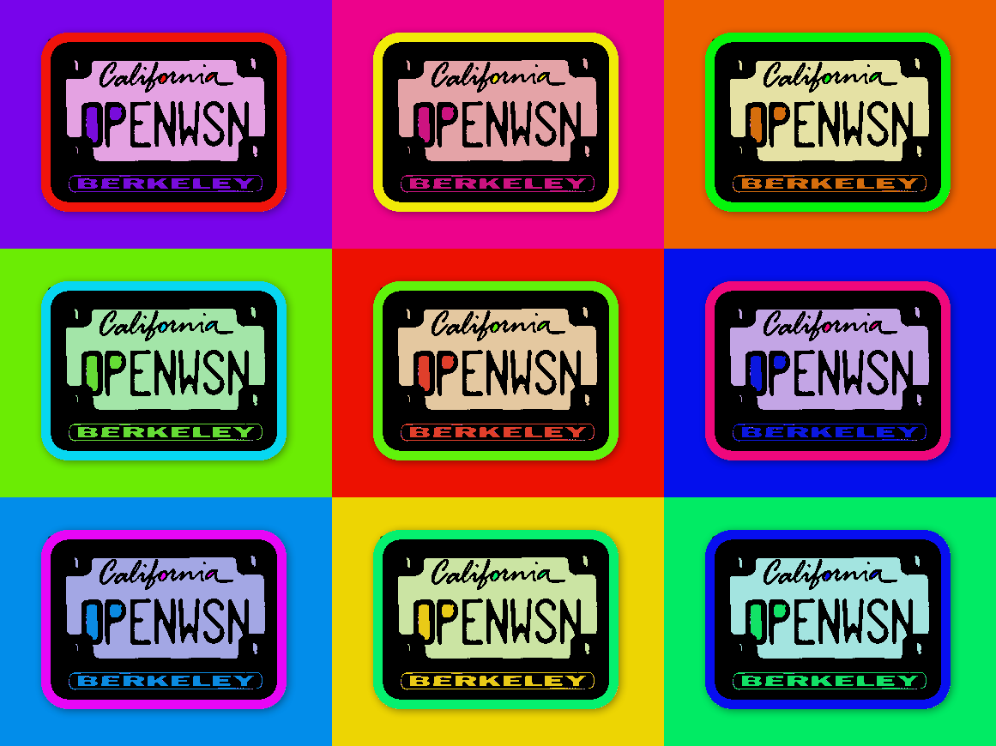

Slide 3

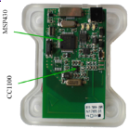
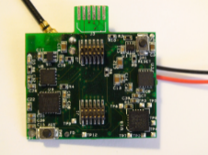
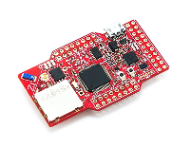
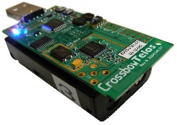
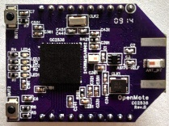
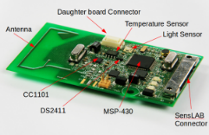
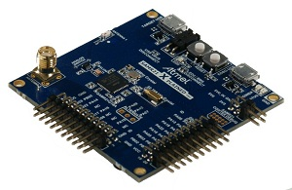
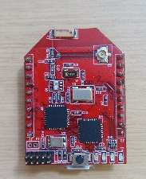
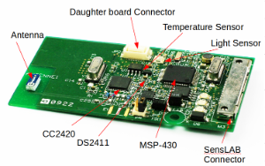
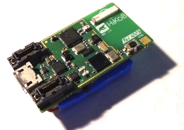
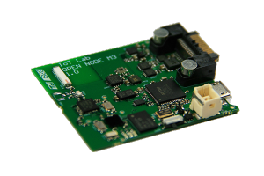
OpenWSN
Open-source implementation for the Industrial Internet of Things
BSD license
Applications
Application
Application
CoAP
HTTP
Internet
…
UDP
TCP
RPL
software
firmware
90% hardware independent
Ported to 10 platforms
6LoWPAN
6top (6TiSCH)
IEEE802.15.4e TSCH
IEEE802.15.4 (PHY)
Platforms
Application
10% BSP
Built-in simulator/emulator

Slide 4

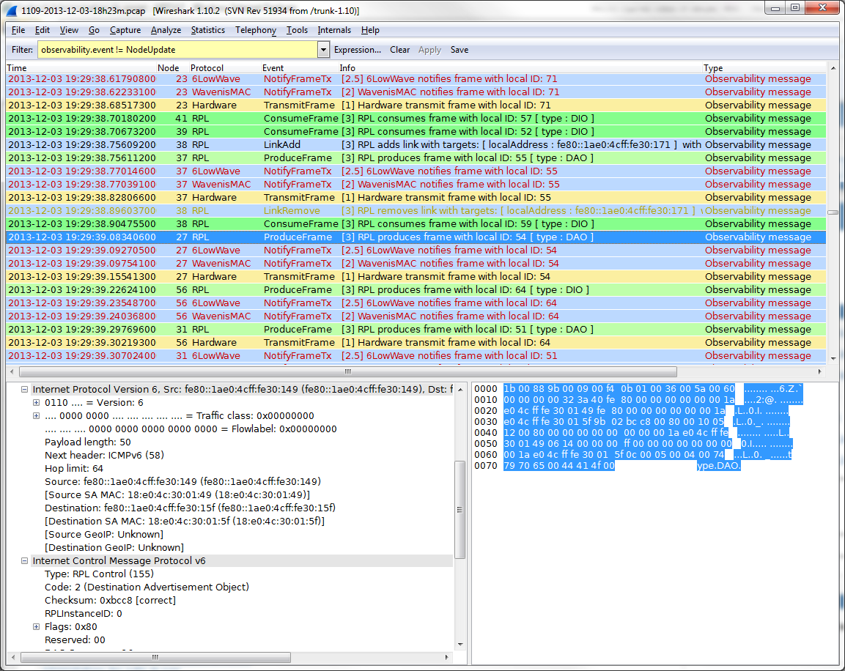
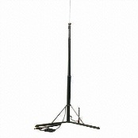
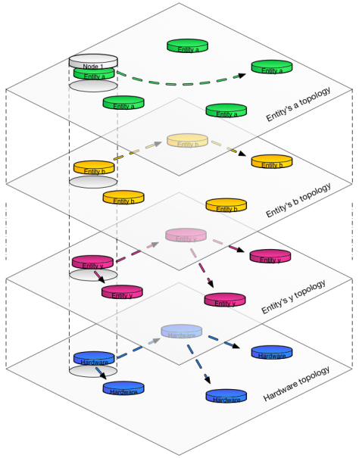
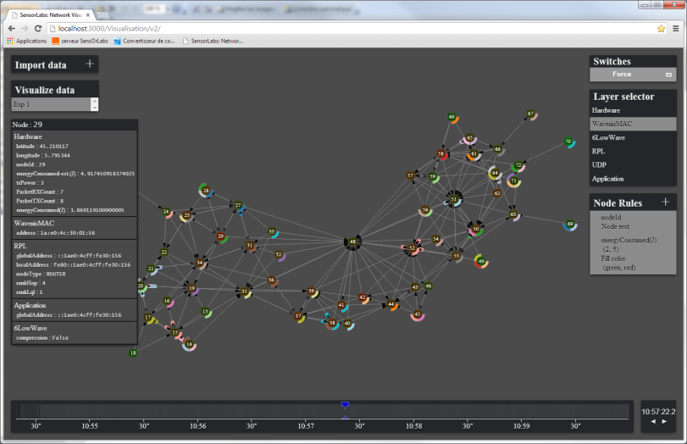
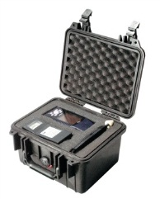

6TiSCH validation
15.4 TSCH Wireshark dissector
node backdoor monitoring
network model
network visualization tool

