Slide 1
IETF Hackathon
IETF 94, October 31 – November 1,
Yokohama, Japan

Slide 2
Note Well
Any submission to the IETF intended by the Contributor for publication as all or part of an IETF Internet-Draft or RFC and any statement made within the context of an IETF activity is considered an "IETF Contribution". Such statements include oral statements in IETF sessions, as well as written and electronic communications made at any time or place, which are addressed to:
The IETF plenary session
The IESG, or any member thereof on behalf of the IESG
Any IETF mailing list, including the IETF list itself, any working group or design team list, or any other list functioning under IETF auspices
Any IETF working group or portion thereof
Any Birds of a Feather (BOF) session
The IAB or any member thereof on behalf of the IAB
The RFC Editor or the Internet-Drafts function
All IETF Contributions are subject to the rules of RFC 5378 and RFC 3979 (updated by RFC 4879).
Statements made outside of an IETF session, mailing list or other function, that are clearly not intended to be input to an IETF activity, group or function, are not IETF Contributions in the context of this notice. Please consult RFC 5378 and RFC 3979 for details.
A participant in any IETF activity is deemed to accept all IETF rules of process, as documented in Best Current Practices RFCs and IESG Statements.
A participant in any IETF activity acknowledges that written, audio and video records of meetings may be made and may be available to the public.
IETF 93

Slide 3
Goals
Running Code (RFC 6982)
Open Source
Speed and Relevance of Standards
Collaborate and Learn
Have Fun
Cookies!!!

Slide 4
Technologies – Need to Update
Authentication and Authorization for Constrained Environments (ACE)
BIER (Bit Index Explicit Replication)
DNS / DNSSEC / DANE / DNS-over (D)TLS
DHCPv4o6 (Dynamic Host Configuration Protocol IPv4 over IPv6)
HOMENET – auto config for IPv6 routed home networks
HTTP/2.0
NETCONF/YANG, I2RS, OpenDaylight
NETVC (Internet Video Codec) and Daala, Thor
MPTCP (Multi-Path TCP)
OpenWSN/6TiSCH/Cryptech: implementing Internet of (Important) Things
RPKI (Resource Public Key Infrastructure)
RIOT (OS for internet of things)
SCTP (Stream Control Transmission Protocol)
SFC in OpenDaylight
SPUD (Substrate Protocol Underneath Datagrams)

Slide 5
Collaborate on Code https://github.com/eckelcu/ietf-hackathon
Git/GitHub commonly used for open source projects
Getting started:
Install Git on laptop https://help.github.com/articles/set-up-git/
Join Hackathon repo https://github.com/eckelcu/ietf-hackathon
Working on existing project, or add a new one, by forking https://help.github.com/articles/fork-a-repo/
“Follow” team members and “watch” project(s) https://help.github.com/articles/be-social/
More info: http://gitref.org

Slide 6
Agenda - Saturday
09:00: Room opens, pastries & coffee
09:30: Overview of technologies, form teams
12:00: Lunch
15:00: Snack break
18:30: Progress check
19:00: Dinner
21:00: Room locked

Slide 7
Agenda - Sunday
09:00: Room opens, pastries and coffee
12:00: Lunch
15:00: Hacking stops, prepare presentations
15:00: Snack break
16:00: Present projects
17:00: Winners announced, prizes given
17:30: Recap and suggestions for IETF 94
18:00: Tear down

Slide 8
Judges
Advance pace and relevance of IETF standards
Bring speed and collaborative spirit of open source software into the IETF
Flush out ideas, feed into WG session
Produce sample code/reference implementations
Create useful utilities
Attract developers, young people to IETF
There’s cool shit at IETF
#IETFhackathon, #IETF93

Slide 9
Bits-N-Bites
Table for Hackathon Projects
Show off what you did
Thursday, 19:15 – 21:15
Congress Hall Foyer
Food and drinks provided

Slide 10
#IETFhackathon Photo Contest
Best IETF Hackathon Photo
Post to Twitter
#IETFhackathon
#IETF93

Slide 11
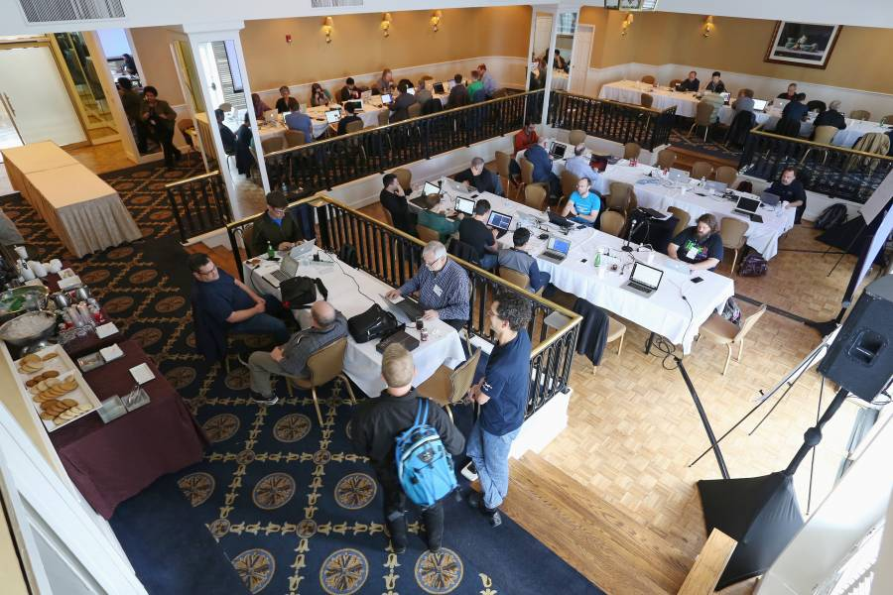
Let’s Get Hacking!

