Slide 1
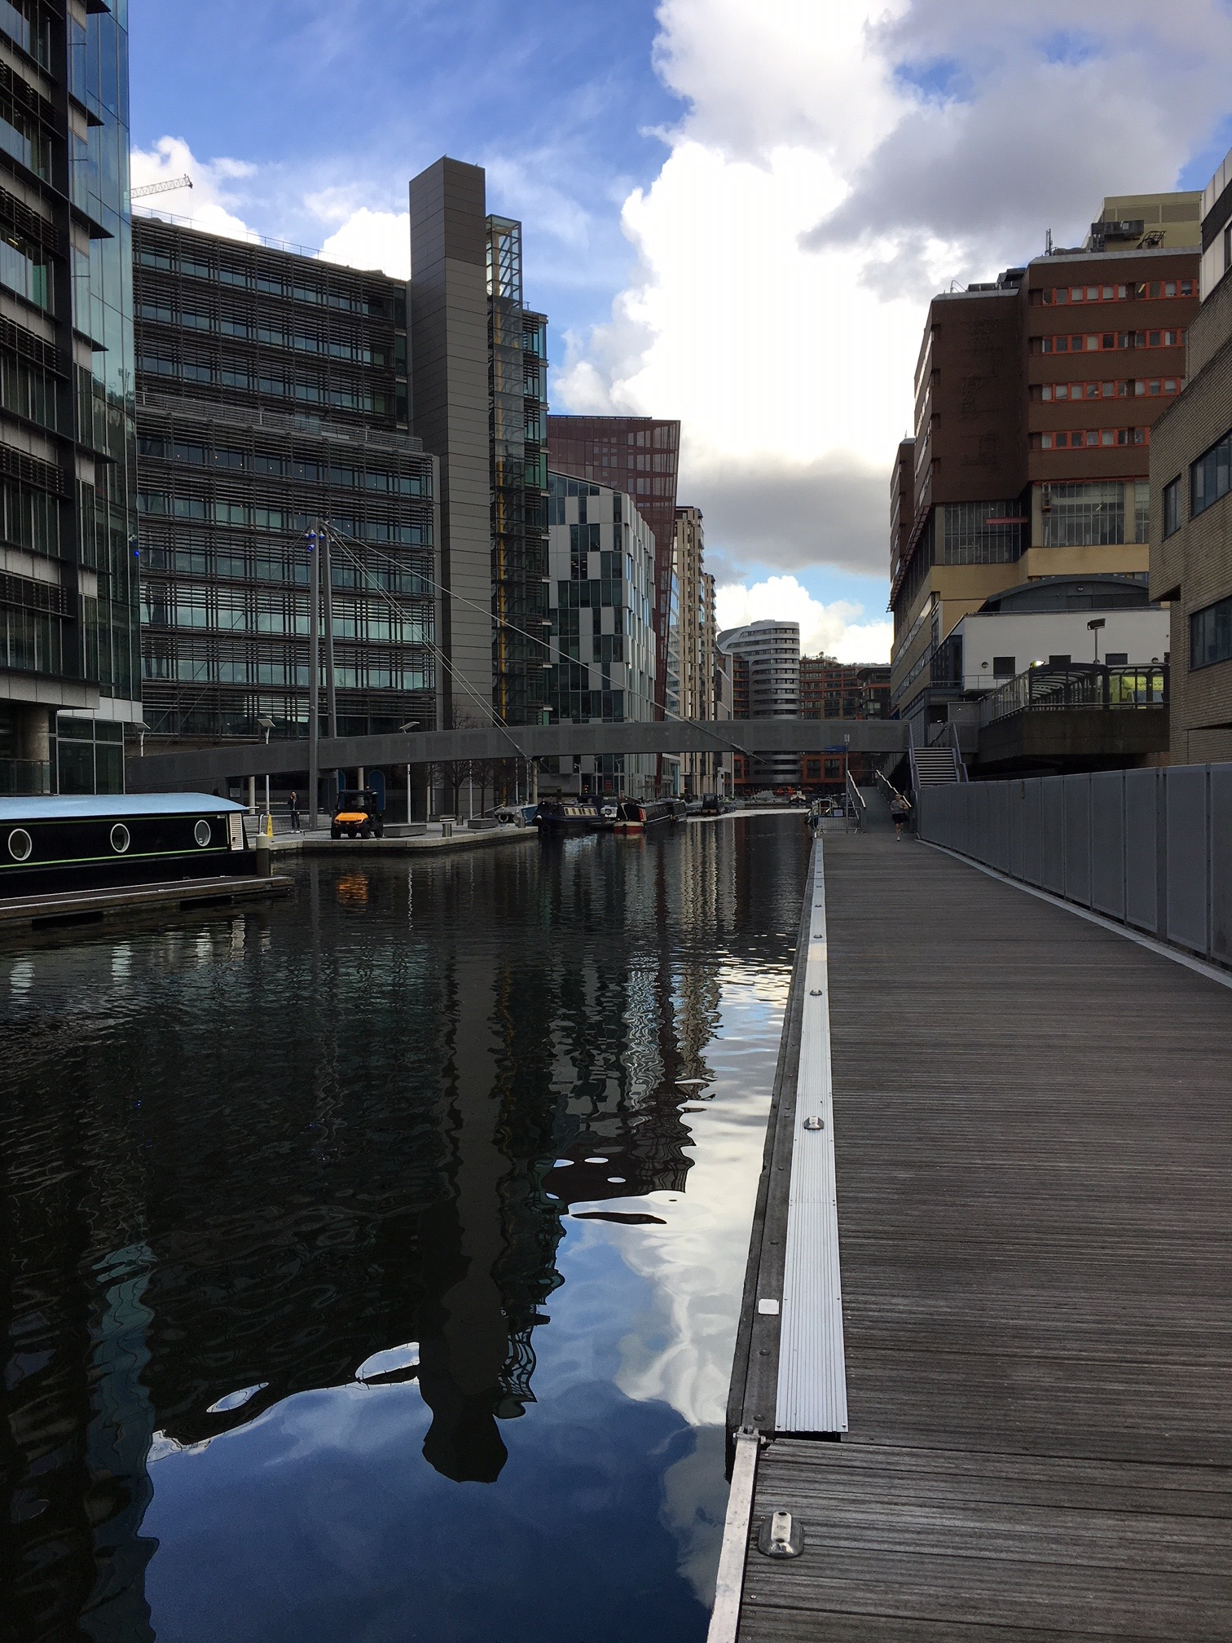
IETF Hackathon:
IPv6 over LPWAN
IETF 101
17-18 March, 2018
London

Slide 2
Hackathon Plan
Consolidate early implementations of SCHC compr/fragm
https://datatracker.ietf.org/doc/draft-ietf-lpwan-ipv6-static-context-hc/
Port fragmentation to micro-Python
Integrate compression and fragmentation
Test fragmentation
Implement server side in Python
Discuss ICMPv6 options

Slide 3
What got done
Dissemination of knowledge of Pycom boards, of SCHC principles
Ran CoAP/UDP/IPv6 compression over live LoRaWAN and Sigfox networks, ran fragmentation over UDP
Implemented comp/decomp on server side in Python instead of JS
Fixed bugs in compression implementation
Bridged computer-based fragmentation with LoRaWAN transmission (RiOT over Nucleo board), success
First application for firmware update over LoRaWAN at SUIT table
Focussed time and fun reuniting with long-time and new friends

Slide 4
What we learned
Getting started with live LPWAN, motes, can take time
Fixed typos, discussed interpretation and implementation of https://datatracker.ietf.org/doc/draft-ietf-lpwan-ipv6-static-context-hc/
More coding to be done to achieve full implementation

Slide 5
Wrap Up
Team members:
7 in the room + 1 in Japan
Compression (uPython, over LoRaWAN and Sigfox)
https://github.com/ltn22/SCHC
Fragmentation (Python, over UDP)
https://github.com/tanupoo/schc-test
Integrated micro-Python code
Repo to be announced

