Slide 1
Firmware Updates for Internet of Things Devices (SUIT)

Slide 2
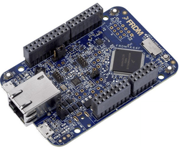
SUIT Software Updates for Internet of Things
In trusted environment (e.g., production)
✔
Source Code v1 -> Binary Firmware
Certificates / Keys / etc.
New Firmware
Source Code v2 -> New Binary Firmware
+Manifest to validate
firmware is not bogus
✔

Slide 3
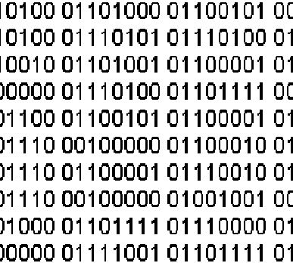

Our Goal
Input to the recently formed SUIT WG
Creating signed manifest
Encoded in CBOR
COSE signed with ECDSA.
Manifest & firmware transport to IoT board via UART.
Bootloader verifies received manifest and installs new firmware.
Firmware + Manifest
Via UART
K64F

Slide 4
Who participated?
Markus Gueller (Infineon) *
Max Groening (Texas Instruments) *
Hannes Tschofenig (Arm)
Brendan Moran (Arm) – remote *
Jaime Jiménez (Ericsson)
Alexander Pelov (Acklio)
*: New participants

Slide 5
What was accomplished?
Got development environments working (online IDE, desktop IDE, CLI) on different OSs.
Running code:
Code for manifest generation (in Python) working.
Pseudo-bootloader running on IoT board
UART communication to load firmware working
Keys and example manifests created.
Code for manifest verification (C) in progress.
Walkthrough on Etherpad: http://etherpad.tools.ietf.org:9000/p/FUIETF101

Slide 6
Lessons Learned
Low level IoT development is hard:
Setup of development environment & Python took some time.
UART communication setup
Debugging is more complex
COSE C library was difficult to use for embedded environment.
We needed a C implementation that uses the embedded crypto (instead of OpenSSL).
Basic manifest functionality worked fine.

