Slide 1

IETF Hackathon:
DOTS Interop
IETF 101
17-18 March, 2018
London

Slide 2
DOTS Hackathon Plan
Test the interoperability between independent implementations:
​See the maturity of these core specs of DOTS protocol
draft-ietf-dots-signal-channel-17
​draft-ietf-dots-data-channel-13
Implementations
OSS by NTT: nttdots: ​https://github.com/nttdots/go-dots
Proprietary implementation of NCC Group
Proprietary implementation of Arbor (couldn’t attend this time)
Proprietary implementation of Huawei based on nttdots

Slide 3
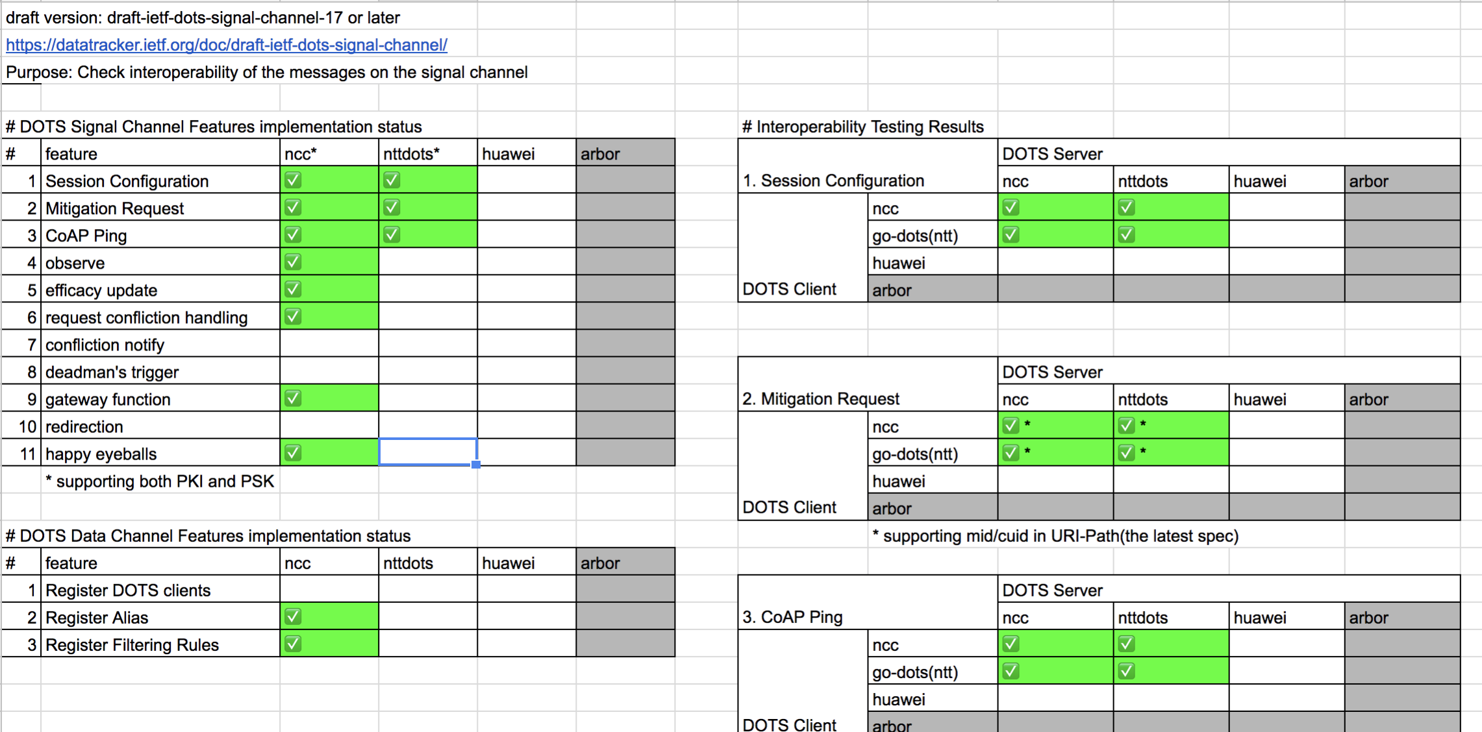
DOTS Hackathon Achieved

Slide 4
We are getting there!
DOTS (DDoS Open Threat Signaling) protocol
Makes Distributed Denial of Service (DDoS) Protection more effective with its programmatic capability.
Protects the Internet from DDoS attacks.
We confirmed that we can do cooperative DDoS Protection operations between (at least 2) independent implementations

Slide 5
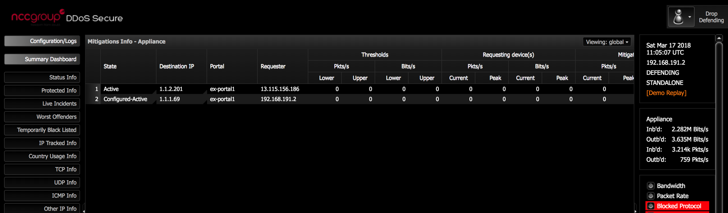
Example Protection of IP
Successful Mitigation Request from OSS DOTS client (nttdots) to proprietary DOTS server (NCC Group) – and vice versa.

Slide 6
What we learned
We can meet the expectations for DOTS protocol from the market soon
Draft Signal Channel spec is almost stable
In the Hackathon, we tested based on proposing spec (to be included in the coming -18 draft), so it is proven to work!
Discussed and clarified a lot about the current drafts text
Discussed adding new feature on the protocol, which could be included in the DOTS spec in future

Slide 7
Achievements in detail (for WG)
Achievement 1. During the Hackathon
Successfully worked interoperable features
CRUD operations on session configuration and mitigation request
gateway function (on NCC Group side)
Nttdots client traffic to NCC Group DOTS Gateway relayed to nttdots server + cdid addition
the usage of "cdid" is now under discussion
PKI and PSK mode on DTLS
cuid/mid in URI-path: it helps an implementation using libcoap
Achievement 2. In preparation for the Hackathon
Actually nttdots and NCC Group did interop tests internally 3 times! before the Hackathon
Agreed on trying with the latest spec (-17 or later)
Updated models so as to comply with that
Added CoAP ping capability (on nttdots side)
Many fixes of the code on both side

Slide 8
Wrap Up
Team members: Kaname Nishizuka (NTTCom)
Jon Shallow (NCC Group)
Liang 'Frank' Xia (Huawei)
First timers @ IETF/Hackathon:
Nagata Takahiko (Lepidum)
Dong Yue (Huawei)
Thank You!

