Slide 1
Scalable, Privacy-preserving In-Network Bandwidth-Independent Technology (SPINBIT) measurement in QUIC
IETF 101 Hackathon, London, 18 March 2018

Slide 2
Why?
Explicit signal for passive measurement of per-flow RTT
QUIC doesn't expose its transport internals to the wire (this is good)
Passive performance measurement of QUIC flows yields much less usable data (this is bad)
Replace lost visibility of metrics with respect to TCP:
Replaces SEQ/ACK or TSval/TSecr calculation in TCP
Superior to QUIC handshake RTT measurement: multiple samples per flow, no additional handshake-linked delay

Slide 3
How does it work?
client
0
1
0
0
1
0
0
1
0
0
1
0
server
0
1
0
1
0
1
0
1

Slide 4
Unidirectional one-point measurement
observer
client
0
1
0
0
1
0
0
1
0
0
1
0
server
0
1
0
1
0
1
0
1
RTT
spin
time

Slide 5
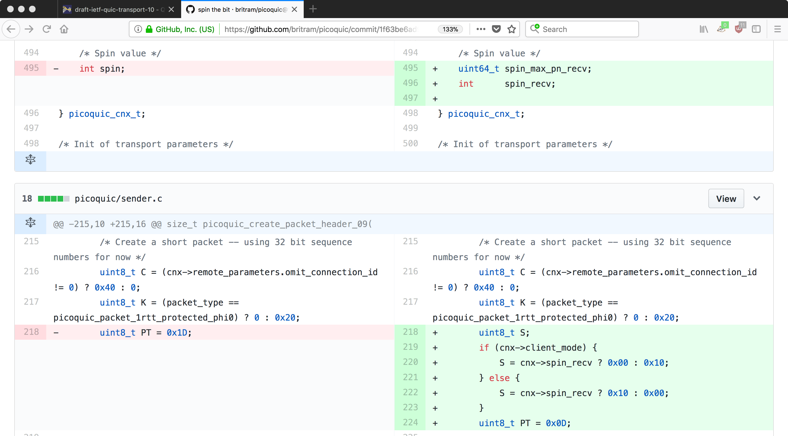
What we did
Endpoint implementation:
Added experimental spin bit support to four QUIC implementations (minq, picoquic, quicly, quic-go)
...and did some interop on the underlying code
There's not much to it, which is nice:

Slide 6
What we did
Measurement device implementation:
Built and tested a minimal RTT measurement tool based on the spinbit (https://github.com/britram/minspin)
Added current spin bit support to a passive measurement experimentation platform (https://github.com/mami-project/vpp-plus)
P4 QUIC parser and RTT measurements (https://github.com/rvdpdotorg/)
Other projects still in progress (see you at hackathon 102)

