Slide 1
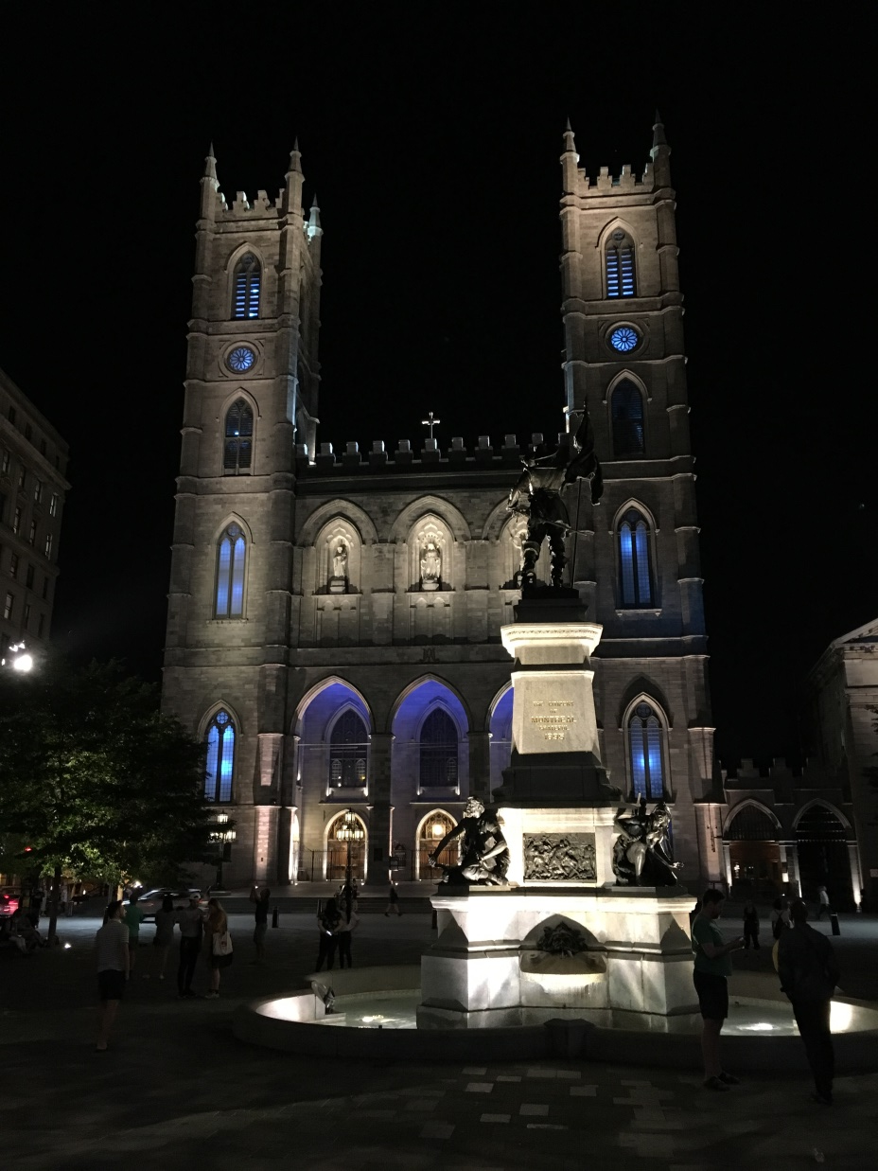

IETF Hackathon: TLS 1.3
IETF 102
14-15 July, 2018
Montreal

Slide 2
Hackathon Plan
TLS 1.3 for applications and Interoperability
draft-ietf-tls-tls13-28
Application Integration and Support
Interoperability
Two teams
1

Slide 3
What got done
Achievements – Implementation Team
PHP (PR 3386)
Httperf ( PR 60 / 61)
NRPE (PR 186)
Mercurial (Mail sent to Mercurial Mailing List)
SOCAT (Mail sent to developer)
CURL (Middlebox Compat toggle)
Nagios-Plugins (Started during IETF101)
GIT (Started 101 hackathon)
1

Slide 4
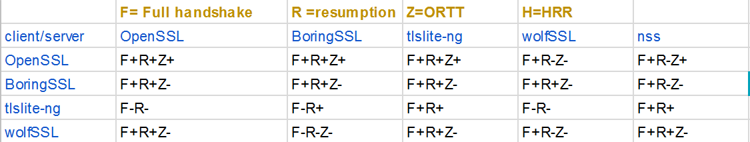
What got done
Achievements – Interoperability Team
1

Slide 5
What we learned
Interop is important
Wireshark helps independently to verify working code.
Listen to feedback on patches from OpenSource developers.
1

Slide 6
Wrap Up
Team members – hackers.mu - remote only
Loganaden Velvindron (logan)
Jaykishan Mutkawoa (Nitin)
Rahul Golam (Rahul)
Kifah Sheik Meeran (Kifah)
Muzaffar Auhammud (Muz)
Nigel Yong Sao Young Steven Ken Fouk (Nigel)
Codarren Velvindron (Codarren)
Yasir Auleear (Yasir)
1

Slide 7
Wrap Up
First Timers – remote only
Veegish Ramdani (Veegish)
Jeremie Daniel (Jeremie)
Jagveer Loky (Loki)
Nathan Sunil Mangar (Chromico)
Avishai Poorun (Avishai)
1

Slide 8
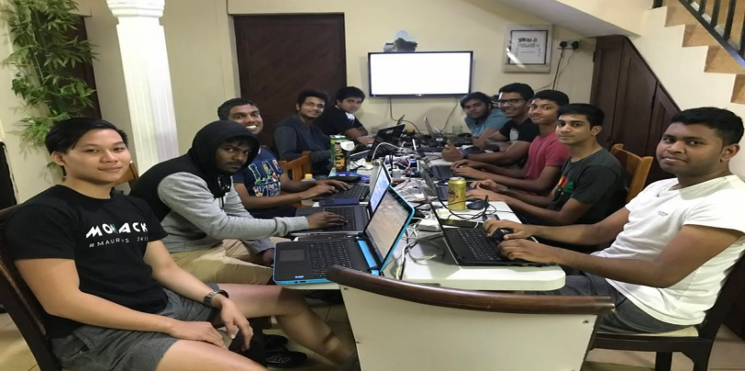
The team in Mauritius

Slide 9
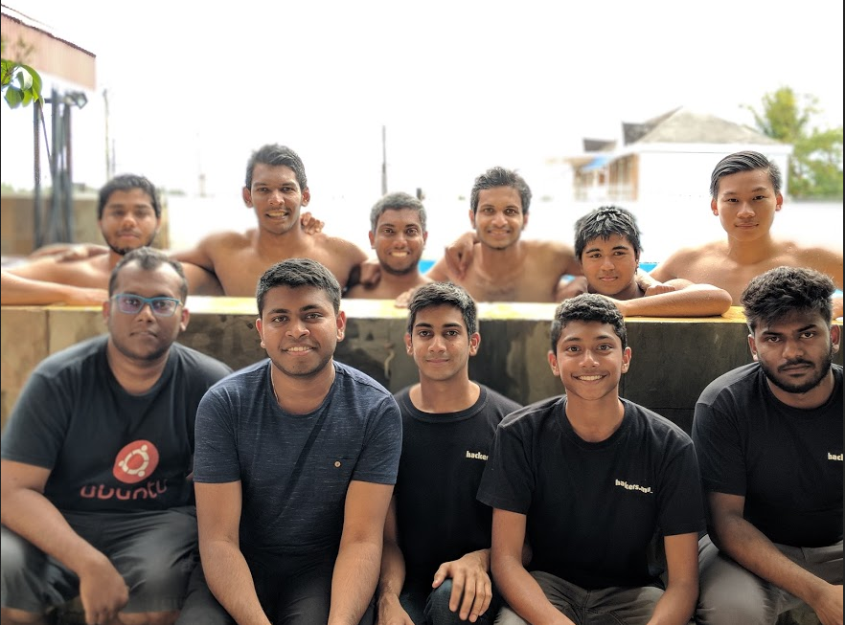
The team in Mauritius

Slide 10
Thank you
TLS 1.3 development team (Nick Sullivan and others)
Meetecho team (Lorenzo Miniero and others)
Charles Eckel & Barry Leiba
OpenSource developers who collaborated with us
Juniper, Akamai, Oracle, Verisign for sponsoring the IETF hackathon.

