Slide 1

IETF Hackathon:
DOTS Interop
IETF 102
14-15 July, 2018
Montreal

Slide 2
Hackathon Plan
DOTS: DDoS Open Threat Signaling
standardization of signaling for DDoS protection
Hackathon | What we did | Signal Channel | Data Channel | Participants
IETF99 | Implementation of OSS (go-dots) | ✔︎ |  | NTT
IETF100 | 1st Interoperability Test | ✔︎ |  | NTT, NCCGroup, Huawei
IETF101 | 2nd Interoperability Test | ✔︎ |  | NTT, NCCGroup, Huawei
IETF102 | 3rd Interoperability Test - The first data-channel interop | ✔︎ | ✔︎ | NTT, NCCGroup, Huawei

Slide 3
Interop
Signal Channel
Session Configuration/Mitigation Request
go-dots
NCC Group
DDoS
Mitigation
Action
DDoS
Mitigation
Action
Data Channel
Register Client/Aliases/ACLs
Capability Discovery
DOTS client/
DOTS server
DOTS server/
DOTS client
DOTS
DOTS
CoAP
RESTCONF
TLS
DTLS
TLS
TCP
UDP
TCP
IP
IP
Signal Channel Layers
Data Channel Layers

Slide 4
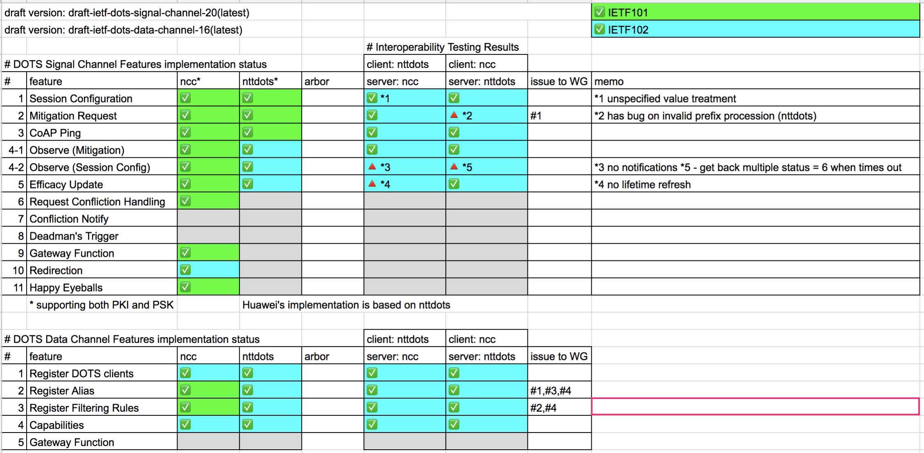
Interop Results

Slide 5
Takeaway
Core specification of DOTS is now mature enough
Successful interop testing
several issues found (not so significant) will be reported to WG
One is OSS, One is Proprietary, more implementations are welcome
code is available on https://github.com/nttdots/go-dots

Slide 6
Wrap Up
Team members: Kaname Nishizuka (NTTCom)
Nagata Takahiko (Lepidum)
Jon Shallow (NCC Group)
Liang 'Frank' Xia (Huawei)
First timers @ IETF/Hackathon:
Thank You!

