Slide 1
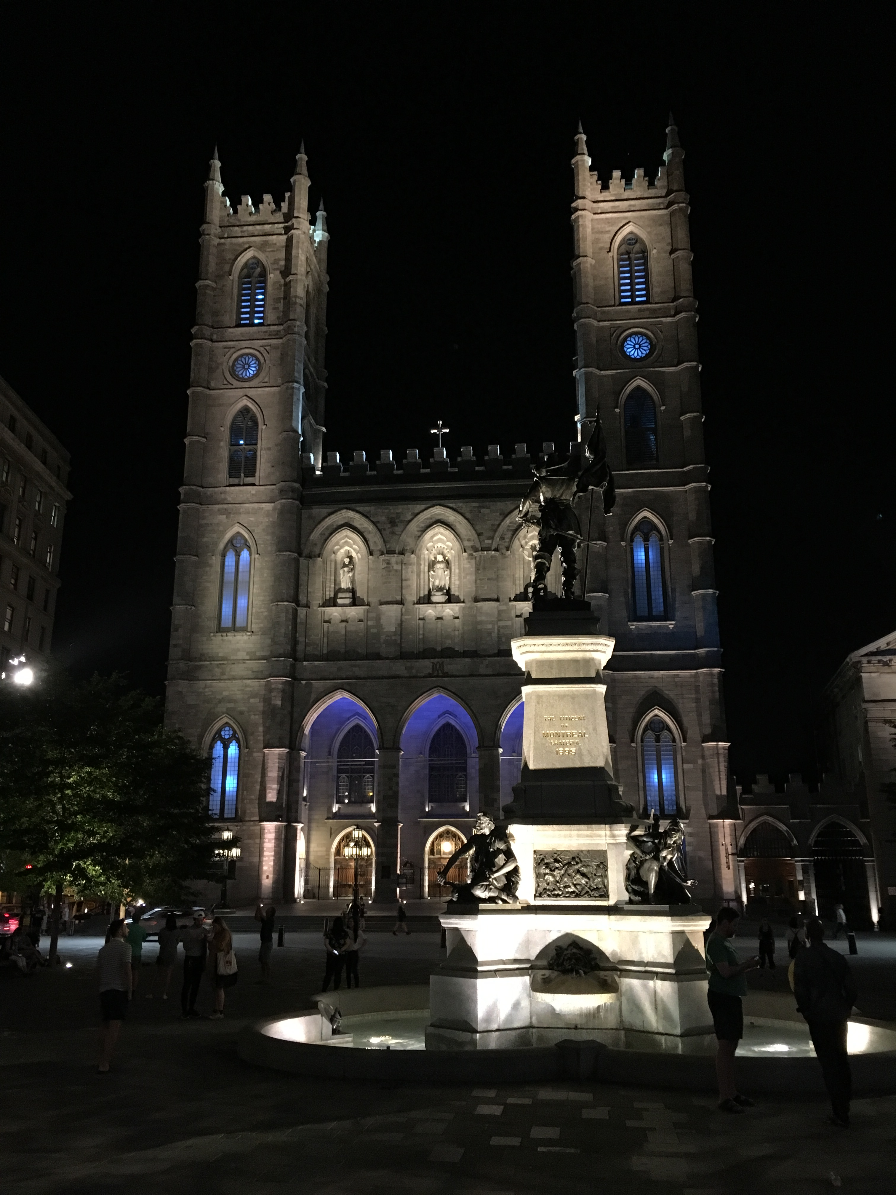
IETF Hackathon:
Message Layer Security (MLS)
IETF 102
14-15 July, 2018
Montreal

Slide 2
Hackathon Plan
Working on common understanding and very basic interop of tree-based group key exchange
Arch: draft-omara-mls-architecture
Keying (ART, TreeKEM): draft-barnes-mls-protocol
Rough goal: can we compute the same trees?
New code: ART: C implementation (DKG, Shivan); TreeKem: JS/Node (M&M), Java (Jon), Python (Nat)
Most ported RLB’s Node code, Jon did not

Slide 3
What got done
What kinds of learning/hacking happened?
A good deal of whiteboard work to understand the two keying models and potential formats of the trees
DKG’s C: https://gitlab.com/dkg/nettle-mls
M&M’s node using p25519: https://github.com/linuxwolf/treekem-25519
Trivial PRs to the MLS drafts

Slide 4
What we learned
Whole lot of learning!
Disclaimer: Drafts are in an early state
Discovery: In TreeKEM imp, leaf may be indirectly sharing private key (no bueno!)
<New feedback/work to take to WG?>

Slide 5
Wrap Up
Team members (affiliation for ID only):
Daniel Kahn Gillmor (ACLU), Matt Miller (Mozilla), Jon Millican (Facebook), Nat Meysenburg (New America OTI), Shivan Kaul Sahib (Salesforce), Joseph Lorenzo Hall (CDT)
First timers @ IETF/Hackathon: Nat Meysenburg

