Slide 1
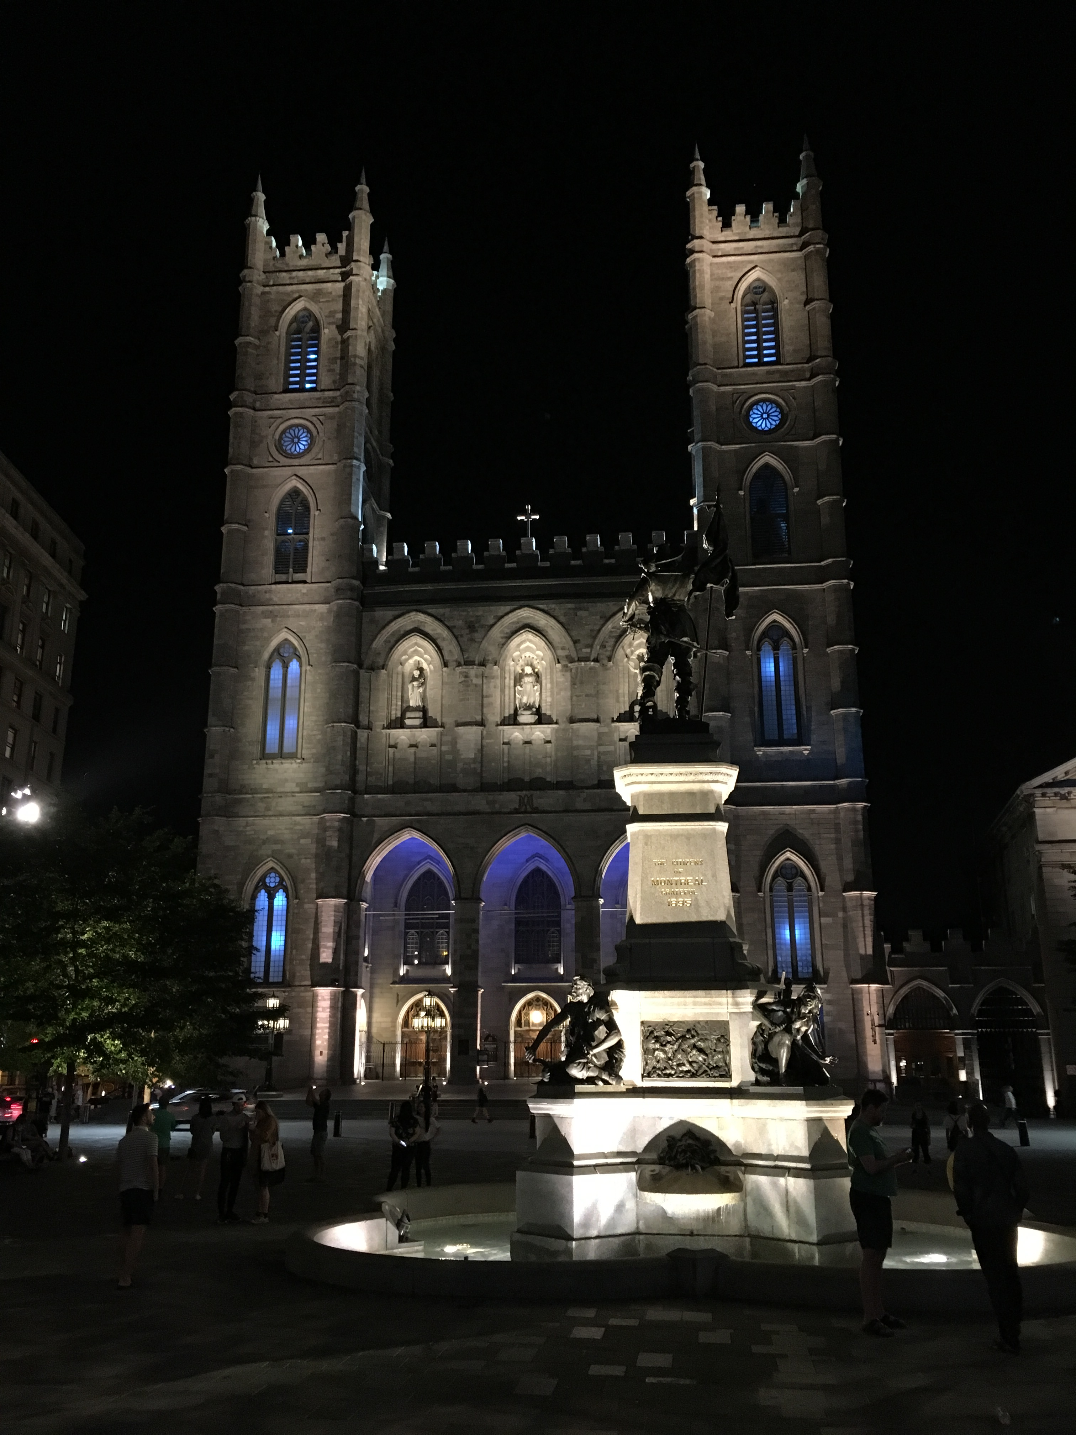
IETF Hackathon:
Network Time Security (NTS)
IETF 102
14-15 July, 2018
Montreal

Slide 2
Hackathon Plan
Integration of NTS with different NTP implementation
draft-ietf-ntp-using-nts-for-ntp-12
draft-dansarie-nts-00
Verifying interoperability between various NTS implementations

Slide 3
Team and Technology
Team members:
NTS-M (Martin) - draft-ietf-ntp-using-nts-for-ntp-11 (C++)
NTS-D (Daniel) - draft-ietf-ntp-using-nts-for-ntp-11 (Python)
NTS-S (Sweden) - Malmö team - draft-dansarie-nts-00 (golang)
NTS-N (NTF - draft-ietf-ntp-using-nts-for-ntp-12) (NTPD)
NTS-O (Jean-Philippe - draft-ietf-ntp-using-nts-for-ntp-12) (OpenNTPD)
NTP working group:
https://datatracker.ietf.org/wg/ntp
Involved documents:
draft-ietf-ntp-using-nts-for-ntp-12
draft-dansarie-nts-00
RFC 5905 (NTPv4)
RFC 5297 (AES-SIV)
RFC 7822 (NTP EF)
Git repositories:
https://github.com/dfoxfranke/nts-hackathon
https://gitlab.com/MLanger/nts
https://gitlab.com/MLanger/ntp
https://github.com/beevik/ntp
TLS 1.3
https://github.com/bifurcation/mint
https://github.com/beevik/ntp

Slide 4
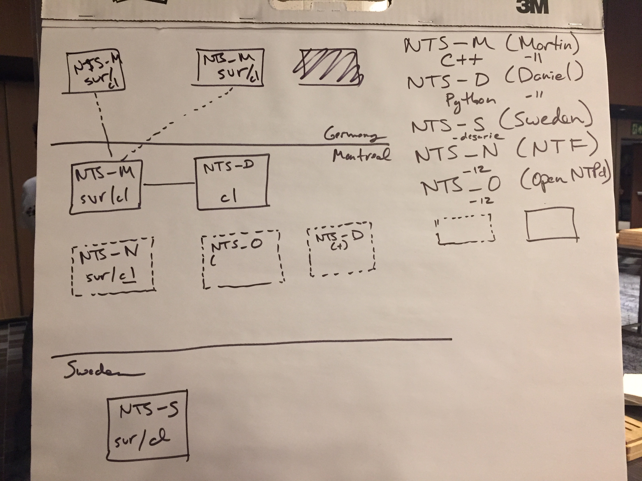

Slide 5
What got done
Team | Draft | Language | Notes
Martin | draft-ietf-ntp-using-nts-for-ntp-11/12 | C++ | Continuation of hackathon 101
Daniel Lavinia Lee | draft-ietf-ntp-using-nts-for-ntp-11/12 | Python | Continuation of hackathon 101
Team Sweden | draft-dansarie-nts-00 | Golang | NTP in FPGA
Network Time Foundation | draft-ietf-ntp-using-nts-for-ntp-12 | C | Start of NTS integration in NTP’s reference implementation
Jean-Philippe Ouellet (openNTPD) | draft-ietf-ntp-using-nts-for-ntp-12 |  | Start of implementation work

Slide 6
What we did/learned
Client/server | Martin (Server) | Python (Server) | Team Sweden Server
Martin (Client) | Key and time exchange Time exchange: drop of NTP mode 3 packets between Germany and Montreal | KE as demonstrated at 101 Hackathon | TLS 1.3 issues between golang package and openssl
Python (Client) | KE and TE demonstrated at 101 Hackathon
Team Sweden Client | TLS 1.3 issues between golang package and openssl |  | Key and time exchange
NTF (Client) | First phase of KE

Slide 7
Wrap Up
Interoperability tests are important
The NOC is very helpful!
Wireshark helps…

