Slide 1
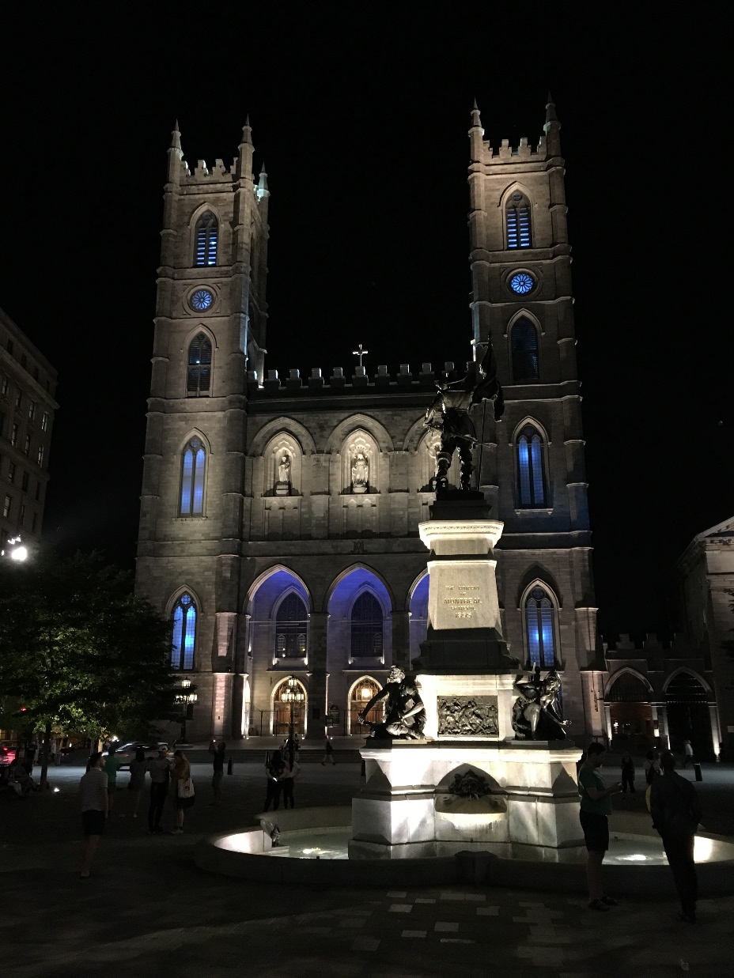
IETF Hackathon:
Control Plane and User Plane Separation BNG control channel Protocol (CUSP)
IETF 102
14-15 July, 2018
Montreal

Slide 2
Goals
Verify the validity and performance of CUSP
Control Plane communicate with User Planes via CUSP;
Control Plane centralized manage the UP resource;
Dynamic assign the IP address field to UPs.
Specifications:​
https://tools.ietf.org/html/draft-cuspdt-rtgwg-cu-separation-bng-architecture-01
https://tools.ietf.org/html/draft-cuspdt-rtgwg-cu-separation-bng-protocol-01

Slide 3
Demo – CUSP
In remote lab environment;
Implementing Control Plane and User Plane Separation BNG;
Simulate user access;
CAN create the CUSP session between CP and UPs;
CP CAN distribute/recycle the IP field to UPs dynamically;

Slide 4
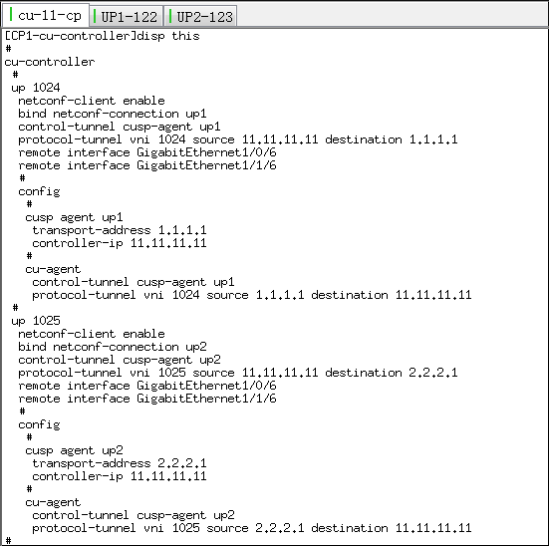
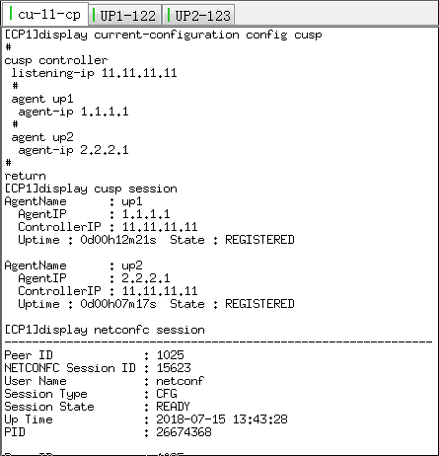
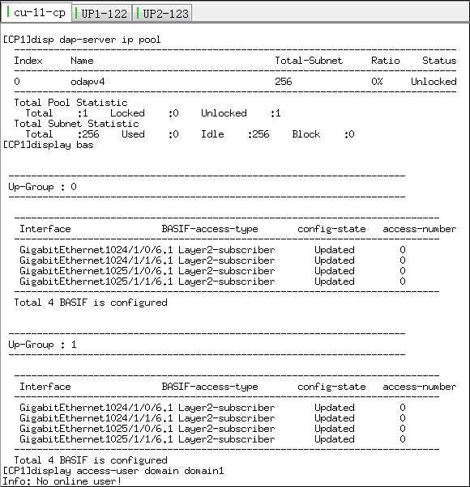
DemoTopology

Slide 5
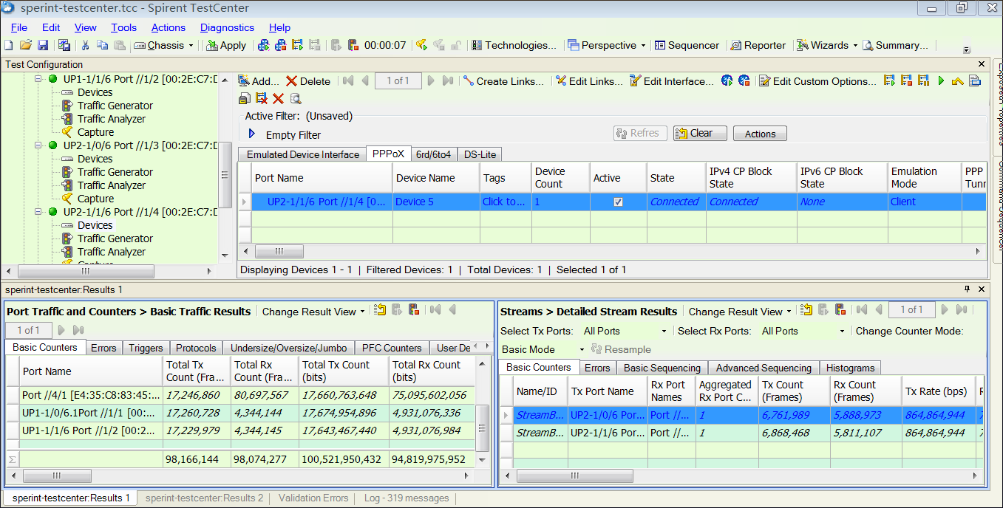
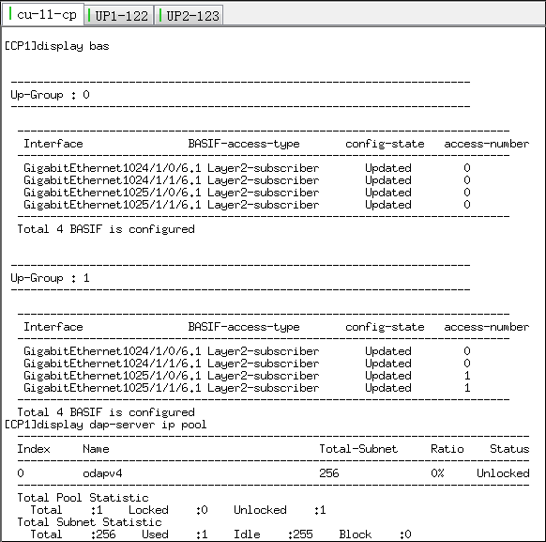

Slide 6
Team
Zhenqiang Li
Michael Wang
Guangying Zheng
Shujun Hu
Fengwei Qin
Jun Song
Xiaoming Chen
Zhunfeng Wu
Gang Yan
Xia Chen
Xinguo YANG
Mengmeng Li
Fenghua Zhao
Yongkang Zhang
Sue Hares

Slide 7
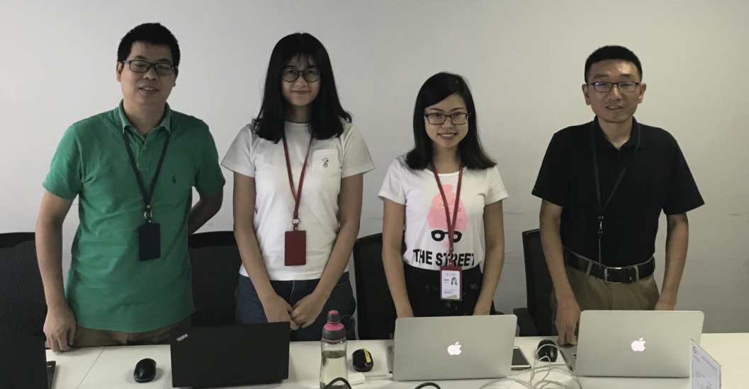
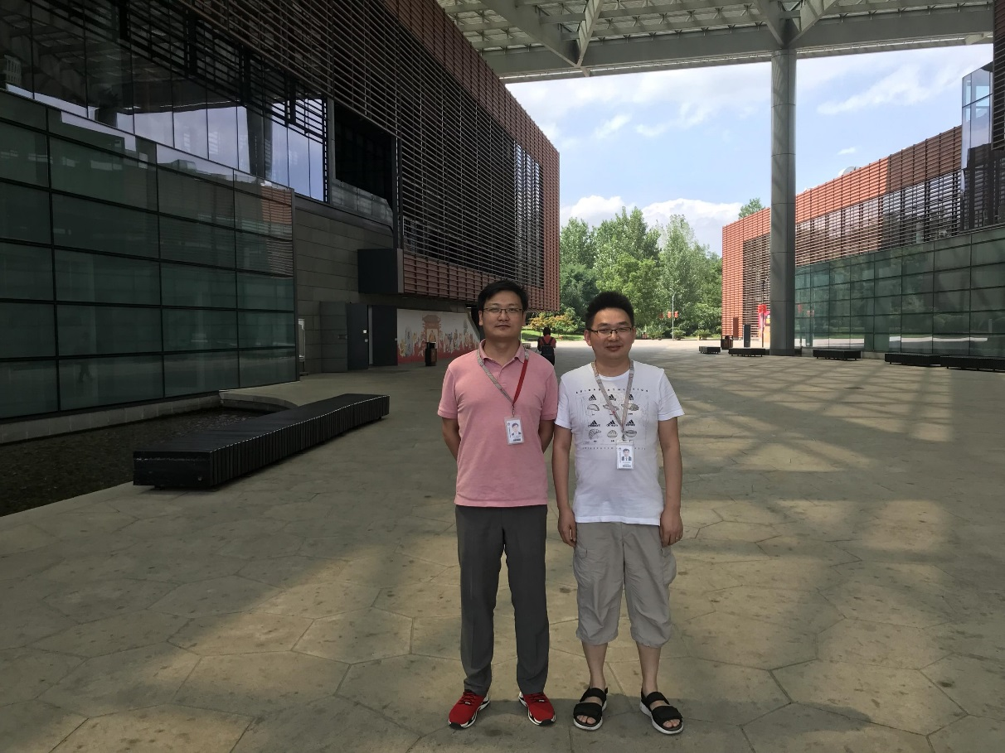
Remote participation
Beijing Team
Xinguo YANG, Mengmeng Li, Fengwei Qin, Shujun Hu
Nanjing Team
Xiaoming Chen, Zhunfeng Wu

Slide 8
See you in Hackdemo happy hour!

