Slide 1

IETF Hackathon:
LURK
IETF 102
14-15 July, 2018
Montreal

Slide 2
LURK – IETF 102 Hackathon
Problem Space we are looking at:
Separation of private keys from the certificate
How we aim to address the problem space:
Protect security credentials of a security service
Isolate operations associated to these credentials into specific cryptographic services
Use Case:
Enable delegation of video sessions from one domain, such as a Content Delivery Network (CDN) to another domain such as an Internet Service Provider (ISP) hosted “caches”, where a CDN can securely store content but without sharing of private keys
Relevant RFC’s:
https://datatracker.ietf.org/doc/draft-mglt-lurk-lurk/
https://datatracker.ietf.org/doc/draft-mglt-lurk-tls12/
https://tools.ietf.org/pdf/draft-mglt-lurk-tls13-00.pdf

Slide 3
What got done
What we achieved?
Two running implementations: cLURK and pyLURK
What the team agreed?
Proverif implementation to formally verify the LURK protocol
Links to github
https://github.com/mami-project/KeyServer
https://github.com/mglt/pylurk
https://github.com/jesusalber1/clurk
New design?
ECDHE implemented in pyLURK
Disabling non-secure configurations (LURK TLS 1.2 draft)

Slide 4
What we learned
Lessons learned from this hackathon?
Integrate with NGNIX OpenSSL
Trusted environment
Issues with existing draft
Fully implement LURK extensions for TLS 1.2
Future implementation Plans
Formal verification for LURK extension for TLS 1.3 (using Proverif)

Slide 5
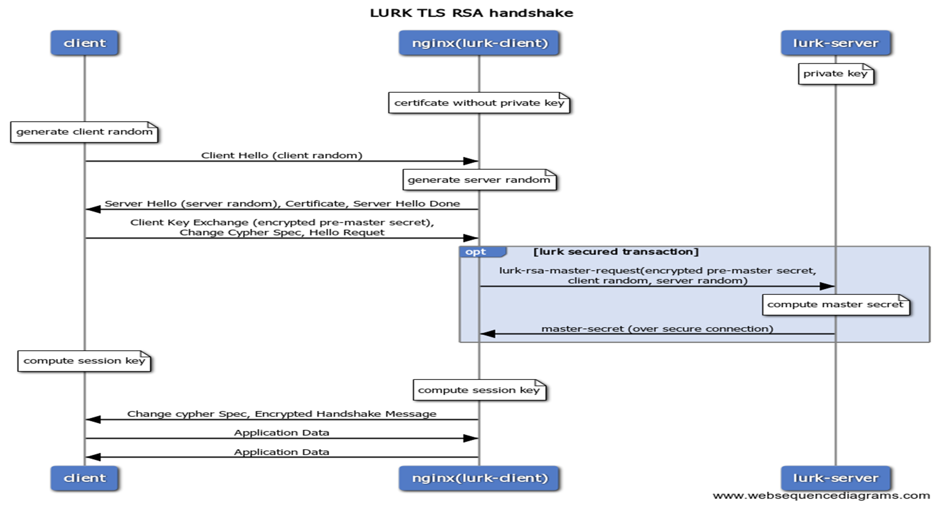
Wrap Up
Team members:
Daniel Migault (Daniel.Migault@ericsson.com)
Sanjay Mishra (sanjay.Mishra@verizon.com)
Ori Finkelman (orif@qwilt.com)
Dmitry Kravkov (dmitryk@qwilt.com)
Frederic Fieau (Frederic.fieau@orange.com)
Emile Stephane (emile.stephan@orange.com)
Jesús Alberto Polo (ietf@jesusalberto.me)

Slide 6
Delegation of HTTPS Video Session CDNI Use case
CNAME to CDN
ISP cache
Video content provider (Domain owner of
Video.example.com)
Delegation of HTTPS Video Session to a Cache located on an ISP Edge
Do not expose private keys of the Domain Name Owner to the ISP cache [maintaining the trust boundaries between DNO/CDN & ISP]

