Slide 1
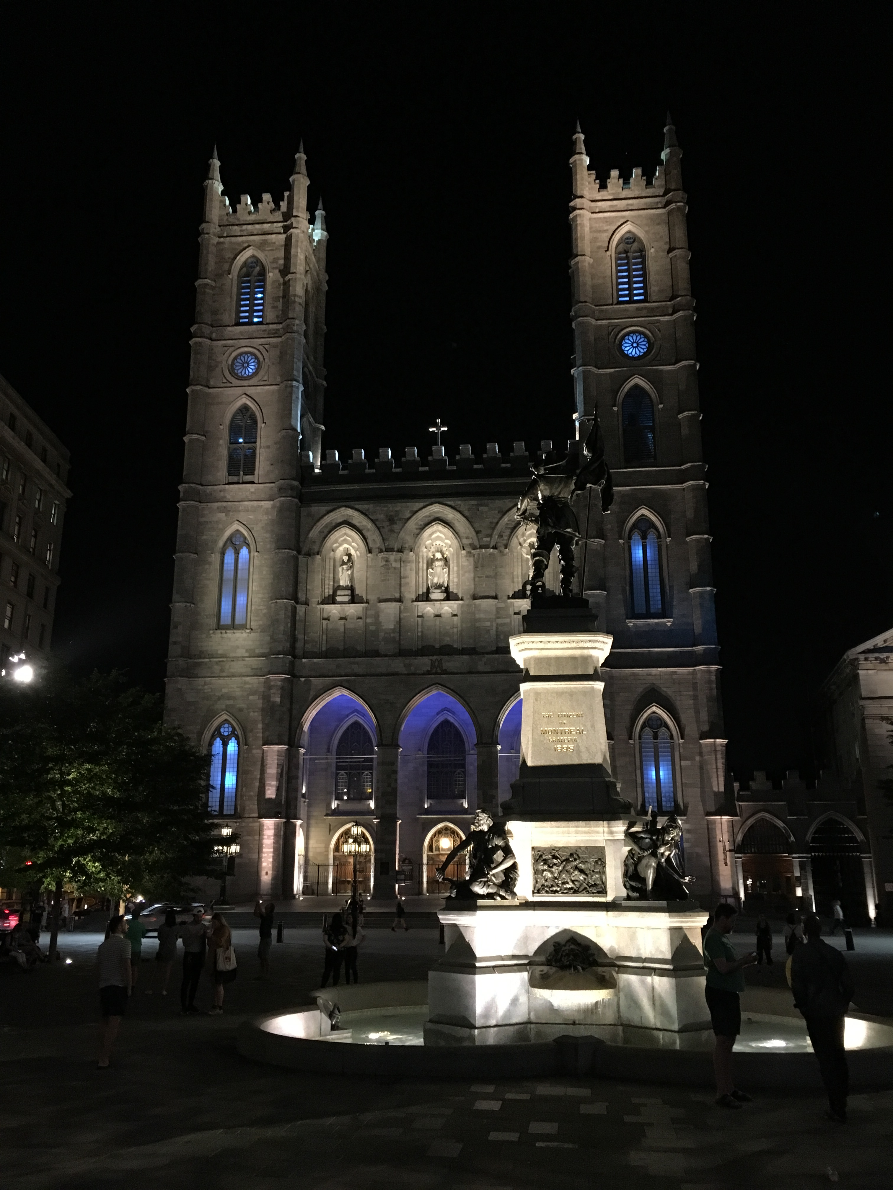
IETF Hackathon:
Message Layer Security (MLS)
IETF 102
14-15 July, 2018
Montreal

Slide 2
Hackathon Plan
Working on common understanding and very basic interop-ish of:
tree-based group key exchange
Arch: draft-omara-mls-architecture
Keying (ART, TreeKEM): draft-barnes-mls-protocol
C implementation (DKG), JS (M&M), Jon (Java), Nat (Python)

Slide 3
What got done
What kinds of learning/hacking happened?
A good deal of whiteboard work to understand the two keying models and potential formats of the trees
A few trivial PRs to the docs
DKG’s C: https://gitlab.com/dkg/nettle-mls
<New inter-op testing? - link to results>

Slide 4
What we learned
Whole lot of brain-folding (learning)
<Issues with existing drafts/RFCs>
Discovery: In TreeKEM imp, leaf may be indirectly sharing private key (no bueno)
<New feedback to take to WG?>
<New work to take to WG?>

Slide 5
Wrap Up
Team members: Daniel Kahn Gillmor, Matt Miller, Jon Millican, Nat Meysenburg, Shivan Kaul Sahib, Joseph Lorenzo Hall
First timers @ IETF/Hackathon: Nat Meysenburg
<Other links, contacts or notes>

