Slide 1
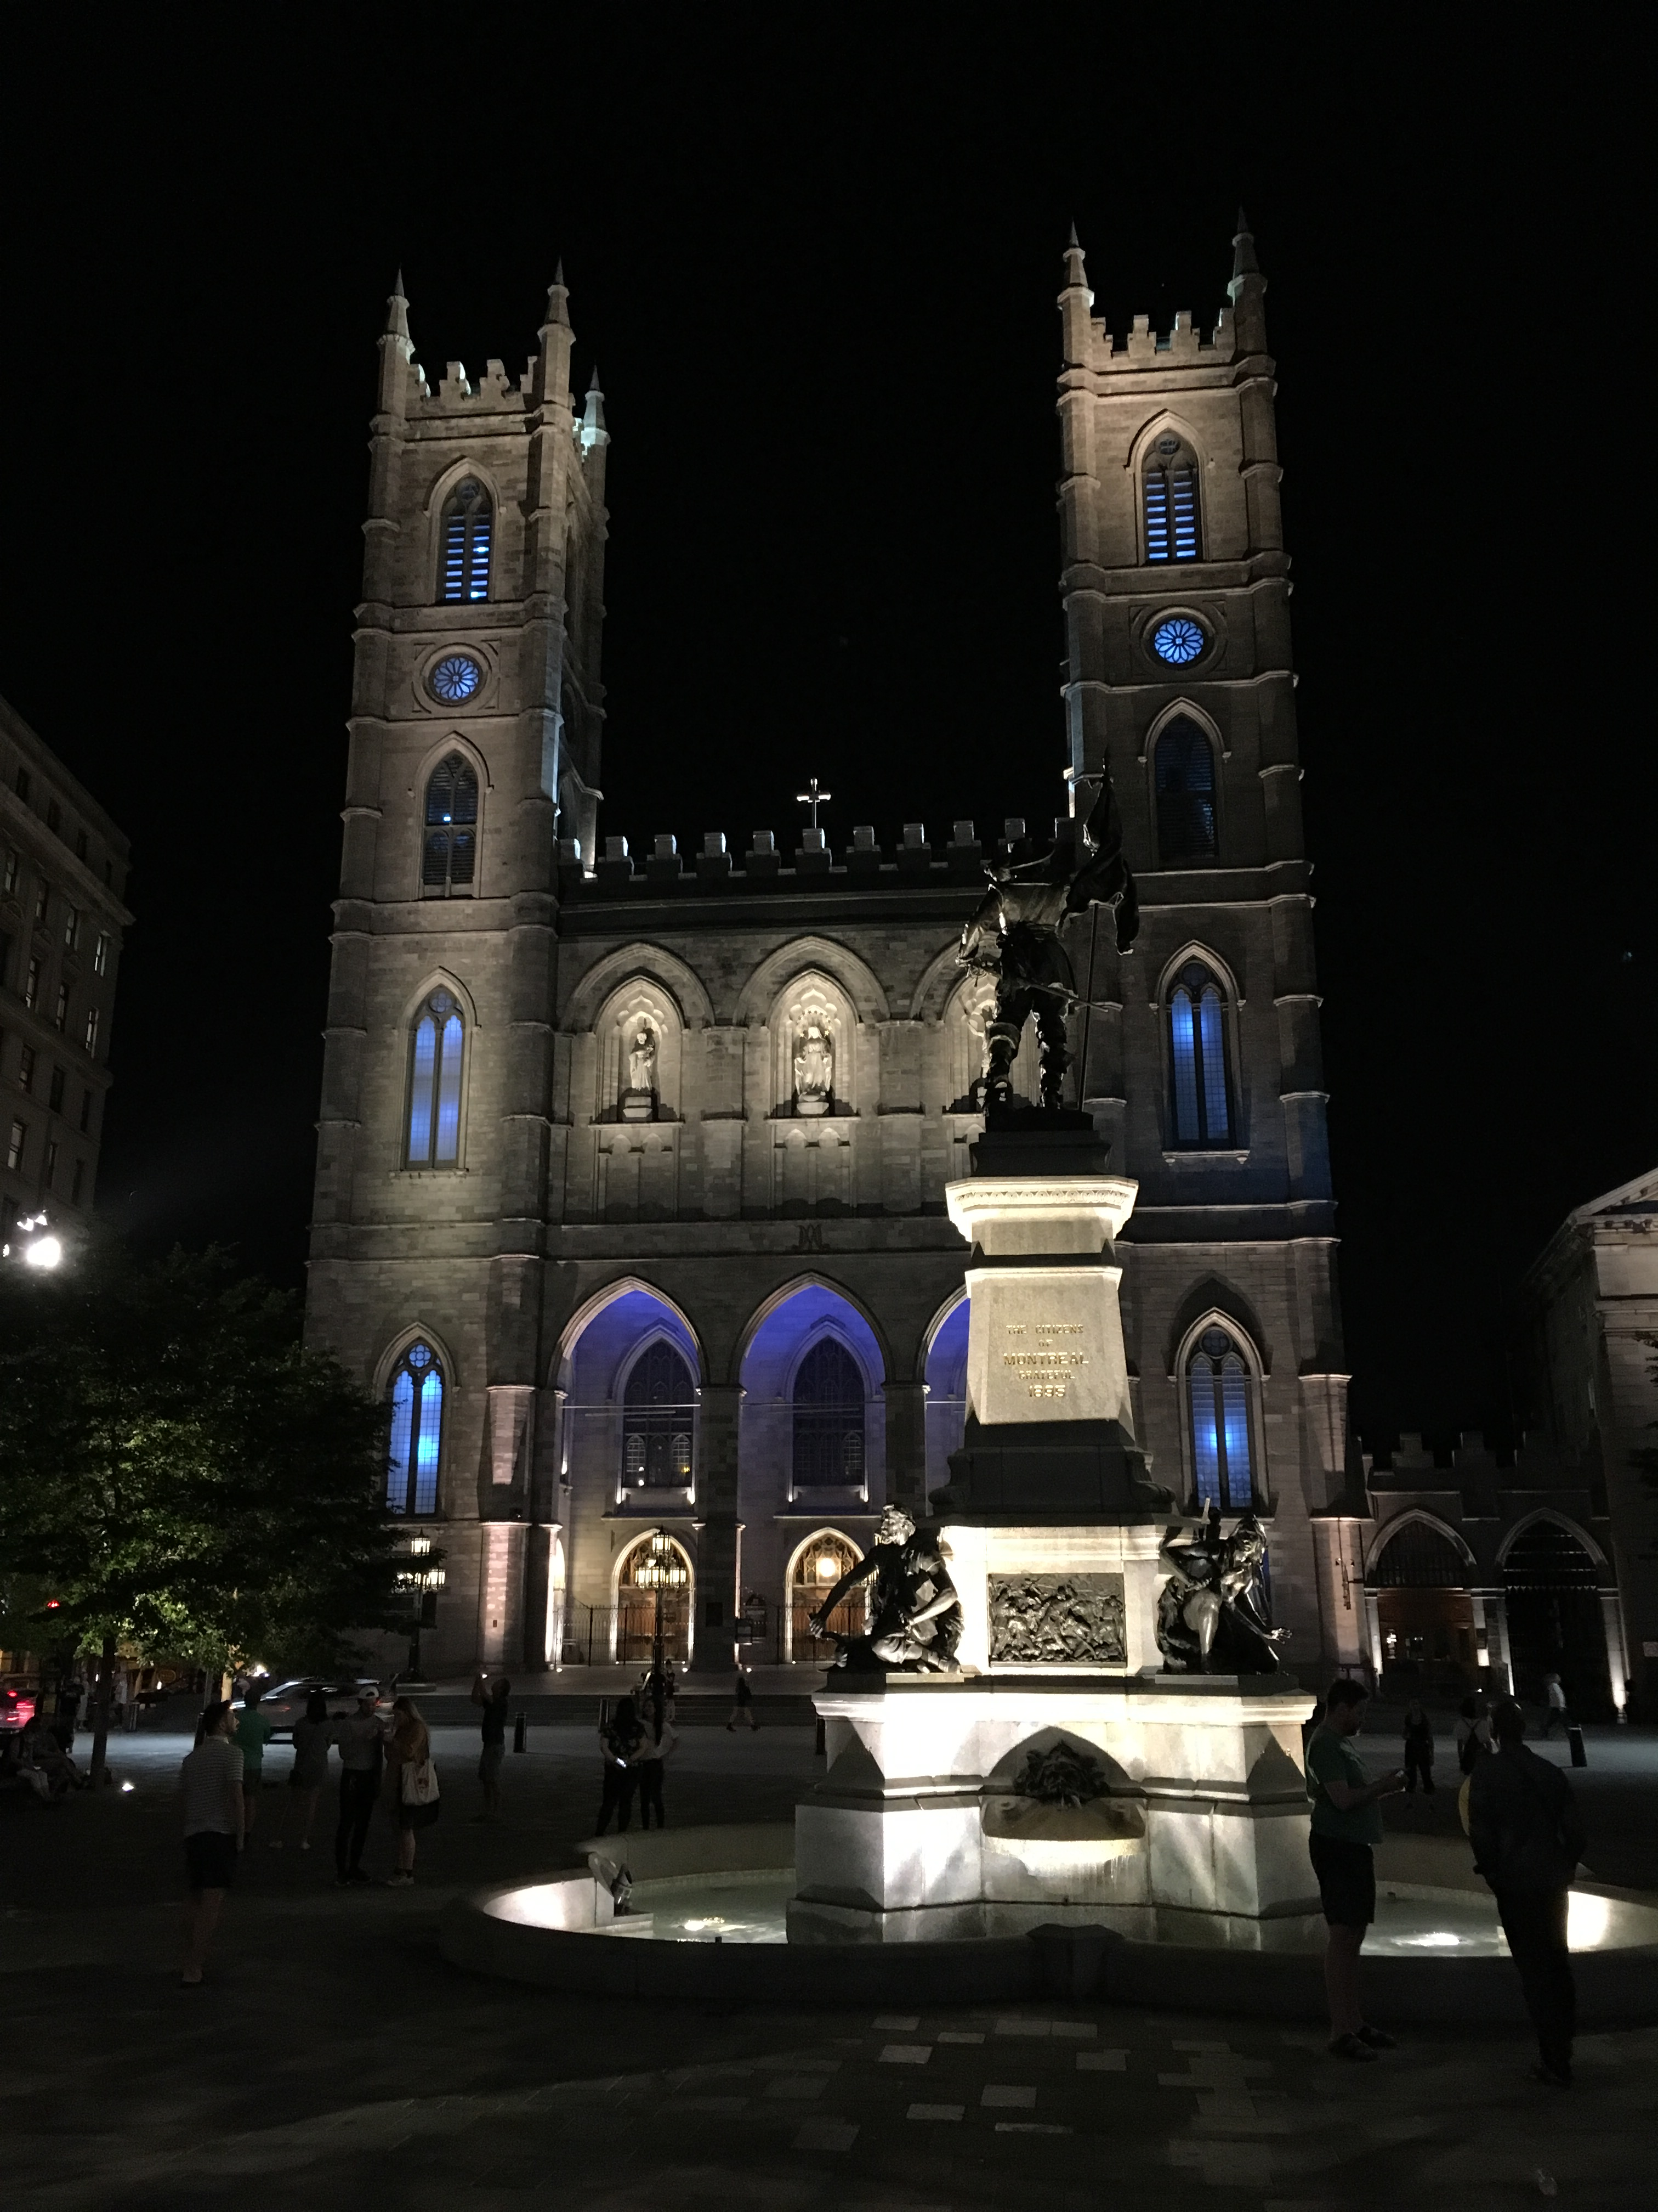
IETF Hackathon:
PERC
IETF 102
14-15 July, 2018
Montreal

Slide 2
Hackathon Plan
Putting together the whole picture of PERC-based private conferencing
draft-ietf-perc-srtp-ekt-diet
draft-ietf-perc-double
draft-ietf-perc-private-media-framework
Solution: libsrtp + NSS + Firefox + Go MD + C++ KD

Slide 4
What we learned
For the most part, things worked as specified
Several clarifications
Couple of minor bugs in mostly complete I-Ds

Slide 5
Wrap Up
Team members:
Adam Roach
Cullen Jennings
Eric Rescorla
Johannes Wilbold
Nils Ohlmeier
Richard Barnes
Suhas Nandakumar

