Slide 1

End-to-End Networking with ILNP
DEMONSTRATION
Ryo Yanagida & Saleem Bhatti
University of St Andrews
https://ilnp.cs.st-andrews.ac.uk/

Slide 2

Our thanks to
RStor.io https://rstor.io/
for sponsoring this attendance at IETF104.

Slide 3
Addresses and interfaces
system@ilnp-test-00:~$ ifconfig eno1
eno1: flags=4163<UP,BROADCAST,RUNNING,MULTICAST> mtu 1500
inet 138.251.30.200 netmask 255.255.255.192 broadcast 138.251.30.255
inet6 2001:630:35::200 prefixlen 56 scopeid 0x0<global>
inet6 fe80::12c3:7bff:fe9e:1f0d prefixlen 64 scopeid 0x20<link>
ether 10:c3:7b:9e:1f:0d txqueuelen 1000 (Ethernet)
RX packets 1392657 bytes 171061587 (171.0 MB)
RX errors 0 dropped 172169 overruns 0 frame 0
TX packets 776378 bytes 136654615 (136.6 MB)
TX errors 0 dropped 0 overruns 0 carrier 0 collisions 0
device interrupt 20 memory 0xf7c00000-f7c20000
system@ilnp-test-00:~$

Slide 4
Addressing and naming
Protocol layer | IP | ILNP
Application | FQDN / IP address / App. | FQDN / App.
Transport | IP address (+ port number) | Node Identifier (NID) (+ port number)
Network | IP address | Locator (L64)
(interface) | IP address | (dynamic binding to L64)
Transport / Application
session is tied to a
specific interface.
Transport (or Application)
session is bound only to NID,
NID has dynamic binding to L64.
App. Application-specific naming/addressing
FQDN Fully Qualified Domain Name
NID Node Identifier (for ILNP)
L64 Locator (for ILNP)

Slide 5
ILNP – new namespaces
Locator (L64)
Topologically significant
Used for routing
Not used in transport state
Node Identifier (NID)
Not topologically significant
Not used for routing
Used in transport state
RFCs 6740 – 6748 (Experimental)
from the IRTF Routing Research Group (RRG now concluded)
see RFC6115

Slide 6
ILNP: Identifier Locator Vector (I-LV)
/* IPv6 - RFC4291 + RFC3587 */
| 64 bits | 64 bits |
+-----------------------------+-------------------------+
| IPv6 Unicast Routing Prefix | Interface Identifier |
+-----------------------------+-------------------------+
/* ILNPv6 - RFC6741 */
| 64 bits | 64 bits |
+-----------------------------+-------------------------+
| Locator (L64) | Node Identifier (NID) |
+-----------------------------+-------------------------+

Slide 7
Mobility-Multihoming Duality
Multihoming:
  Node bound to multiple networks.
  NID bound to multiple L64 values.
Mobility:
  Move from one network to another.
  Handoff from one network to another.
ILNP: network layer soft handoff through multihoming.

Slide 8
End-to-end mobility: demo
Mobility
without
proxies,
tunnels,
“anchors”.
Across an
IPv6
network.
MN
network
bb
R2
MN
network
aa
CN
R1
R3
MN
network
cc
MN
R4
MN
network
dd
R router (IPv6)
CN correspondent node (ILNP)
MN mobile node (ILNP)
https://ilnp.cs.st-andrews.ac.uk/

Slide 9
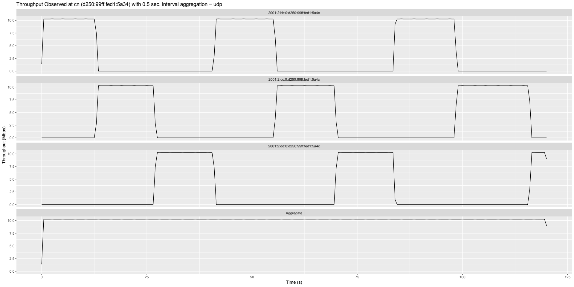
UDP throughput as seen at CN

Slide 10
Come and see the demo
at the
Hackdemo Happy Hour!
https://ilnp.cs.st-andrews.ac.uk/

Slide 11
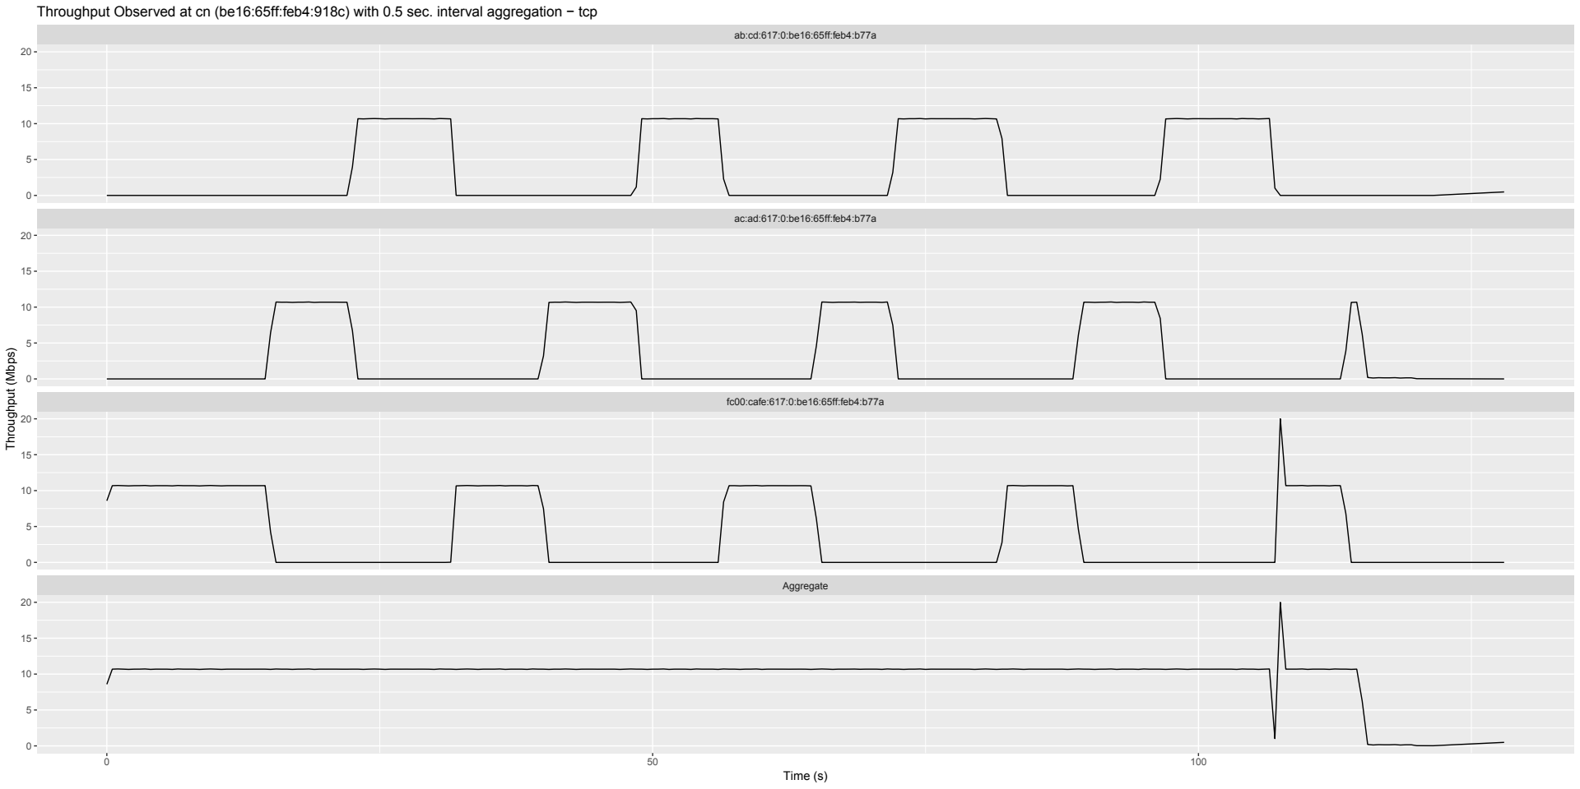
TCP throughput (lab, debugging)

Slide 12
Locator Update handshake
CN
MN
Locator Update (LU)
1 RTT
Locator Update Acknowledgement (LU-Ack)

Slide 13
ILNP: Locator Update Message
/* ILNPv6 (ICMPv6) - RFC6743 */
0 1 2 3
0 1 2 3 4 5 6 7 8 9 0 1 2 3 4 5 6 7 8 9 0 1 2 3 4 5 6 7 8 9 0 1
+-+-+-+-+-+-+-+-+-+-+-+-+-+-+-+-+-+-+-+-+-+-+-+-+-+-+-+-+-+-+-+-+
| Type=156 | Code | Checksum |
+-+-+-+-+-+-+-+-+-+-+-+-+-+-+-+-+-+-+-+-+-+-+-+-+-+-+-+-+-+-+-+-+
| Num of Locs | Operation | RESERVED |
+-+-+-+-+-+-+-+-+-+-+-+-+-+-+-+-+-+-+-+-+-+-+-+-+-+-+-+-+-+-+-+-+
/ Locator [1] /
+-+-+-+-+-+-+-+-+-+-+-+-+-+-+-+-+-+-+-+-+-+-+-+-+-+-+-+-+-+-+-+-+
| Preference [1] | Lifetime [1] |
+-+-+-+-+-+-+-+-+-+-+-+-+-+-+-+-+-+-+-+-+-+-+-+-+-+-+-+-+-+-+-+-+
/ Locator [2] /
+-+-+-+-+-+-+-+-+-+-+-+-+-+-+-+-+-+-+-+-+-+-+-+-+-+-+-+-+-+-+-+-+
| Preference [2] | Lifetime [2] |
+-+-+-+-+-+-+-+-+-+-+-+-+-+-+-+-+-+-+-+-+-+-+-+-+-+-+-+-+-+-+-+-+
| . |

Slide 14
ILNP: Nonce Header (Dst. Option)
/* ILNPv6 – RFC6744 */
0 1 2 3
0 1 2 3 4 5 6 7 8 9 0 1 2 3 4 5 6 7 8 9 0 1 2 3 4 5 6 7 8 9 0 1
+-+-+-+-+-+-+-+-+-+-+-+-+-+-+-+-+-+-+-+-+-+-+-+-+-+-+-+-+-+-+-+-+
| Next Header | Hdr Ext Len | Option Type | Option Length |
+-+-+-+-+-+-+-+-+-+-+-+-+-+-+-+-+-+-+-+-+-+-+-+-+-+-+-+-+-+-+-+-+
/ Nonce Value /
+-+-+-+-+-+-+-+-+-+-+-+-+-+-+-+-+-+-+-+-+-+-+-+-+-+-+-+-+-+-+-+-+
Option Type: 0x8b
Option Length: 4 or or 12 bytes
Nonce Value: 32 or 96 bits

