Slide 1
Postcard Based Telemetry for Insitu Flow Information Telemetry
IETF 105, Montreal

Slide 2
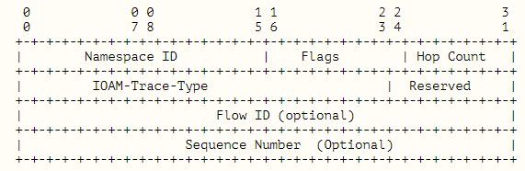
Postcard Based Telemetry
Separate the Telemetry Instruction Header and the Meta data.
Postcard will ship out the meta data hop by hop.
PostCard
Detect the location of packet loss.
Fixed packet header
Differentiate the QoS priority for the metadata from user traffic
instruction
Meta data
User packet
Postcard-based On-Path Flow Data Telemetry (https://datatracker.ietf.org/doc/draft-song-ippm-postcard-based-telemetry)
Notes:
Pre-allocated Trace Option
o Incremental Trace Option
o Proof of Transit (POT) Option
o Edge-to-Edge (E2E) Option

Slide 3



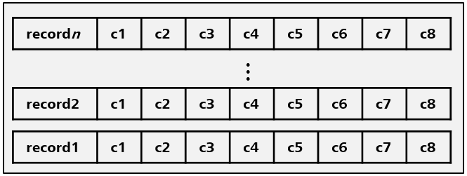

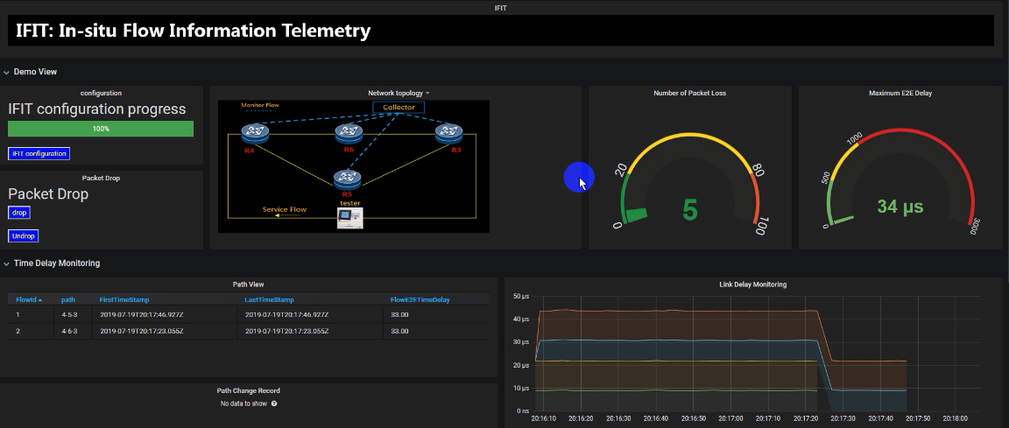

Architecture
Receive Data
Record
Memory DB
Kafka
Data Analysis
MySQL DB
Collector
Collector Framework
Postcard metadata
Case 1: Delay Monitoring（node，link，E2E）
Case 2: Packet Loss Monitoring
Case 3: Path tracking
R4
R6
R3
R5
Two Test Flows
Tester
instruction
Meta data
User packet

Slide 4
Thanks

