Slide 1

BMP BGP Monitoring Protocol GROW WG
IETF 108
July 20-24th, 2020
Virtual Hackathon

Slide 2
Hackathon - Plan
Functionality
Test BMP BGP Local RIB to IPFIX metric correlation and interoperability between router and data-collection for peer and route monitoring for message type extensions defined in
draft-ietf-grow-bmp-local-rib (BGP Local RIB)
draft-grow-bmp-tlv (TLV support for BMP Route Monitoring and Peer Down Messages)
draft-lucente-grow-bmp-tlv-ebit (Support for Enterprise-specific TLVs)
draft-cppy-grow-bmp-path-marking-tlv (Path Marking TLV)
draft-xu-grow-bmp-route-policy-attr-trace (BGP Route Policy and Attribute Trace)
Performance
Test performance impact of BMP on router CPU/Memory resources and BGP route propagation with YANG push.

Slide 3
Hackathon – Software
Software
pmacct nfacctd for IPFIX and BMP data collection
pmacct pmgrpcd for YANG push data collection
Apache Kafka as message broker
Apache Druid as timeseries DB
Pivot as user interface
Wireshark BMP dissector for packet analysis
Spirent Testcenter for BGP VPnv4/6 route and IPV4/6 traffic generation
Tutorial
https://imply.io/post/add-bgp-analytics-to-your-imply-netflow-analysis

Slide 4
Hackathon - Network

Slide 5
Swisscom – lab environment
Achievements
Spirent Testcenter added for IPv4/6 traffic generation
YANG push data collection for CPU and memory
Gaps Identified
Test verification needs to be further automatized to improve efficiency
Next Steps
BMP BGP RIB update flow delay heatmap to facilitate convergence delay RCA
Improve testbed to measure the impact on network convergence with BMP
Validate BGP router reset notification PDU for Adj-RIB In/Out and consequent action in correlator

Slide 6
Pmacct – nfacctd/pmbmpd
Achievements
BMP BGP Local RIB to IPFIX correlation now works for prefixes with BGP route-distinguisher as well.
2 of 5 TLV's decoded of draft-xu-grow-bmp-route-policy-attr-trace
Gaps Identified
Path Marking TLV could be optimized if contained paths would have been indexed. Input for draft-cppy-grow-bmp-path-marking-tlv-04
https://github.com/pmacct/pmacct/

Slide 7
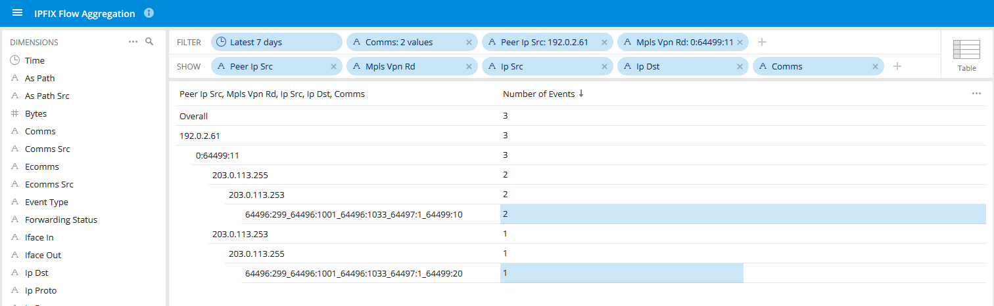
BMP BGP Local RIB with IPFIX Correlation
UDP Testflow between two IPv4 Addresses with
BMP BGP Local RIB dimensions measured on MPLS PE in a VRF

Slide 8
Huawei - VRP
Achievements
Supporting draft-grow-bmp-tlv-00 and draft-lucente-grow-bmp-tlv-ebit-00
Supporting path status of draft-cppy-grow-bmp-path-marking-tlv-04 Supporting draft-xu-grow-bmp-route-policy-attr-trace-04
Stress tests showing CPU and memory usage increase but no BGP propagation delay. CPU increase not to be realistic
Wireshark dissector for route-policy tracing BMP message-type and route-monitoring path marking TLV
Next Steps
Redo the BGP propagation delay tests with improved testbed
Investigate BMP impact in CPU usage graph

Slide 9
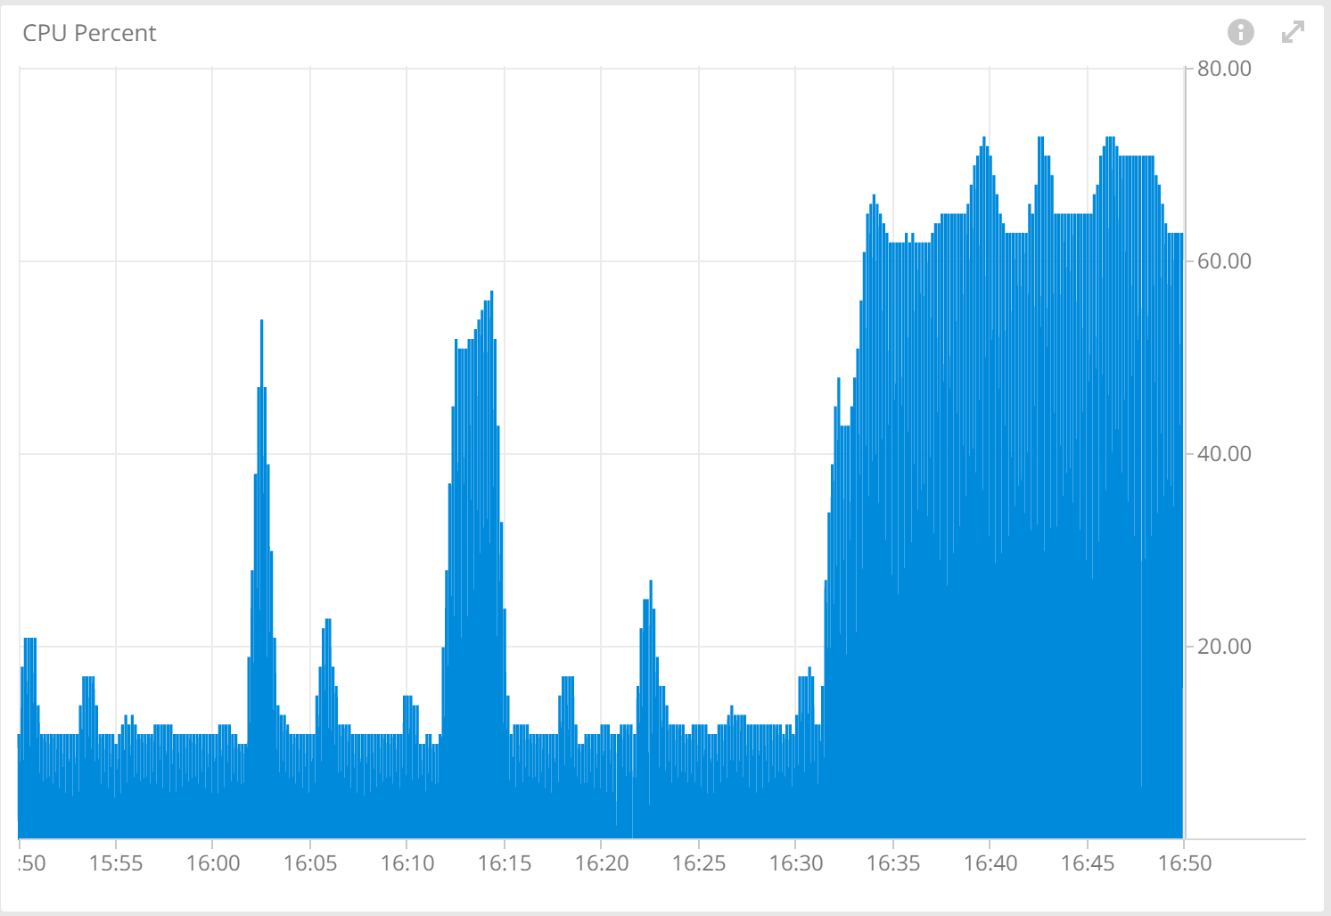
BMP Stress Test – CPU usage
Dataset:
• Dataset 1: 100K routes from Spirent
• Dataset 2: 500K routes from Spirent
• Dataset 3: 1000K routes from Spirent
BMP disabled: 15:50 ~ 16: 15
BMP enabled: 16:30 ~ 16:50
CPU usage monitoring of Router Reflector

Slide 10
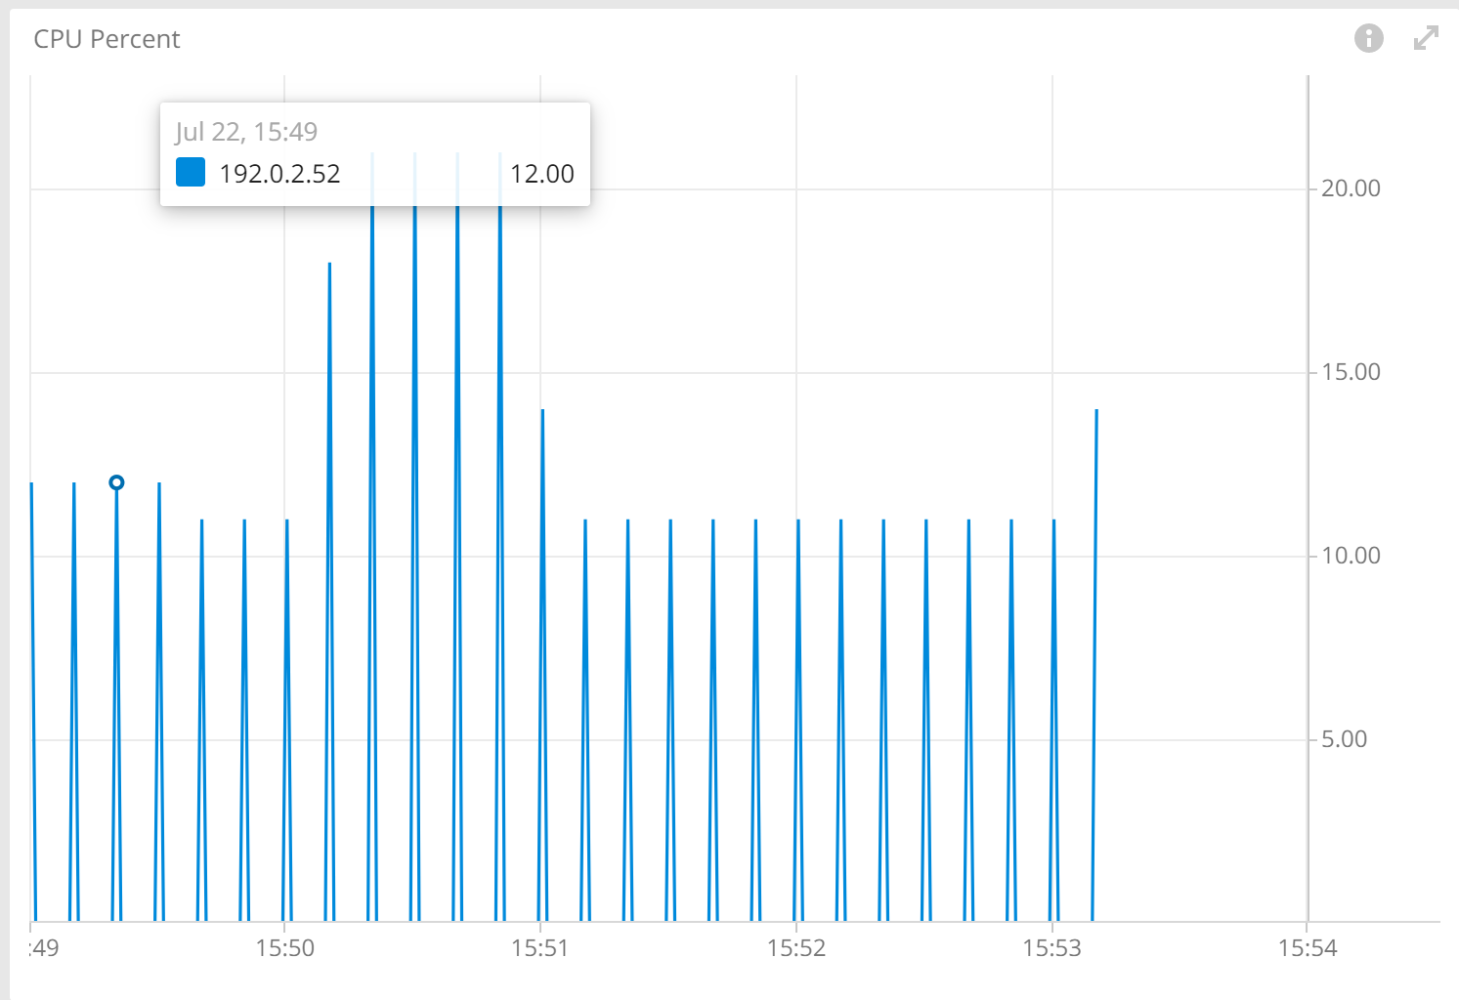
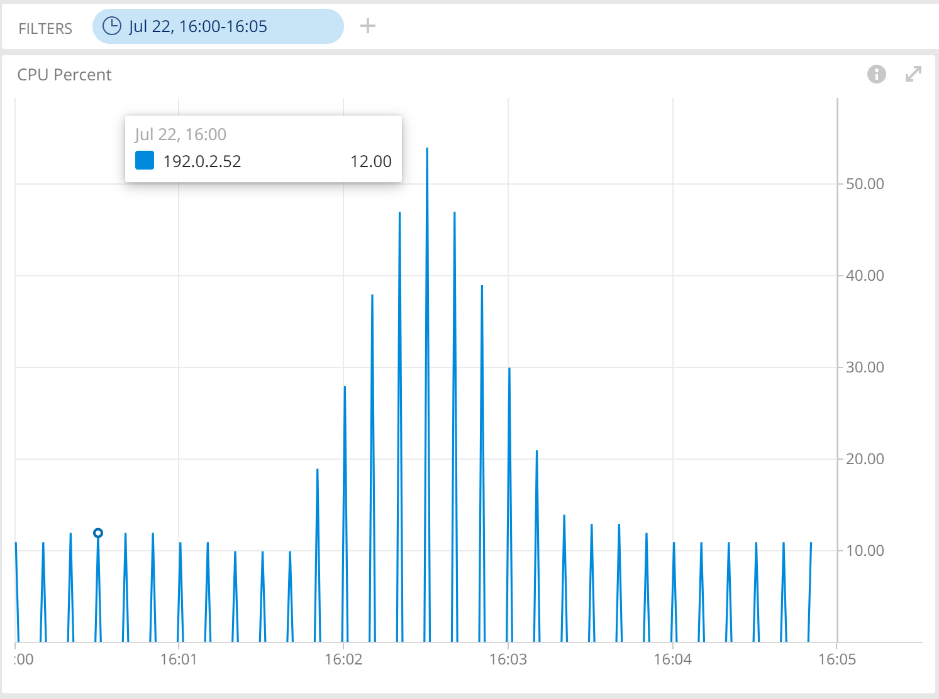
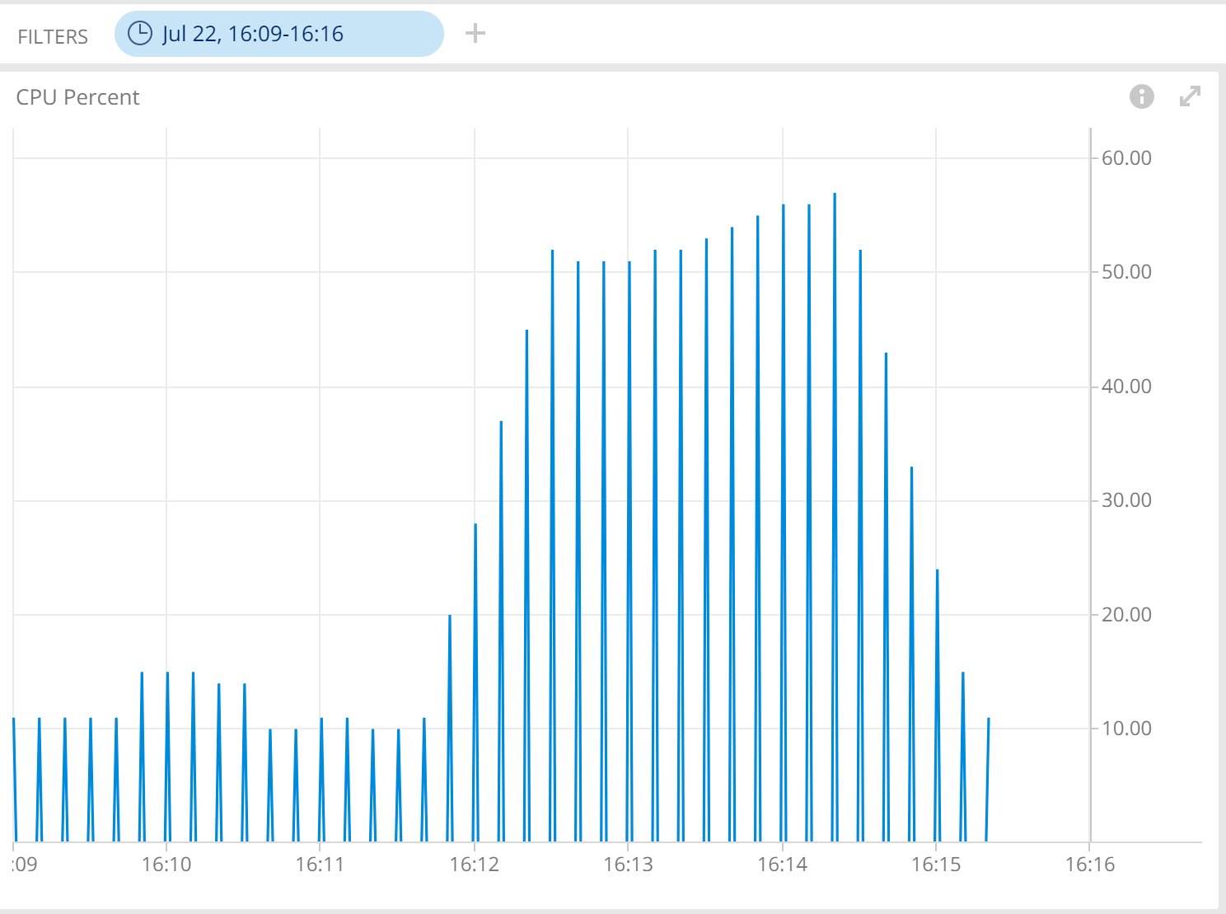
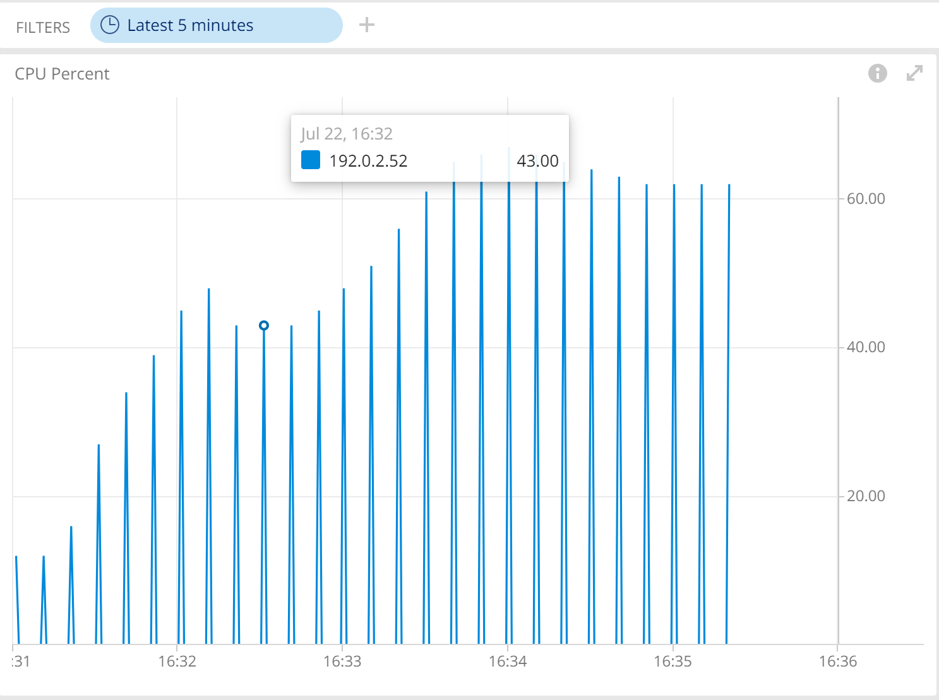
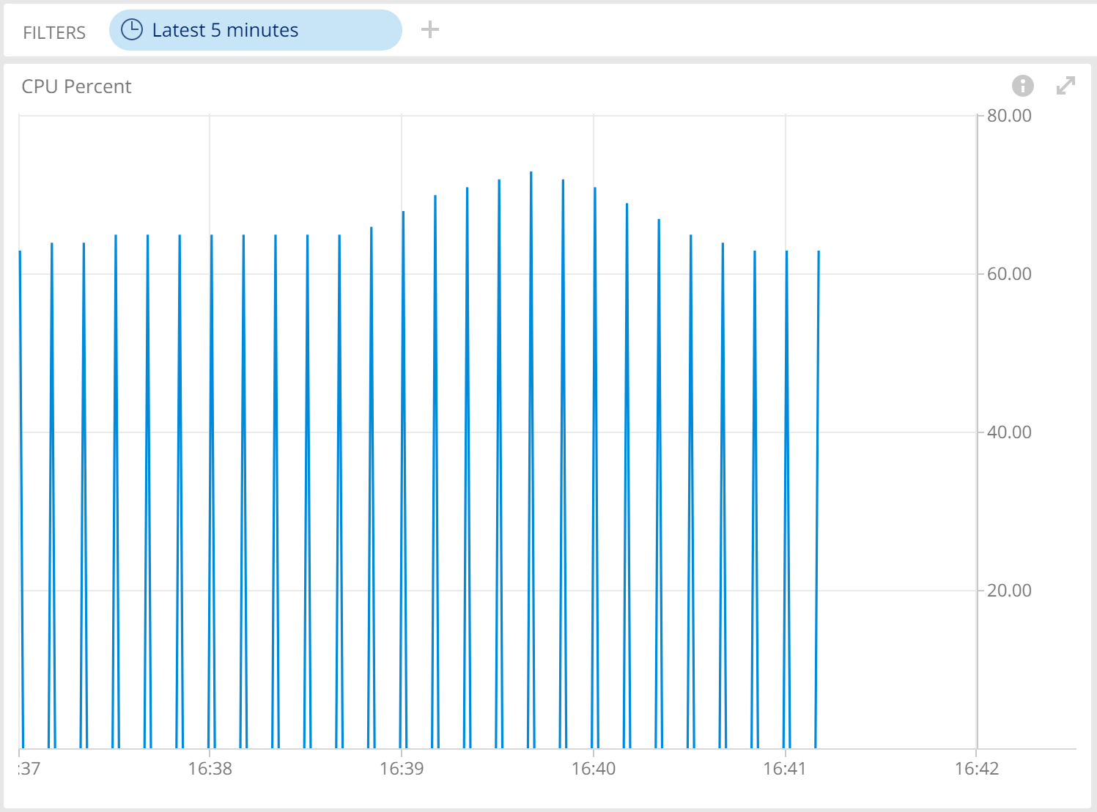
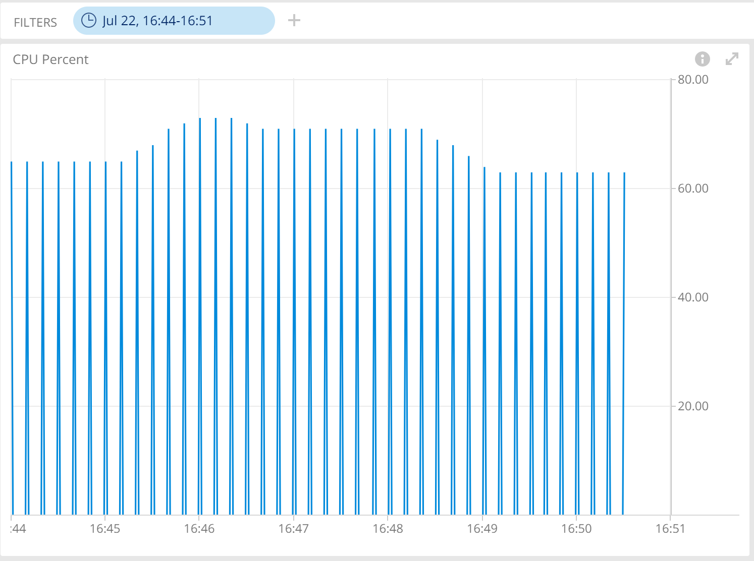
BMP Stress Test – CPU usage
Before BMP enabled: 100K routes adv.
Before BMP enabled: 500K routes adv.
Before BMP enabled: 1000K routes adv.
After BMP enabled: 100K routes adv.
After BMP enabled: 500K routes adv.
After BMP enabled: 1000K routes adv.

Slide 11
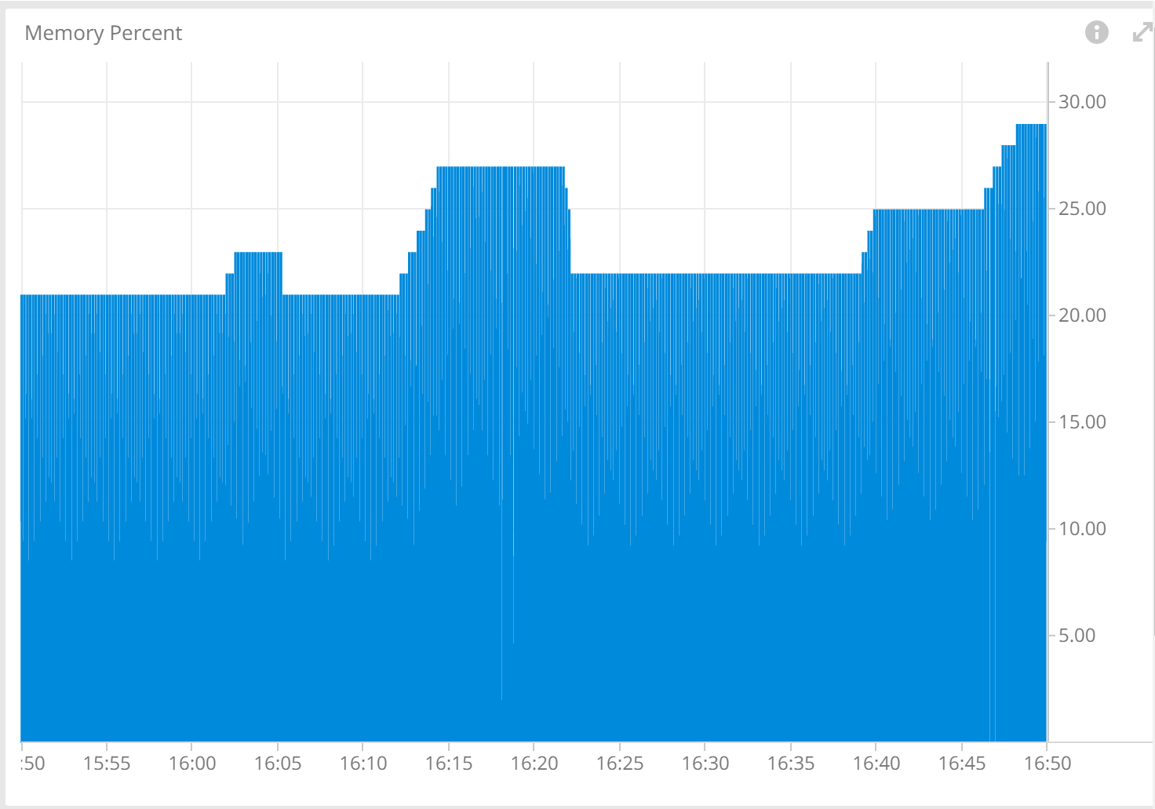
BMP Stress Test – Memory Usage
Dataset:
• Dataset 1: 100K routes from Spirent
• Dataset 2: 500K routes from Spirent
• Dataset 3: 1000K routes from Spirent
BMP disabled: 15:50 ~ 16: 15
BMP enabled: 16:30 ~ 16:50
Memory usage monitoring of Router Reflector

Slide 12
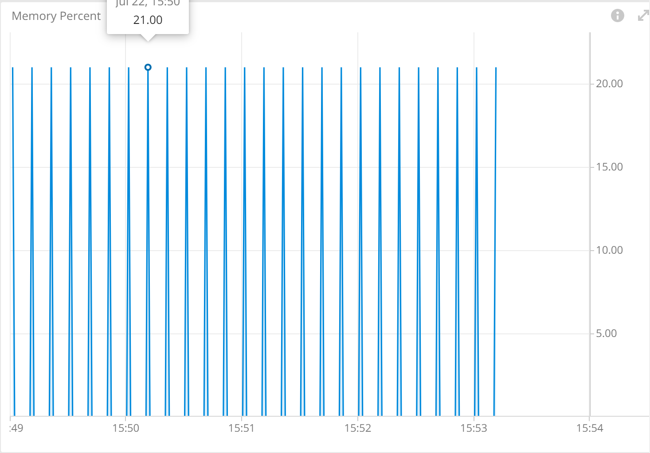
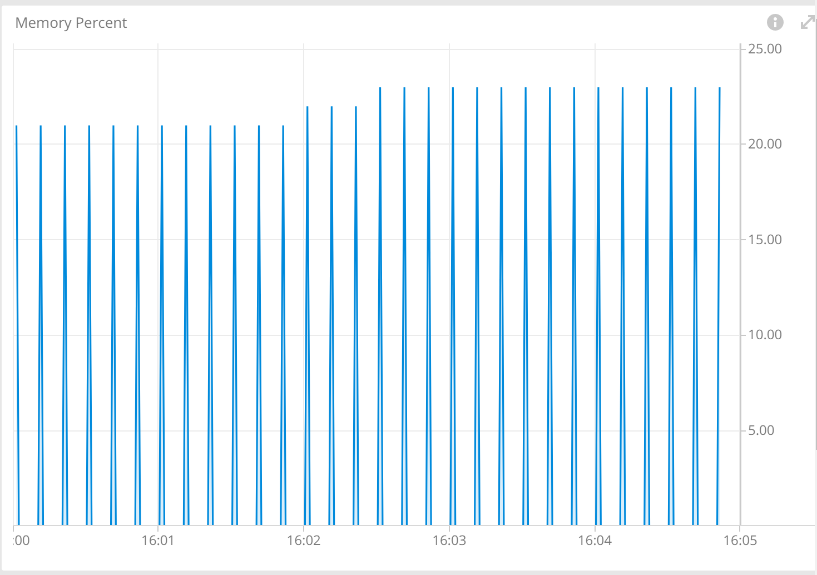
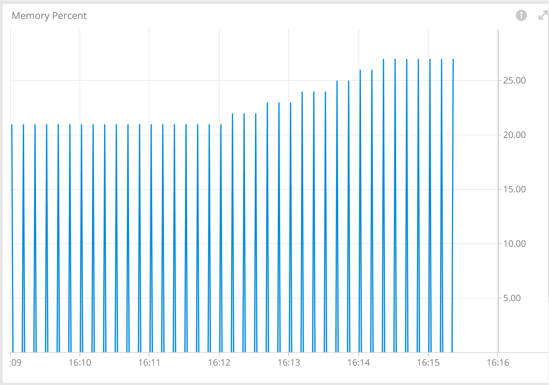
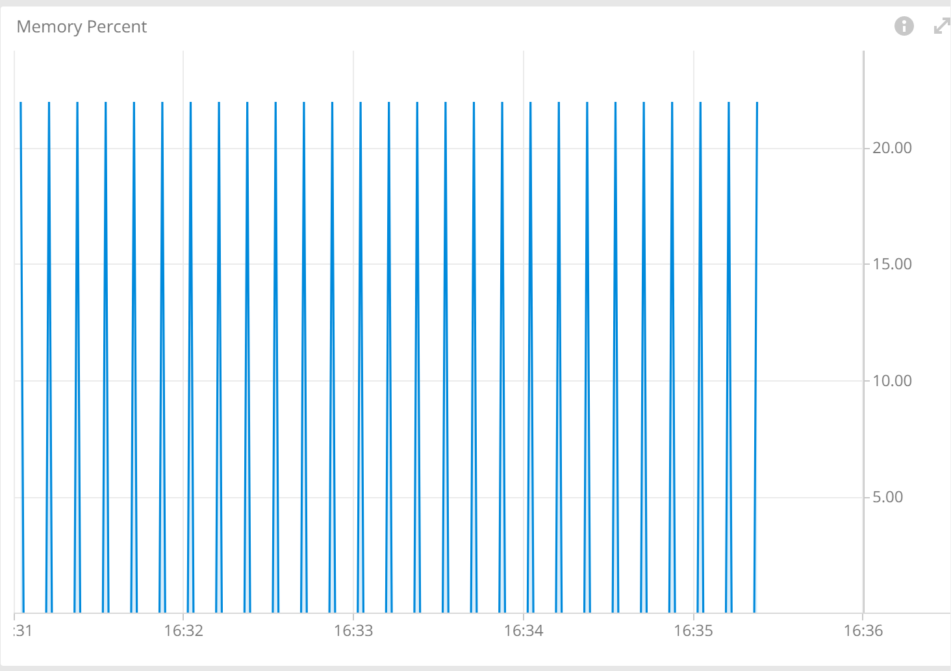
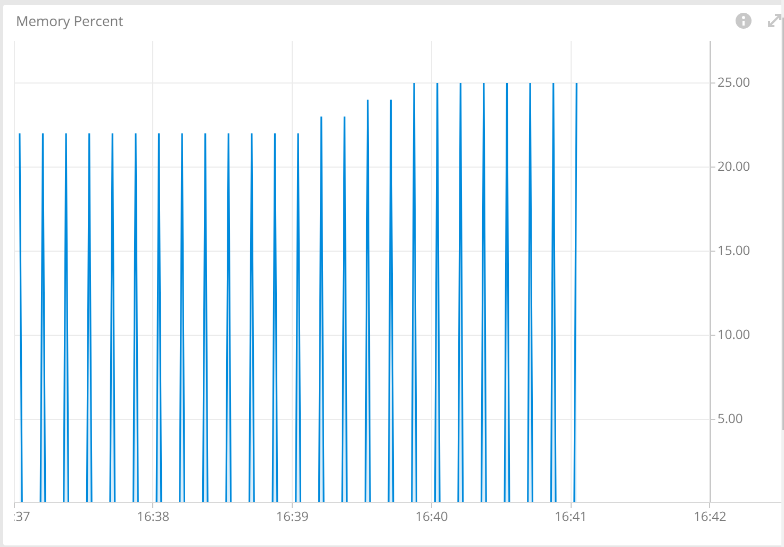
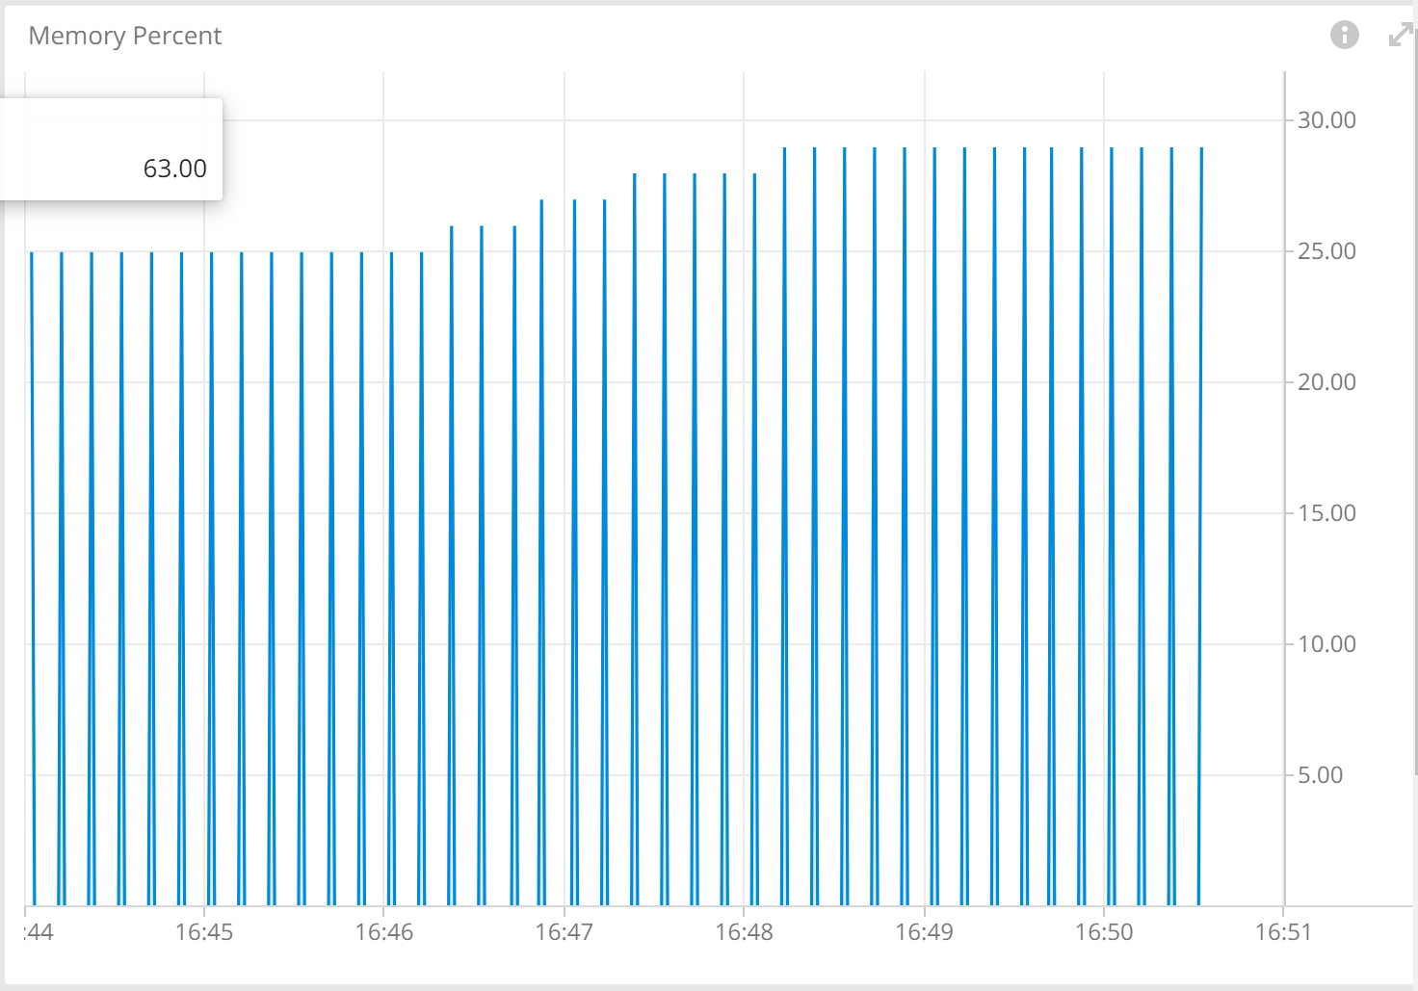
BMP Stress Test – Memory Usage
Before BMP enabled: 100K routes adv.
Before BMP enabled: 500K routes adv.
Before BMP enabled: 1000K routes adv.
After BMP enabled: 100K routes adv.
After BMP enabled: 500K routes adv.
After BMP enabled: 1000K routes adv.

Slide 13
BMP Stress test – Convergence time
A very rough estimation of individual device RIB convergence time based on CPU stabilization
Dataset | Device | updates | Convergence time by clock (BMP disabled) | Convergence time by clock (BMP enabled)
Dataset 1: | RR: 10.215.184.52 | 100000 | 60 sec | 60 sec
Dataset 2 | RR: 10.215.184.52 | 500000 | 110 sec | 120 sec
Dataset 3 | RR: 10.215.184.52 | 1000000 | 220 sec | 240 sec

Slide 14
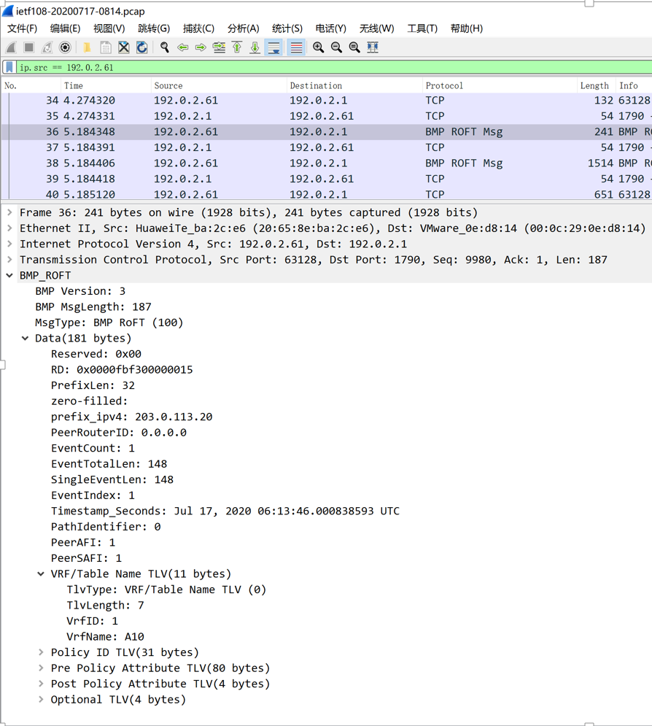
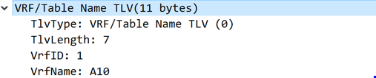
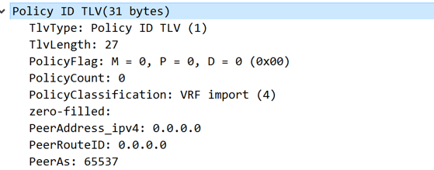
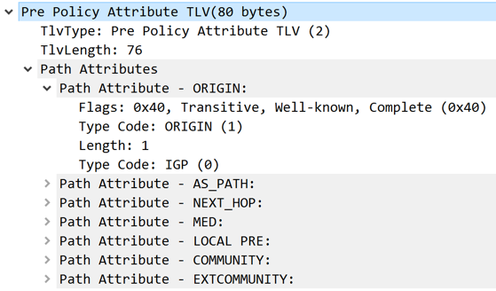


BMP route-policy trace data visualization

Slide 15
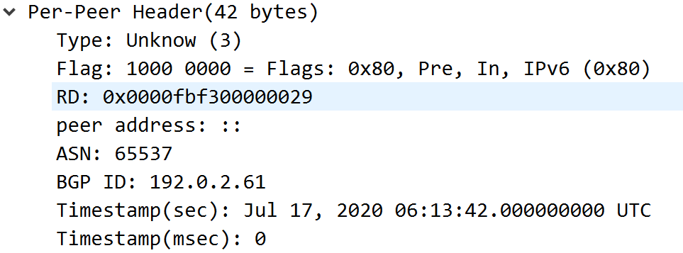
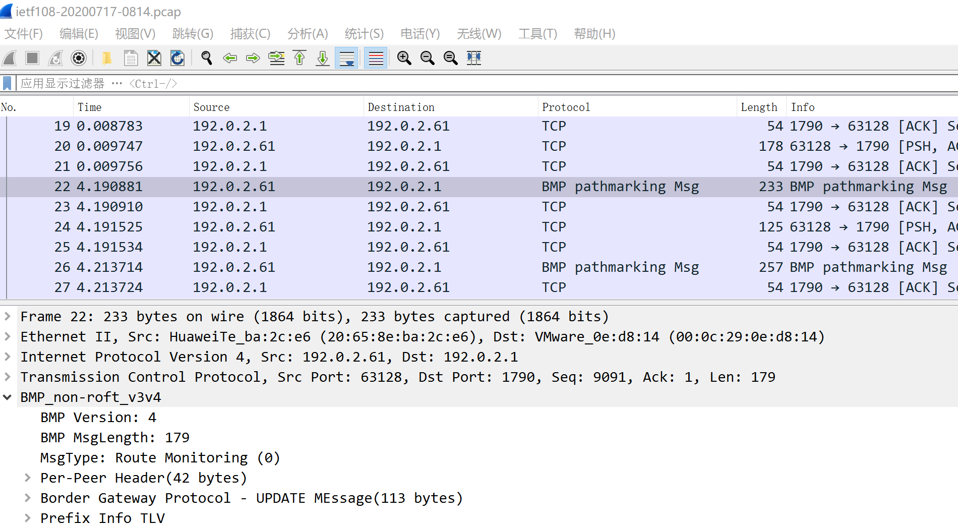
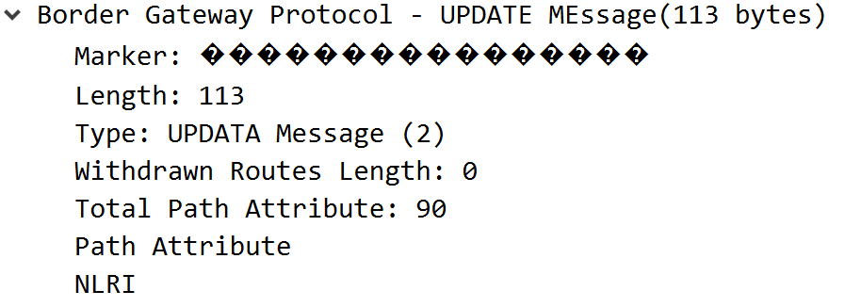
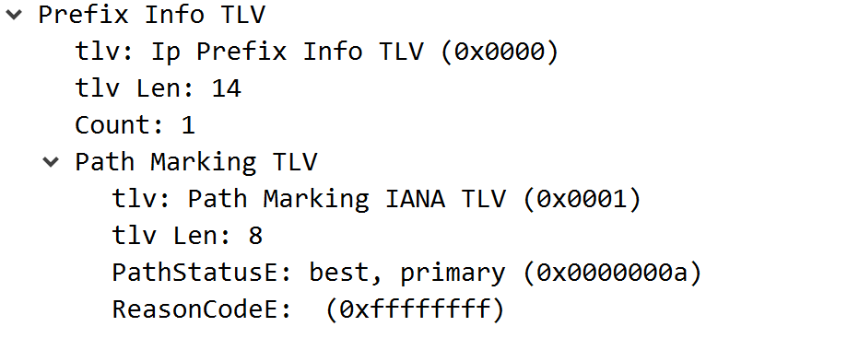
BMP path marking data visualization

Slide 16
Wireshark – BMP Dissector
Achievements
Supporting draft-xu-grow-bmp-route-policy-attr-trace-04 in latest code commit
Next Steps
Support draft-grow-bmp-tlv-00 and draft-grow-bmp-tlv-ebit-00
Support draft-cppy-grow-bmp-path-marking-tlv-04

Slide 17
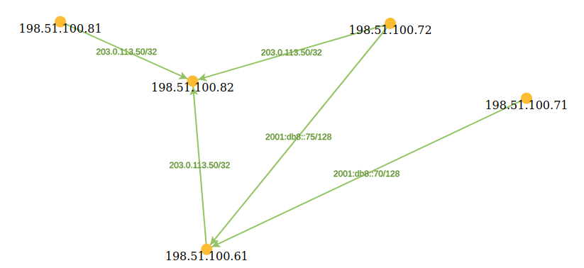
ETHZ – Livio Sgier
Achievements
Setting up of end-to-end export/collection/visualization pipeline based on time-series database Druid
D3.js visualization front-end for quick prototyping
Next Steps
Testing new visualization use-cases (L3 topology, VPN abstraction, control/data plane correlation, incorporating data from new drafts supplied by pmacct)
D3.js Front-end

Slide 18
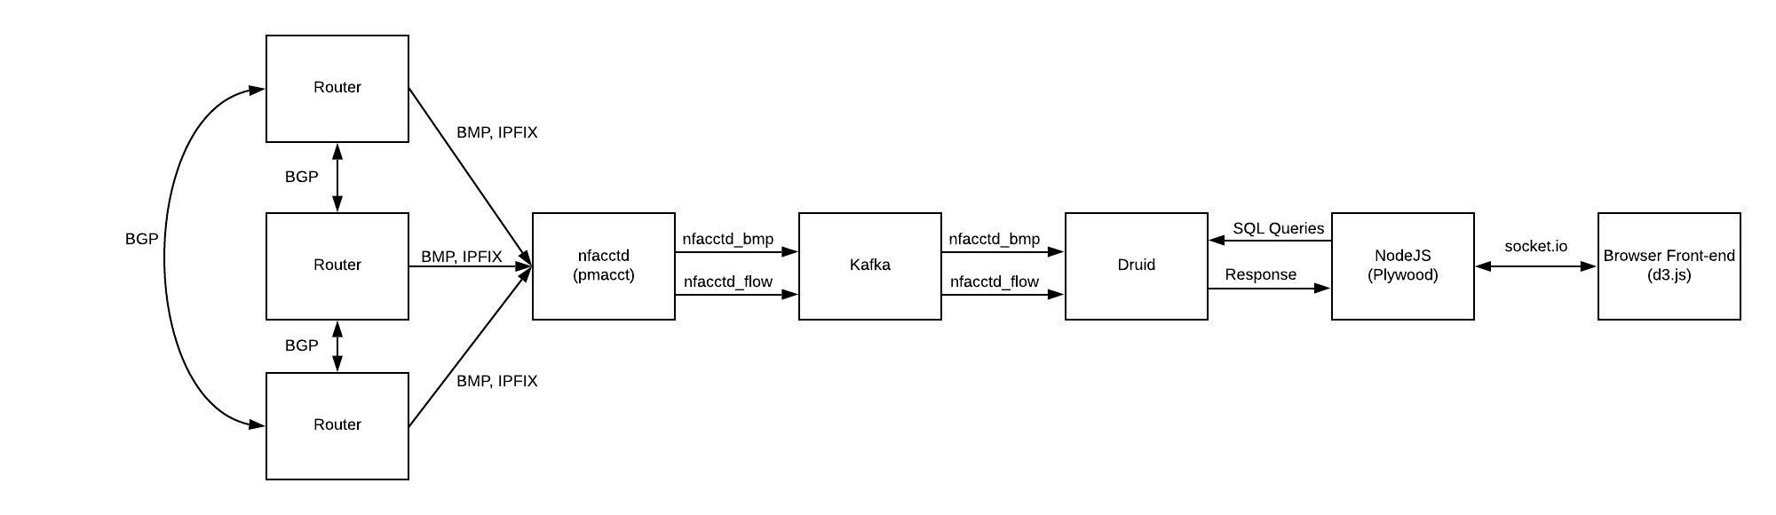
ETHZ – Livio Sgier
End-to-End export/collection/visualization pipeline

Slide 19
What we learned
Good
Being virtual makes the BMP project more accessible to people
Newcomers bring a fresh mindset and wonderful ideas into the team
BFD correlation to BMP peer_up/down message type
YANG push CPU and memory with a 10 second, BMP with a second granularity improved insights into the performance impact
Bad
The missing beers and cocktails after ☺

Slide 20
Thanks to…
Anurag Prakash - Ciena
Hongwei Li - HPE
Kian Jones - CENGN
Alexis La Goutte – Wireshark
Livio Sgier - ETHZ
Yunan Gu - Huawei
Binyang Huang - Huawei
Paolo Lucente - NTT
Heng Cui - Swisscom
Matthias Arnold - Swisscom
Thomas Graf - Swisscom
…Imply and Swisscom Time Analytics Platform team for providing us the big data and Huawei for the network environment.

