Slide 1
BMWG – Containerized Infrastructure Benchmarking
IETF 109
November 9-13, 2020
Online

Slide 2
Hackathon Plan
The main goal is to figure out container networking performance impacts by various resource options.
Related Draft: Considerations for Benchmarking Network Performance in Containerized Infrastructures ​https://tools.ietf.org/html/draft-dcn-bmwg-containerized-infra
Two main features
Implementing containerized infrastructure with various network models
Verifying performance impacts depending on configuration settings

Slide 3
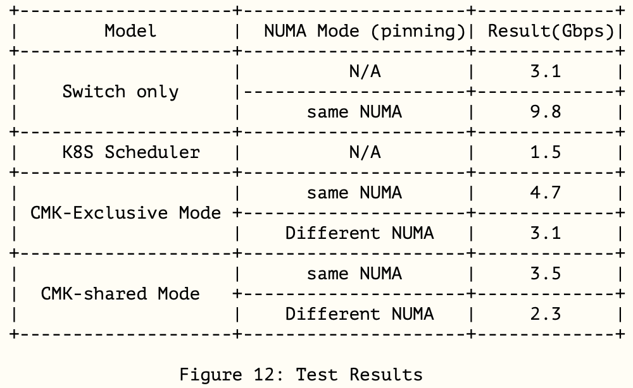
Hackathon Plan
1st Hackathon at 106 Singapore
Network technology : User-space vSwitch model
DPDK / Contiv-vpp
Verifying CPU allocation using current container orchestration engine
Kubernetes CPU Scheduler (v1.6.1)
Compare with CPU pinning technology
CMK(CPU Manager for K8S)
NUMA-affinity
Hackathon results were included in our updated draft
Chapter 6

Slide 4
Hackathon Plan
This is our 2nd Hackathon
Using Network model : User-space device pass-through model
SR-IOV / DPDK
Verifying huge pages impacts on network performance and resource utilization
In our draft, Chapter 5;
“… the container is isolated in the application level and administrators can set huge pages more granular level.
..Even if the page size is smaller than the VM, the effect of the huge page is large, which leads to the utilization of physical memory and the increasing number of functions in the host.”

Slide 5
What got done
Infrastructure Setting
https://github.com/huyng14/bmwg- container-network
Kubernetes (1 master, 1 worker)
MULTUS CNI
CMK for CPU Pinning
SRIOV plugin with DPDK

Slide 6
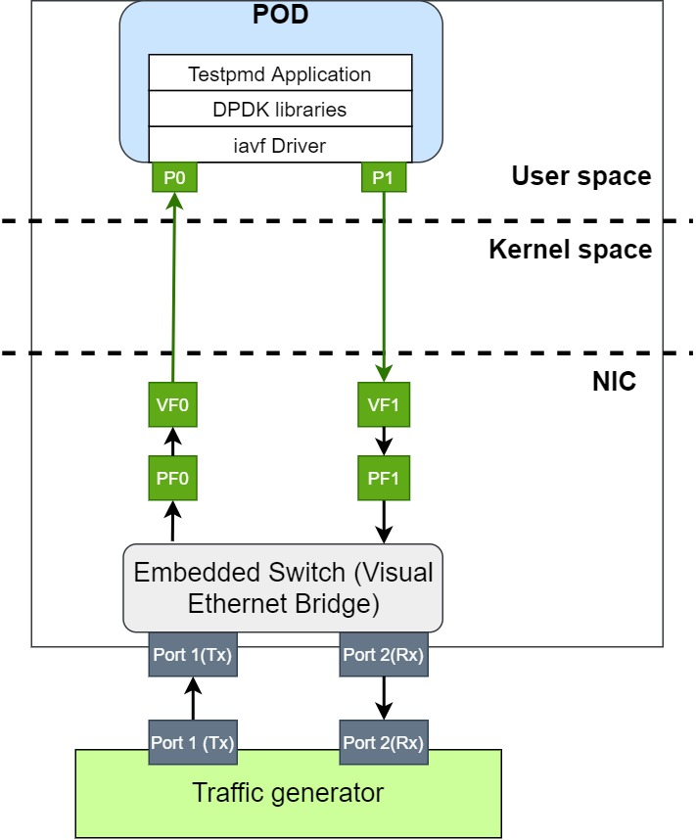
What got done
Depending on huge page size, there are different number of virtual address space
2Mi huge pages = 2,048 pages
1Gi huge pages = 4 pages
Data path

Slide 7
What we learned
Test Results
The hugepage size does not affect the network performance
Ethernet frame is limited to 1518 Bytes
Just for networking, small size of hugpage is enough
But we do not measure application process
Depending on application, performance can be different
Issues
Out of memory error
POD access to the non-allocated memory
Just 1 hugepage size should be tested for each time
Different configuration of Grub, plugins and K8s should be required for each time
It takes a lot of time to change configuration, and also high risk to be error!

Slide 8
What we learned
Future Plans
Update content of test environment, trouble-shooting and results
Using other network technologies and benchmarking scenarios for contributing to our draft
East-West traffic pattern test
Memif, …
Kernel based model consideration
eBPF with variation of resources

Slide 9
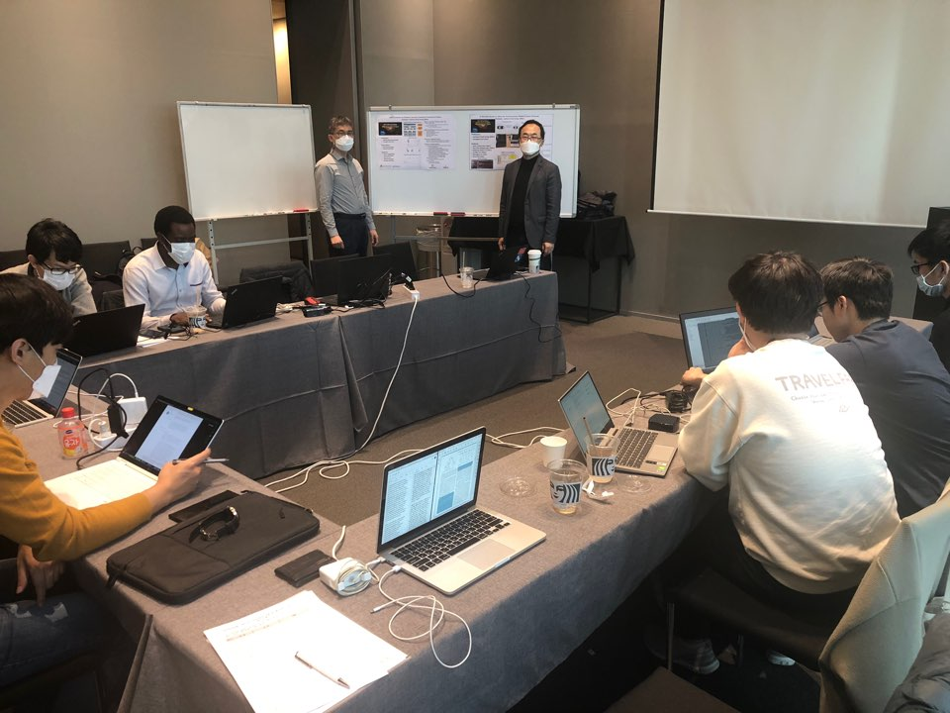
Wrap Up
Team members:
Younghan Kim (SSU)
Hyunsik Yang (SSU)
KJ Sun (SSU)
First timers @ IETF/Hackathon:
Quang Huy Nguyen (SSU)
Vu Dinh Dai (SSU)
Jangwon Lee (SSU)
Hackathon mirror workshop at Busan, South Korea : Collaborated with IPWAVE and I2NSF team (SKKU)

