Slide 1

BMP & YANG GROW and NETCONF WG
IETF 109
November 9-13th, 2020
Virtual Hackathon

Slide 2
BMP Hackathon - Plan
Functionality
Test BMP BGP Local RIB to IPFIX metric correlation and interoperability between router and data-collection for peer and route monitoring for message type extensions defined in
draft-ietf-grow-bmp-local-rib (BGP Local RIB)
draft-grow-bmp-tlv (TLV support for BMP Route Monitoring and Peer Down Messages)
draft-lucente-grow-bmp-tlv-ebit (Support for Enterprise-specific TLVs)
draft-cppy-grow-bmp-path-marking-tlv (Path Marking TLV)
draft-xu-grow-bmp-route-policy-attr-trace (BGP Route Policy and Attribute Trace)
Test BMP BGP Local RIB to IPFIX metric correlation with IE90 (BGP route-distinguisher).
Performance
Test performance impact of BMP on router CPU/Memory resources and BGP route propagation with YANG push.

Slide 3
YANG Hackathon - Plan
Functionality
Develop and test UDP-based Transport for Configured Subscriptions data export and collection.
Collect the YANG schema tree of a YANG subscription, convert to JSON and register at Confluent JSON schema registry.
draft-ietf-netconf-udp-notif (UDP-based Transport for Configured Subscriptions)
draft-ietf-netconf-distributed-notif (Subscription to Distributed Notifications)

Slide 4
Hackathon – Software
Software
pmacct nfacctd for IPFIX and BMP data collection
pmacct udp-notif for YANG push data collection
ncclient to create subscription and collect YANG schema
Apache Kafka as message broker
Apache Druid as timeseries DB
Pivot as user interface
Wireshark BMP dissector for packet analysis
Spirent Testcenter for BGP VPnv4/6 route and IPV4/6 traffic generation
Tutorial
https://imply.io/post/add-bgp-analytics-to-your-imply-netflow-analysis

Slide 5
Hackathon - Network

Slide 6
Swisscom – lab environment
Achievements
Cisco IOS XR and XE, Juniper Junos and frrouting in the topology for IPFIX and BMP added
YANG recursive schema collection with netconf <get-schema>, JSON conversion and schema registration.
Gaps Identified
Big Data test setup needs to be scaled to accommodate peaks at BMP and YANG push stress tests.
Next Steps
Optimize and increase the parallelization of time series data ingestion.

Slide 7
Pmacct – nfacctd/udp-notif
BMP Achievements
3 of 5 TLV's decoded of draft-xu-grow-bmp-route-policy-attr-trace
1 of 1 TLV decoded of draft-cppy-grow-bmp-path-marking-tlv
BMP BGP Local RIB to IPFIX data correlation with IPFIX IE90 (BGP route-distinguisher) attribute.
YANG Achievements
Support of draft-ietf-netconf-udp-notif
https://github.com/pmacct/pmacct/

Slide 8
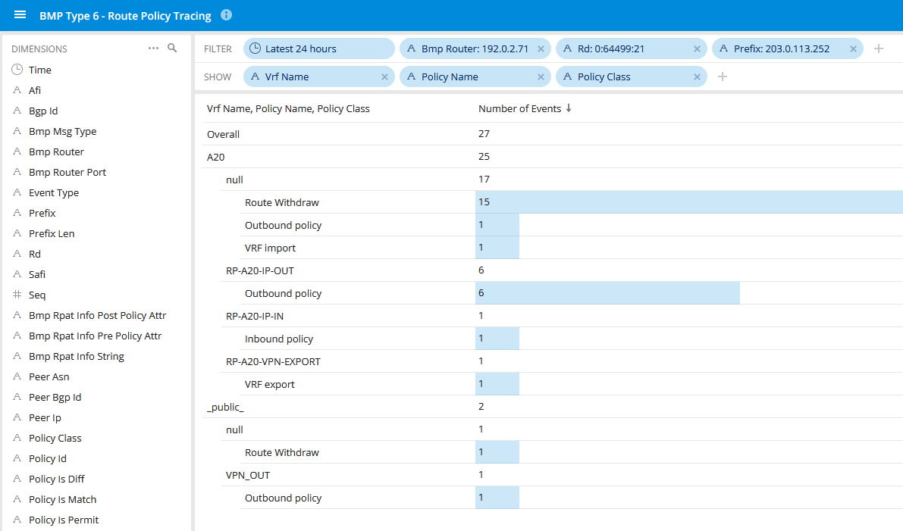
BMP route-policy attribute tracing
On a MPLS PE router for a particular VPNv4 prefix which route-policies and attachment points were involved

Slide 9
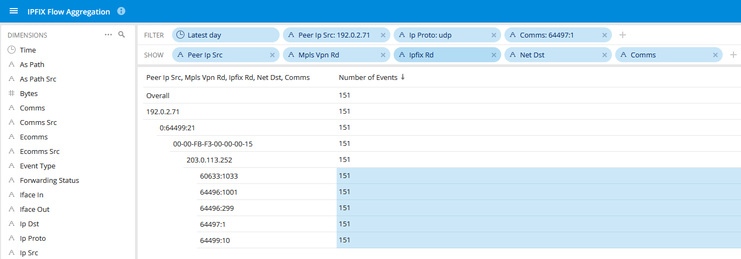
BMP BGP Local RIB with IPFIX Correlation
UDP Testflow between two IPv4 Addresses with
BMP BGP Local RIB dimensions measured on MPLS PE in a VRF

Slide 10
Huawei - VRP
Achievements
Supporting latest path status of draft-cppy-grow-bmp-path-marking-tlv-07
Supporting latest route-policy attribute tracing draft-xu-grow-bmp-route-policy-attr-trace-05
Supporting draft-ietf-netconf-udp-notif-01 and draft-ietf-netconf-distributed-notif-01
Test and compare CPU and memory usage with and without BMP in stress tests with 100'000, 500'000 and 1'000'000 BGP VPNv4 routes.

Slide 11
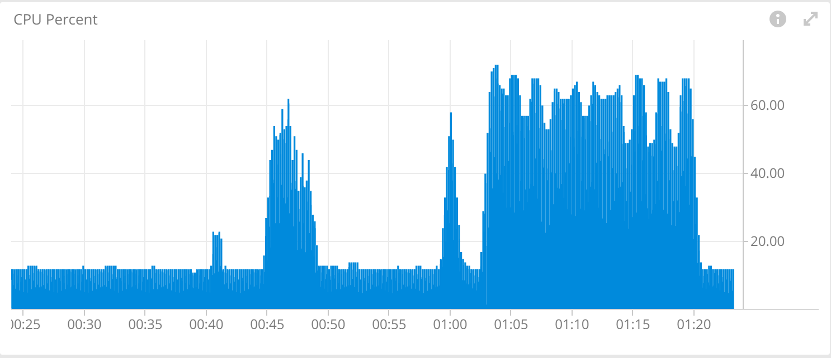
BMP Stress Test – CPU usage
Dataset 1
BMP disabled
Dataset 1
BMP enabled
Dataset 2
BMP disabled
Dataset 2
BMP enabled
Dataset:
• Dataset 1: 100K routes from Spirent
• Dataset 2: 500K routes from Spirent
CPU usage monitoring of 192.0.2.52

Slide 12
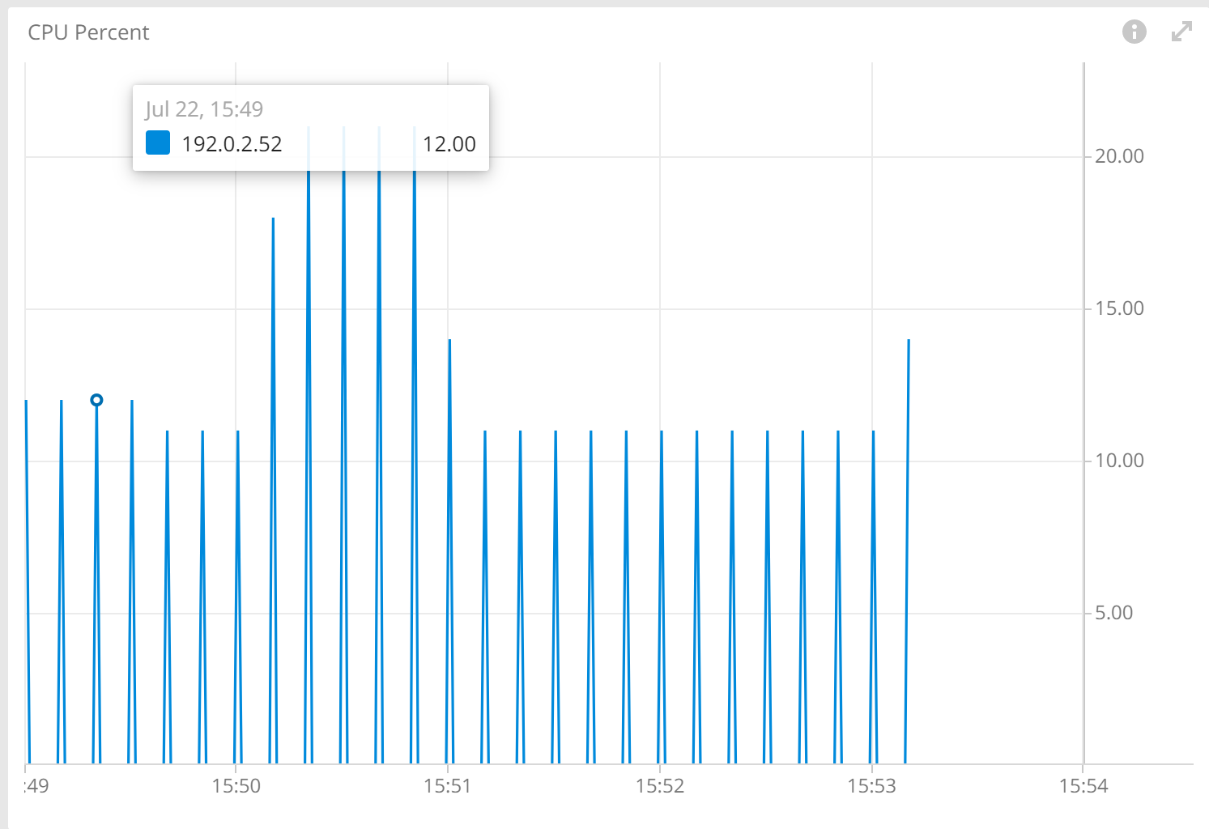
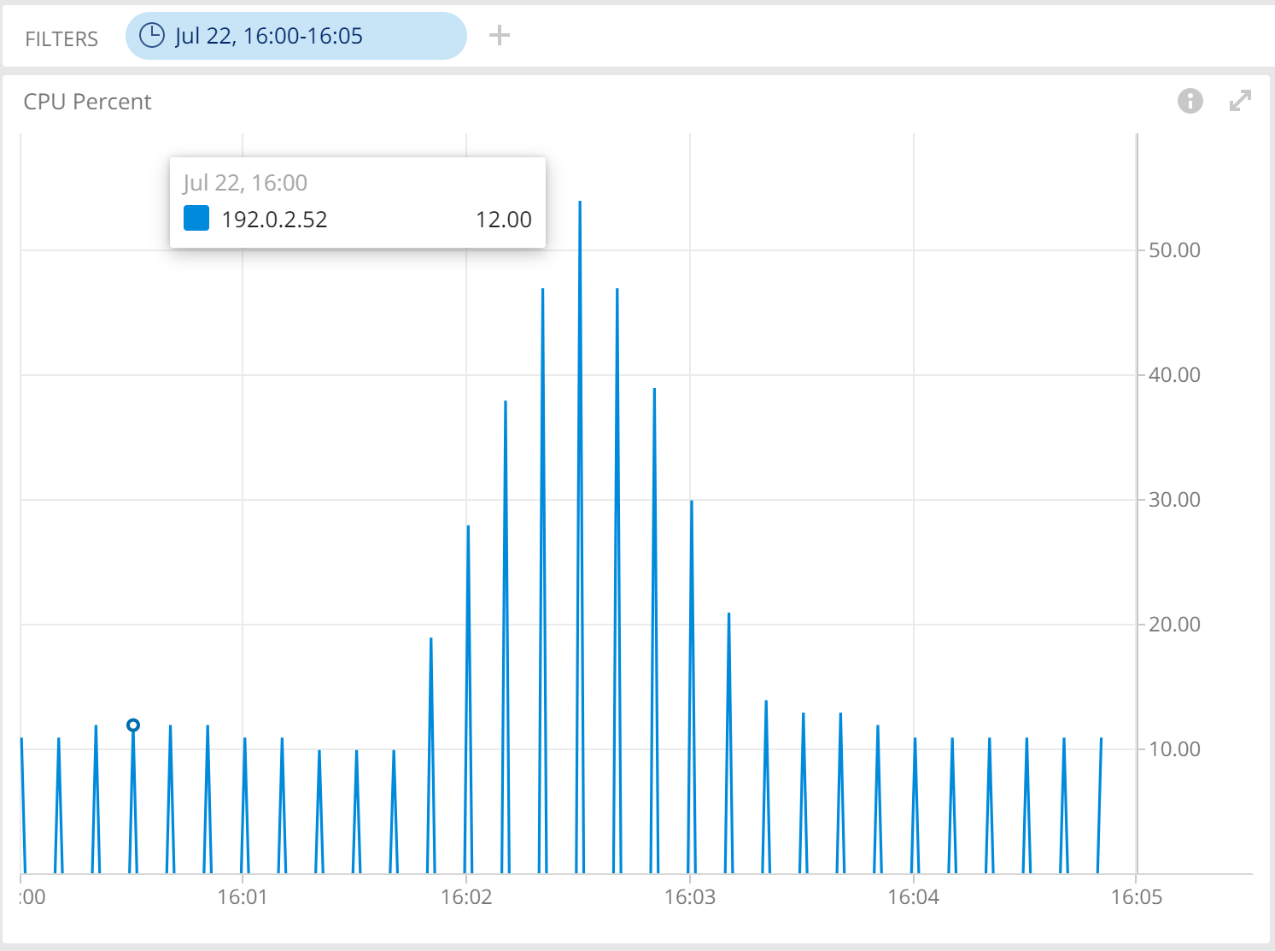
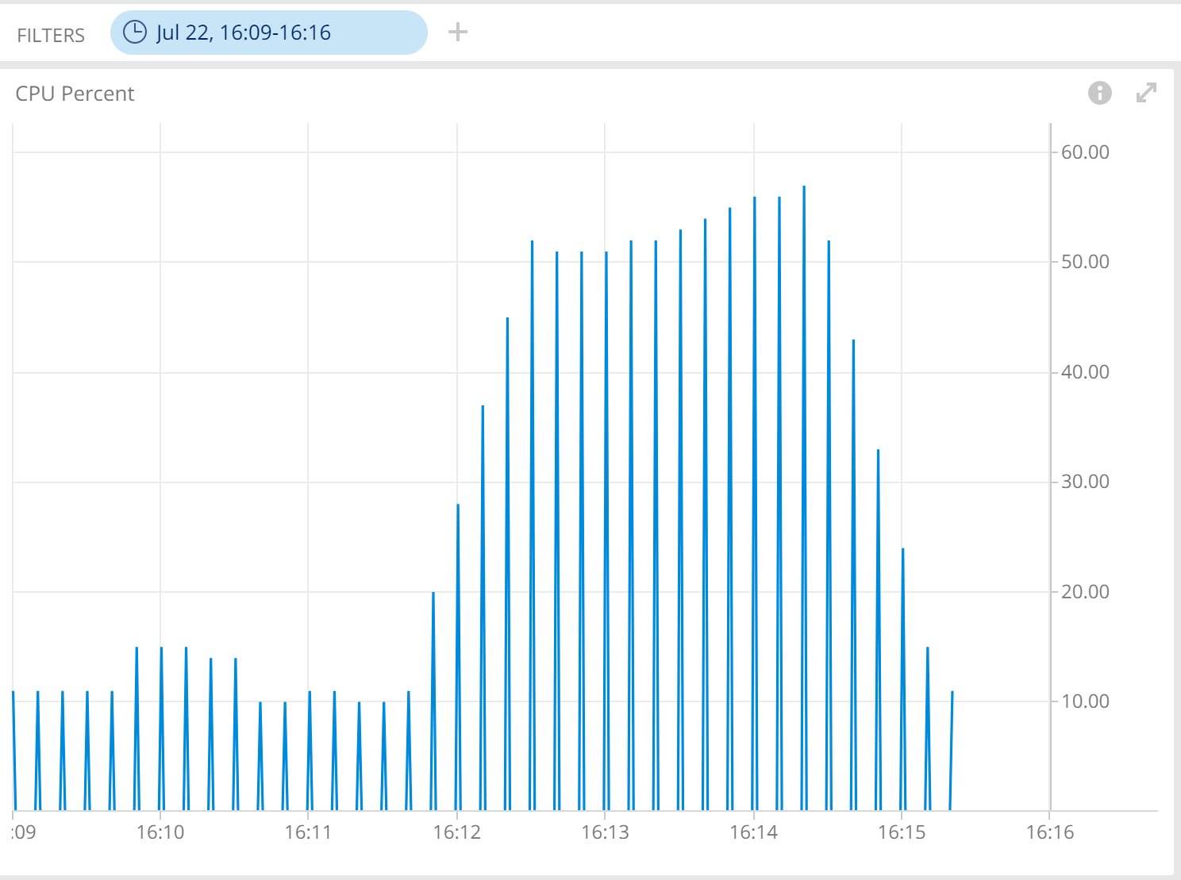
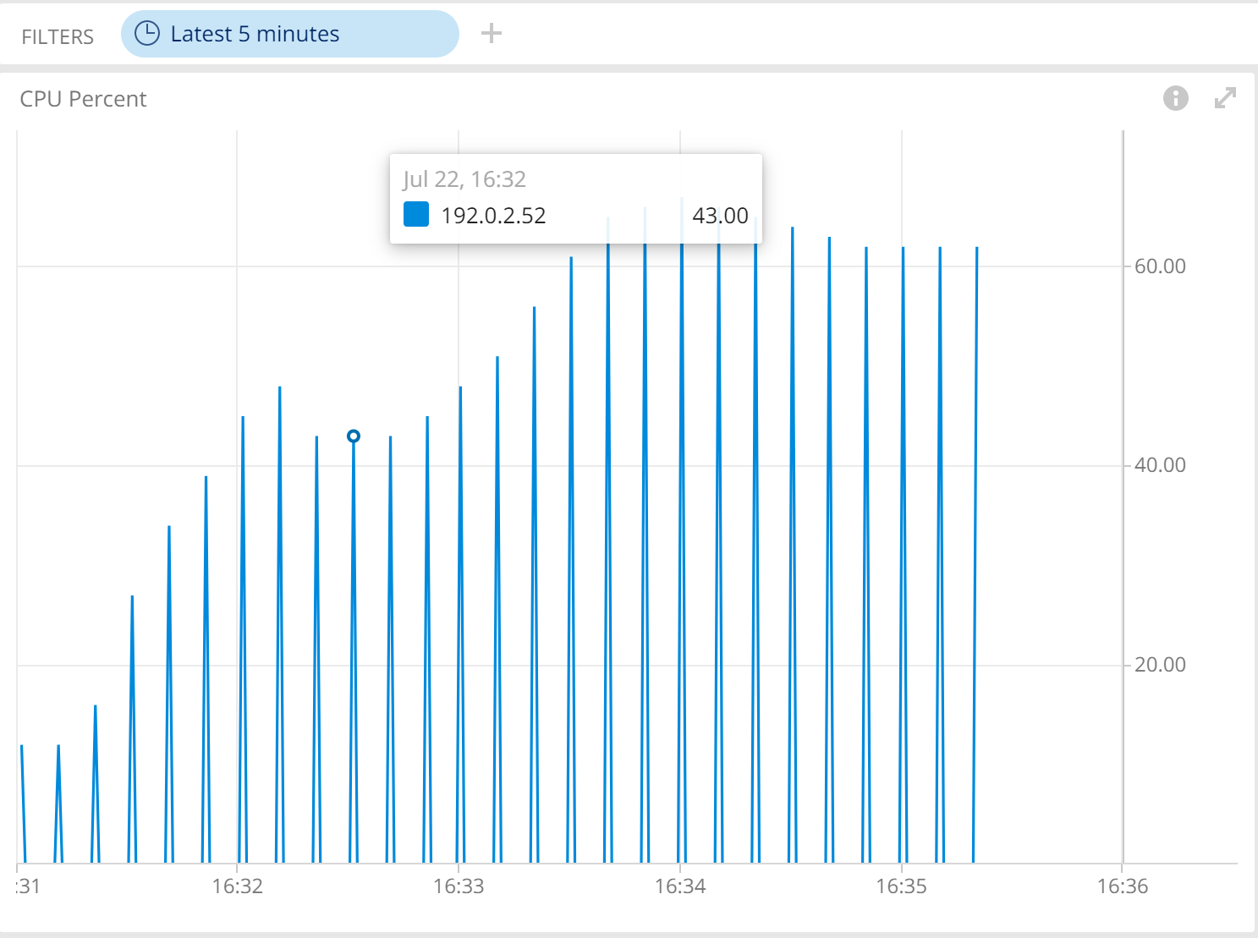
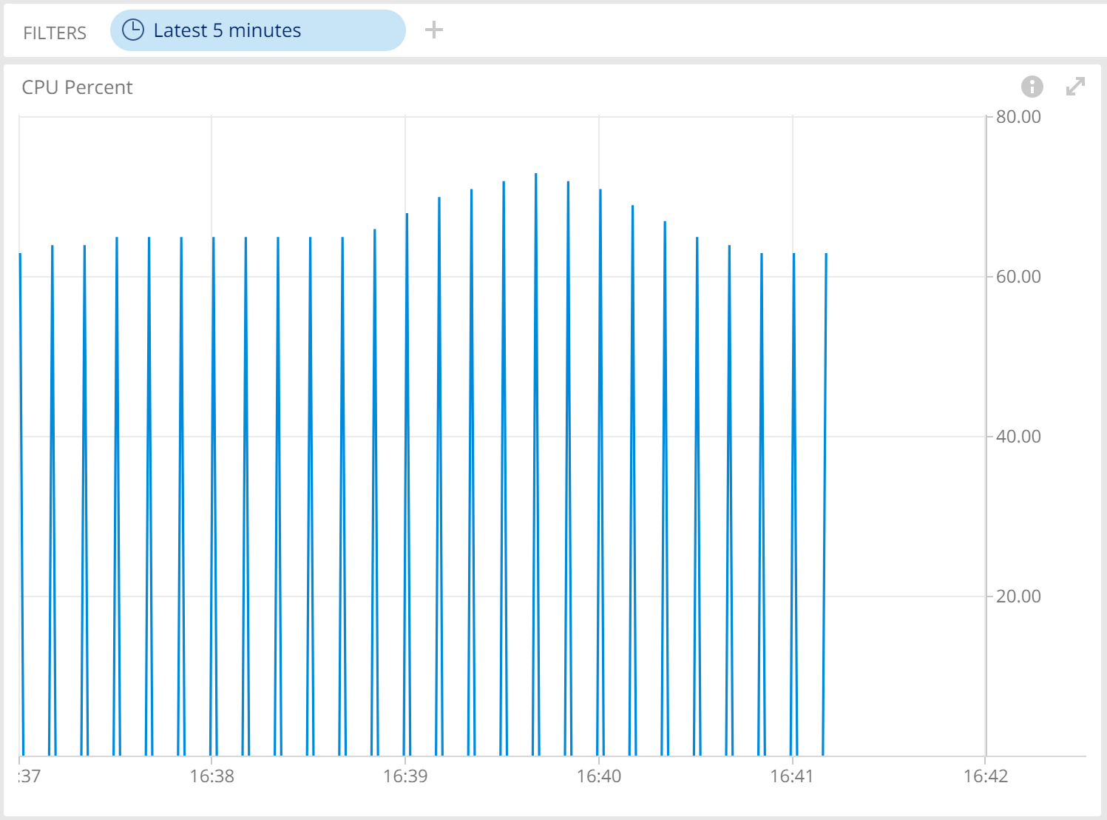
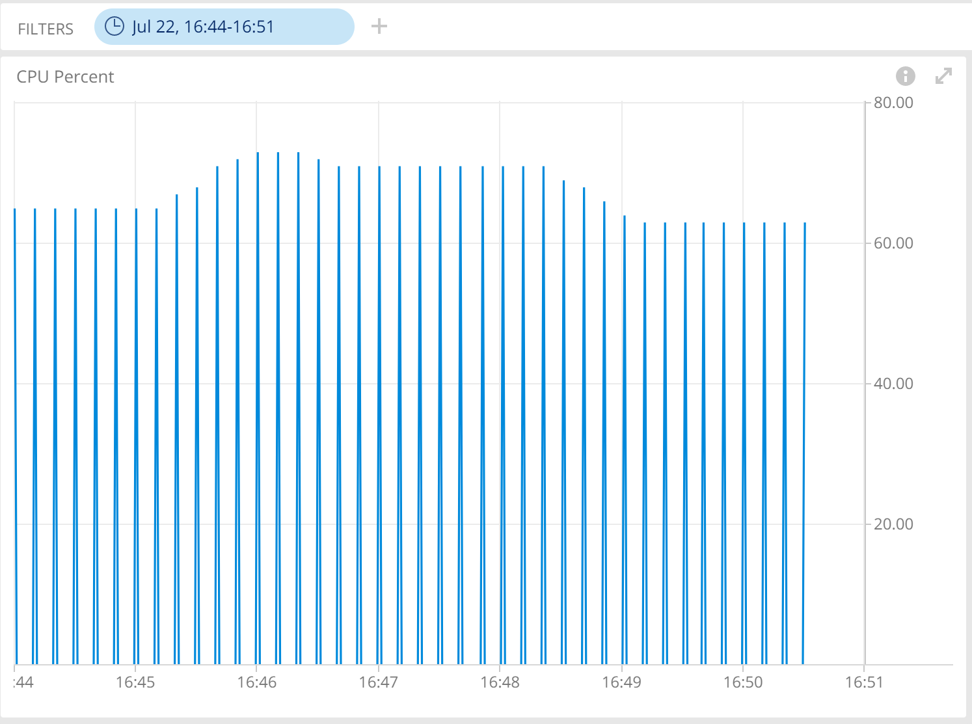
BMP Stress Test – CPU usage
Before BMP enabled: 100K routes adv.
Before BMP enabled: 500K routes adv.
Before BMP enabled: 1000K routes adv.
After BMP enabled: 100K routes adv.
After BMP enabled: 500K routes adv.
After BMP enabled: 1000K routes adv.

Slide 13
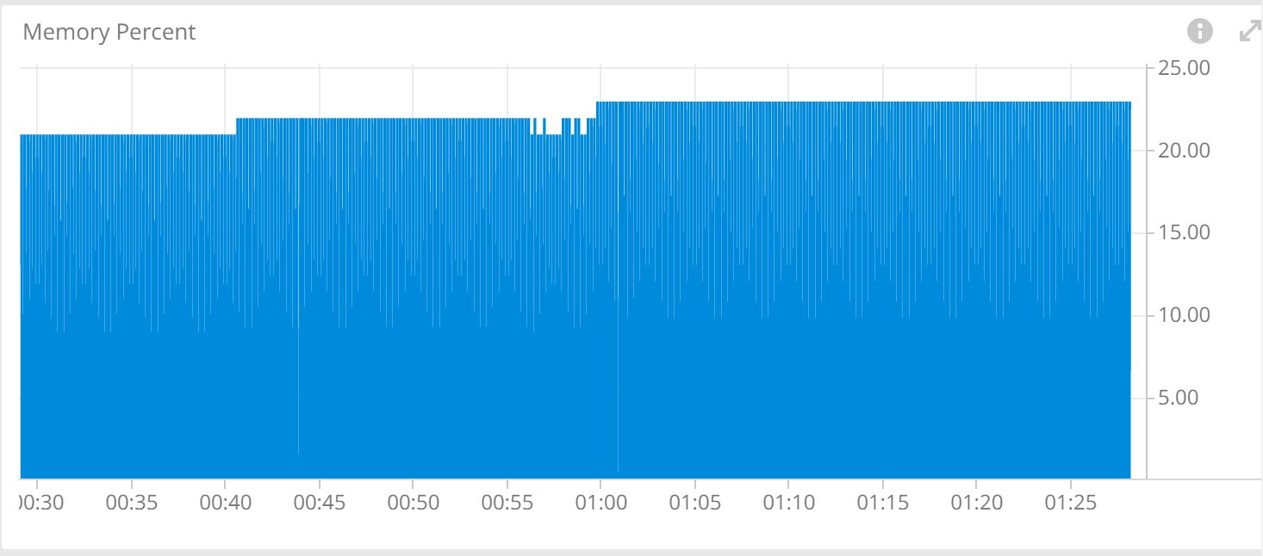
BMP Stress Test – Memory Usage
Dataset 1
BMP disabled
Dataset 1
BMP enabled
Dataset 2
BMP disabled
Dataset 2
BMP enabled
Dataset:
• Dataset 1: 100K routes from Spirent
• Dataset 2: 500K routes from Spirent
Memory usage monitoring of 192.0.2.52

Slide 14
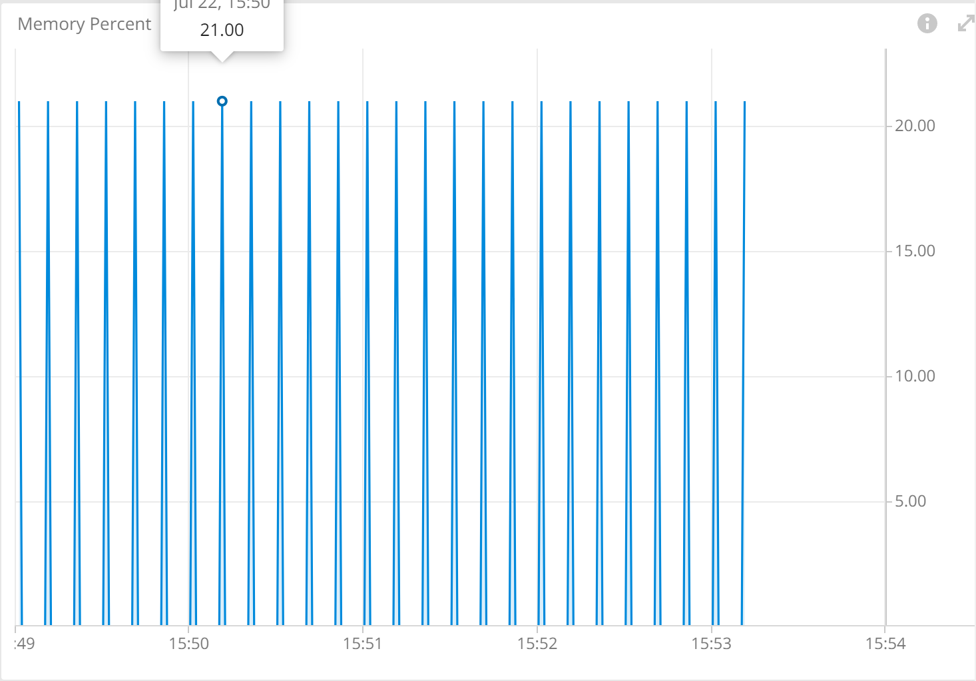
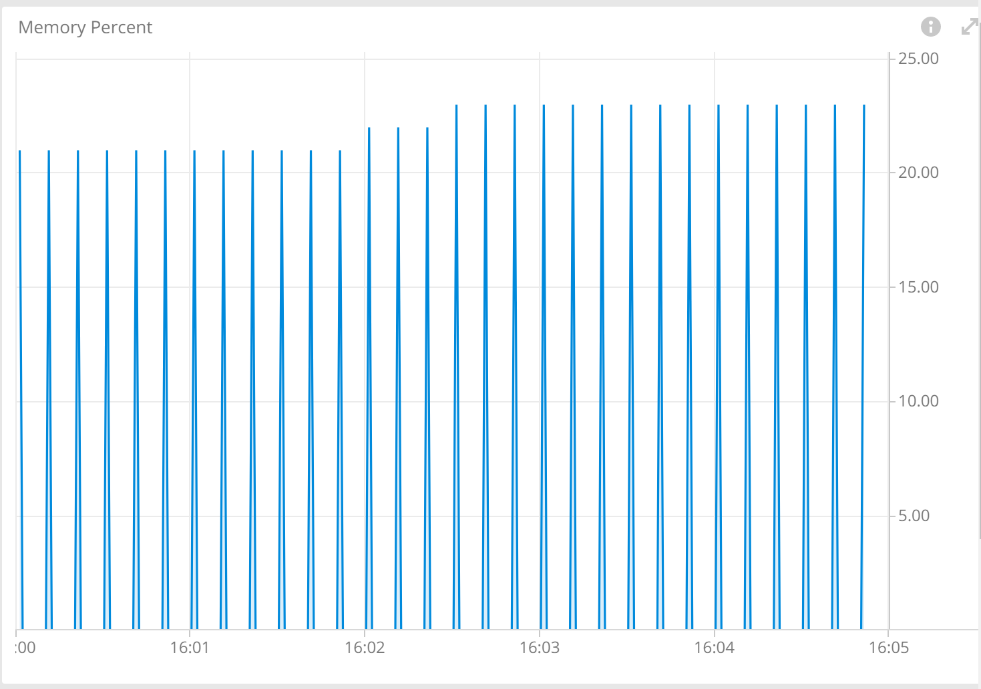
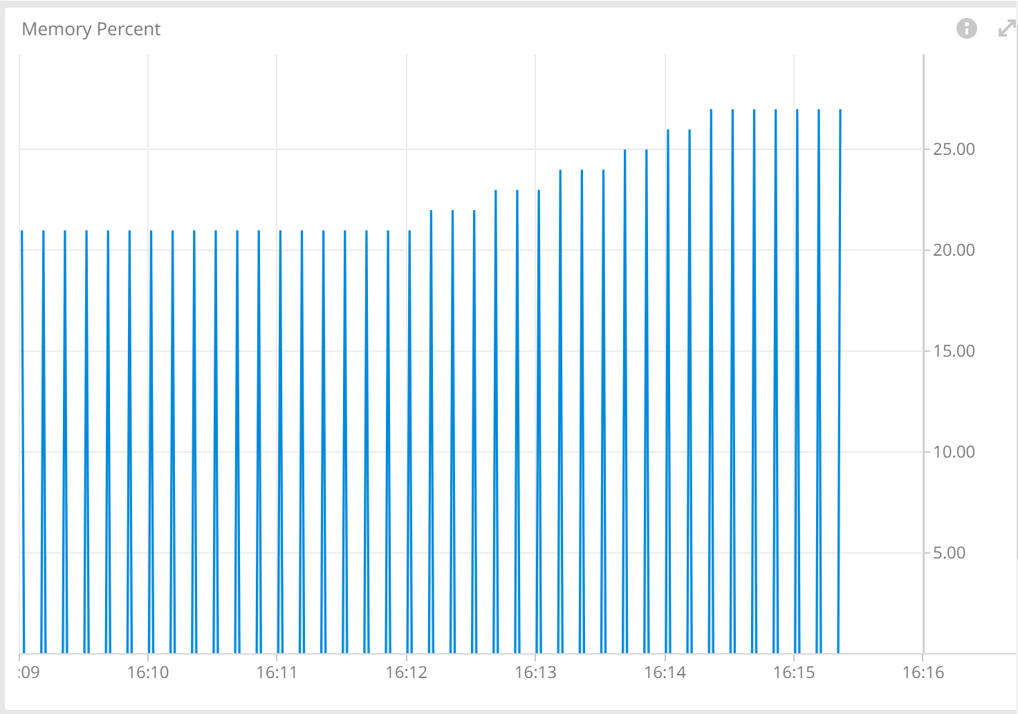
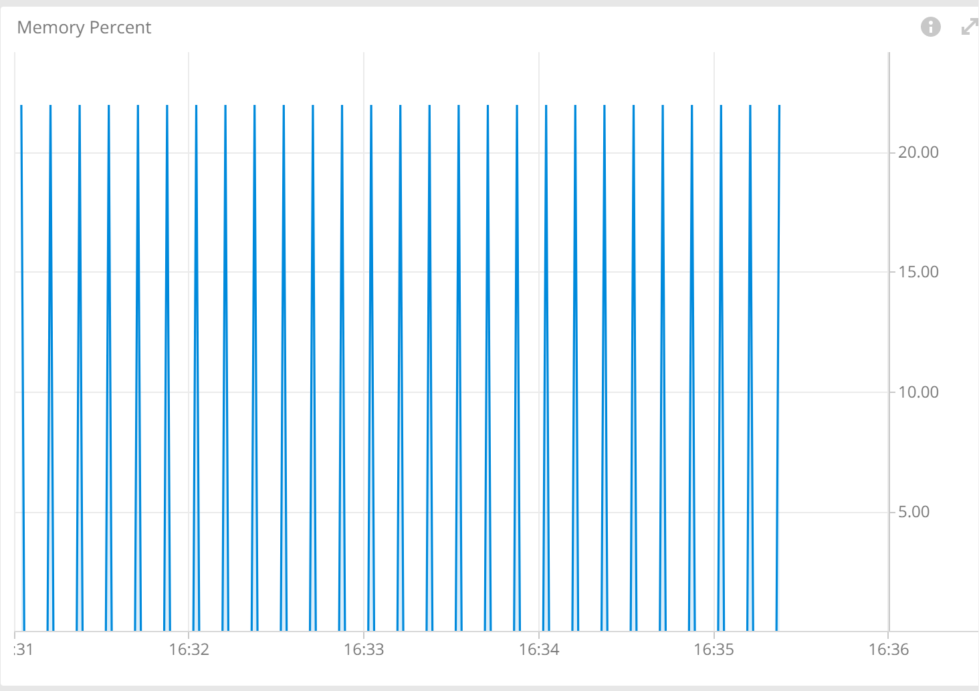
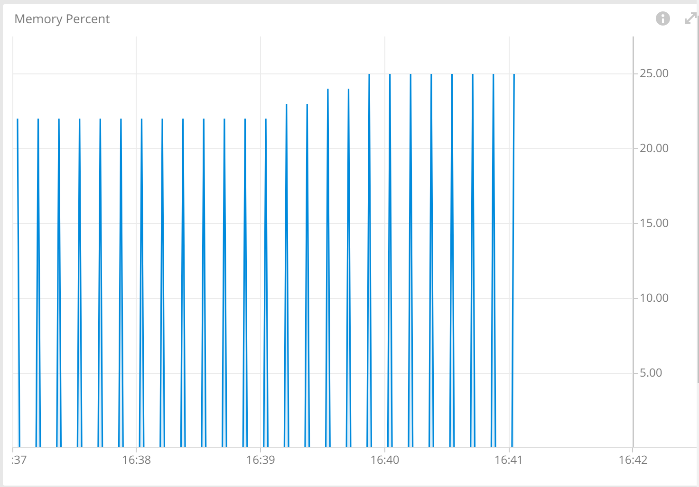
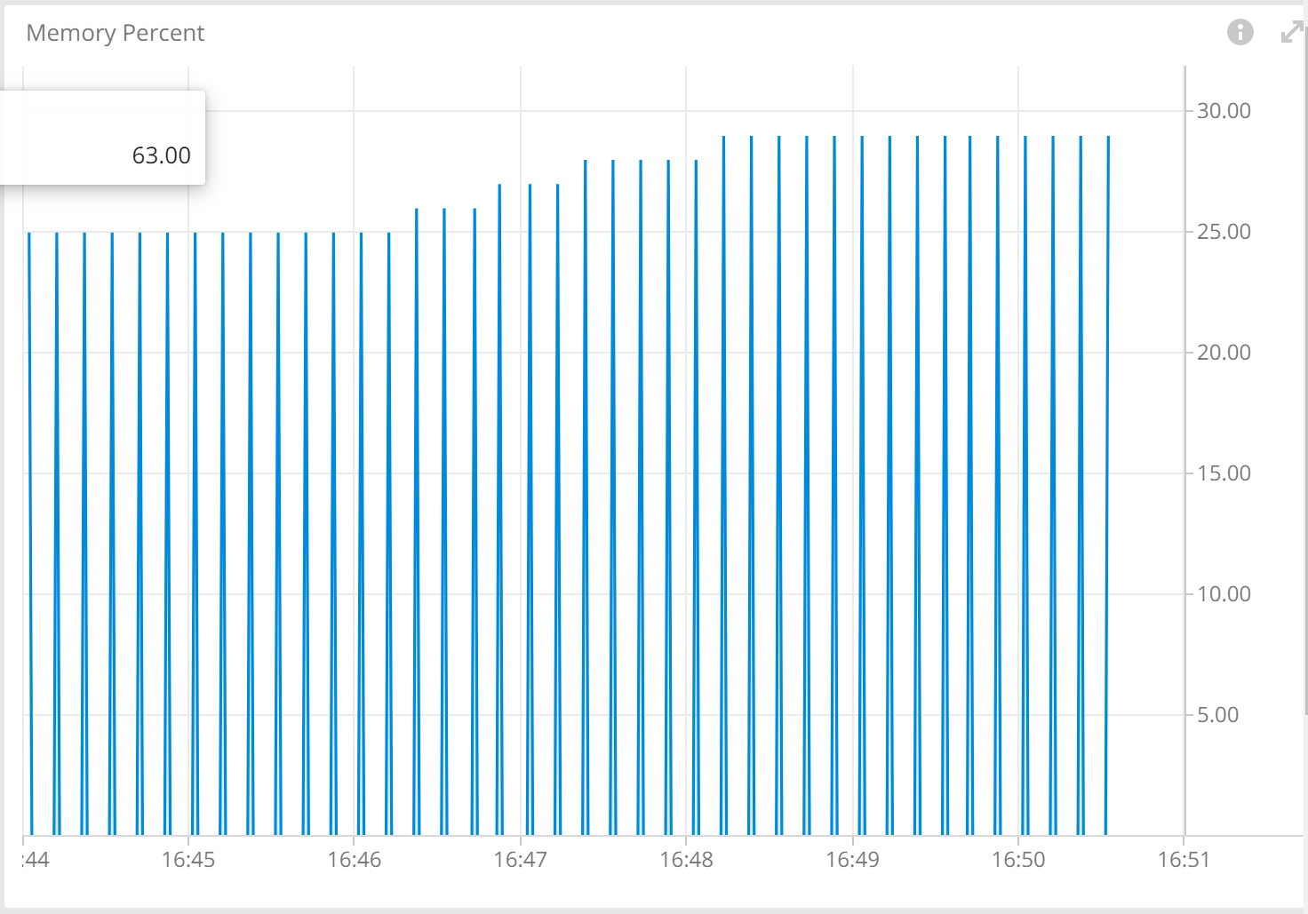
BMP Stress Test – Memory Usage
Before BMP enabled: 100K routes adv.
Before BMP enabled: 500K routes adv.
Before BMP enabled: 1000K routes adv.
After BMP enabled: 100K routes adv.
After BMP enabled: 500K routes adv.
After BMP enabled: 1000K routes adv.

Slide 15
Wireshark – Dissector
Achievements
Ongoing work on supporting draft-cppy-grow-bmp-path-marking-tlv-07
Ongoing work on supporting draft-ietf-netconf-udp-notif
Next Steps
Validate dissector and commit in next Wireshark release.

Slide 16
What we learned
Good
With the 4th hackathon, nice team collaboration and good spirit.
Slack helped to keep connected through different time zones.
Bad
Yet again, missing beers and cocktails after ☺

Slide 17
Thanks to…
Alexis La Goutte – Wireshark
Uli Heilmeier – Wireshark
Pierre Francois – INSA
Stephane Frenot – INSA
Tom Sampic – INSA
Axel Rosennstiehl – INSA
Anurag Prakash - Ciena
Kian Jones - CENGN
Yunan Gu - Huawei
Binyang Huang – Huawei
Tianran Zhou - Huawei
Paolo Lucente – NTT
Marco Tollini - Swisscom
Raphaël Barazzutti - Swisscom
Matthias Arnold - Swisscom
Thomas Graf - Swisscom
…Imply for providing us the big data and Huawei for the network environment.

