Slide 1
IETF Hackathon
IETF 113
19-20 March 2022
Vienna, Austria
Notes:
<number>

Slide 2
Hackathon Plan
Make OpenSCHC usable for everyone
RFC 8724
Draft-ietf-lpwan-schc-yang
Update code for fragmentation compound ack
draft-ietf-schc-over-sigfox
1

Slide 3
What got done
Documentation of NoAck and compression in OpenSCHC
ICMPv6 Echo Query and Response
Implement SCHC YANG model in CORECONF
https://github.com/openschc/opensch
Updating schc over sigfox code
https://github.com/schc-over-sigfox/schc-over-sigfox
<number>

Slide 4
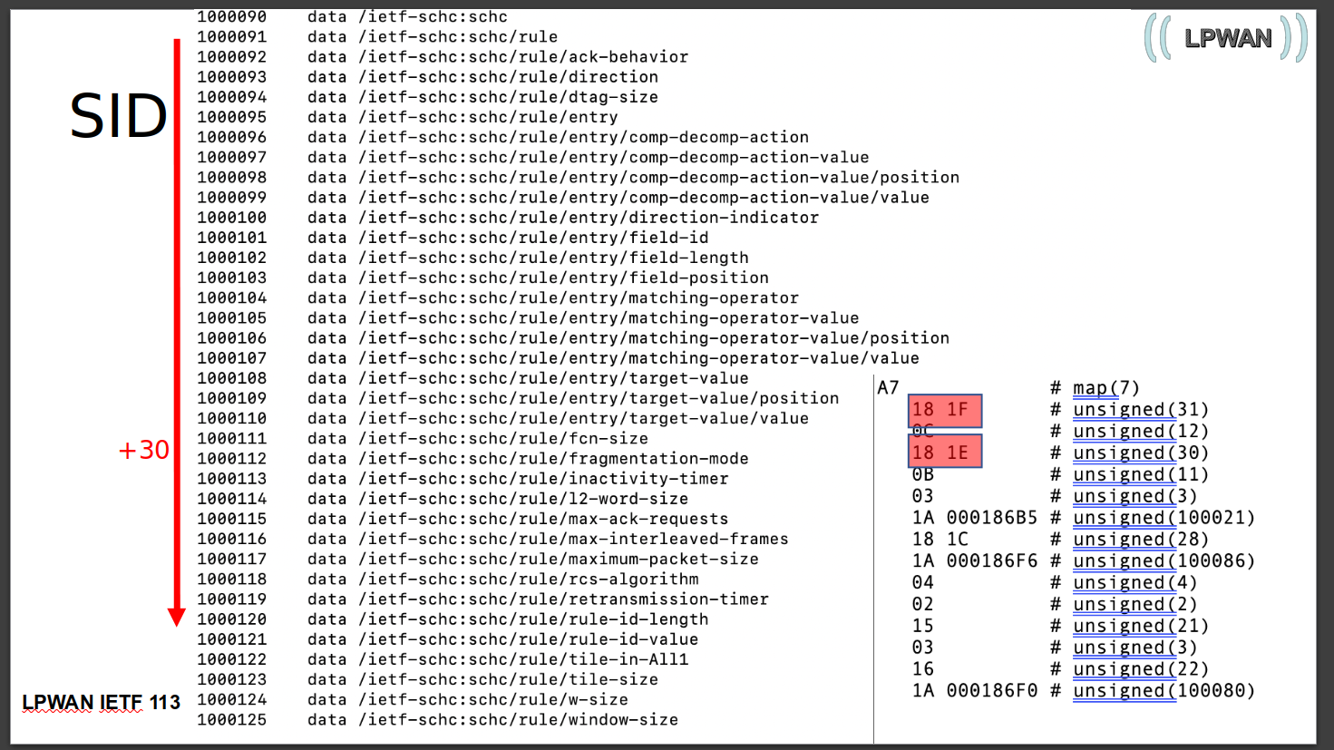
What we learned
The SID value should be selected carefully to get a more compact cbor representation
<number>

Slide 5
Wrap Up
Team members:
Laurent Toutain
Dominique Barthel
Cedric Adijh
Sergio Aguilar
First timers @ IETF/Hackathon:
Ivan Martinez
Diego Wistuba
https://github.com/openschc/openschc
https://github.com/schc-over-sigfox/schc-over-sigfox
<number>

