Slide 1
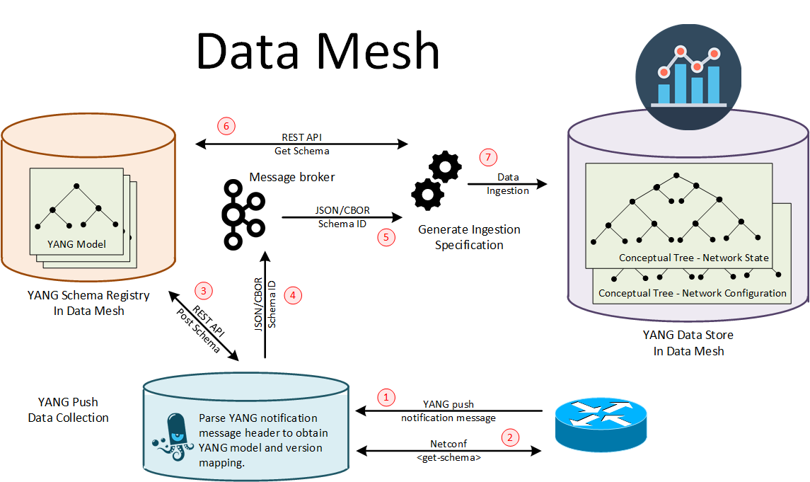
Network Telemetry - YANG Push Integration into Apache Kafka: Overview
We focus on step 2 and step 3.

Slide 2
Network Telemetry - YANG Push Integration into Apache Kafka: Challenge
module: a-module
+--rw a-container
+--rw x? b:bar
+--rw d:y
+--rw d:y-leaf? b:myenum
Challenge: find dependency
create module yang-push msg
<subscriptions>
<subscription>
<id>2222</id>
<datastore>ds:operational</datastore>
<datastore-xpath-filter>
/a-module:a-container
</datastore-xpath-filter>
<encoding>encode-xml</encoding>
<periodic>
<period>30000</period>
</periodic>
</subscription>
</subscriptions>
b.yang
import
a.yang
deviate
augment
a-deviation.yang
d.yang
Subscribe to: /a-module:a-container
Require to fetch all these modules.
Then register then into schema registry.

Slide 3
Network Telemetry - YANG Push Integration into Apache Kafka: Status
Able to fetch schema from NETCONF server using libnetconf2
Able to resolve all dependencies
Able to generate payload for schema registry. (Tested with current schema registry)
Implement a simulator that generate UDP-notif messages base on netopeer2 and https://github.com/network-analytics/udp-notif-scapy
Ongoing integration with pmacct
Drafts:
https://datatracker.ietf.org/doc/html/draft-ahuang-netconf-notif-yang
https://datatracker.ietf.org/doc/html/draft-tgraf-netconf-yang-notifications-versioning
https://datatracker.ietf.org/doc/html/draft-tgraf-netconf-notif-sequencing
https://datatracker.ietf.org/doc/html/draft-tgraf-yang-push-observation-time

