Slide 1
IETF Hackathon
Sustainability Insights
IETF 118
4–5 November 2023
Prague, Czech Republic

Slide 2
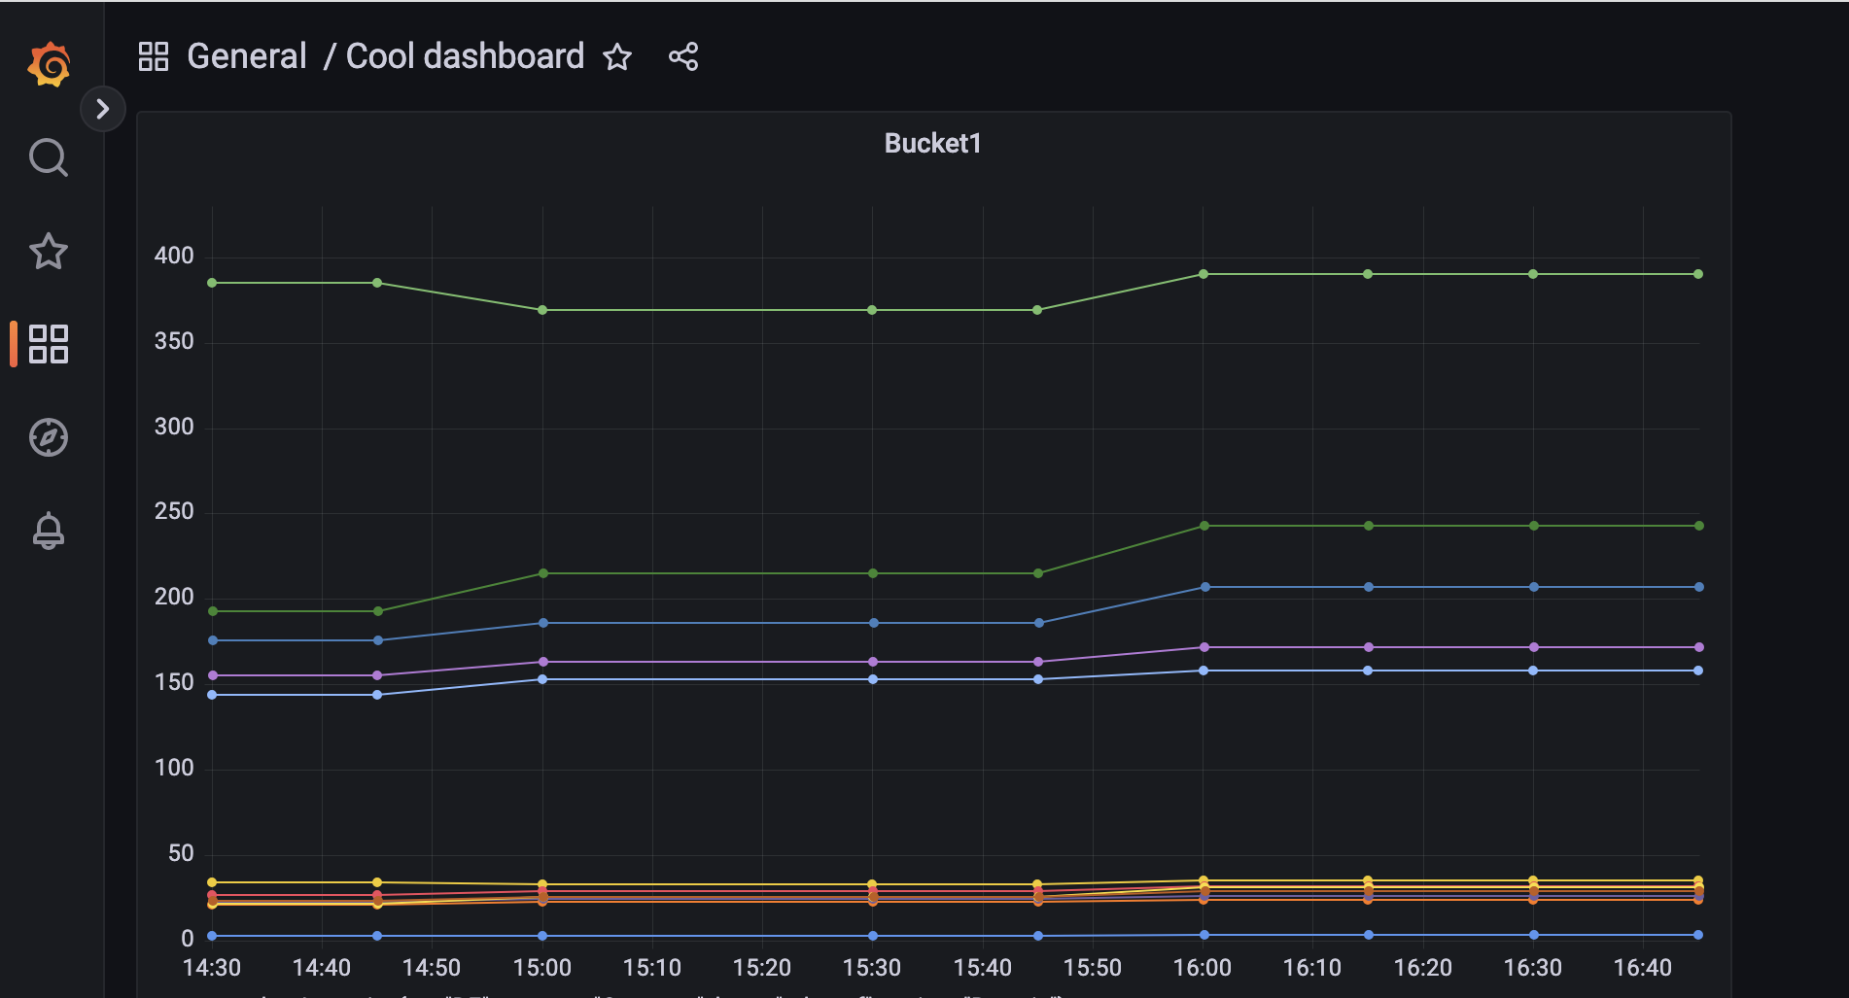
YANG-based Time Series Telemetry ✅

Slide 3
YANG-based Time Series Telemetry ✅
🤥 🤷‍♂️
✅ Really Nice Graphs
What is included?
Traceability?
Measurement Units?
Precision?
Compare numbers and graphs? Between systems? Vendors?
Use as input for decisions?

Slide 4
YANG to Time Series Database Mapping
Original YANG Instance-Identifier:
/interfaces/interface[name='eth0']/statistics/in-unicast-pkts
Metric: interfaces_interface_statistics_in_unicast_pkts
Value: 5432100
Labels:
host = router-01
interfaces_interface_name = eth0
draft-kll-yang-label-tsdb-00

Slide 5








Hackathon - Flow Diagram
green-monitoring @ github
green-monitoring
InfluxDB
Normalizer
Telegraph
YANG based input Plug-in
SNMP Plugin
NetConf Plugin
RESTCONF polling
CLI Plugin
NON-YANG SYS
PROVIDER
NON-YANG SYS
PROVIDER
NON-YANG SYS
PROVIDER
YANG capable Device
Notes:
YANG based input methods

Slide 6
Wrap Up
Team members:
Emile, Esther, Gonzalo, Jan, Marisol, Per, Snezana, Ajit, Vesna
Open Source Github project:
https://github.com/cisco-open/green-monitoring
Many thanks to all the people who came by to discuss!
Read more in
draft-lindblad-tlm-philatelist
draft-opsawg-poweff
draft-almprs-sustainability-insights
draft-kll-yang-label-tsdb-00

