Slide 1
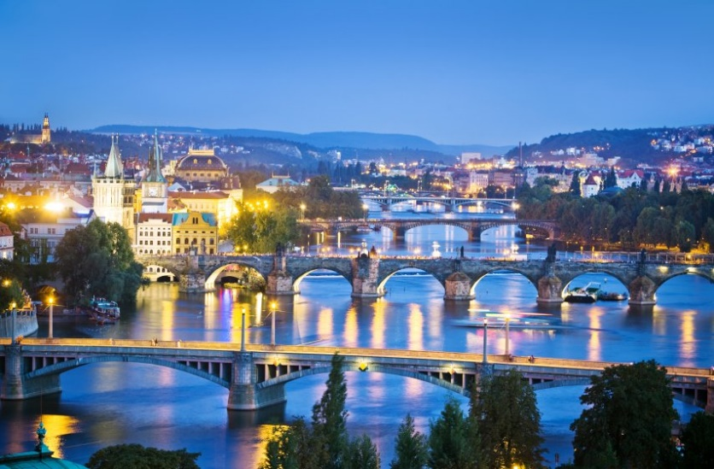
Semantic Metadata Annotation for Network Anomaly Detection OPSAWG/NMRG WG
IETF 118
November 4-5th, 2023
Hackathon
draft-netana-opsawg-nmrg-network-anomaly-semantics

Slide 2
Problem Statement
Want to solve the Automated Network Anomaly Detection?
How do you know if you are doing a good job?
How do you know how to improve?
One step towards the solution:
A YANG model to standardize the way anomalies are described
This can enables a structured and consistent exchange of data between:
Network engineers investigating anomalies
Human and Machines, for
Ground Truth
Validation

Slide 3
Hackathon - Plan
Finalize metadata semantics and ontology (draft-netana-opsawg-nmrg-network-anomaly-semantics)
Create YANG models
ietf-symptom-semantic-metadata.yang
ietf-incident-semantic-metadata.yang
Implement a Proof-of-concept to support annotation of operational Network Telemetry (RFC 9232) data.
Support the following two use cases:
Network operator annotates a network incident to generate ground truth
Network operator validates (and corrects) network incidents annotated by anomaly detection algorithms.

Slide 4



Hackathon – Software
4
Ground Truth is exposed through the YANG format
2
Symptom and Incident Data is visually annotated
3
Symptoms and Incidents are processed
1
Telemetry Data is stored
REST
Antagonist (Anomaly tagging on historical data) https://github.com/vriccobene/antagonist
Incidents &
Symptoms
REST

Slide 5
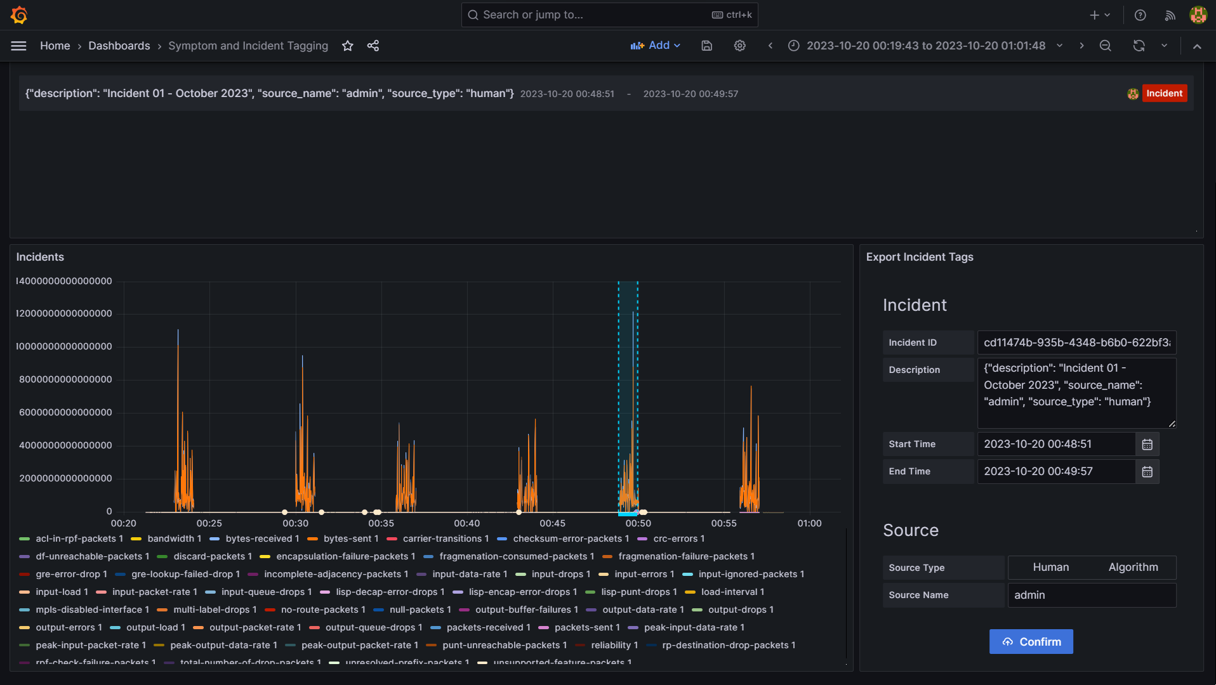
Antagonist – Labelling incidents
Vertical dotted lines are the tagged incidents.
Once the incident is selected, the user can add all the details.
Once the incident is defined it gets submitted to Antagonist.
1
2

Slide 6
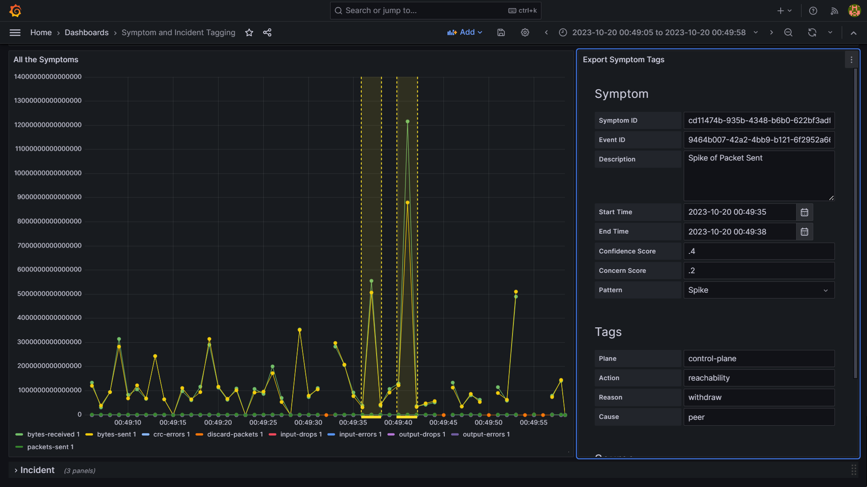
Antagonist – Labelling a Symptom
Vertical dotted lines are the tagged symptoms.
Once the symptom is selected, the user can add all the details.
Once the symptom is defined it gets submitted to Antagonist.
2
1

Slide 7
What’s next?
Improve the project and the code
Integrate this framework with some real anomaly detection system to do:
Use the ground truth as label data
Upload detected anomalies on the system

Slide 8
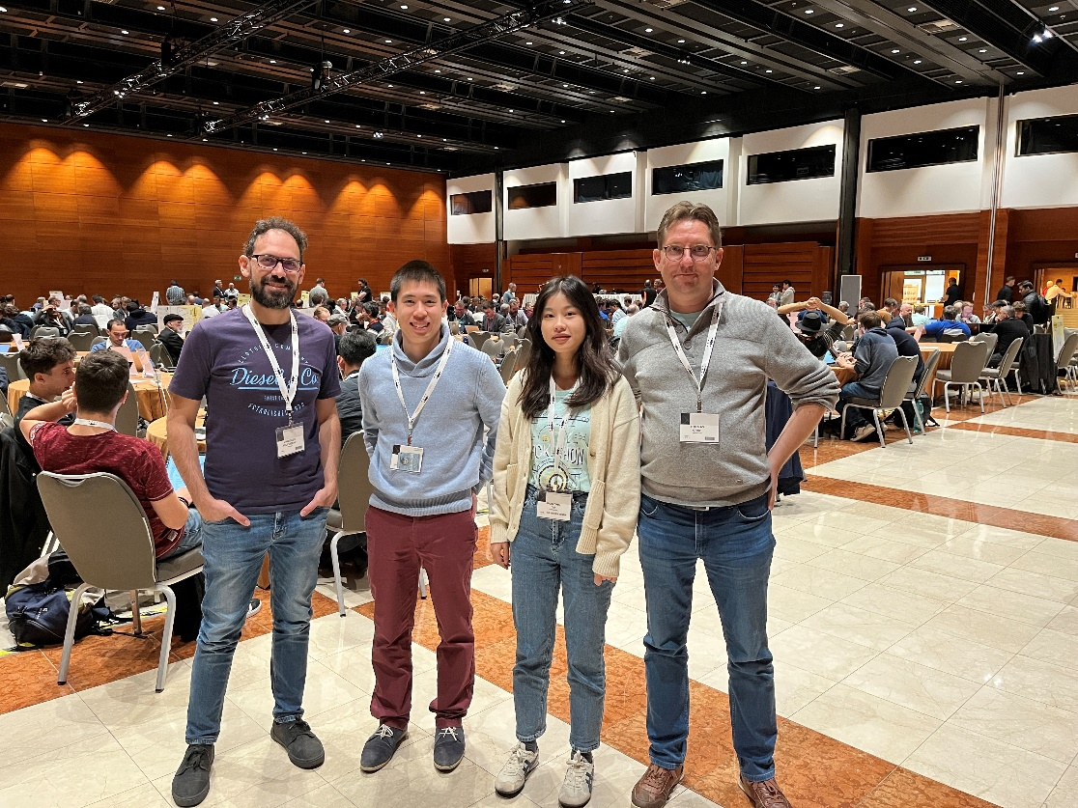
Thanks to…
Vincenzo Riccobene – Huawei
Alex Huang-Feng – INSA Lyon
Wanting Du – Swisscom
Thomas Graf - Swisscom

