Slide 1
Augmented-by Addition into the ietf-yang-library
draft-lincla-netconf-yang-library-augmentation-01
IETF 119 Hackathon
16–17 March 2024
Brisbane, Australia
Presenter: Zhuoyao Lin

Slide 2
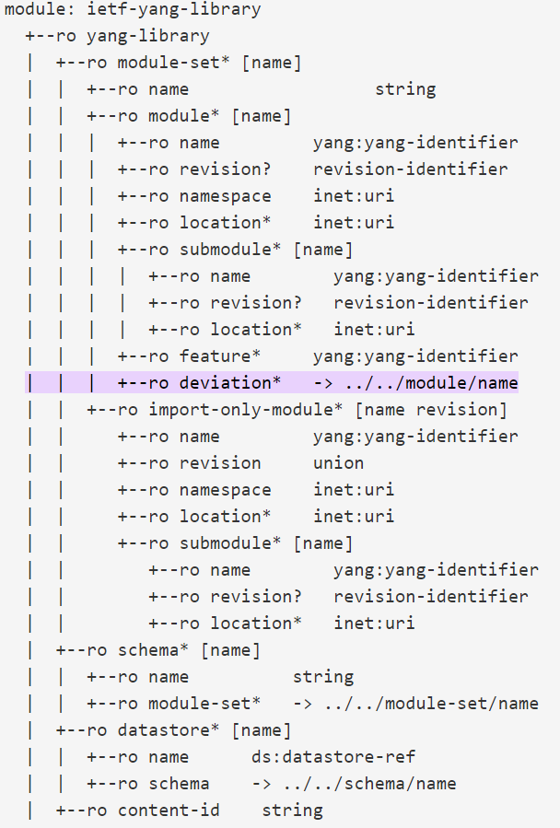
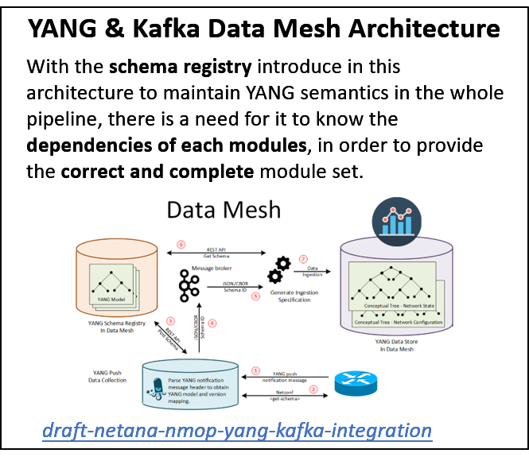
Import: Parse from module source code
Include: Parse from module source code/<get> request to ietf-yang-library
Deviation: <get> request to ietf-yang-library
Augmentation: missing
Background
The YANG library [RFC8525] specifies a YANG module that provides the information about the YANG models and datastores to facilitate a client application to fully utilize and understand the YANG data modelling language.
With the requirement of automated network management arises, more and more scenarios appears where the real-time knowledge of YANG dependencies are needed.
While the deviation is used to understand the API contract of server and client, the augmentation is required to directly understand YANG dependency from ietf-yang-library [RFC8525], and obviously it is missing for the moment.

Slide 3
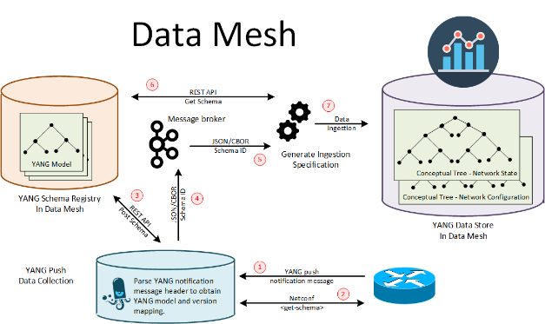
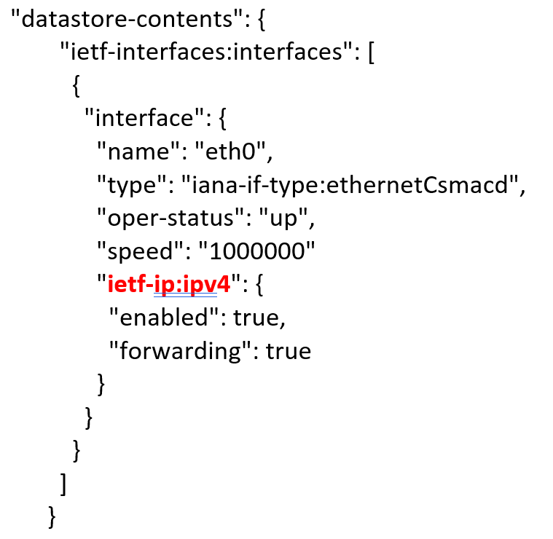
Current solution & Limitation
Get-all-schemas
What it is: Fetch all YANG models and parse them to fully understand their relationship
Real-time parse message
Limitation: Time-consuming. Hard to reflect module changes. Require extra procession of all modules.
What it is: Parse prefix in the message to know the augmentation.
Principle: In the received YANG-push message, fields name with prefix(Or element with namespace) are from the augment module.
Performance:
Device 1 | Device 2
Around 5 min | Around 3 min
Evaluation: Not ideal in the data real-time ingestion background
Evaluation: Dependency missing are highly possible, since not all augments will appear in the first message but it may do in the following.
libyangpush: https://github.com/network-analytics/libyangpush

Slide 4
Hackathon Plan
<Motivation>
Augment the ietf-yang-library defined in RFC8525 to provide an augmented-by list.
Prove how it facilitates obtaining the entire dependencies of a YANG model.
<Draft>
Augmented-by Addition into the ietf-yang-library
<How we planned to solve it?>
Implement the feature to libyang/sysrepo and demonstrate it on netopeer2

Slide 5
YANG tree of ietf-yang-library
Plus the augmentation
ietf-yang-library in RFC8525
ietf-yang-library in RFC7895
module: ietf-yang-library
+--ro yang-library
| +--ro module-set* [name]
| | +--ro name string
| | +--ro module* [name]
| | | +--ro name yang:yang-identifier
| | | +--ro revision? revision-identifier
| | | +--ro namespace inet:uri
| | | +--ro location* inet:uri
| | | +--ro submodule* [name]
| | | | +--ro name yang:yang-identifier
| | | | +--ro revision? revision-identifier
| | | | +--ro location* inet:uri
| | | +--ro feature* yang:yang-identifier
| | | +--ro deviation* -> ../../module/name
| | | +--ro yanglib-aug:augmented-by* -> ../../yanglib:module/name
module: ietf-yang-library
+--ro modules-state
+--ro module-set-id string
+--ro module* [name revision]
+--ro name yang:yang-identifier
+--ro revision union
+--ro schema? inet:uri
+--ro namespace inet:uri
+--ro feature* yang:yang-identifier
+--ro deviation* [name revision]
| +--ro name yang:yang-identifier
| +--ro revision union
+--ro conformance-type enumeration
+--ro submodule* [name revision]
| +--ro name yang:yang-identifier
| +--ro revision union
| +--ro schema? inet:uri
x--ro yanglib-aug:augmented-by* [name revision]
+--ro yanglib-aug:name -> /yanglib:modules-state/module/name
+--ro yanglib-aug:revision -> /yanglib:modules-state/module/revision

Slide 6
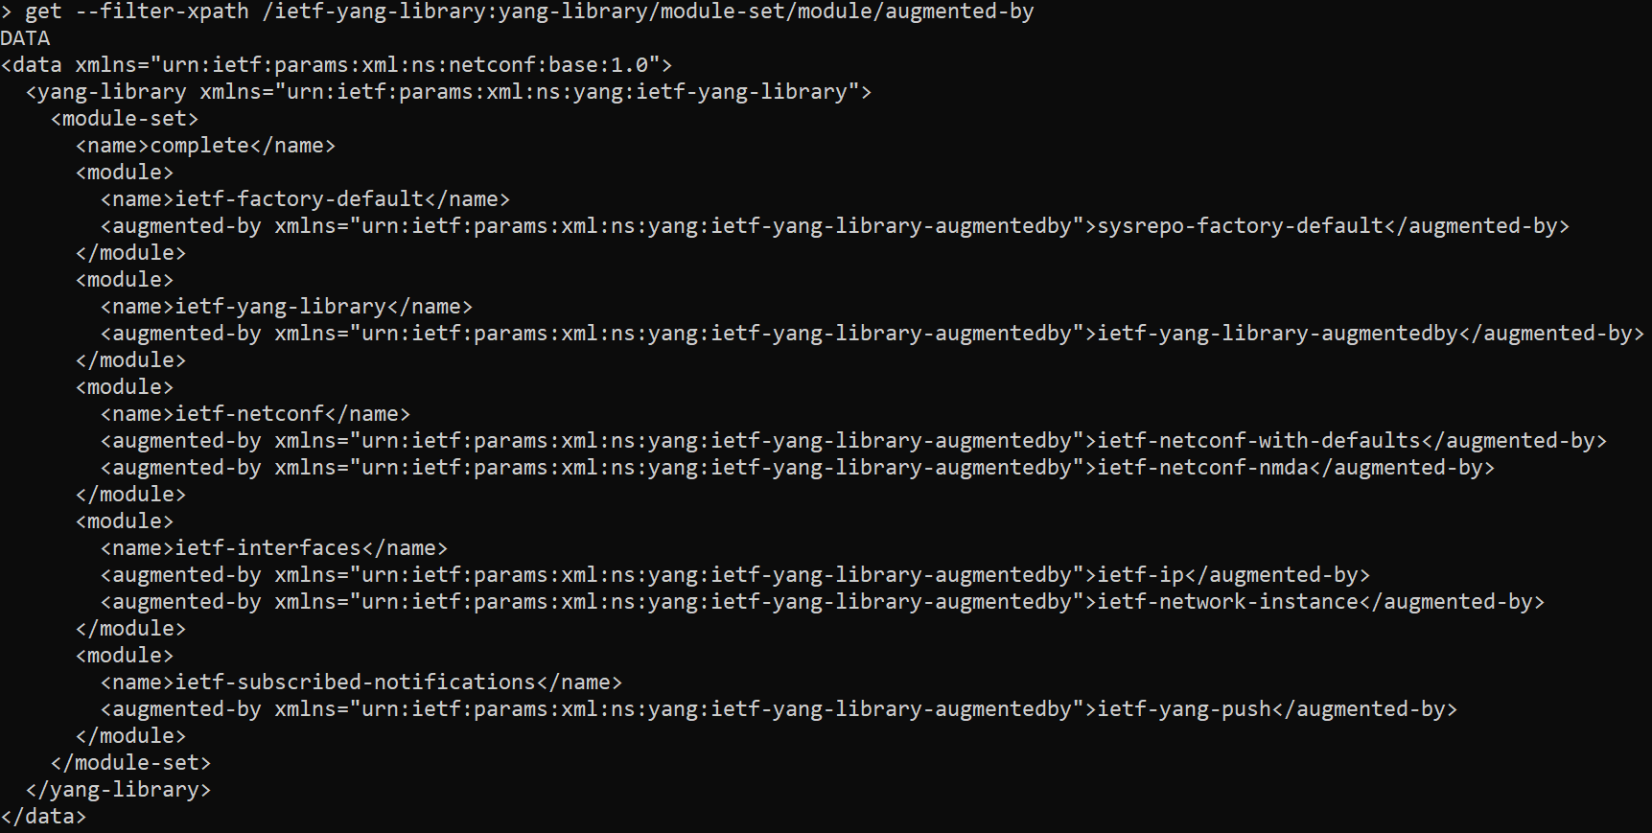
Based on libyang&sysrepo
Run on netopeer2
Hackathon Demo

Slide 7
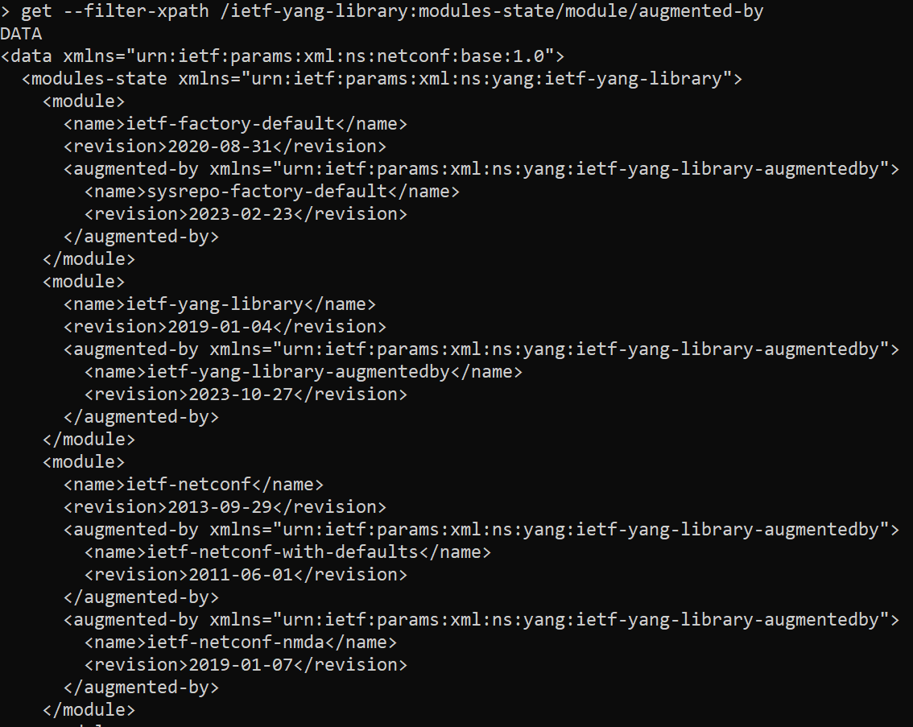
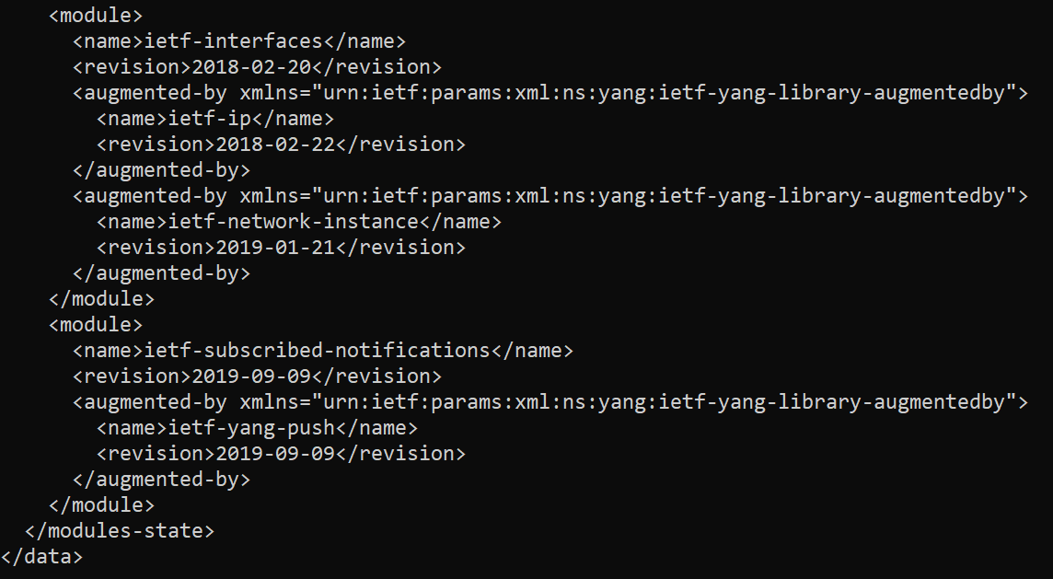
Based on libyang&sysrepo
Run on netopeer2
Hackathon Demo

Slide 8
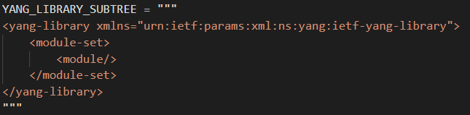
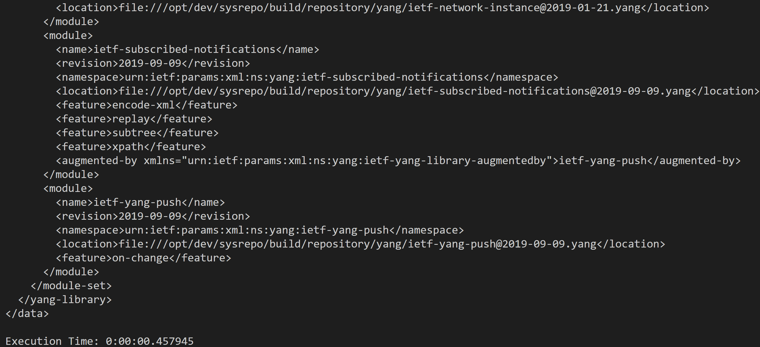
Based on libyang&sysrepo
Run on netopeer2
Hackathon Demo
Device 1 | Device 2 | One <get>
Around 5 min | Around 3 min | 0.46s

Slide 9
Wrap Up
Team members:
Zhuoyao Lin
<zephyre888@gmail.com>
Benoit Claise
<benoit.claise@huawei.com>
IGNACIO DOMINGUEZ MARTINEZ-CASANUEVA <ignacio.dominguezmartinez@telefonica.com>
Repository links:
Libyang with augmented-by: https://github.com/Zephyre777/libyang.git
Sysrepo with augmented-by: https://github.com/Zephyre777/sysrepo.git
Draft repo: https://github.com/Zephyre777/draft-lincla-netconf-yang-library-augmentation.git

