Slide 1
YANG model for management of Network Tester
IETF119 Hackathon
March 16-17, 2023
Online
Notes:
<number>

Slide 2
Network Tester Management Solutions
+-----------------+
eth0 | | eth1
+-<|TG tester0 TA|<-+
| | | |
| +-----------------+ |
| +-----+ |
+------->| DUT |>-------+
+-----+
* Command line (SCPI)
* Cisco TRex
* Keysight Open Traffic Generator APIs & Data Models (2023)
* Other
* YANG model
+-----------------+
eth0 | | eth1
+-<|TG tester0 |x
| | |
| +-----------------+
+-----+
| DUT |
+-----+
| +-----------------+
| | |
+->|TA tester1 |
| |
+-----------------+
1

Slide 3
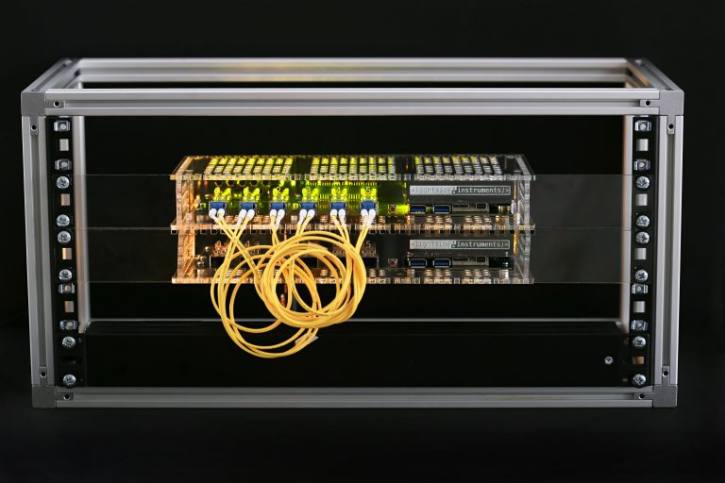
The project
Specification:
* draft-ietf-bmwg-network-tester-cfg-04
Client side:
* Test script – rfc2544-benchmark.py (Python)
Device side:
* Software - ​YANG/NETCONF server instrumentation code (C)
* Firmware - ​(Verilog)
* Hardware – off-the-shelf FPGA module​ Ultra96 + 6x SFP+ network programmability kit shield ( KiCAD, Walk-through, OSHWA UIDs NO000005, NO000006)
* Pre-silicon gate level simulation with cocotb/iverilog as alternative to target hardware
1

Slide 4
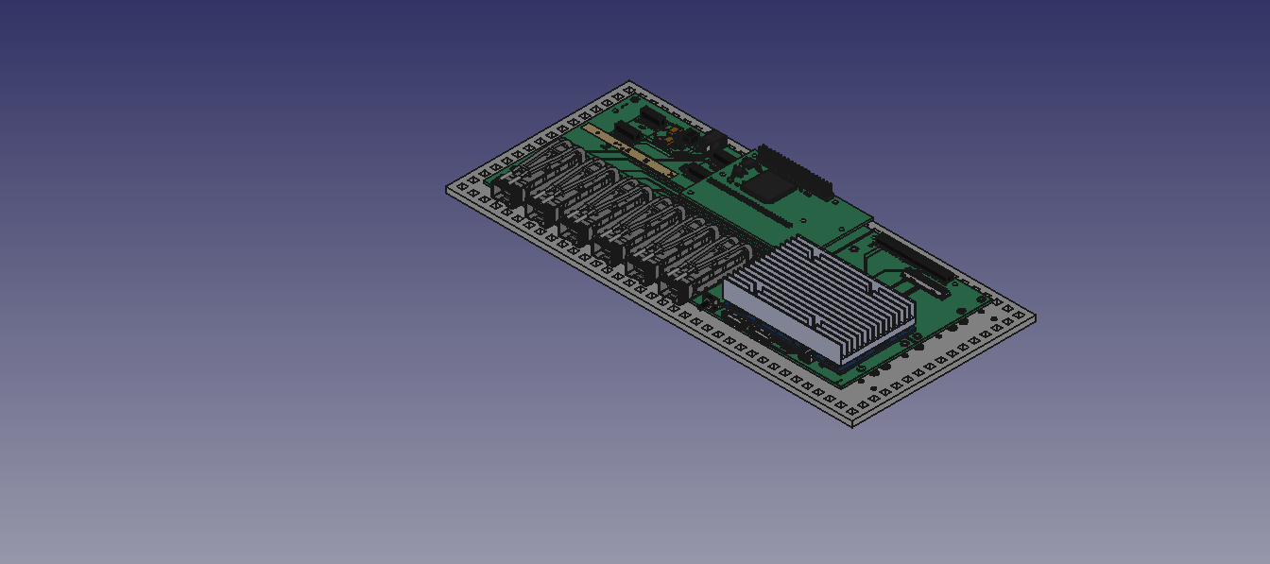


Slide 5
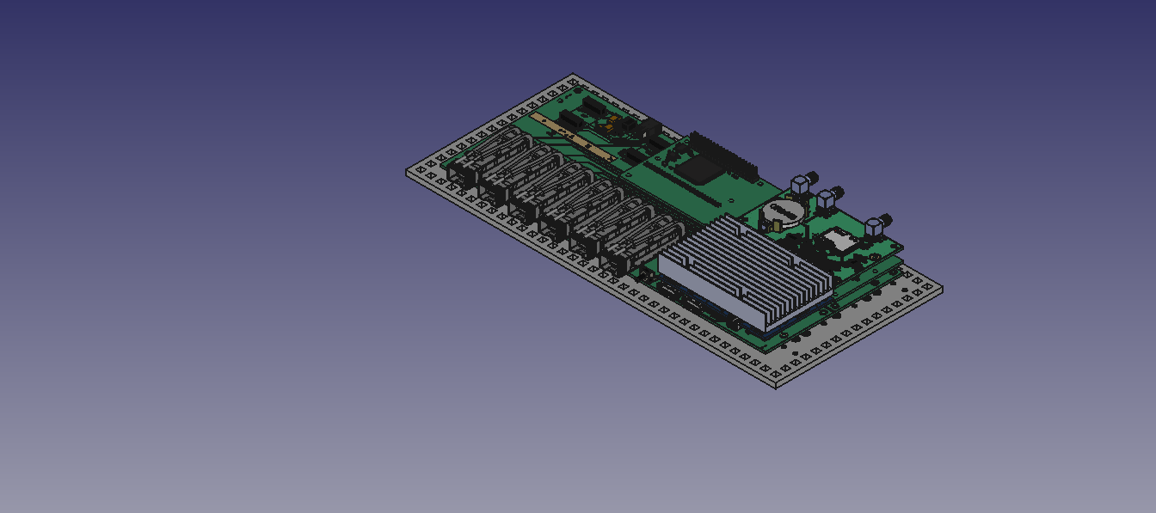


Slide 6
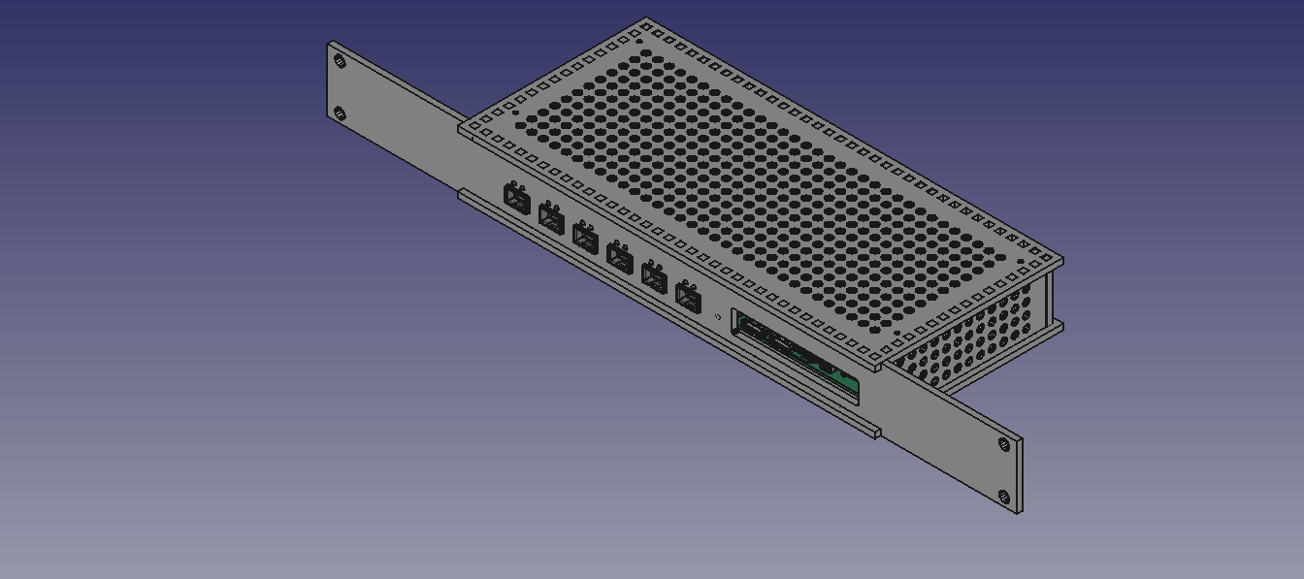

Slide 7
YANG tree diagram of the models
The following slide contains the complete YANG tree diagram
of the ietf-traffic-generator.yang and ietf-traffic-analyzer.yang modules

Slide 9
Design and implementation
NETCONF Server (Model (YANG), Implementation Generator module (C), Analyzer module (C))
TRAFFIC-GENERATOR-SW (C) TRAFFIC-ANALYZER-SW (C)
| |
Socket API Socket API
| \ | / |
Kernel Sync ->{RTCLOCK}(Verilog) Kernel
| PPS / | \ |
DMA DMA
| [AXI] | [AXI]
MAC TRAFFIC-GENERATOR-HW (C,Verilog) MAC TRAFFIC-ANALYZER-HW (C,Verilog)
\ / | |
\ / | |
GMII_MUX +---+---+
| [GMII] | [GMII]
PHY PHY
| |
SFP+ TX SFP+ RX
| |
+->----------------------------------->-+
* - underlined text has links to repositories
1

Slide 10
Some management transaction examples follow:
1. Configuration of 64 octet packet stream with dynamic timestamps
with minial interframe gap on a traffic generator
2. Configuration of testframe filter with bitfield matching
3. Get counters and status information from the traffic anazlizer
* Notice the use of automated command line serialization with yangcli

Slide 11
1. Configure traffic generation:
yangcli user@192.168.4.145> create /interfaces/interface[name='eth0']/traffic-generator -- frame-size=64 interframe-gap=20 \
testframe-type=dynamic \
frame-data=123456789ABCDEF01234567808004500002E000000000A112CBCC0000201C0000202C0200007001A00000\
00102030405060708090A0B0C0D0E0F10119CD50E0F
<edit-config xmlns="urn:ietf:params:xml:ns:netconf:base:1.0">
<target>
<candidate/>
</target>
<default-operation>merge</default-operation>
<test-option>set</test-option>
<config>
<interfaces xmlns="urn:ietf:params:xml:ns:yang:ietf-interfaces">
<interface>
<name>eth0</name>
<traffic-generator
xmlns:nc="urn:ietf:params:xml:ns:netconf:base:1.0"
nc:operation="create"
xmlns="urn:ietf:params:xml:ns:yang:ietf-traffic-generator">
<testframe-type
xmlns:nttg="urn:ietf:params:xml:ns:yang:ietf-traffic-generator">nttg:dynamic</testframe-type>
<frame-size>64</frame-size>
<frame-data>123456789ABCDEF01234567808004500002E000000000A112CBCC0000201C
0000202C0200007001A0000000102030405060708090A0B0C0D0E0F10119CD50E0F</frame-data>
<interframe-gap>20</interframe-gap>
</traffic-generator>
</interface>
</interfaces>
</config>
</edit-config>

Slide 12
2. Configure test frame filter:
yangcli user@192.168.4.145> create /interfaces/interface[name='eth1']/traffic-analyzer/testframe-filter
-- type=bit-field-match data="123456789ABCDEF012345678" mask="000000000000FFFFFFFFFFFF"
<edit-config xmlns="urn:ietf:params:xml:ns:netconf:base:1.0">
<target>
<candidate/>
</target>
<default-operation>merge</default-operation>
<test-option>set</test-option>
<config>
<interfaces xmlns="urn:ietf:params:xml:ns:yang:ietf-interfaces">
<interface>
<name>eth1</name>
<traffic-analyzer xmlns="urn:ietf:params:xml:ns:yang:ietf-traffic-analyzer">
<testframe-filter
xmlns:nc="urn:ietf:params:xml:ns:netconf:base:1.0"
nc:operation="create">
<type
xmlns:ntta="urn:ietf:params:xml:ns:yang:ietf-traffic-analyzer">ntta:bit-field-match</type>
<mask>000000000000FFFFFFFFFFFF</mask>
<data>123456789ABCDEF012345678</data>
</testframe-filter>
</traffic-analyzer>
</interface>
</interfaces>
</config>
</edit-config>

Slide 13
3. Get status information:
<rpc-reply xmlns="urn:ietf:params:xml:ns:netconf:base:1.0">
<data>
<interfaces xmlns="urn:ietf:params:xml:ns:yang:ietf-interfaces">
<interface>
<name>eth1</name>
<traffic-analyzer xmlns="urn:ietf:params:xml:ns:yang:ietf-traffic-analyzer">
<state>
<pkts>43200851</pkts>
<octets>2764854464</octets>
<octets-idle>562950384</octets-idle>
<bad-crc-octets>0</bad-crc-octets>
<bad-crc-pkts>0</bad-crc-pkts>
<bad-preamble-octets>0</bad-preamble-octets>
<bad-preamble-pkts>0</bad-preamble-pkts>
<octets-total>3630210805</octets-total>
<testframe-stats>
<pkts>43200851</pkts>
<sequence-errors>0</sequence-errors>
<latency>
<samples>43200851</samples>
<min-sec>0</min-sec>
<min>832</min>
<max-sec>0</max-sec>
<max>864</max>
<last-sec>0</last-sec>
<last>864</last>
</latency>
</testframe-stats>
<capture>
<timestamp>
<nsec>902536272</nsec>
</timestamp>
<sequence-number>43200851</sequence-number>
<data>555555555555D5123456789ABCDEF01234567808004500002E000000000A112CBCC0000201
C0000202C0200007001A000000000000029331520000000005E735CB98F0345964C7</data>
</capture>
</state>
</traffic-analyzer>
</interface>
</interfaces>
</data>
</rpc-reply>
yangcli user@192.168.4.145>
xget /interfaces/interface/traffic-analyzer/state
<get xmlns="urn:ietf:params:xml:ns:netconf:base:1.0">
<filter type="xpath"
select="/interfaces/interface/traffic-analyzer/state"/>
</get>

Slide 14
Tasks
* Implement -04 updates. Bitwise mask filter for testframes.
* Validate with pre-silicon test environment.

Slide 15
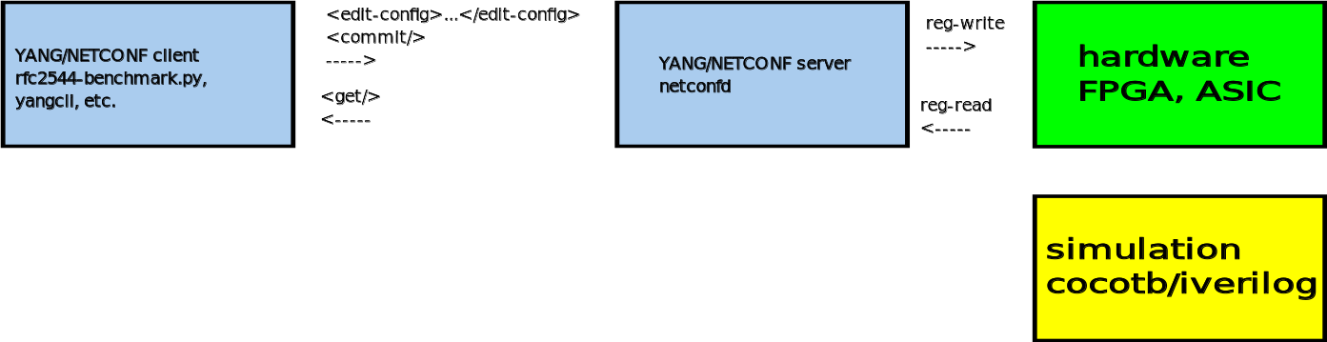
Model defined pre-silicon testing environment
Alternatives:
* UVM, UVVM
* Cadence/Spirent
... sim-run 1000 ns
sim-finish

Slide 16
Results:
We managed to run a RFC2544 benchmark against a netconfd server implementing the model by controling a gate-level simulation of the synthesizble traffic-generator-gmii and traffic-analyzer-gmii cores in cocotb sim_time_ns=1565330 (!!! Notice that we used bogus 10 Kb Ethernet speed to actually simulate the dataplane in realtime).
We published the results in a branch :
* Waveform trace (cocotb/iverilog gate-level generated)
* Report (with verbose NETCONF transaction)
Short RFC2544 report and some random screenshots complete this presentation.

Slide 17
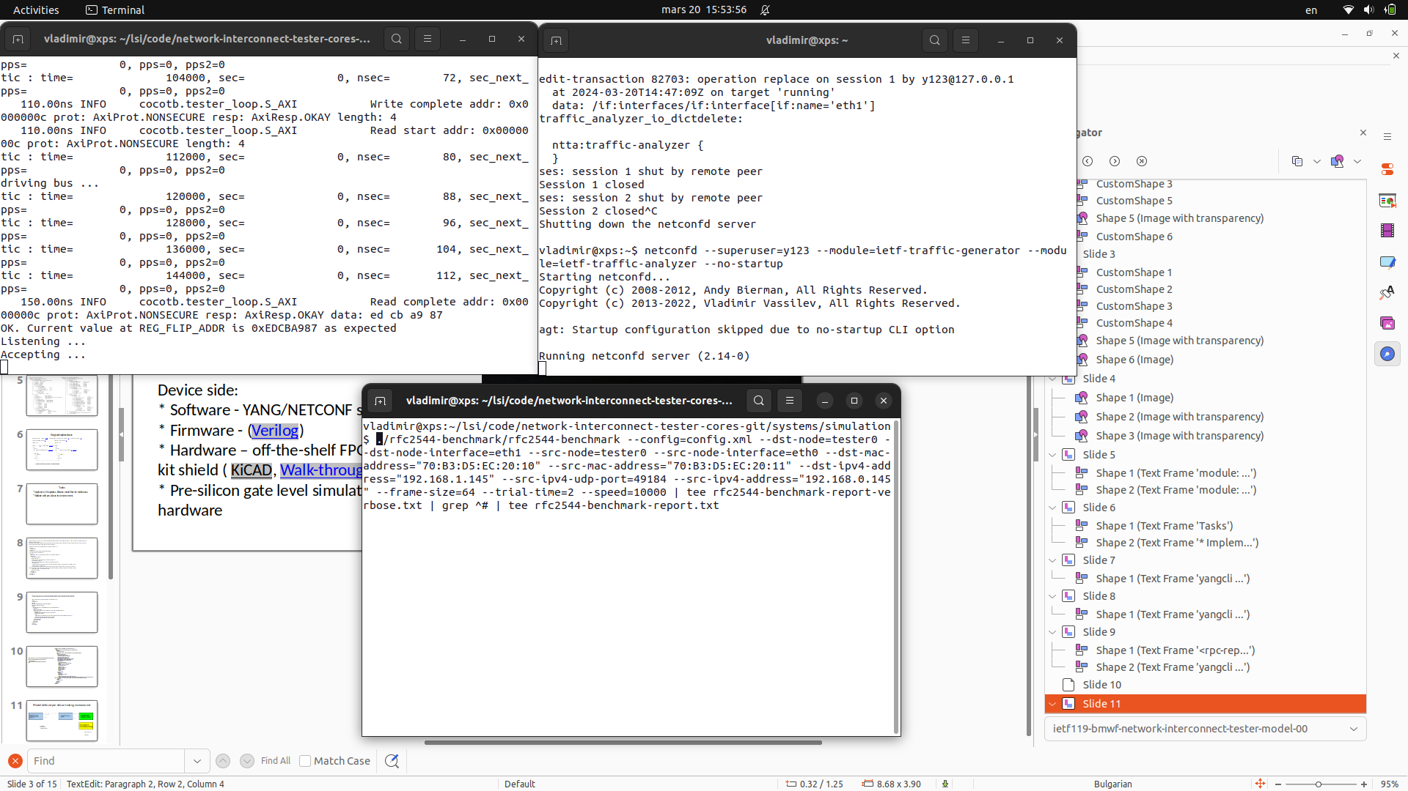

Slide 18
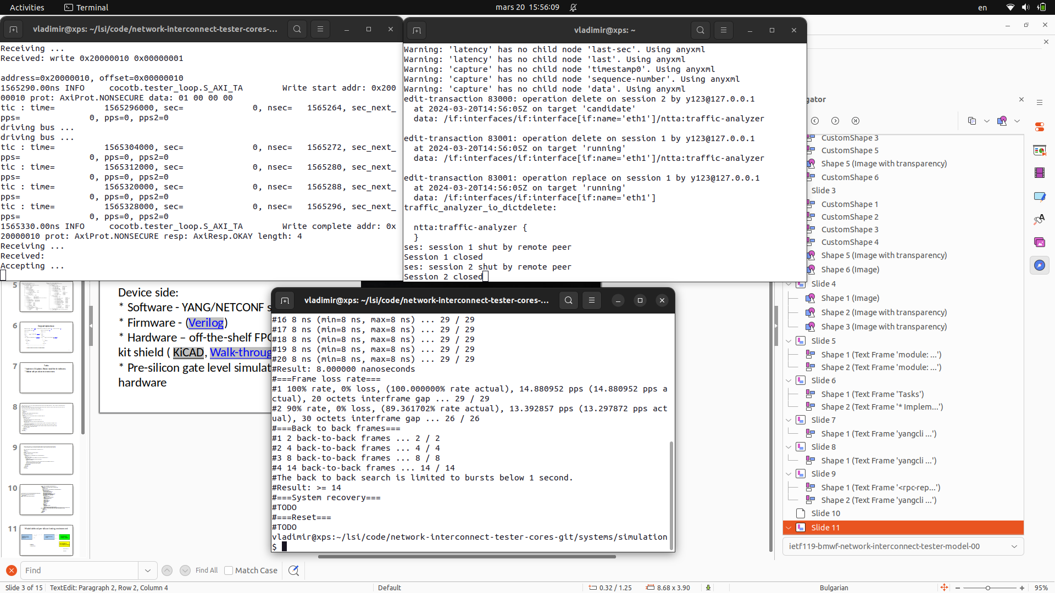

Slide 19
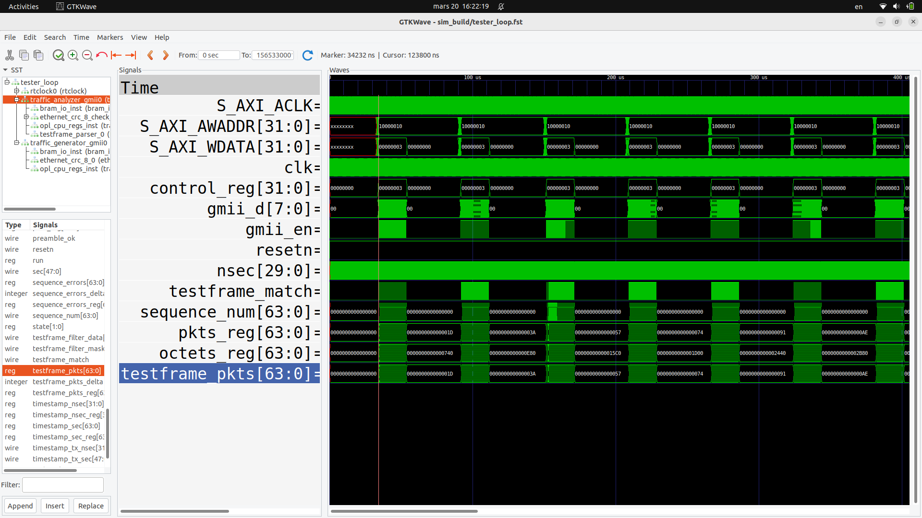

Slide 20
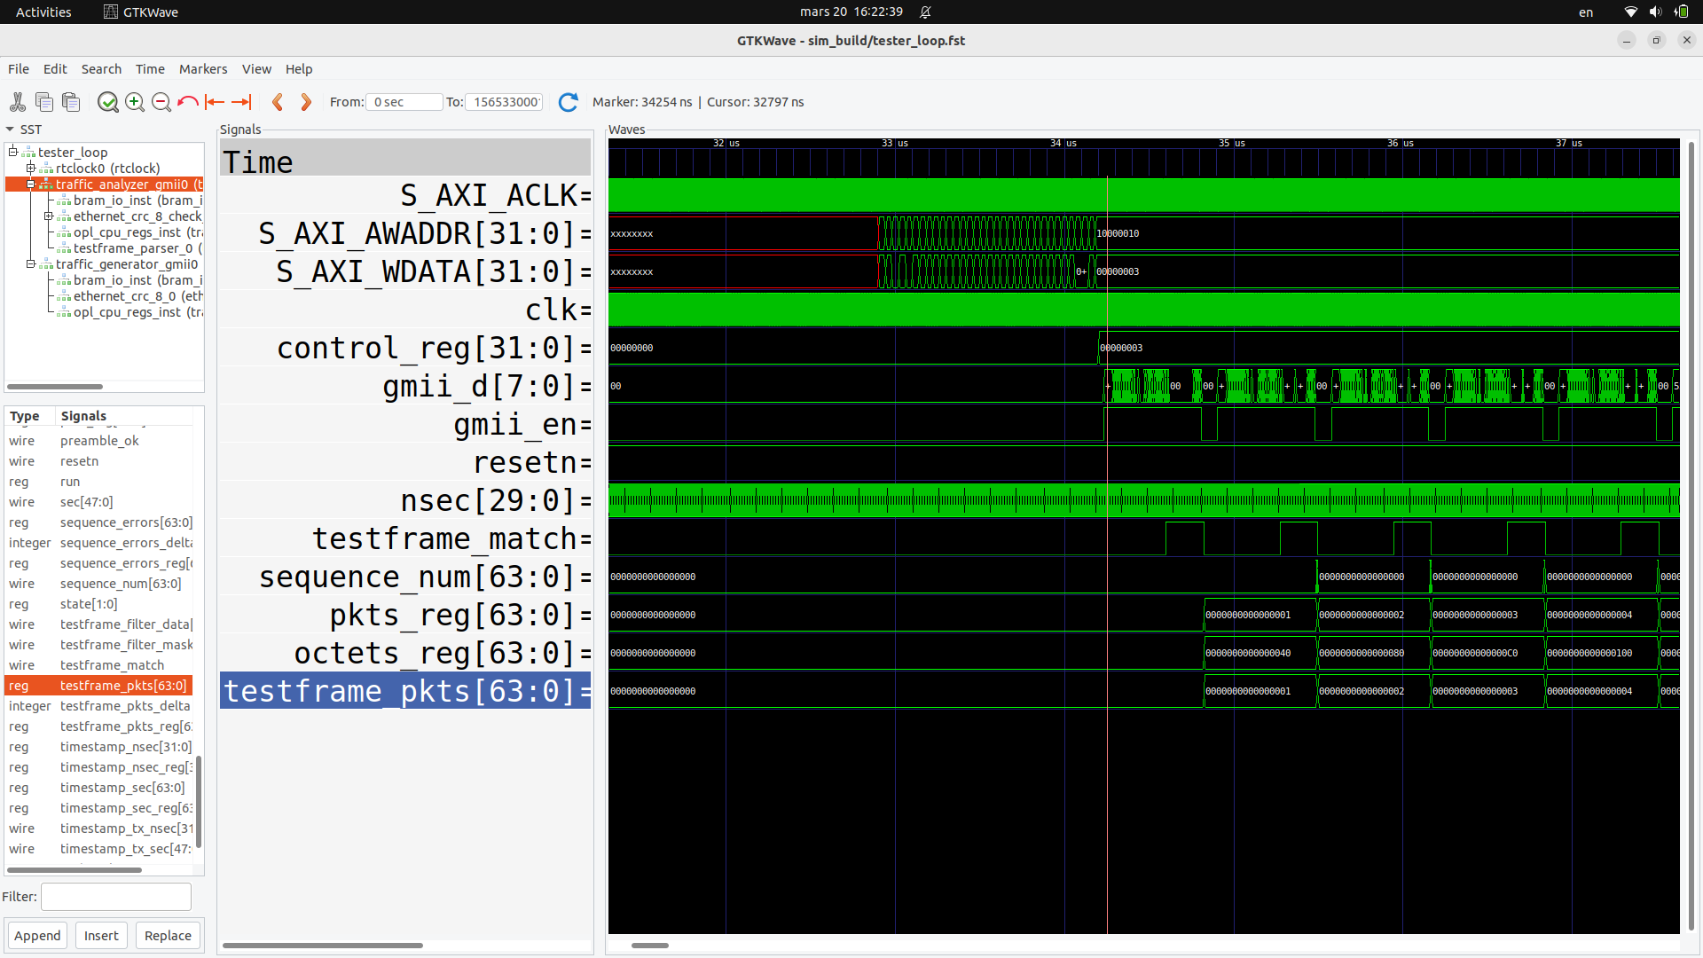

Slide 21
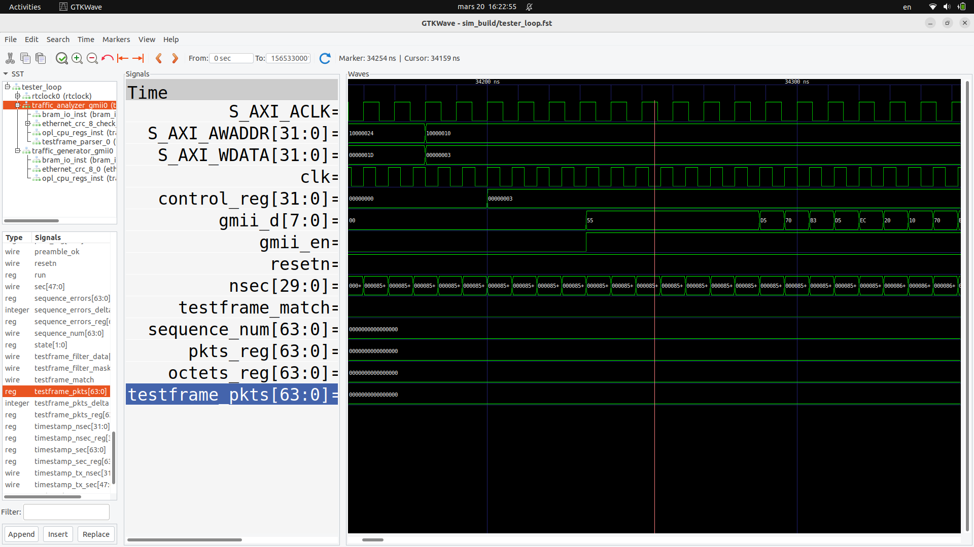

Slide 22
The End
<number>

