Slide 1
IETF 119 Hackathon
SAV-based Anti-DDoS Architecture (SAV-D)
Haoran Luo, Shuisong Hu
Tsinghua University, Beijing Zhongguancun Laboratory
16-17 March 2024

Slide 2
Hackathon Plan
Relevant Draft
SAV-based Anti-DDoS Architecture.
— draft-cui-savnet-anti-ddos-03 - SAV-based Anti-DDoS Architecture (ietf.org)
Running Code
Implementation of each component of the SAV-D architecture.
Design an experiment to simulate the working process of SAV-D.
Demonstrate the effectiveness of the SAV-D architecture in addressing DDoS reflection amplification attacks.

Slide 3
What got done
SAV-D controller
SAV devices identify and report forged source address packets.
Based on the collected information, the SAV-D controller identifies security intelligence.
The security intelligence can be distributed through the SAV-D controller, benefiting the entire network.
Generating Rules
Issuing Rules
Detecting DDoS Attack
Maintain IP blacklists
Sharing Threat Information
SAV Devices
Non-SAV Devices，
Victim’s Defense System
Monitoring
Receiving Rules
Receiving Rules
Filtering Rules
Filtering Rules

Slide 4
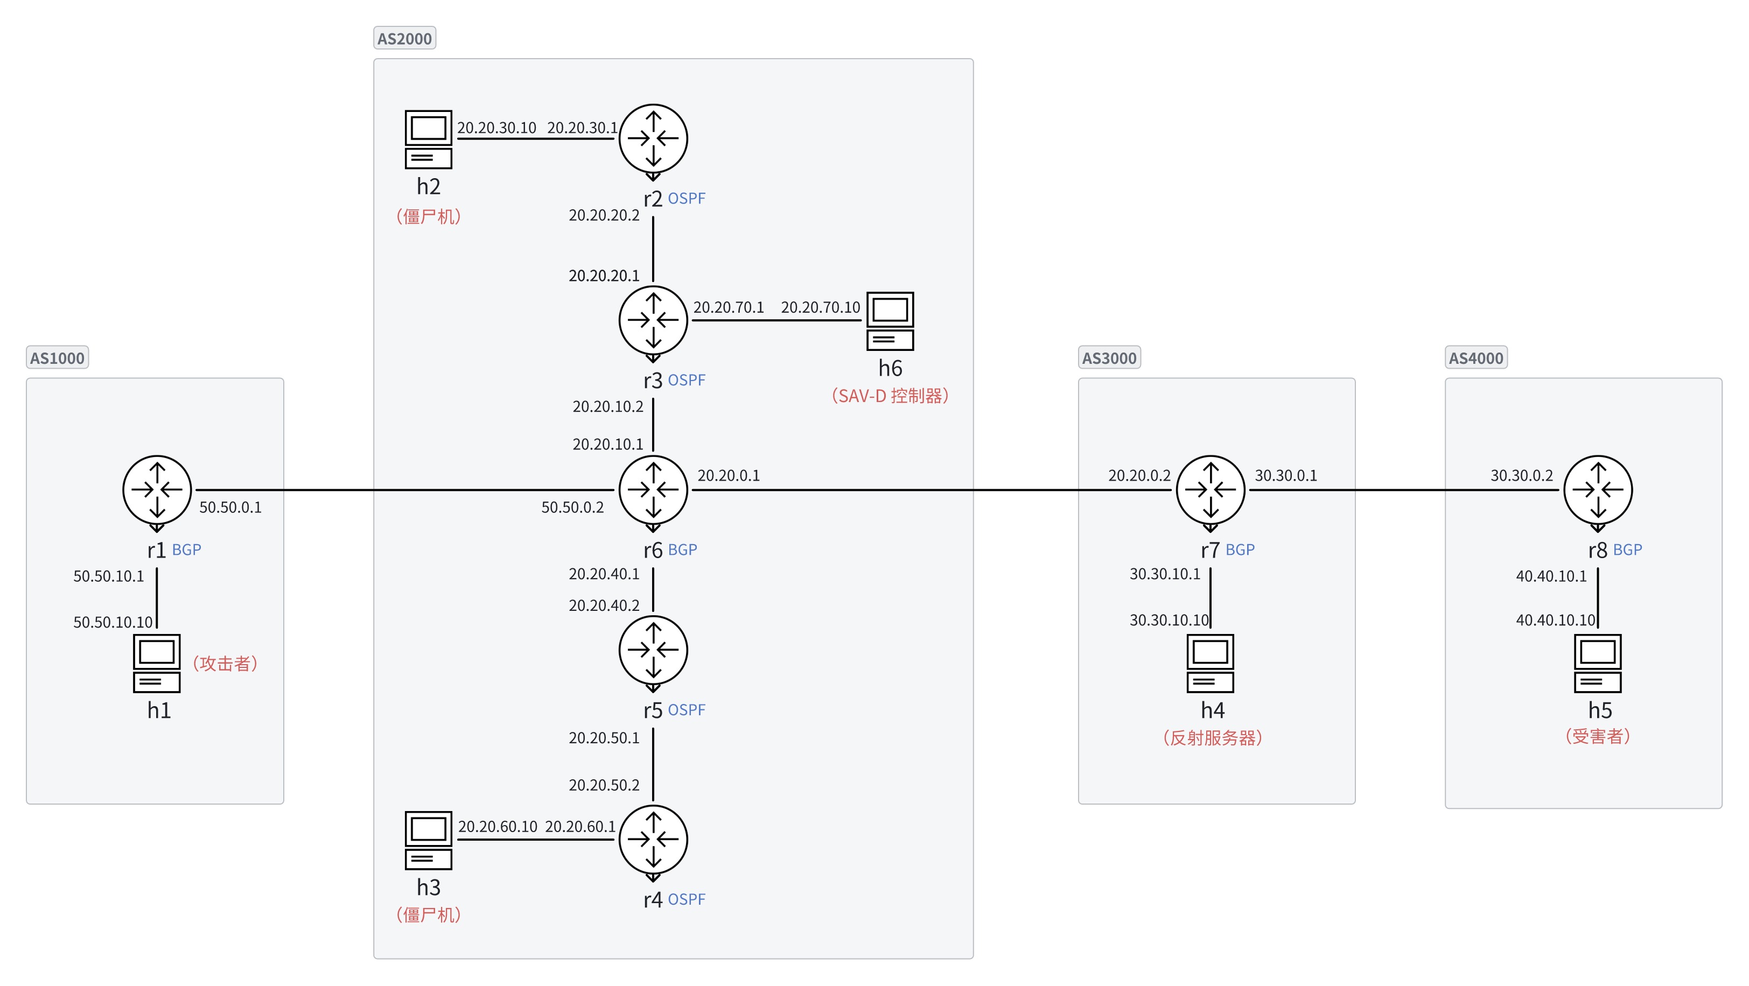







What got done
SAV-D
2
SAVA switch(r2) reports spoofed source address information to SAV-D controller near the source of the attack.
SAV-D controller detects DDoS attack using the reported information.
SAV-D controller generates filtering rules.
SAV-D controller sends rules to chosen devices(r6) .
Chosen devices execute filtering rules.
SAVA Switch
1
Zombie Host
4
SAV-D Controller
3
Attacker
DNS Server
Victim
Zombie Hosts

Slide 5
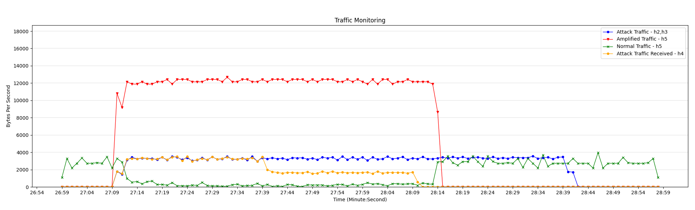
What got done
Amplificated attack traffic
1
2
3
4
Original attack traffic
Normal traffic
Information uploading（r2） instead of direct dropping.
DDoS attacks are detected and blocked at r2 first.
SAV-D controller selects the device that will receive the filtering rule.
R6 receives filtering rules and executes blocking. As a result, normal traffic returns to normal levels.

Slide 6
What we learned
SAV-D acts as a defense amplifier, and its goal is to block attack flows as close to the source as possible.
During incremental SAV deployment, information uploading instead of direct dropping can help collect more threaten intelligence.
Next Step
This is our first time to participate in the IETF. If you are interested, you can join us, communicate with us, and further promote standards.

