Slide 1
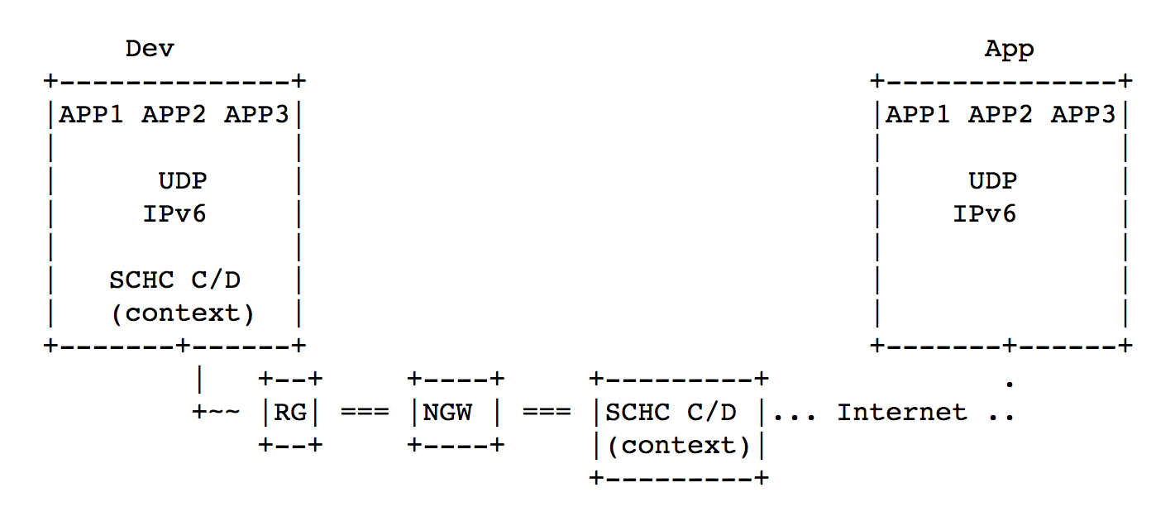







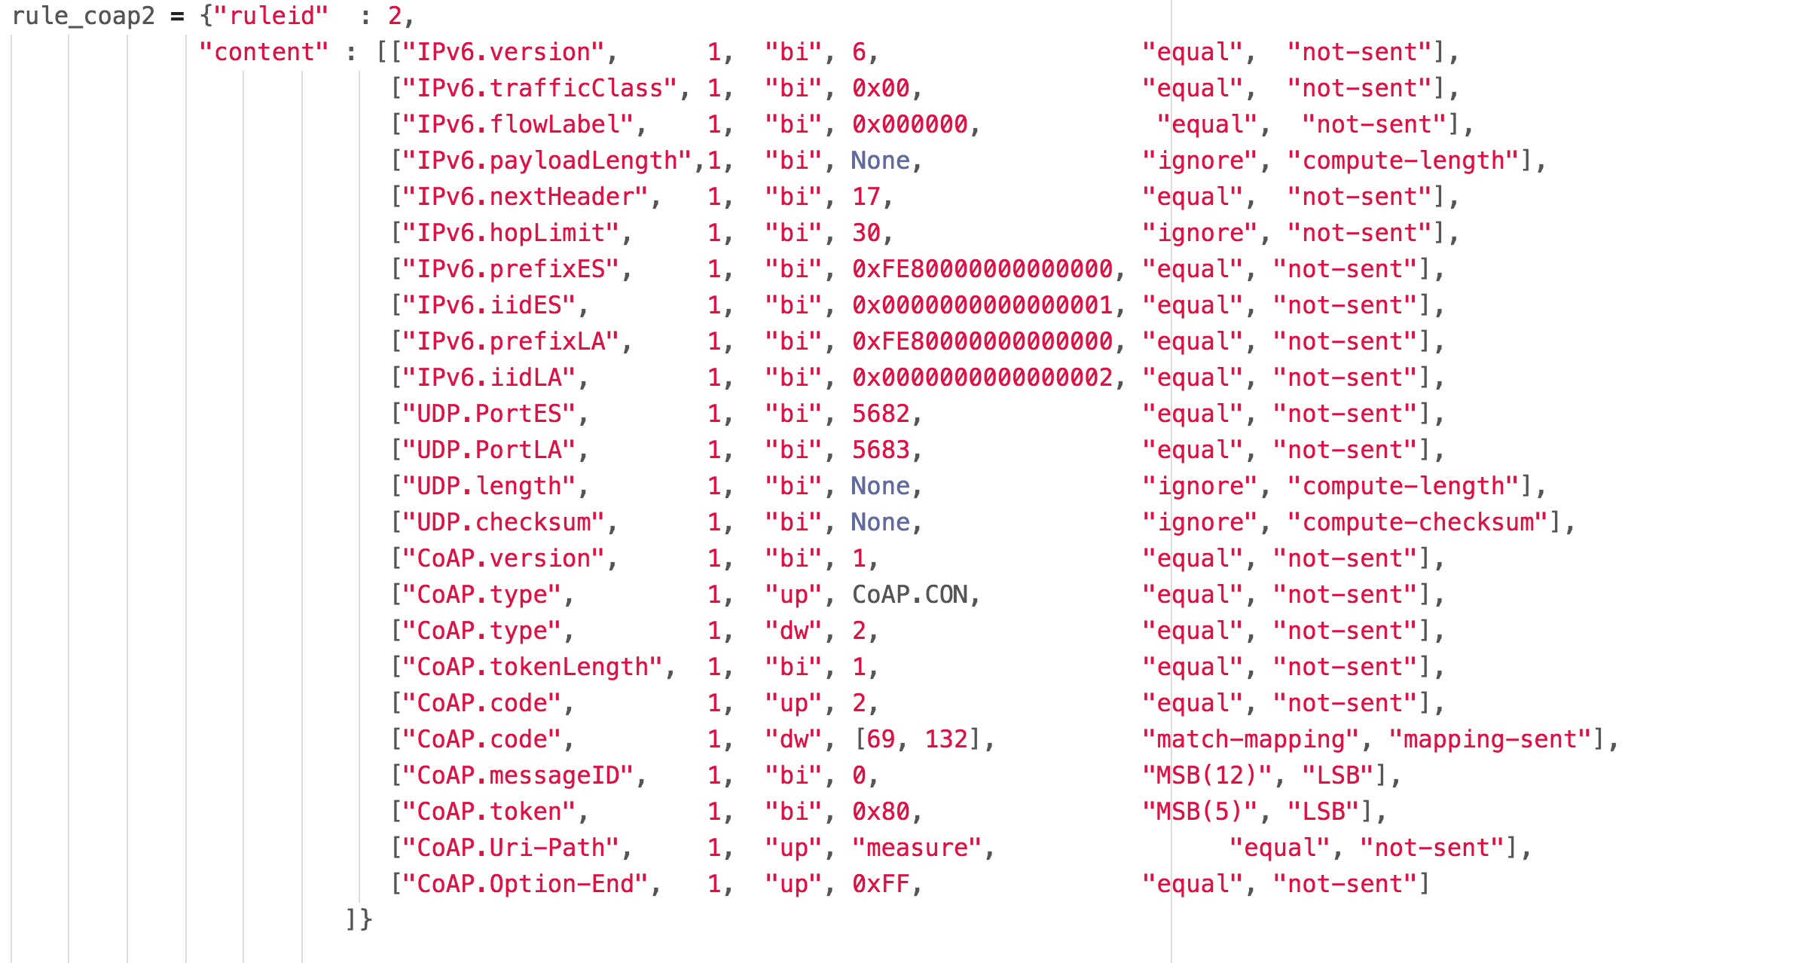
SCHC Header
Compression
for LPWAN
Implementations
SCHC C/D
SCHC C/D
CoAP
UDP
IPv6
CoAP
UDP
IPv6

