Slide 1
Dominique Barthel – Orange
Philippe Clavier – Univ. Buenos Aires
Arunprabhu Kandasamy - Acklio
Ivaylo Petrov – Acklio
Laurent Toutain – IMT Atlantique
SCHC interop

Slide 2
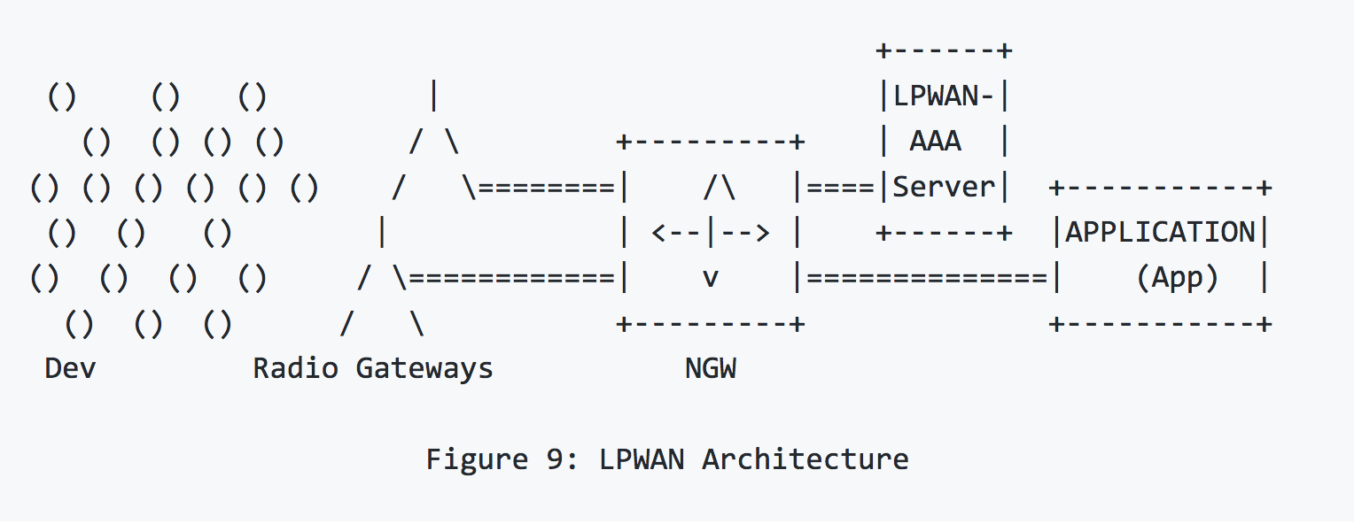
LPWAN
Energy efficient, Long Range
Different technologies: LoRaWAN, Sigfox, NB-IoT, Wi-sun, ….

Slide 3
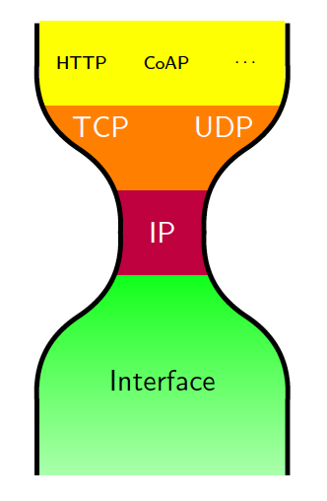
SCHC
Duty cycle: 1%
Sigfox : 140 * 12 Bytes uplink
4 * 8 Bytes downlink
LoRaWAN : up to 200 bytes
symetrical

Slide 4







Hackathon
LoRaWAN
LoRaWAN
Sigfox
LoRaWAN
Sigfox
Interoperability

Slide 5
Hackathon outcomes
Multi-technologies interop.
Padding management.
Canonical compression rule definition:
  Fixed ambiguities in JSON representation
Variable length fields:
  How to manage 0 length values
Reference implementation:
  http://github.com/ltn22/SCHC

