Slide 1
PCAP and PCAPng and PCAP Link Types
draft-gharris-opsawg-pcap
draft-tuexen-opsawg-pcap
draft-richardson-opsawg-pcaplinktype
Guy Harris Michael Richardson
Fulvio Risso Michael Tuexen
Jasper Bongertz Gerald Combs
github.com/pcapng
www.tcpdump.org

Slide 2
The Story so Far
After multiple long discussions in 2019 and 2020, WG Adoption call(s) in October 2021.
  pcap was adopted? pcapng was not?
  It’s really a document set...
“Consensus” became:
  remove LINKTYPE registry from pcap document, put it in a new document.
  New Document is: draft-richardson-opsawg-pcaplinktype-00

Slide 3
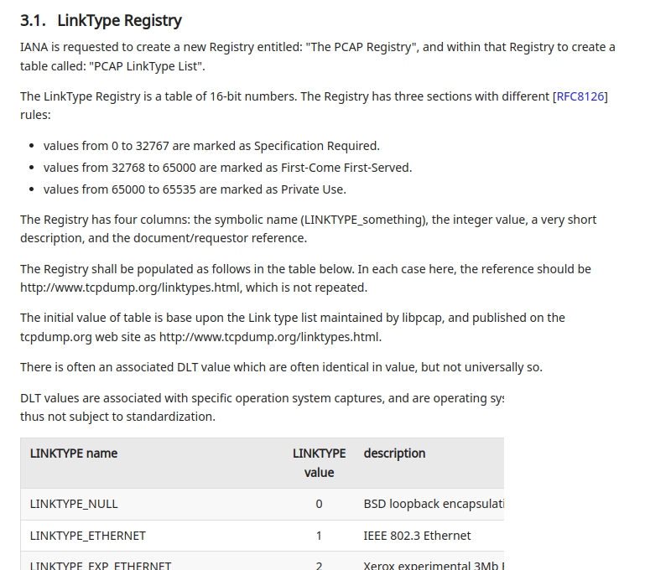
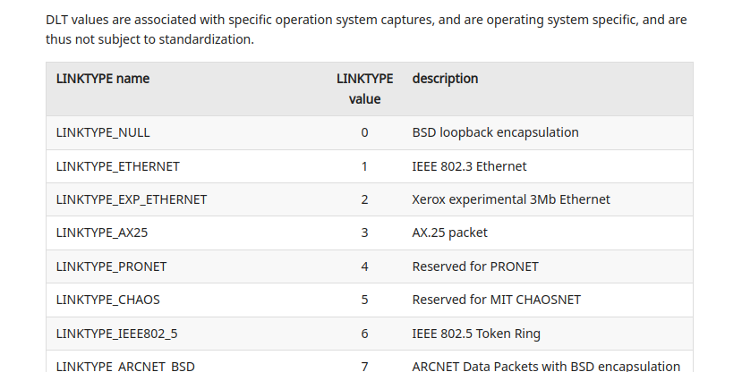
draft-richardson-opsawg-pcaplinktype
Really boring document, standards track
GOES ON LIKE THIS FOR A FEW PAGES

Slide 4
PCAP and PCAPng documents
PCAP document Informational.
  IETF does not have change control.
  Recommend be published as Historic
PCAPng document Informational.
  new work could amend, etc. under IETF change control
Both will reference pcap link types for registration

Slide 5
Adoption Call Actions
Already split out the non-network “systemd” block into
  draft-richardson-opsawg-pcapng-extras-00
PCAP / PCAPng can be adopted or go via AD sponsor or via ISE
PCAP-linktypes needs to be an IETF Action (WG or AD Sponsor) to establish the registry (ISE can not do that)
Recommend that OPSAWG just adopt and progress.

Slide 6
Discussion

