Slide 1
IETF Network Slice Topology YANG Data Model
draft-liu-teas-transport-network-slice-yang-06
Co-authors:
Xufeng Liu (IBM)
Jeff Tantsura (Microsoft)
Igor Bryskin (Individual)
Luis M. Contreras (Telefonica)
Qin Wu (Huawei)
Sergio Belotti (Nokia)
Reza Rokui (Ciena)
Aihua Guo (Futurewei)
Italo Busi (Huawei)

Slide 2
Motivation
A network slice may require an additional level of control to customize its connections, as described in Section 2 of draft-ietf-teas-ietf-network-slices.
“Additionally, the IETF Network Slice service customer might ask for some level of control of, e.g., to customize the service paths in a network slice.”
A network slice can benefit from using a customized topology to allow better resource reservation and resource sharing among connections
We call it a “network slice topology”

Slide 3
Network Slice Topology
A network slice topology is a customized topology used to expresses a customer’s intent for reserving topology resources and expressing connectivity constraints
A network slice topology is defined by the customer(“customized”), not one exposed by the provider(“abstract” or “native” topology)
Existing topology models, e.g. network topology or TE topology is not designed for expressing the slice intent, e.g. no customer SLO/SLEs defined
Service paths for connections in a network slice can be specified on top of a network slice topology
The topology model defined in early revisions of draft-liu-teas-transport-network-slice-yang is a good candidate for defining the network slice topology

Slide 4
Updates in Rev-06
Imported common SLO/SLE attributes from ns-nbi & applied them to the topology constructs
Removed the augments from the TE topology model for model connectivity constructs as they are already covered by the ns-nbi YANG model
Text & diagram updates

Slide 5
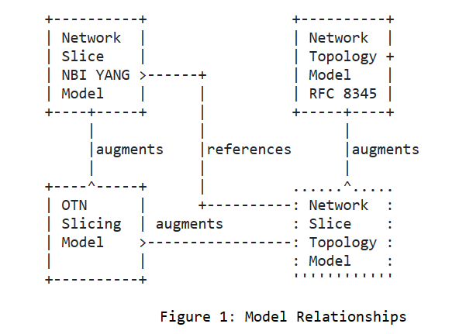
Updated Model Relationships

Slide 6
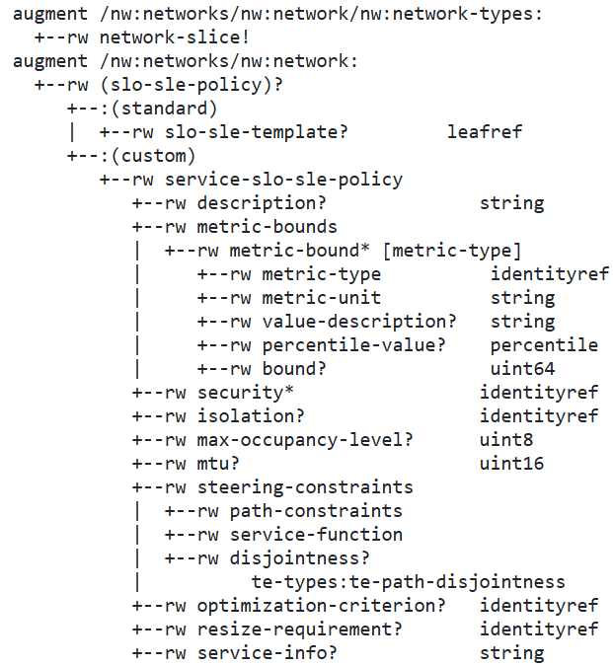
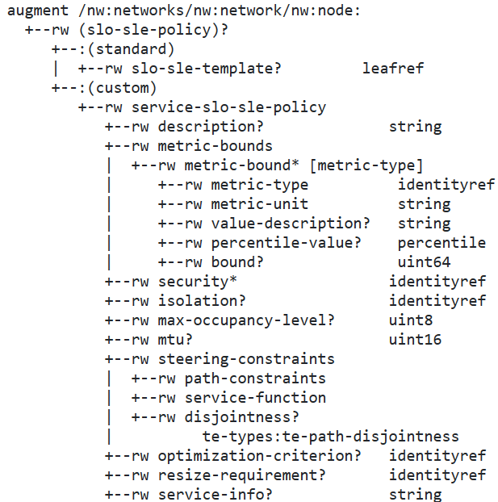
Model Tree
Network augments
Node augments

Slide 7
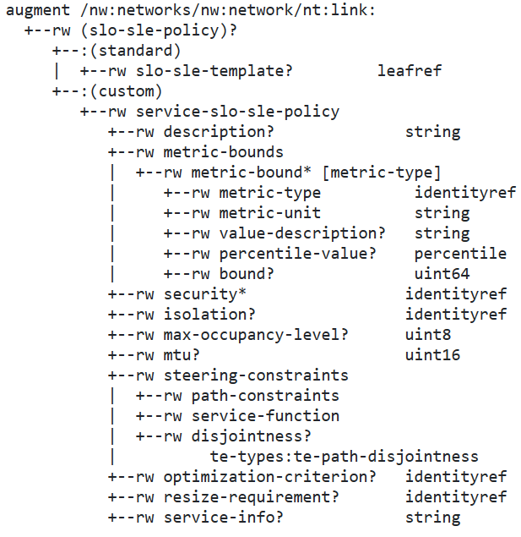
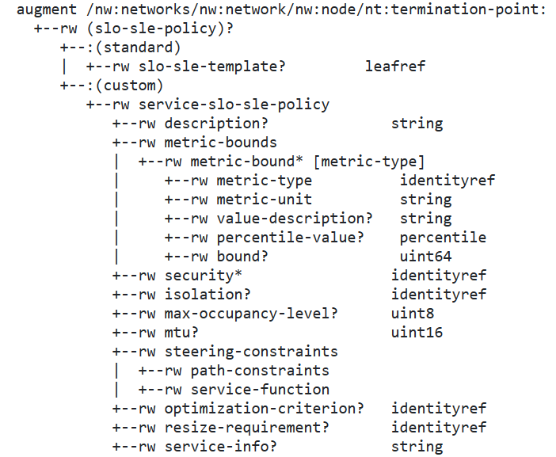
Model Tree (Cont.)
Link augments
TP augments

Slide 8
Open Issue
Since the NS Topology model is a NS technology agnostic topology model, why not reference directly this model in NS-NBI for customized topology
Add constraint into NS-NBI that the reference topology must be of type “network-slice”

Slide 9
Open Issue – Relationship between SDP and LTP
Current NS NBI model defines an SDP to reference an LTP object
+--rw sdps
+--rw sdp* [id]
+--rw id string
+--rw description? string
+--rw location
| ...
+--rw node-id? string
+--rw sdp-ip-address* inet:ip-address
+--rw tp-ref? -> /nw:networks/network[nw:network-id =current()/../../../custom-topology-ref/network-ref]/node/nt:termination-point/tp-id
Should the reference be the other way around, i.g. an LTP object to reference an SDP?
augment /nw:networks/nw:network/nw:node/nt:termination-point:
+--rw customer-facing-sdp-id? Leafref
Can multiple LTPs in different topologies point to the same SDP?
Should an SDP exist before or at the time the LTP is created?

Slide 10
Next Steps
Request for WG adoption
Resolve open issues
* GitHub Repo
https://github.com/aguoietf/ietf-network-slice-topology

Slide 11
Thank You!

