Slide 1
IETF Network Slice Topology YANG Data Model
draft-liu-teas-transport-network-slice-yang-07
Co-authors:
Xufeng Liu (Alef Edge)
Jeff Tantsura (Microsoft)
Igor Bryskin (Individual)
Luis M. Contreras (Telefonica)
Qin Wu (Huawei)
Sergio Belotti (Nokia)
Reza Rokui (Ciena)
Aihua Guo (Futurewei)
Italo Busi (Huawei)

Slide 2
Motivation
A network slice customer may request an additional level of control to customize the service paths in a network slice (Sec. 2 of draft-ietf-teas-ietf-network-slices)
In some use cases, a customer may ask for shared instead of dedicated resources to save cost
Resources are reserved ahead but not activated
Connections can be activated on demand
Current NS NBI model only addresses connectivity-based network slicing
Dedicated connections with resources allocated for each connection
To request resource sharing, on-demand reconfiguration of connections is needed but there is no guarantee that resources are always available at the time of request
Customized topology can help -
Customer can express some level of customized control: explicit path, diversity, protection/restoration, etc.
A customized topology can encode resource reservation request to secure the resources
Allows customer to use resources to create and reconfigure network slice connections in a flexible way
And it’s complementary!
Optional extension to support resource reservation in addition to connectivity-based slicing

Slide 3
Terminologies
Customized Topology: A topology defined by the customer and served as an input to the network slice service provider, i.e. to the Network Slice Controller (NSC). (In scope)
Abstract Topology: A topology exposed to the customer by the network slice service provider prior to the creation of network slices. (Out of scope)
NRP Topology: A topology internal to the NSC to facilitate the mapping of network slices to underlying network resources. (Out of scope)

Slide 4
Some History with This Draft
(-00 to -05) of the draft was positioned as an alternative model for network slicing NBI
Provider may expose an abstract topology using this model
Customer may define a network slice as a customized topology using the same model
(-06 and -07) of the draft re-positioned the draft
As a complementary data model for resource-based network slices (reserve and activate)
Only used by the customer to define customized topologies

Slide 5
An Example Scenario
Option 1
Created NS with dedicated connections (s1-t, s2-t, s3-t)
Pay for 3x needed bandwidth
Option 2
Created NS with one connection (s1-t)
Dynamically reconfigure the NS connection to connect one stadium with the TV station
Bandwidth may not be available at the time of reconfiguration
Stadium 1
PE1
P1
TV Station
Stadium 2
PE2
PE4
Stadium 3
PE3
P2
Network Slice Request: multiple stadiums share one 100G HD broadcast channel to the TV station
Alternating use of bandwidth between the stadiums (no parallel TV broadcast events on the same day)
Bandwidth must be available at the time of request
No pre-defined schedule (or ad-hoc events) with the broadcast

Slide 6
An Example Scenario (Cont.)
Option 3
Create a customized topology with two nodes and one 100G link
vPE1 represents an abstracted view of the 3 stadiums
vPE2 represents the TV station
Pay only 1x 100G bandwidth
Resources are reserved in advance
Customer can dynamically create/remove connections
Of course, the NSC will need to support the resource reservation (part of SLO/SLE for the topology)
More fine-grained control can be expressed
Use P node to describe route preferences (e.g. geo-location)
Multi-path protection & restoration
vPE1
Stadium 1
PE1
P1
vPE2
TV Station
Stadium 2
PE2
PE4
Stadium 3
PE3
P2
Network Slice Request: multiple stadiums share one 100G HD broadcast channel to the TV station
Alternating use of bandwidth between the stadiums (no parallel TV broadcast events on the same day)
Bandwidth must be available at the time of request
No pre-defined schedule (or ad-hoc events) with the broadcast

Slide 7
How does a Customer Understand a Customized Topology?
Customized topology is defined in the customer context, may not be understood by the provider. Provider needs to translate a customized topology an internal realization (e.g. mapped to an NRP)
There are a few options…
Associate a SAP/SDP with a TP in the customized topology
Use the same id between the customer and provider
What about P-nodes in a customized topology?
The customized topology can be as simple as PE nodes + links, so a P-node is completely optional
A P-node may be used to represent a policy node, e.g. a geo location over which a service path must (or must not) traverse
Another option is to expose an abstract topology
Does not apply to all providers due to security / data privacy consideration
However, if exposed, such an abstract topology could help the provider to advertise its capabilities to the customer
Mechanism to expose an abstract topology is outside the scope of this draft
E.g. with an augment of RFC9408, or RFC8795 (TE topology)

Slide 8
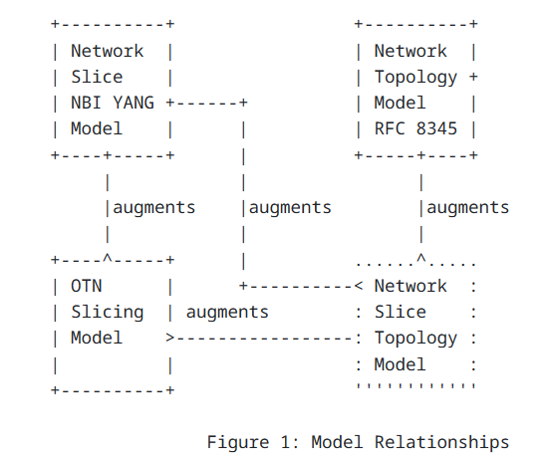
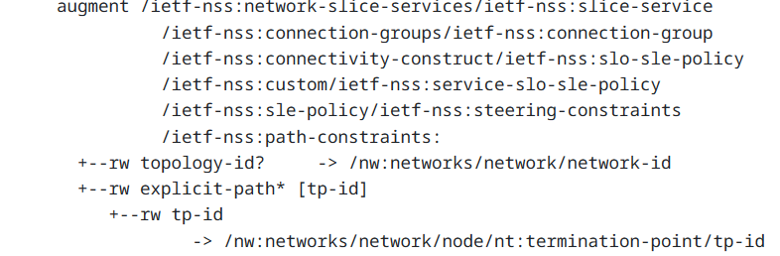
Updates to draft -07
Text updates to clarify the use of customized topology and address comments received from the WG
Moved augments for adding service paths over NS connections from draft-ietf-ccamp-otn-slicing to this draft

Slide 9
Open issue
Currently, draft-ietf-teas-ietf-network-slice-nbi-yang has a reference to a customized topology without specifying how to use it
Shall we move the above reference to this draft?
Clear separation of modeling: ns-nbi focuses only on connection-based network slicing, while this draft provides resource-based slicing with definitions to a customized topology and usage of such a topology

Slide 10
Next Steps
Request for WG adoption
Resolve open issues
* GitHub Repo
https://github.com/aguoietf/ietf-network-slice-topology

Slide 11
Thank You!

