Slide 1
Excellence in Avionics and Cabin Systems
Company Presentation
Release v02/2015

Slide 2
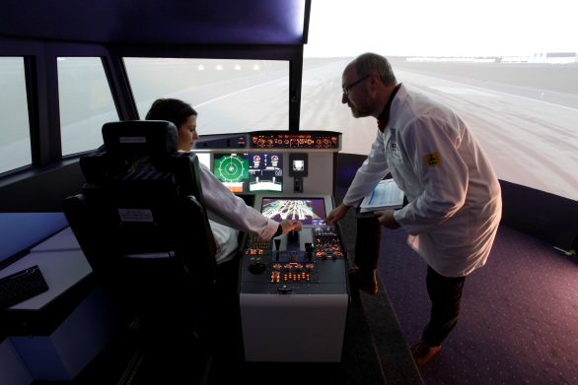
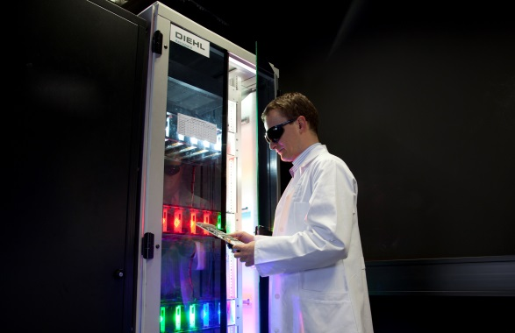
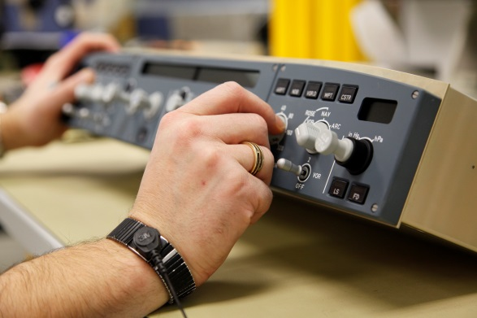
Our Guiding Principles
Principles | Operational Units | History | Figures | Corporate Division | Sites | Portfolio | Customers | Acknowledgements | Approvals
Partnership
Technology Leadership
Reliability
Germany's major first tier supplier for avionics, light and interior functions.
Innovative leading edge technology for commercial and military platforms.
A joint venture, based on successful and long-standing cooperation.
Partner to the aerospace industry with core competencies from cockpit to cabin

Slide 3


Diehl Aerospace - One of Five Operational Units
Principles | Operational Units | History | Figures | Corporate Division | Sites | Portfolio | Customers | Acknowledgements | Approvals
Corporate Division
Sales: over € 1,010 m | Employees: ≈ 4,700 | Headquarters: Laupheim, Germany
Operational Units
Sales: ≈ € 300 m
Employees: ≈ 1,200
Shareholders: 51% Diehl, 49% Thales
Sales: ≈ € 390 m
Employees: ≈ 2,000
Sales: ≈ € 190 m
Employees: ≈ 800
Sales: ≈ € 40 m
Employees: ≈ 250
Sales: ≈ € 90 m
Employees: ≈ 470
joint venture with Thales
Numbers are based on forecast 2015

Slide 4
History
Principles | Operational Units | History | Figures | Corporate Division | Sites | Portfolio | Customers | Acknowledgements | Approvals
VDO Luftfahrtgerätewerk
2000
Diehl Avionik
Systeme
Bodenseewerk
Gerätetechnik GmbH
Joint Venture with Thales
2006
Diehl Aerospace
Joint Venture with Thales
1998
Diehl Group
Diehl Luftfahrt
Elektronik

Slide 5
Key Figures
Principles | Operational Units | History | Figures | Corporate Division | Sites | Portfolio | Customers | Acknowledgements | Approvals
Employee Structure
Quality 6%
Administration 10%
Sales (€ m)
Sales & Program & Service 15%
≈1,200 Employees
Research & Development 31%
Supply Chain Management 8%
Production 30%
*Numbers are based on forecast 2015

Slide 6
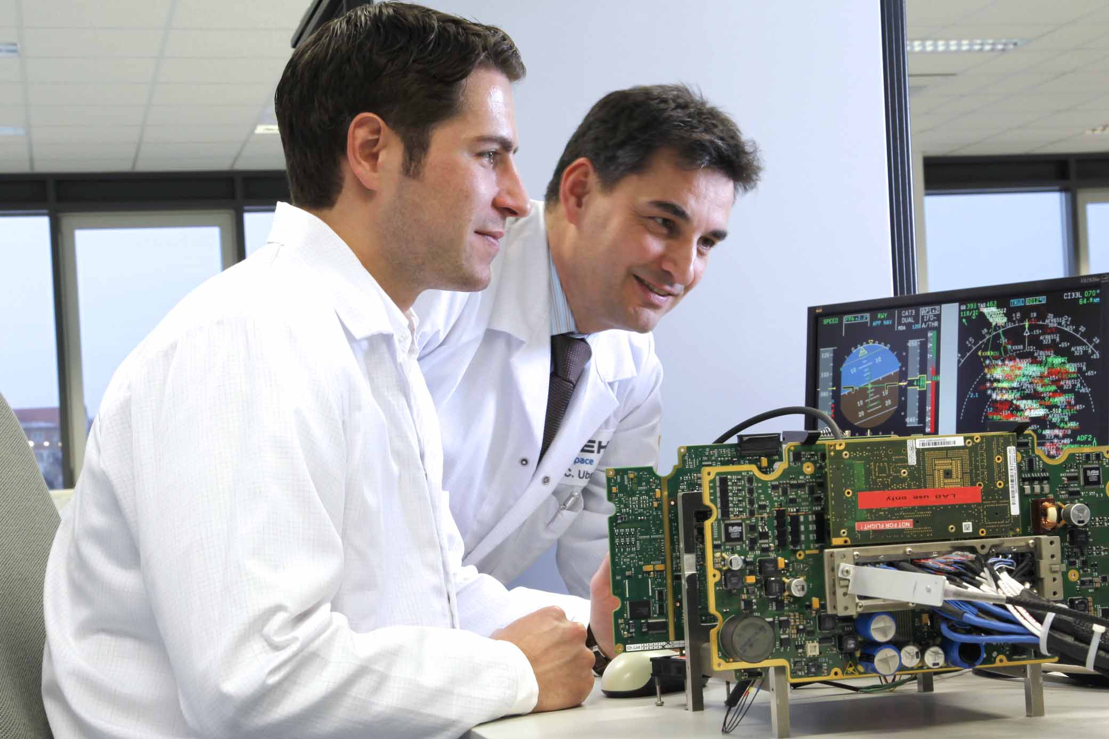
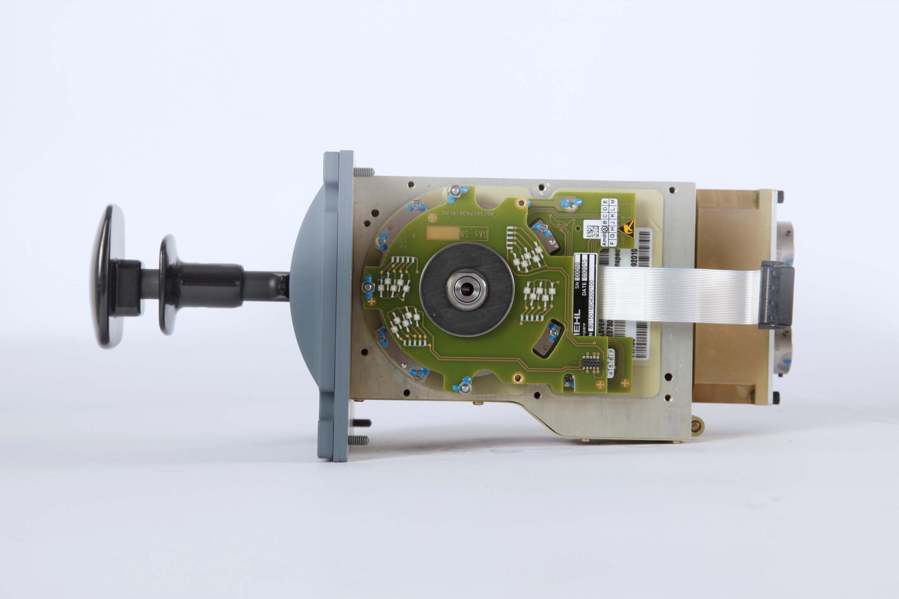
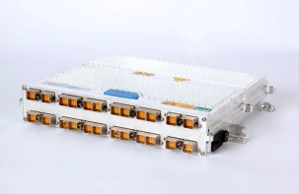
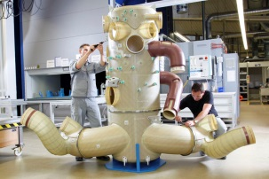
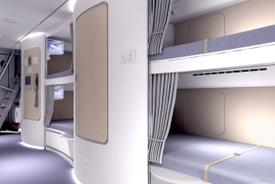
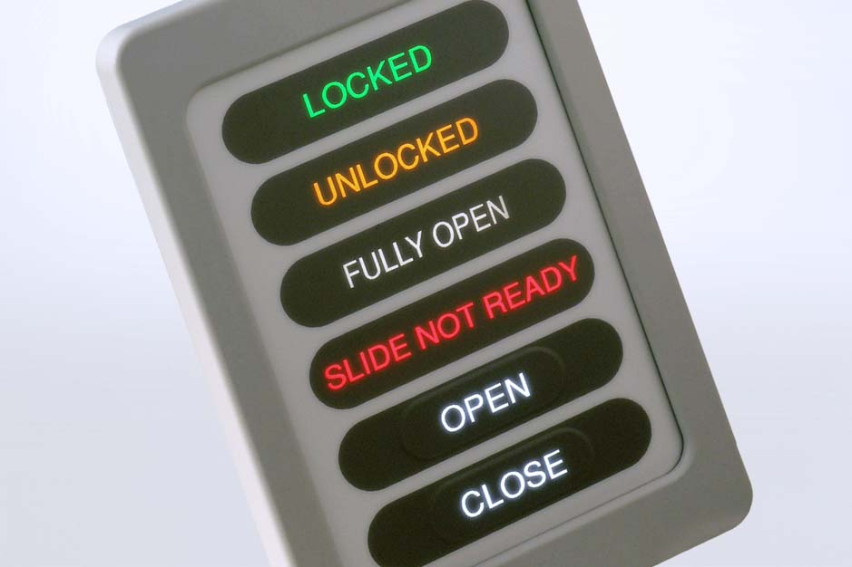
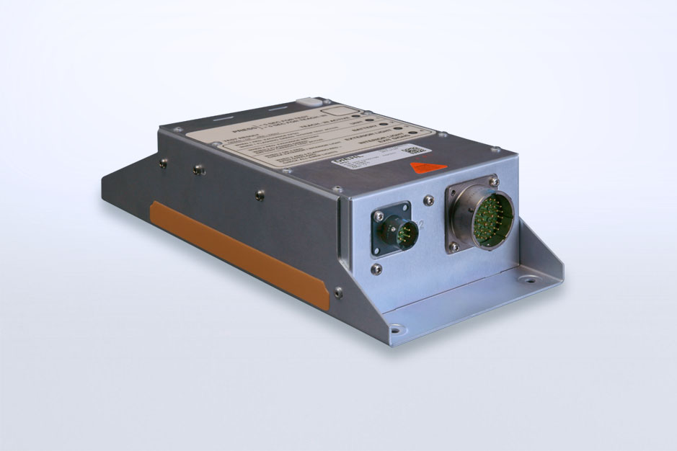
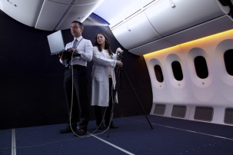
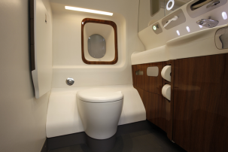
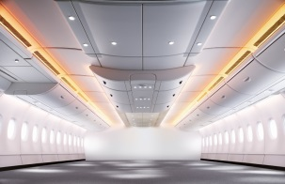
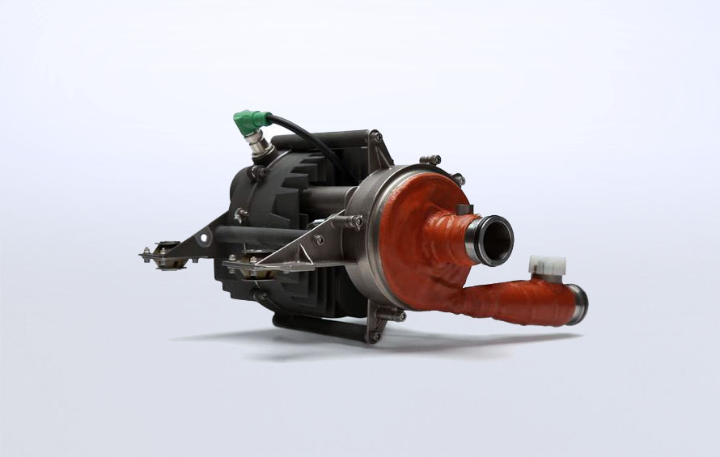
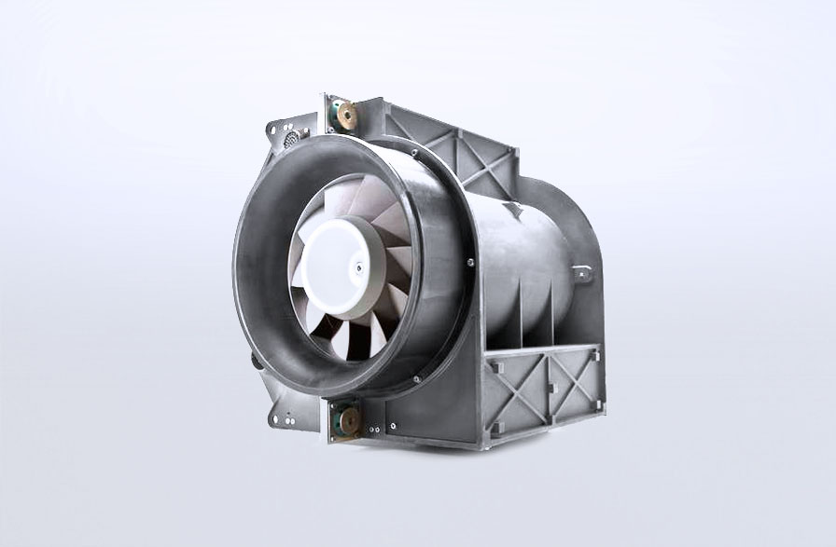
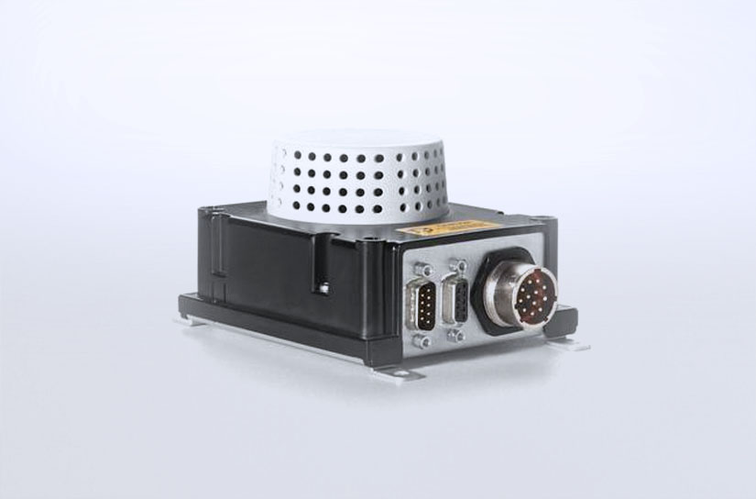
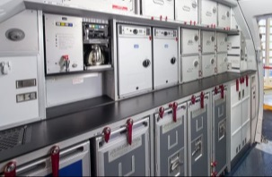
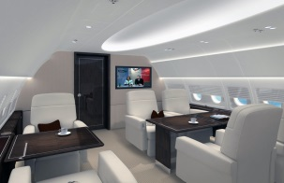
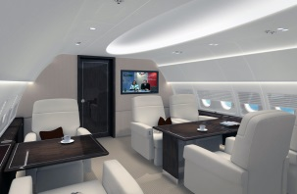

Corporate Division Diehl Aerosystems - Building Blocks
Principles | Operational Units | History | Figures | Corporate Division | Sites | Portfolio | Customers | Acknowledgements | Approvals
Aircraft Systems
Cabin Interiors
Cockpit Systems
Flight & Engine Control Systems
Avionic Platforms
Air Distribution
Systems
Crew Rest
Compartments
Utility Systems
Safety & Supply
Systems
Interior Lighting
Systems
Comfort Modules
Floor-to-Floor/
Lining
Water Management
Air Management
Fire Protection
Service Modules
VIP Furniture
From cockpit to cabin. Fully integrated or individual packages.

Slide 7
Our Presence around the World
Principles | Operational Units | History | Figures | Corporate Division | Sites | Portfolio | Customers | Acknowledgements | Approvals
Everett
Toulouse
Nyírbátor
production
Tianjin
Sterrett
Anniston
Mobile
Abu Dhabi
Dubai
Rostock
development
Singapore
Hamburg
Dresden
Frankfurt
Nuremberg
Development & Production
Customer Support
FAL-Support
Liaison Office
Laupheim
Donauwörth
Oberpfaffenhofen
Überlingen

Slide 8
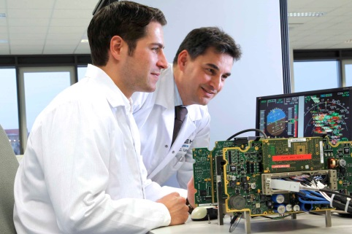
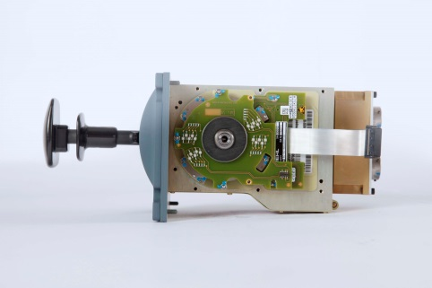
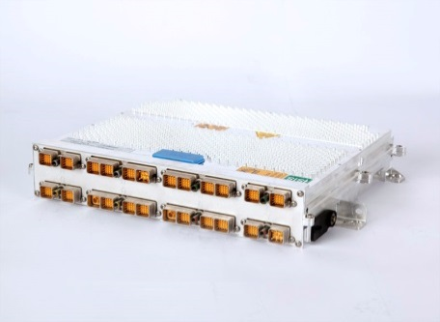
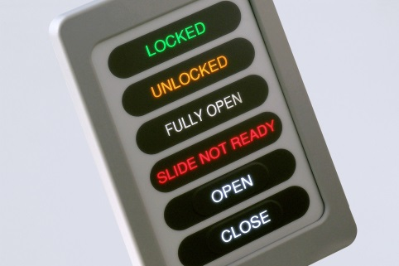
Avionics
Principles | Operational Units | History | Figures | Corporate Division | Sites | Portfolio | Customers | Acknowledgements | Approvals
Cockpit Systems
Flight and Engine Control Systems
Avionics Platforms
Utility Systems
Multi-Function Displays
Display Management Computers
Symbol Generators
Flight Control Units
Operator Control Panels
Instruments & Sensors
Enhanced Lighting Controller
Flight Control Computer & Electronics
Slat Flap Control Computers
Control Sticks
Flaps Lever
Sensors
Engine Control & Monitoring Unit
Electronic Control Boxes for APUs
Motor Management
Integrated Modular Avionics
IMA Tool Suite
Core Processing Input/Output Module (CPIOM)
Common Remote Data Concentrator (cRDC)
AFDX End Systems
Doors & Slides Management System
Privacy Door Locking System
Cabin Management Systems
Fuel Computer
Landing Gear Computer
Sensing

Slide 9
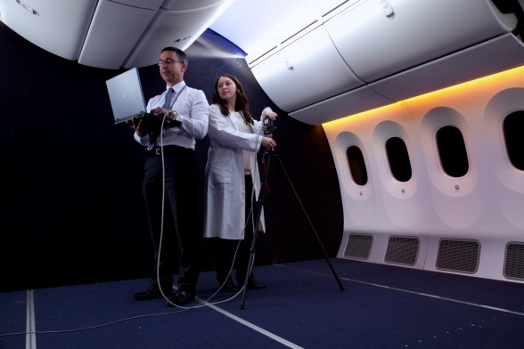
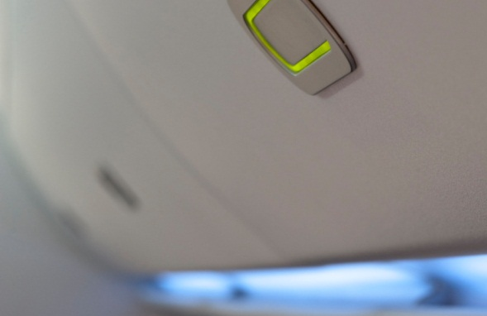
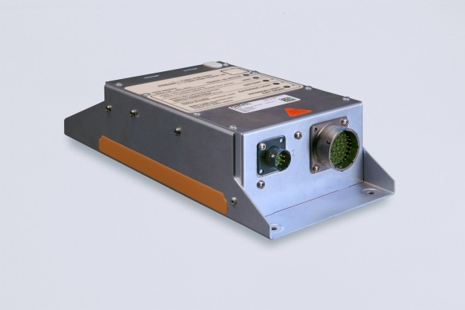
Cabin
Principles | Operational Units | History | Figures | Corporate Division | Sites | Portfolio | Customers | Acknowledgements | Approvals
Interior Lighting
Interior Functions
Safety & Supply Systems
Premium Mood Lighting
Eco-Line LED White and Full Color Cabin Lighting
Dome and Application Lighting
Spotlights, Reading and Work Lights
Monument Lighting
Cargo Compartment Lighting
NVIS and IR Lighting
Full Automatic Hat Rack Functions
Passenger Service Unit Electronics
Noise Masking Units
Powered Window Shades
Heating Panels
Universal Light Adapters
Area Light Controller
Flight Attendant Panels
Emergency Power Supplies
Slide Release Power Supplies
Battery Packs
Emergency Lighting Units
Emergency Signs
Floor Path Marking
Static Inverters
Power Systems

Slide 10
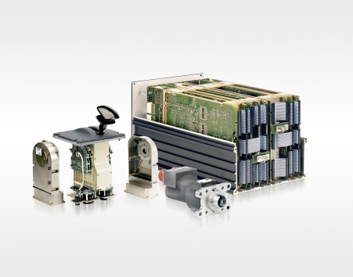
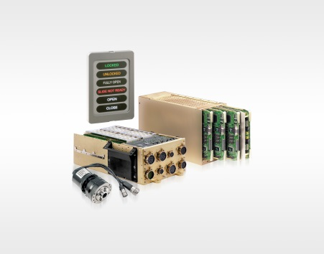
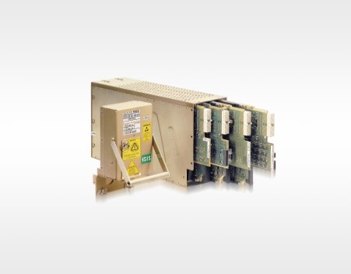
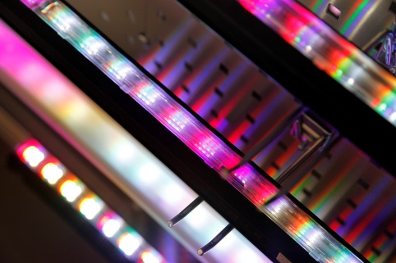
System Expertise
Principles | Operational Units | History | Figures | Corporate Division | Sites | Portfolio | Customers | Acknowledgements | Approvals
Flight Control
Doors & Slides
Management System
Integrated Modular Avionics
Lighting & Interior Functions
Slat Flap Control Computer
Flaps Lever
Position Pick-Off Unit
Doors & Slides Management Control Unit
Local Door Controller
Autonomous Standby Power Supply Unit
Control Panels & Indicators
Sensing
Swivel Actuator
Core Processing Input/Output Module (CPIOM)
Standardized hardware module, I/O capabilities & mechanical packaging
IMA Tool Suite
Cabin Lighting Systems
Cabin Mood Lighting Systems
Emergency Lighting Systems
Starlight Systems
Noise Masking Systems
Full Automatic Hat Rack Systems

Slide 11


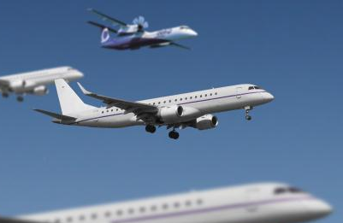
Overview Civil Portfolio
Principles | Operational Units | History | Figures | Corporate Division | Sites | Portfolio | Customers | Acknowledgements | Approvals
Airbus
Boeing
Embraer/Bombardier
High Lift Control
Cabin & Utility Control System
Cockpit & Display Systems
Engine Control
Interior Lighting Systems & Applications
Emergency Lighting Systems
Cargo Lighting
IMA Platform / AFDX
Cabin Lighting Systems
Lighting Applications
Starlight Systems
High Lift Control Application
Powered Window Shades
Cabin Lighting Systems
Flight Attendant Panels
Emergency Lighting Systems

Slide 12
Organisation der SW-Entwicklung
Standortübergreifende Engineering Organisation
Insgesamt 90 Entwickler in der SW-Entwicklung
Größter Anteil der Entwickler (40) in Frankfurt
Verschiedene Schwerpunkte
Türsysteme
Integrierte Modulare Avionik (zentral und dezentral)
Grafikentwicklung
Flight Control
Beleuchtung
Kabinenmanagement
Tool Development (Code- und Configgeneratoren, Monitor- und Testtools)

Slide 13
Standards der SW-Entwicklung
Wichtigster Standard: DO-178B/C
DO-178B gilt seit 1992
DO-178C wurde 2011 verabschiedet
Zusätzlich Supplements für Tool-, objektorientierte und modellbasierte Entwicklung sowie formale Methoden
5 Kritikalitätsstufen
Level | Failure condition | Objectives | With independence
A | Catastrophic | 71 | 33
B | Hazardous | 69 | 21
C | Major | 62 | 8
D | Minor | 26 | 5
E | No Safety Effect | 0 | 0

Slide 14
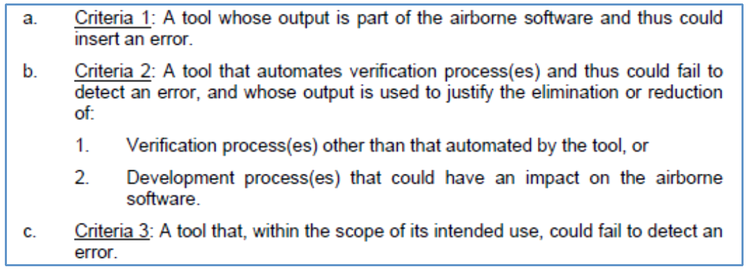
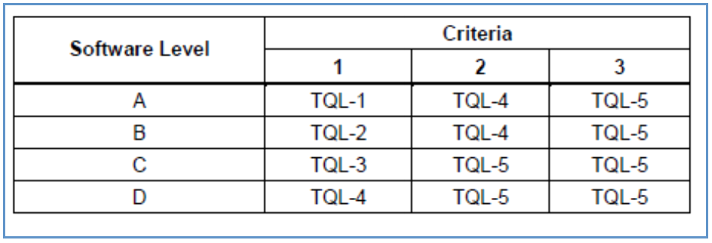
Standards der SW-Entwicklung
Tool Qualification
In DO-178B wird unterschieden zwischen
Development Tools
Verification Tools
In DO-178C wurde dies verfeinert

Slide 15

V Modell SW Entwicklung
SES
Tests
SRD
Tests
SDD
Tests
CODE

Slide 16



DAs SW Toollandschaft
Methodenverbesserungen ASSET
Trace
Unterschiedliche Tools (*)
Hoher Aufwand für Dokumentengenerierung (**)
Hoher Aufwand der Konsistenzhaltung im Config Management (**)
Unterschiedliche Methoden (*)
Hoher manueller Aufwand für „Bruchpflege“
Unmögliche Komplexitäts- und Aufwandschätzung (*) (**)
Hoher Aufwand der Review-Aktivitäten über Toolgrenzen
Hoher Aufwand der Dokumentation (Ausfüllen von Checklisten)
Trace
IBM DOORS
Configuration Management
PR Handling
Planung
Komplexität
Aufwand
Excel
IVT
Development
Development
IBM DOORS
Review
Review
Trace
IBM Rhapsody
Enterprise Architect
RTRT
Cantata
SCADE
Matlab / Simulink
Excel
Development
Trace
Development
Review
Review
Trace
Eclipse CDT
Notepad++
PCLint
QA-C
PFD
JEdit
Excel
Development
Review
Tool- und Methodenbruch
Manueller Aufwand

Slide 17
Diehl Aerospace GmbH
Alte Nussdorfer Str. 23
88662 Überlingen
Phone +49 7551 891 0
Fax +49 7551 891 4001
Diehl Aerospace GmbH
An der Sandelmühle 13
60439 Frankfurt
Phone +49 69 5805 0
Fax +49 69 5805 1399
Diehl Aerospace GmbH
Donaustr. 120
90451 Nuremberg
Phone +49 911 9494 0
Fax +49 911 9494 209
www.diehl-aerospace.com

