Slide 1

IETS3: ZF-Participation

Slide 2

THE POWER OF² Key figures
The new ZF Group – An Overview
 | ZF (incl. TRW) | ZF | TRW
Sales | > € 30 billion | € 18.4 billion | € 13 billion
Employees | 134,000 | 71,000 | 63,000
R&D expenditure | € 1.6 billion | € 891 million | € 720 million

Slide 3
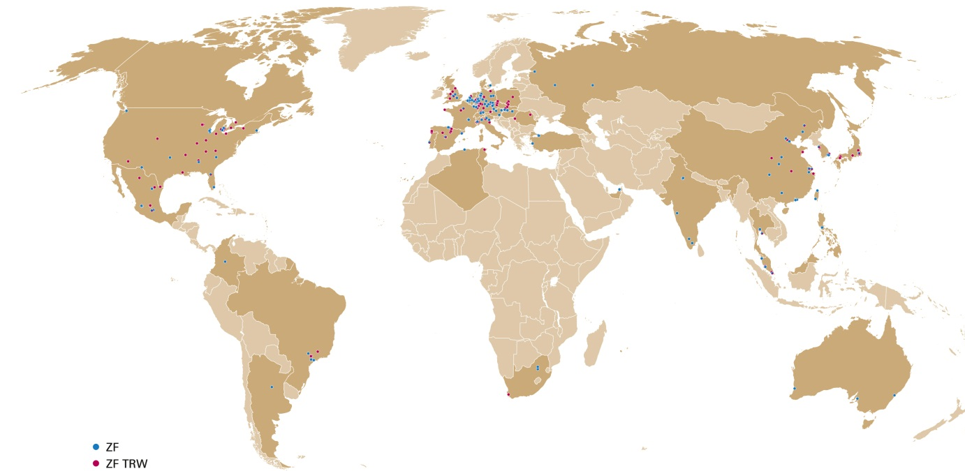
Key Figures Locations
Worldwide Presence with Production, Development, Sales
230 | Locations
17 | Main development locations
77 650 | Service locations Service partners

Slide 4
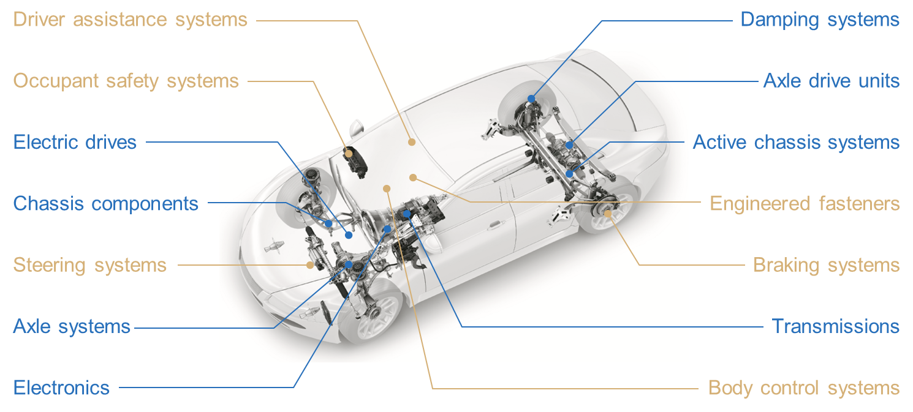
THE POWER OF² Product Portfolio
ZF
TRW
Notes:
Our portfolio is very balanced in terms of industry coverage, customer outreach and global footprint.
We combine ZF’s driveline and chassis technologies, incl. e-mobility solutions and electronics, with TRW’s safety, steering, braking, and autonomous driving technologies.
We use the opportunity to leverage TRW’s car-focused products to further expand ZF’s diversified portfolio across multiple industries.
We bring together ZF’s premium with TRW’s volume customer access.
We integrate ZF’s strength in Europe with TRW’s strength in North America, and develop a joint approach to reach a comparable position in Asian growth markets.
Complemented by a comprehensive and strong aftermarket, this gives us broad market coverage to build on.

Slide 5
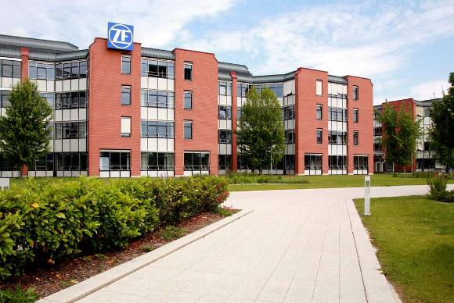
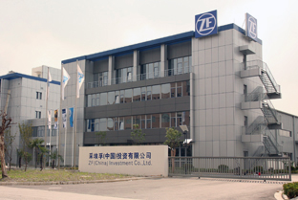
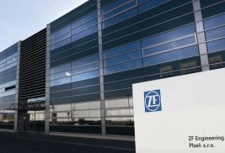
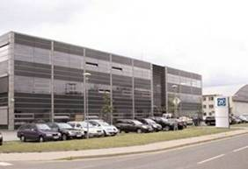
Zentrale Elektronikentwicklung - Standorte Weltweit
Standorte Weltweit
Friedrichshafen
Deutschland
Shanghai
China
Pilsen
Tschechien
Elektronikentwickler an den Standorten:
ca. 430 MA ZF ca. 15 MA ZF ca. 120 MA ZF ca. 100 Externe

Slide 6
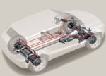
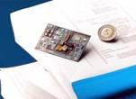
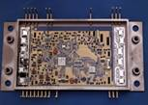
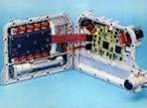

Zentrale Elektronikentwicklung - Kompetenzfelder
Vernetzte
Systeme
Software
Steuergeräte
Mechatronik
E-Komponenten
Einrichtungen
Prozesse
Systemanalyse
und –Design
Software für
Hybrid-Systeme
Funktionale und
elektronische Systemvernetzung
Bordnetzsysteme
Funktions- und Softwarestrukturen
Software Design
Steuer- und Regelfunktionen
Industrielle
SW-Produktion
Hardware Design
Signal- und Leistungselektronik
Energiemanagement
EMV
Bussysteme
Module
Sensoren
Aktuatoren
Elektrische Stell-
und Fahrantriebe
Aufbau- und Verbindgstechnik
Verkabelung
Funktions/-Umwelt/-Lebens-dauertests
EMV-Tests
Virtual Prototyp,
Hardware/Softw. in the Loop
Qualität, Entwicklungsprozesse, Methoden und Tools

Slide 7
Managing SW-Requirements – Today
Requirements are managed using IBM’s DOORS
Most of the requirements are textual
Some requirements are semi-formal
Safety-Requirements (ASIL-C/D)
State-Machines or similar
Three level concept:
L1: Customer requirements, Norms & Laws, FMEA
L2: System requirements, Safety concept
L3: Software requirements
Variant handling
Many projects use the same requirements but with different input data (e.g. parts of the algorithms are disabled, different data settings etc. )
Use a second DOORS module with variant information integrated into master module
Evaluation based on link coverage
L1: Requirements
Acceptance Test
L2: Requirements
System Test
L3: Requirements
Module Test
Master DOORS-Module
DXL
Variant Information

Slide 8
IETS3 software at ZF’s
Intended use of the software
Increase quality of requirements
Fulfill ISO26262 standard
Assessment of requirements
Nightly evaluation of requirements
Enhance writing of requirements
Guideline for the developers
Similar structure for requirements
Code completion and alike as support for the developers
Requirements to be use to test IETS3
ASIL-D (highest safety level) requirements used for electrical power steering
122 textual elements written in DOORS
Most of the requirements deals with a closed loop controller architecture

Slide 9

Thank you

