Slide 1

Uiua

Slide 2
Description
Array oriented
Stack based
Interpreted / Compiled
Concise and tacit

Slide 3
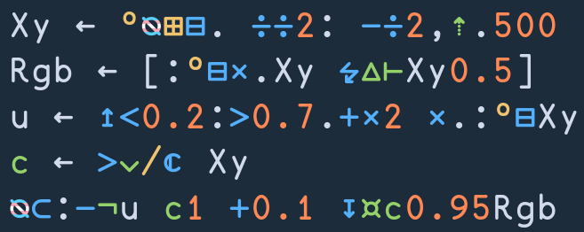
Examples

Slide 4
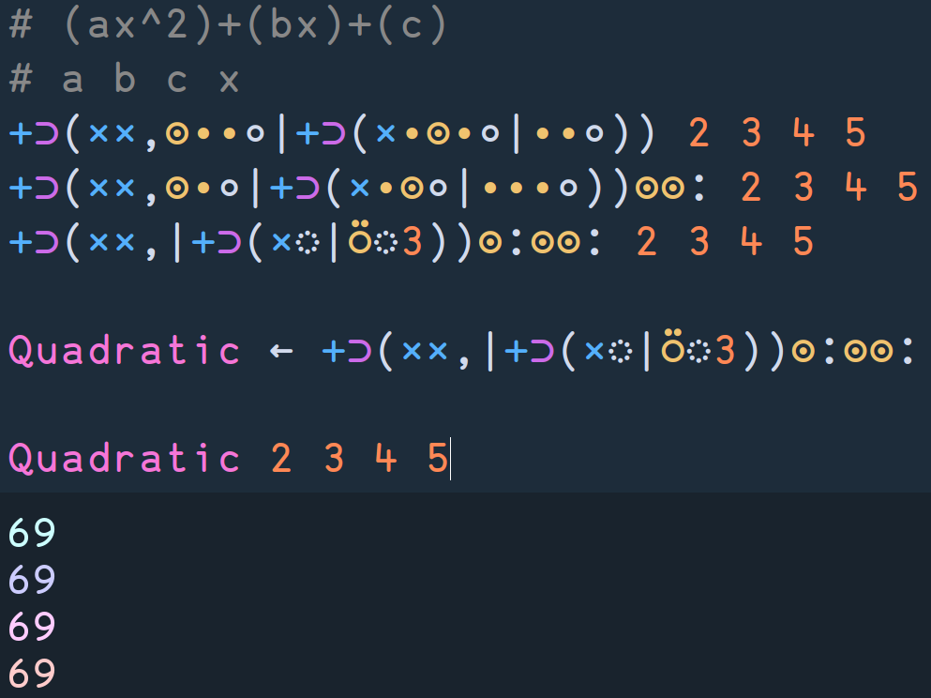
Example

Slide 5
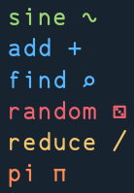
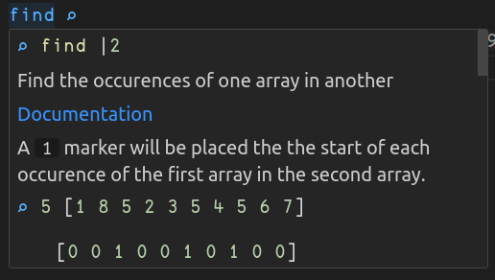
Symbols
Single unicode character
Hard to read but less space
Full name available
IDE integration (LSP)

Slide 6
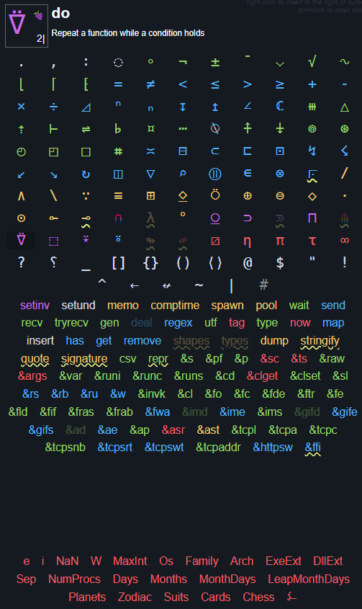
Uiua keyboard
Lists sortcuts to all Uiua functions.
Also display a short explanation of a symbol when hovering it.

Slide 7
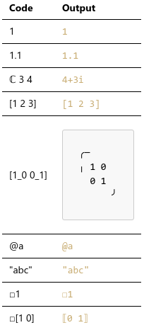
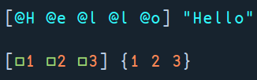
Types
Number
Int, float, complex
Array
Multi-dimensional
Different shape → different type
Only 1 type per array
Character
Strings as arrays of chars
Box
Bypass 1 type per array limitation

Slide 8
Functions
Not a type
Inferable signature
No named params (stack)
Pervasives operations
System functions
Media types
FFI

Slide 9




Function Examples
Uiuisms:
Find the nth fibonacci number
Dot product
Stack-idioms:
“ABAB”
“BAA”

Slide 10
Project
Image creation app
Array manipulation
Predefined shapes
Curves
Saving in different formats
System functions
Graphical interface
FFI

