Slide 1
Slides with code
Vincent Guillemot

Slide 2
Import COVID data
covid <- read_csv("data/covid.csv") covid
# A tibble: 32 × 582 id time status ABCB1 ABL1 ADA AHR AICDA AIRE APP ARG1 ARG2 <chr> <dbl> <chr> <dbl> <dbl> <dbl> <dbl> <dbl> <dbl> <dbl> <dbl> <dbl> 1 HC59 0 HC 7.43 6.33 6.87 9.31 3.97 4.23 9.34 6.93 4.87 2 HC60 0 HC 7.71 6.28 7.34 8.78 4.6 4.44 9.23 6.74 3.74 3 HC68 0 HC 7.01 6.02 7.09 8.69 3.95 3.81 9.02 5.72 4.66 4 HC98 0 HC 7.44 6.47 7.31 8.74 3.73 3.73 9.06 6.77 3.83 5 HC74 0 HC 7.48 6.53 7.14 9.6 3.89 4.33 9.45 6.24 3.99 6 HC88 0 HC 7.25 6.58 7.13 10.1 3.93 3.88 9.34 7.92 3.88 7 HC91 0 HC 7.52 6.21 7.06 8.84 4.17 4.17 9.56 7.65 3.66 8 HC94 0 HC 6.84 6.51 7.59 9.41 3.77 3.95 9.39 6.96 3.95 9 HC75 0 HC 7 6.22 7.07 9.34 3.82 4.71 9.41 6.68 3.82 10 HC76 0 HC 7.27 6.41 6.41 9.4 4.88 3.86 9.08 4.83 3.86 # ℹ 22 more rows # ℹ 570 more variables: ARHGDIB <dbl>, ATG10 <dbl>, ATG12 <dbl>, ATG16L1 <dbl>, # ATG5 <dbl>, ATG7 <dbl>, ATM <dbl>, B2M <dbl>, B3GAT1 <dbl>, BATF <dbl>, # BATF3 <dbl>, BAX <dbl>, BCAP31 <dbl>, BCL10 <dbl>, BCL2 <dbl>, # BCL2L11 <dbl>, BCL3 <dbl>, BCL6 <dbl>, BID <dbl>, BLNK <dbl>, BST1 <dbl>, # BST2 <dbl>, BTK <dbl>, BTLA <dbl>, C14orf166 <dbl>, C1QA <dbl>, C1QB <dbl>, # C1QBP <dbl>, C1R <dbl>, C1S <dbl>, C2 <dbl>, C3 <dbl>, `C4A/B` <dbl>, …

Slide 3
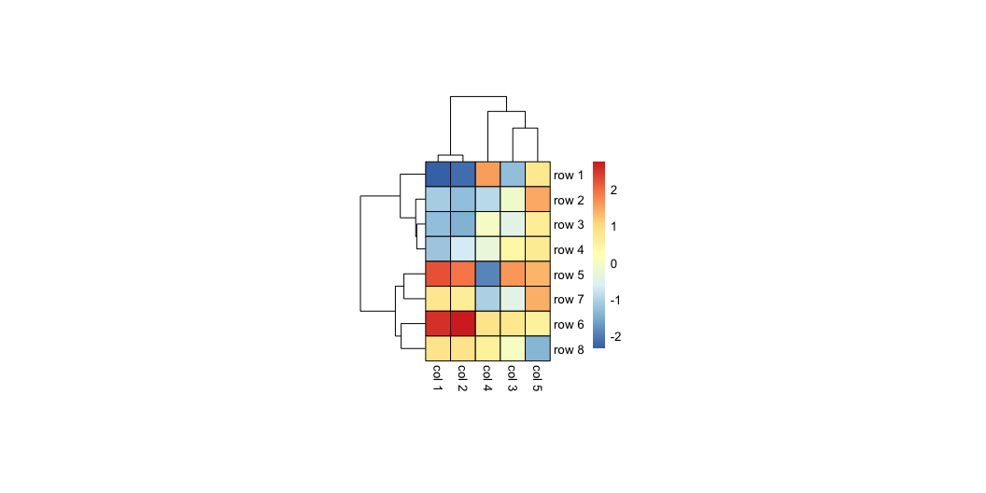
Pheatmap (small)
library(pheatmap) I <- 8 J <- 5 set.seed(543) sig <- Matrix::bdiag( 0.8 + diag(0.2, 3), -0.7 + diag(1.7, 2)) mat <- rbind( MASS::mvrnorm( n = I/2, mu = c(-1, -1, 0, 0, 1), Sigma = sig), MASS::mvrnorm( n = I/2, mu = c(1, 1, 0, 0, 0), Sigma = sig)) rownames(mat) <- sprintf("row %i", 1:I) colnames(mat) <- sprintf("col %i", 1:J) pheatmap( mat = mat, clustering_method = "ward.D2", cellwidth = 20, cellheight = 20, border_color = "black")

Slide 4
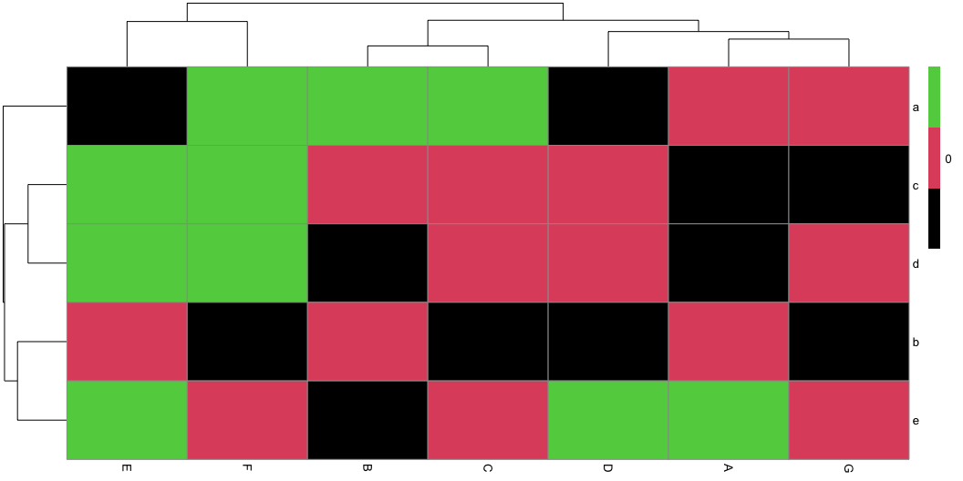
Pheatmap demo
library(pheatmap) M <- matrix(rnorm(35), 5, 7) dimnames(M) <- list(letters[1:5], LETTERS[1:7]) pheatmap(mat = M, color = 1:3, legend_breaks = c(-2, 0, 2))

Slide 5
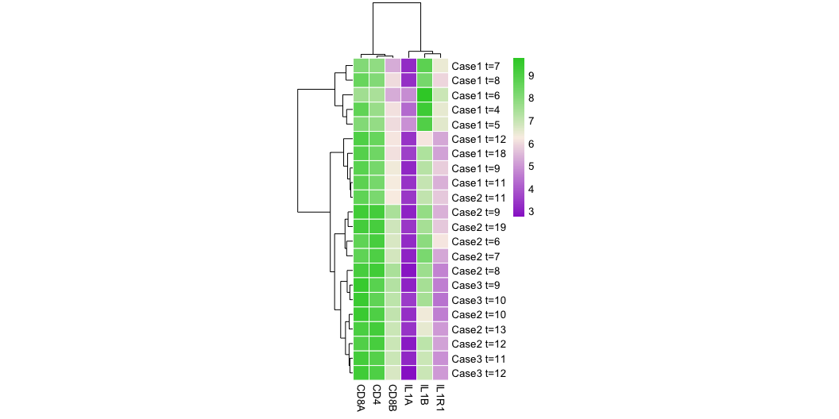
Pheatmap example
library(pheatmap) select_cases <- covid$status == "nCOV" minicovid <- as.data.frame(covid[select_cases, c("IL1A", "IL1B", "IL1R1", "CD4", "CD8A", "CD8B")]) rownames(minicovid) <- with(covid[select_cases,], paste0(id, " t=", time)) pheatmap(minicovid, clustering_method = "ward.D2", clustering_distance_cols = as.dist(1 - cor(minicovid)), cellwidth = 15, color = colorRampPalette(c("darkorchid3", "linen", "limegreen"))(100), border_color = "white")

Slide 6
Simple dplyr
covid %>% filter(status == "HC") %>% select(IL1R1) %>% summarize(meanIL1R1 = mean(IL1R1))
# A tibble: 1 × 1 meanIL1R1 <dbl> 1 5.2

Slide 7
Grouping and summarizing
Grouping with group_by
covid |> group_by(id) |> select(id, time, status, IFNG)
# A tibble: 32 × 4 # Groups: id [13] id time status IFNG <chr> <dbl> <chr> <dbl> 1 HC59 0 HC 4.31 2 HC60 0 HC 5.35 3 HC68 0 HC 5 4 HC98 0 HC 5.11 5 HC74 0 HC 4.73 6 HC88 0 HC 5.35 7 HC91 0 HC 5.78 8 HC94 0 HC 4.31 9 HC75 0 HC 5.05 10 HC76 0 HC 4.93 # ℹ 22 more rows
Summarizing with summarize
covid |> group_by(status) |> summarize(mean_IFNG = mean(IFNG))
# A tibble: 2 × 2 status mean_IFNG <chr> <dbl> 1 HC 4.99 2 nCOV 4.12

Slide 8
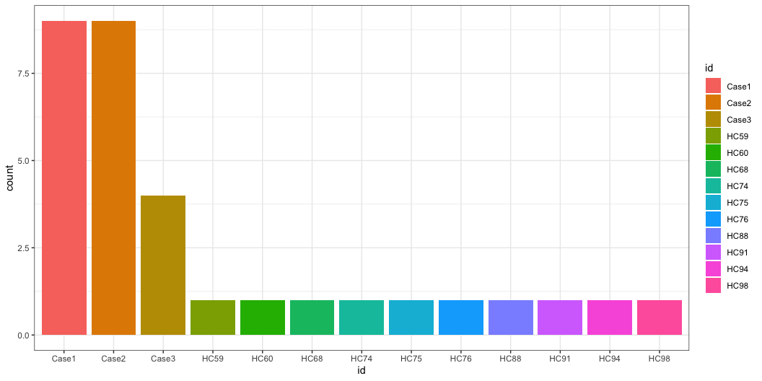
Barplot of the number of observations per subject
covid |> ggplot(aes(id, fill = id)) + geom_bar()

Slide 9
Implémentation dans ggplot2
Données | data | Les données à représenter. Chaque ligne représente un élément à représenter graphiquement.
Géométries | geom_ | Les formes à créer pour représenter les données. Cela peut être des points, des lignes, des surfaces etc.
Esthétiques | aes() | Les paramètres esthétiques de ces formes. Par exemple la position, la couleur, la taille, la forme, la transparence etc.
Échelles | scale_ | Des fonctions permettant de paramétrer la transformation de données en formes ou en objets graphiques. Par exemple la fonction scale_color_manual permet de choisir soi-même les couleurs à utiliser dans un graphique.

Slide 10
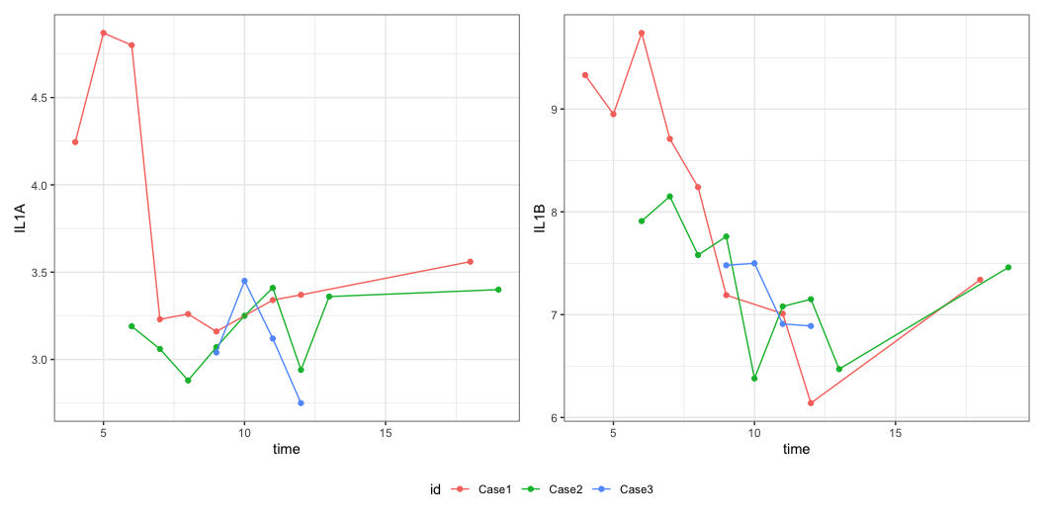
Patchwork
il1a <- covid |> filter(status == "nCOV") |> ggplot(aes(x = time, y = IL1A, color = id)) + geom_point() + geom_line() il1b <- covid |> filter(status == "nCOV") |> ggplot(aes(x = time, y = IL1B, color = id)) + geom_point() + geom_line() (il1a | il1b ) + plot_layout(guides = "collect") & theme(legend.position = "bottom")

