Slide 1
The R Day
Vincent Guillemot

Slide 2



$$≠$$

Slide 3
Today’s program
10:45–12:45 : Session 1
14:30–16:00 : Session 2
16:30–18:30 : Session 3
My first R Markdown report
Using dplyr
Using ggplot2

Slide 4
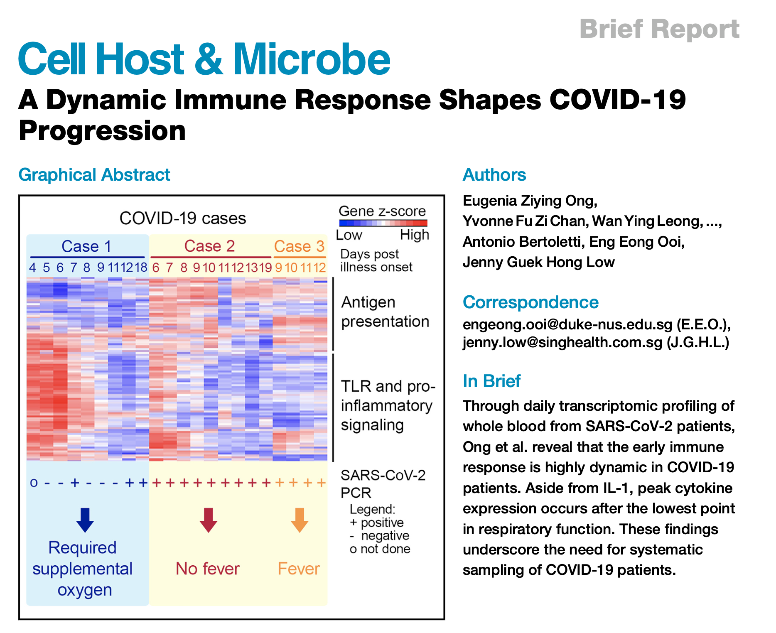
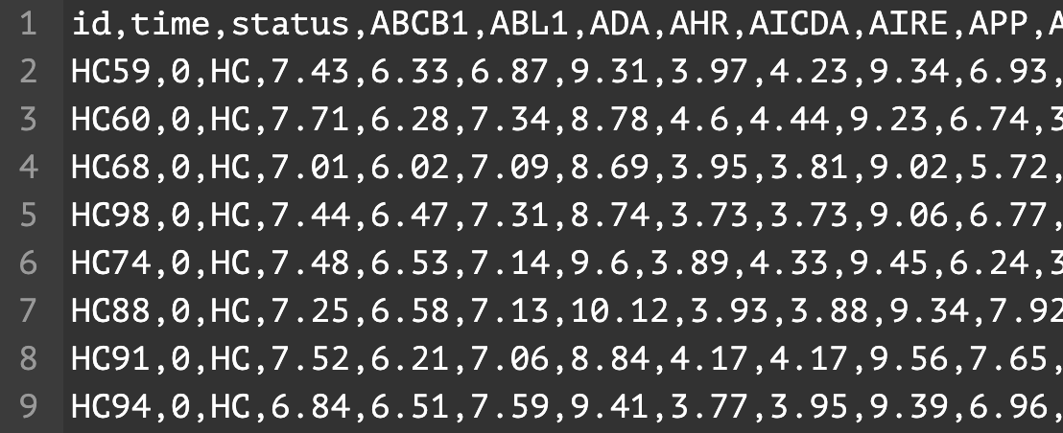
Today's dataset
Scenario: I want to produce a nice figure and a short report for my boss.
The data is called “covid.csv”… let’s take a look!
Which R command would you use to import this data into the environment?

Slide 5
A few practical details…
Training material:
On Moodle!
In /shared/projects/2514_ebiii_n2/01_R
R and Rstudio
OnDemand
On your laptop ( see here to install R and Rstudio https://posit.co/download/rstudio-desktop/)
R >= 4.3.0
Rstudio >= 2024
If the OS on your laptop is too outdated……….

Slide 6

Welcome Quiz

Slide 7
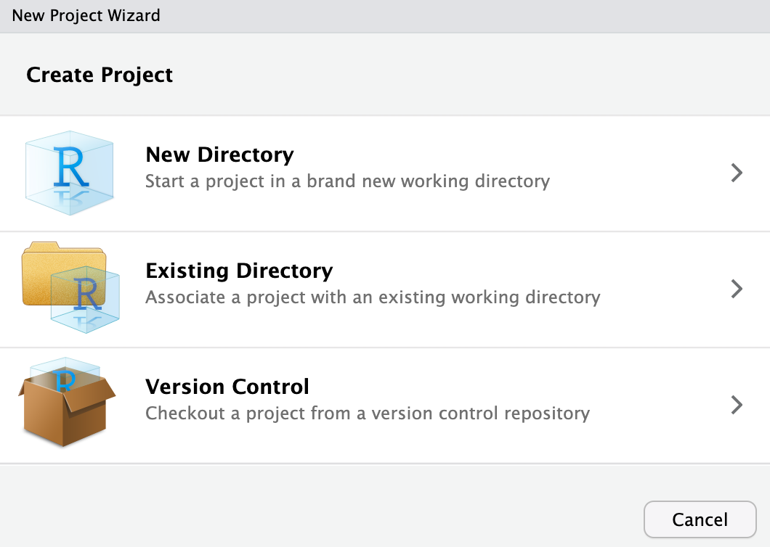
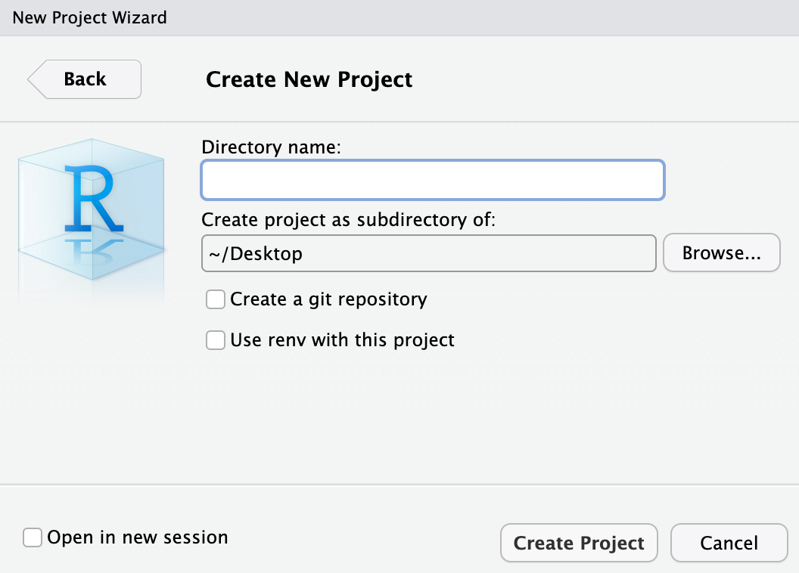
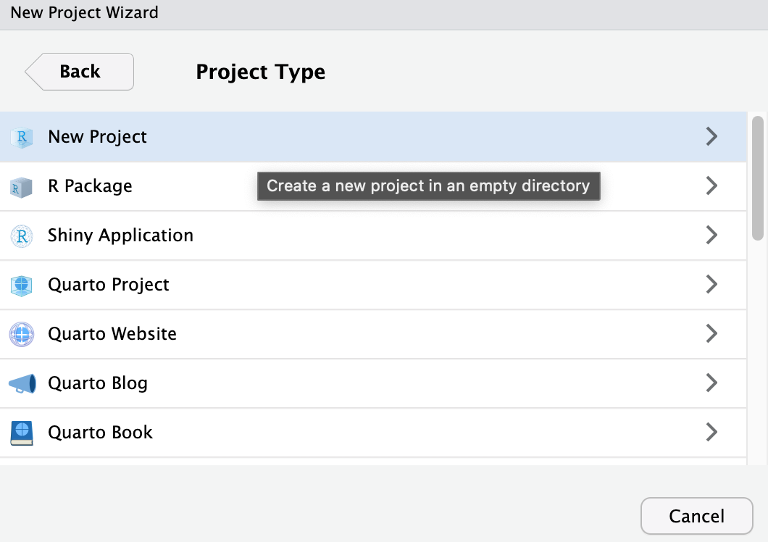
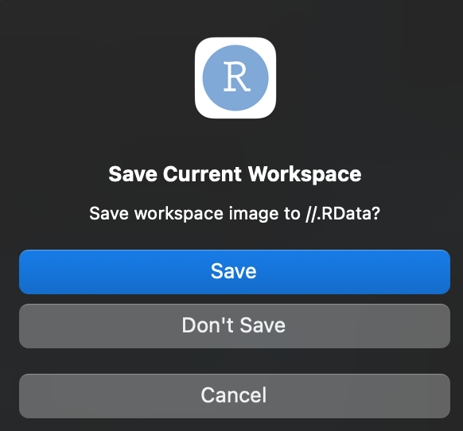
Before we move on…
Let’s create a project
File > New Project… >

Slide 8
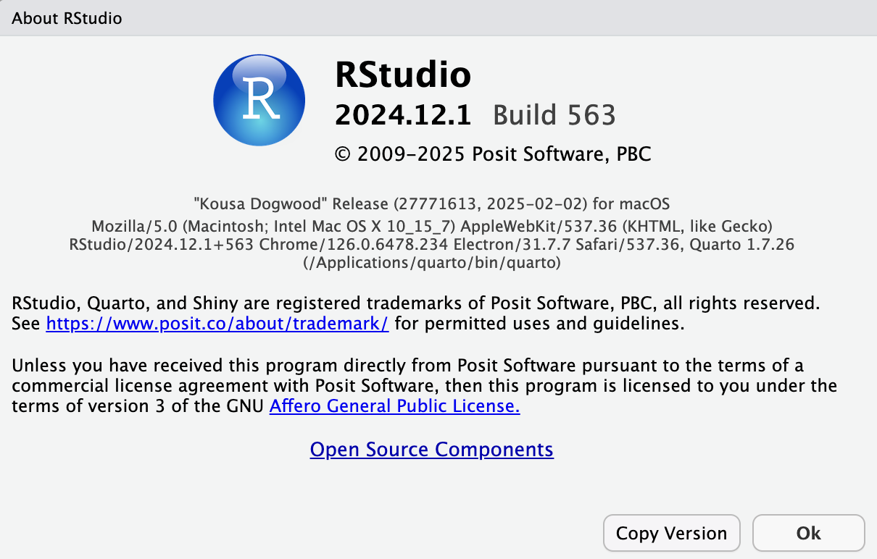
Exercise: shared script
Share your current Rstudio version in the shared script:
Help > About Rstudio + “Copy Version”
Link to shared script

