Slide 1
Complements
Vincent Guillemot

Slide 2
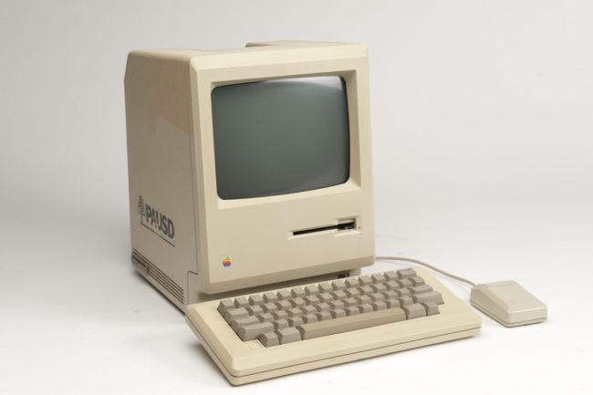
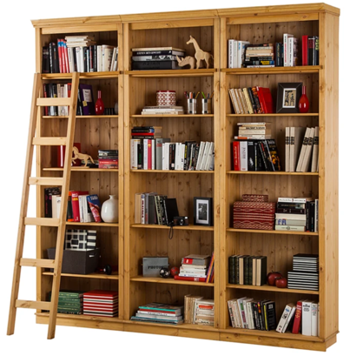
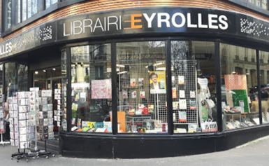



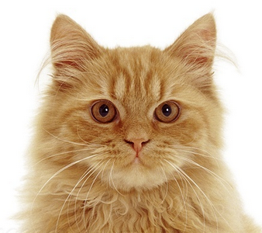
Package installation with Fripouille
ouaf()
install.packages(”dog")
library(dog)

Slide 3
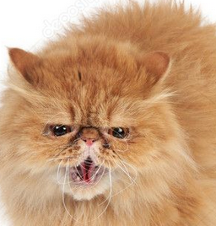
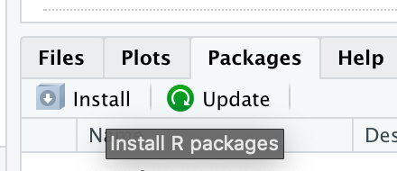
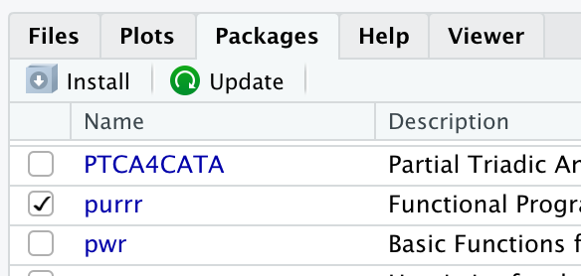
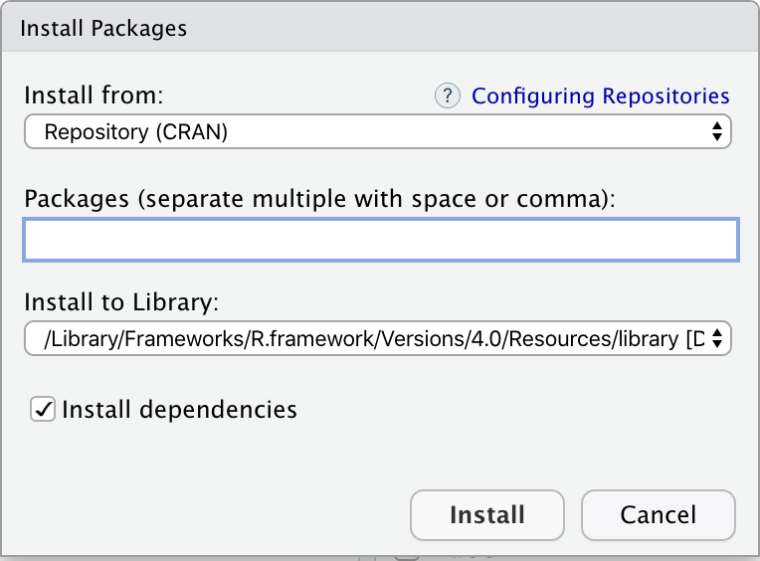
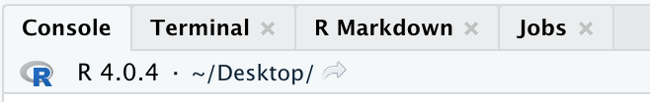
I forgot the names of the commands!
Installation : just once*
Load the library: when needed
(frequently)
> library(purr)
> aFunctionThatILike(42)
*Except to reinstall or update, of course

Slide 4
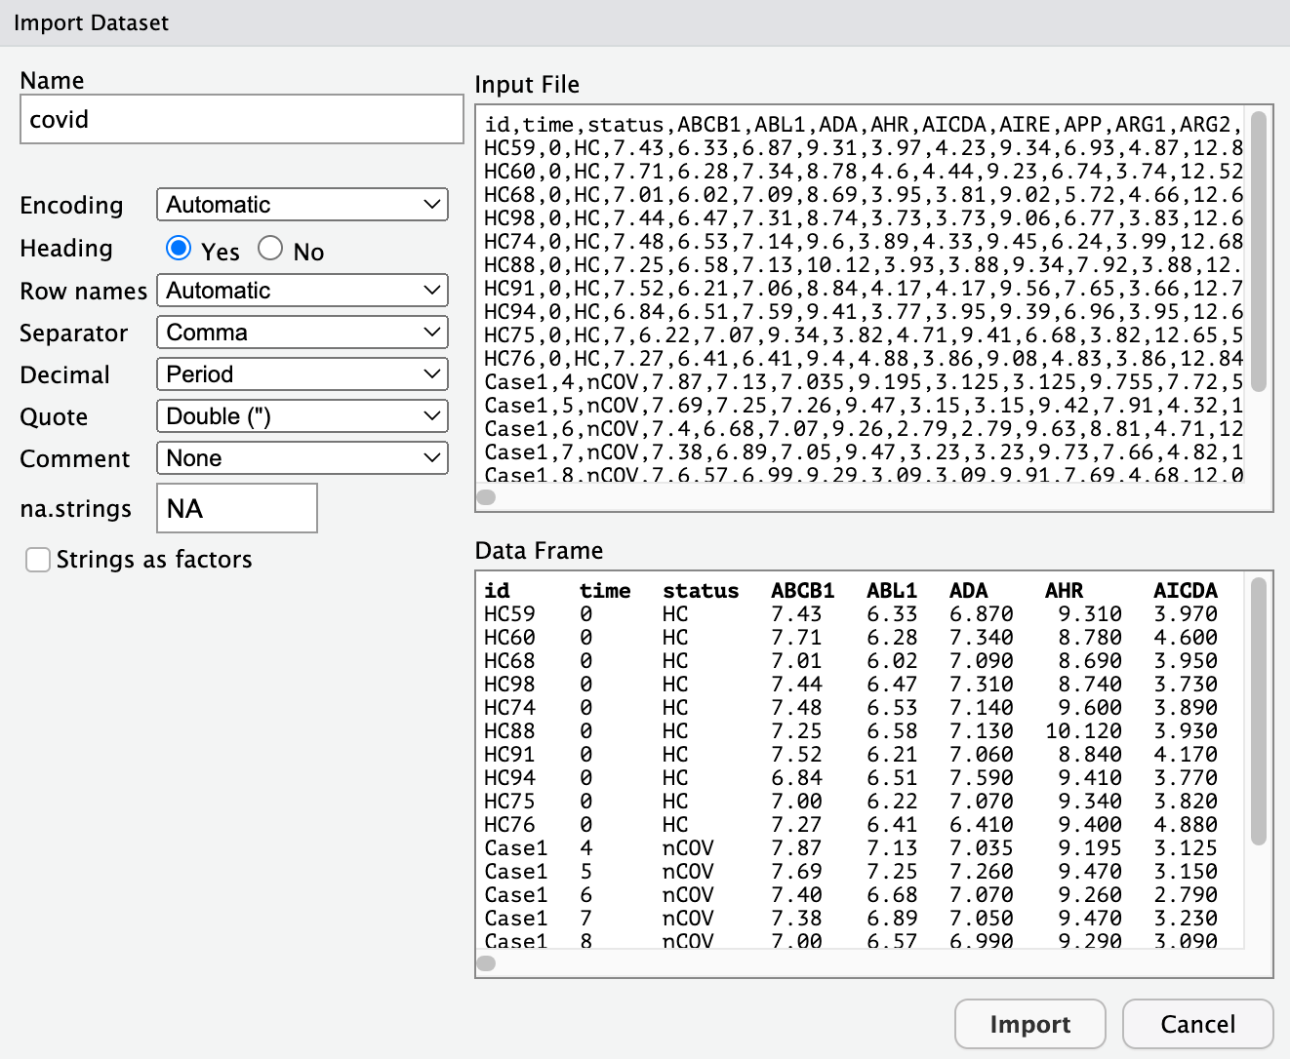
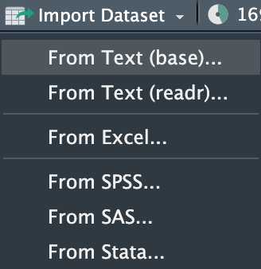
Import data (with a little help from Rstudio)
Import Dataset > …
Save the commands in your script: covid <- read.csv("covid.csv")
View(covid) Yes, it’s useful! (and add comments)

Slide 5
Extract rows and columns with [,] or $
With a dollar sign
covid$IFNG
With integers
covid[, c(1, 2, 4, 156)]
With booleans
covid[covid$status != "HC", ]
With character strings…
covid[, c("IFNG")]
Or with combinations of one or several techniques
covid$IFNG[covid$status == "HC"]
covid[covid$status == "nCOV", 1:3]
covid[
covid$status == "nCOV",
c("IL1A", "IL1B", "IL1R1")]

Slide 6
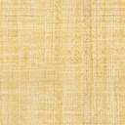
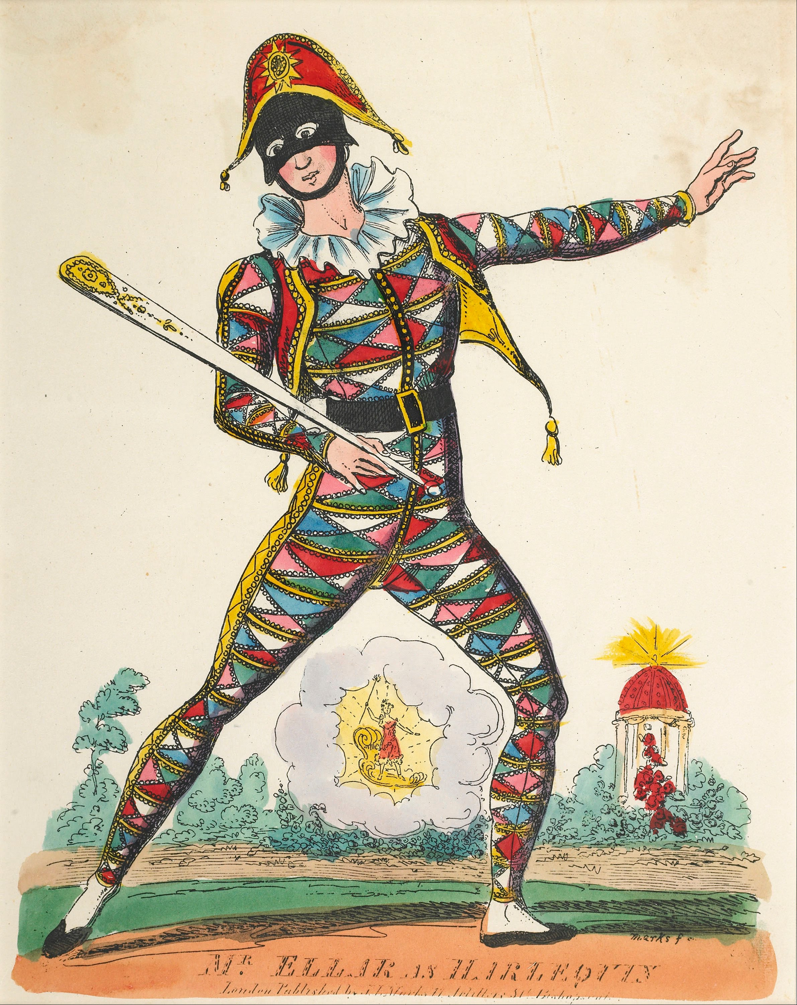
Colors: the colourpicker Add-in
(super useful)
CC BY-SA

Slide 7
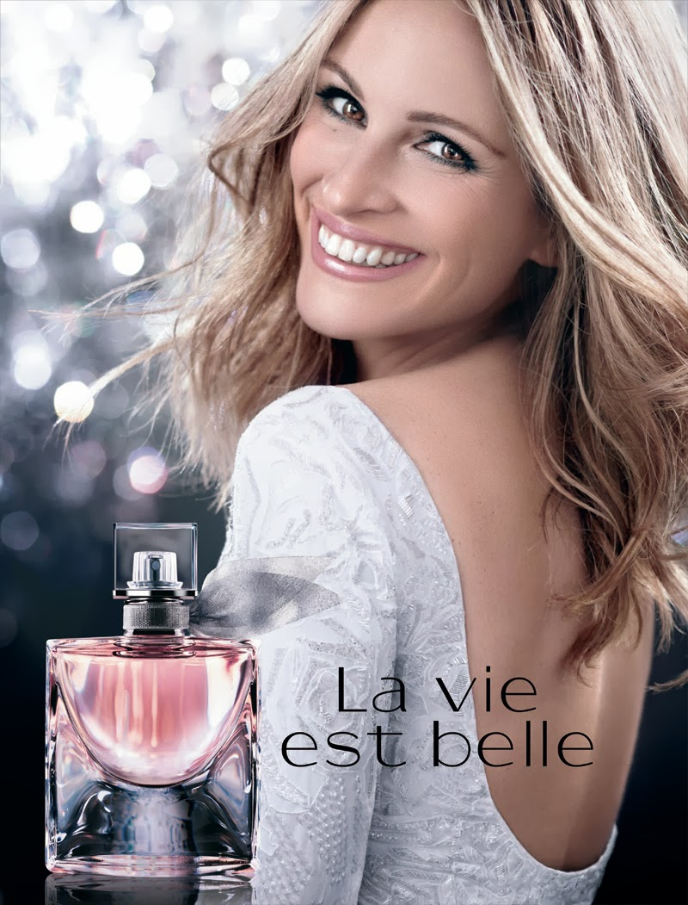
pheatmap: “Pretty” heatmaps
Cette photo par Auteur inconnu est soumise à la licence CC BY-NC-ND

Slide 8
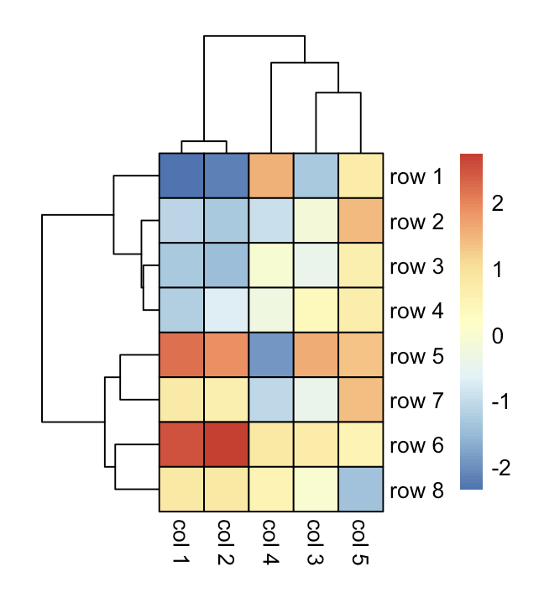
What is it?
 | col 1 | col 2 | col 3 | col 4 | col 5
row 1 | -2.34 | -2.16 | -1.28 | 1.54 | 0.75
row 2 | -1.10 | -1.30 | -0.11 | -0.96 | 1.45
row 3 | -1.29 | -1.47 | -0.44 | -0.02 | 0.65
row 4 | -1.18 | -0.67 | 0.39 | -0.30 | 0.70
row 5 | 2.22 | 1.92 | 1.60 | -1.90 | 1.34
row 6 | 2.53 | 2.75 | 0.75 | 0.86 | 0.52
row 7 | 0.78 | 0.65 | -0.41 | -1.03 | 1.38
row 8 | 0.84 | 0.83 | 0.00 | 0.56 | -1.39

Slide 9
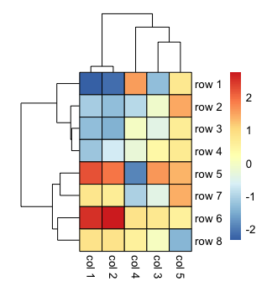
Composition
Dendrogram of the columns
Legend (color of the cells)
Dendrogram of the rows

Slide 10
Demo
library(pheatmap)
M <- matrix(rnorm(35), 5, 7)
dimnames(M) <- list(letters[1:5], LETTERS[1:7])
pheatmap(mat = M)

Slide 11
Exercise
Create a heatmap of the expression of genes IL1A, IL1B, IL1R1, CD4, CD8A, and CD8B.
Bonus constraints:
show only cases
use Ward agglomeration method
use a correlation distance on the columns
change the colors
….

