Slide 1
Introduction to dplyr
Vincent Guillemot

Slide 2

Cheatsheet
data-transformation.pdf

Slide 3
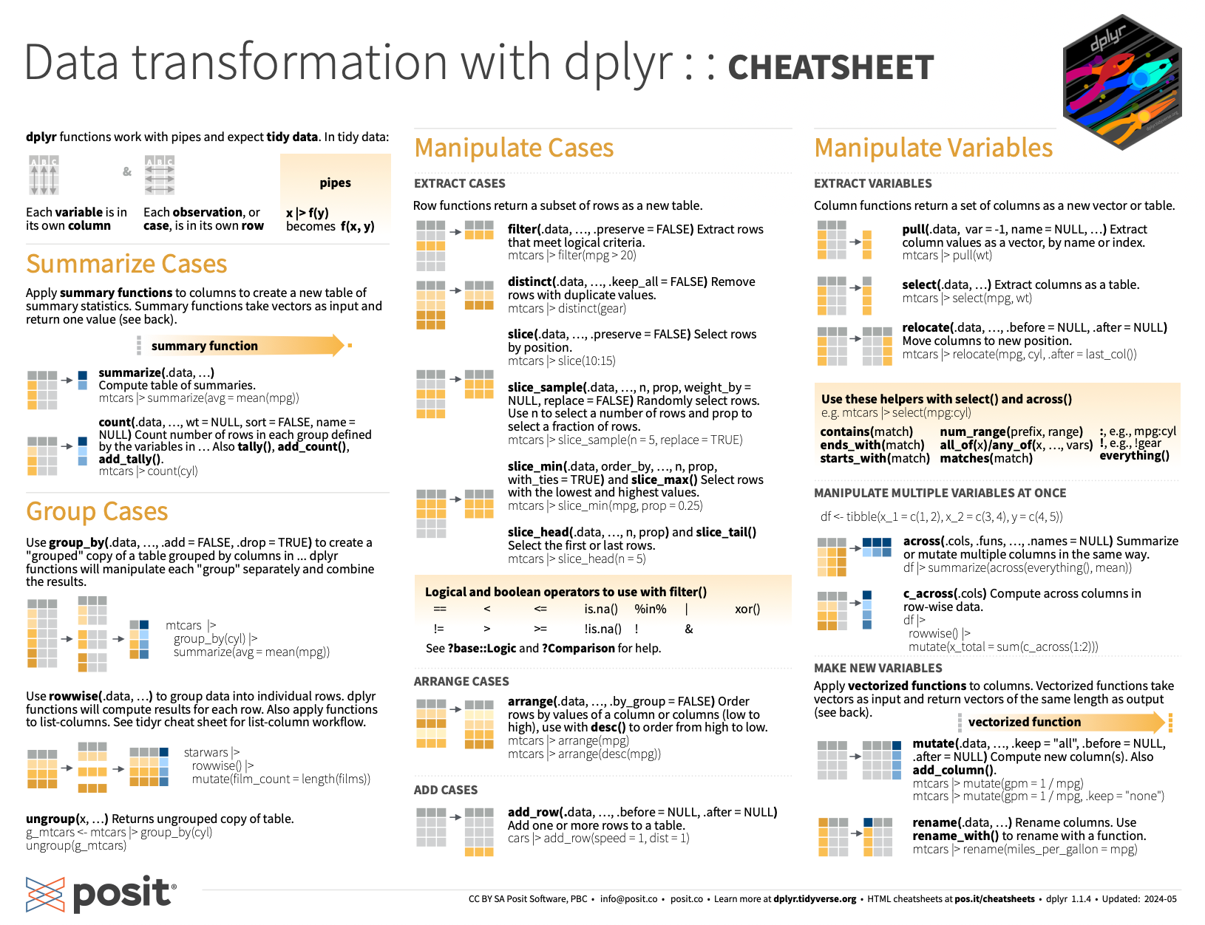

Slide 4
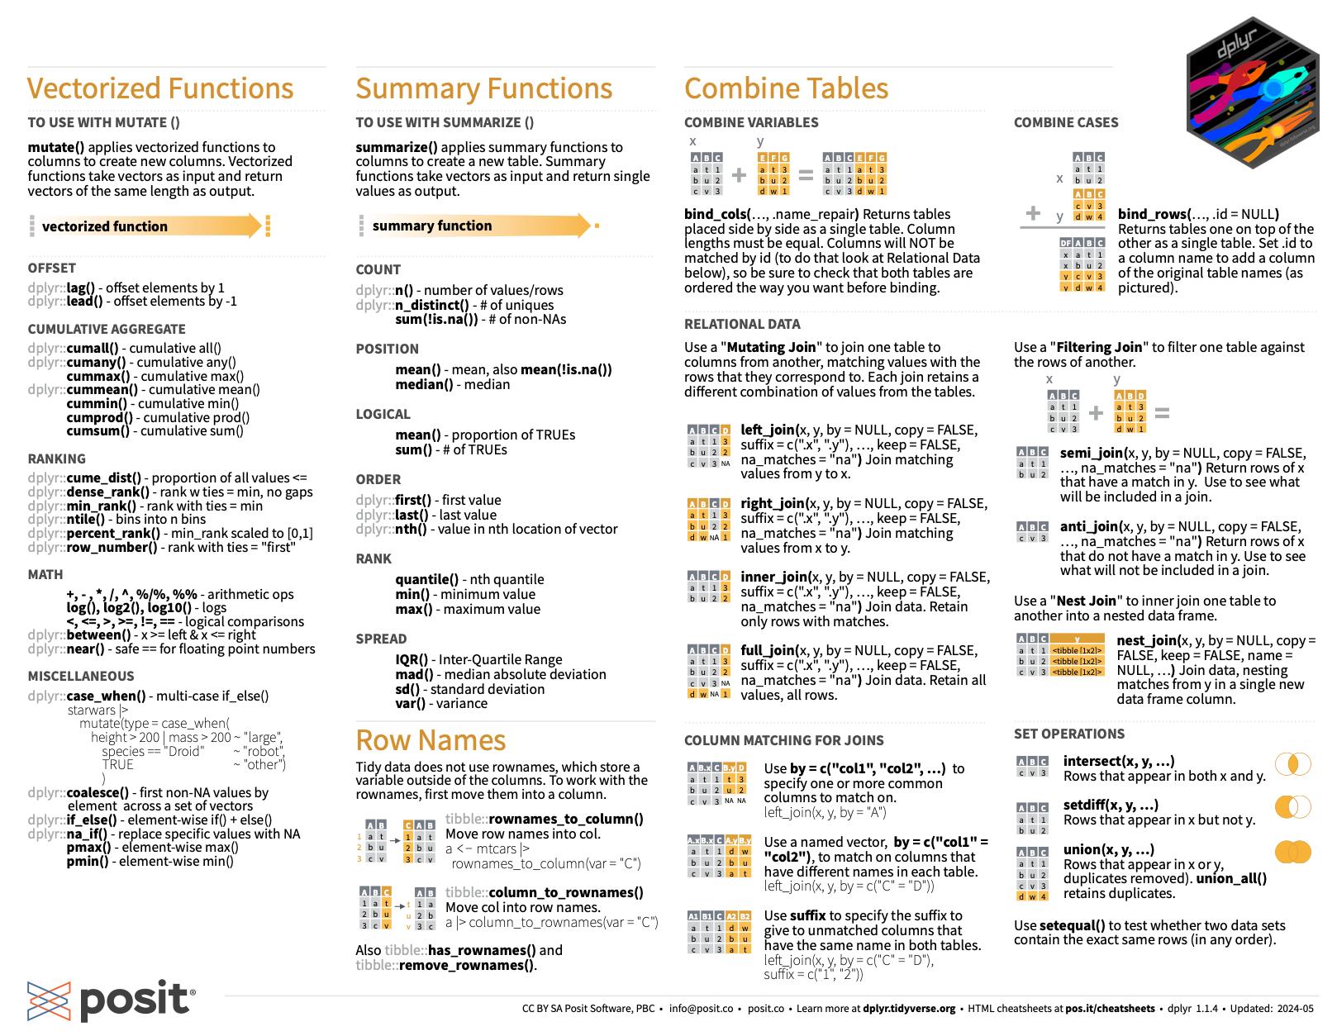

Slide 5
Exercise: read the covid data
Create an R script named “data-manipulation.R” in your project
Load the following libraries:
dplyr (manipulate data)
readr (import data)
Read the data with function read_csv, assign the result to an object called “covid”
What is the class of this “covid” object?

Slide 6
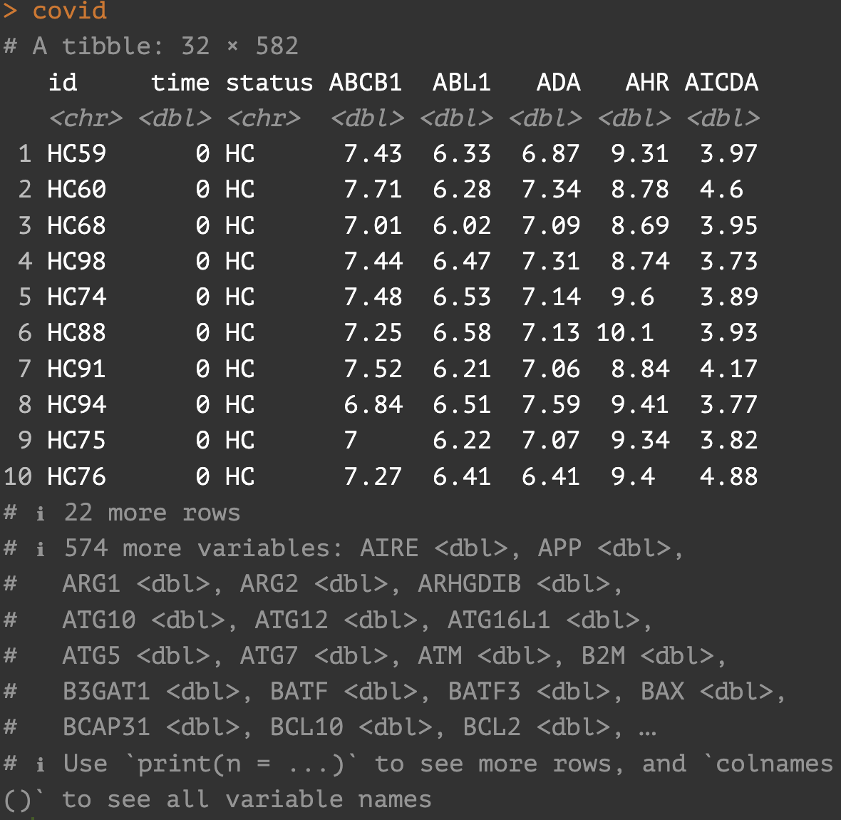
What is a tibble?
“stricter checking and better formatting than the traditional data frame.”
In practice: no very very big difference with our usual dataframes…
BUT… no row names!
Going back and forth:
base::as.data.frame
tibble::as_tibble

Slide 7
These are pipes!
print(covid, n = 2)
|> : available in base R
covid |> print(n = 2)
%>% : available through a package (magrittr)
covid %>% print(n = 2)
ERROR
Error in covid %>% print() : could not find function "%>% »
SOLUTION
library(dplyr)

Slide 8
Two very useful dplyr verbs
Select columns with select()
covid |> select(IL1A)
Filter rows with filter()
covid |> filter(status == “HC”)
Both:
covid |>
filter(status == “HC”) |>
select(IL1A)
How to use a verb?
covid |>
verb1(arg = val) |>
verb2(other_arg = other_val)

Slide 9
Grouping and summarizing
Grouping with group_by
covid |> group_by(id) |> select(
id, time,
status, IFNG)
# A tibble: 32 × 4 # Groups: id [13] id time status IFNG <chr> <dbl> <chr> <dbl> 1 HC59 0 HC 4.31 2 HC60 0 HC 5.35
Summarizing with summarize
covid |> group_by(status) |> summarize(
mean_IFNG = mean(IFNG))
# A tibble: 2 × 2 status mean_IFNG <chr> <dbl> 1 HC 4.99 2 nCOV 4.12

Slide 10
Exercise
Compute the mean expression of IL1R1 in healthy controls using pipes and dplyr verbs (or base R if you prefer).
NB: There are several possible solutions. Try to find at least two.

