Slide 1
Introduction to ggplot2
Vincent Guillemot

Slide 2
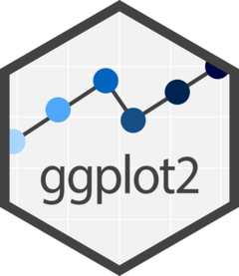
Cheatsheet
data-visualization.pdf

Slide 3
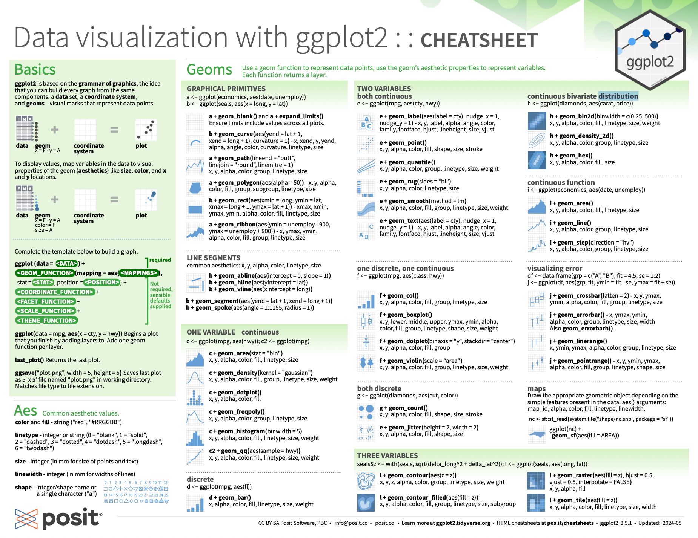

Slide 4
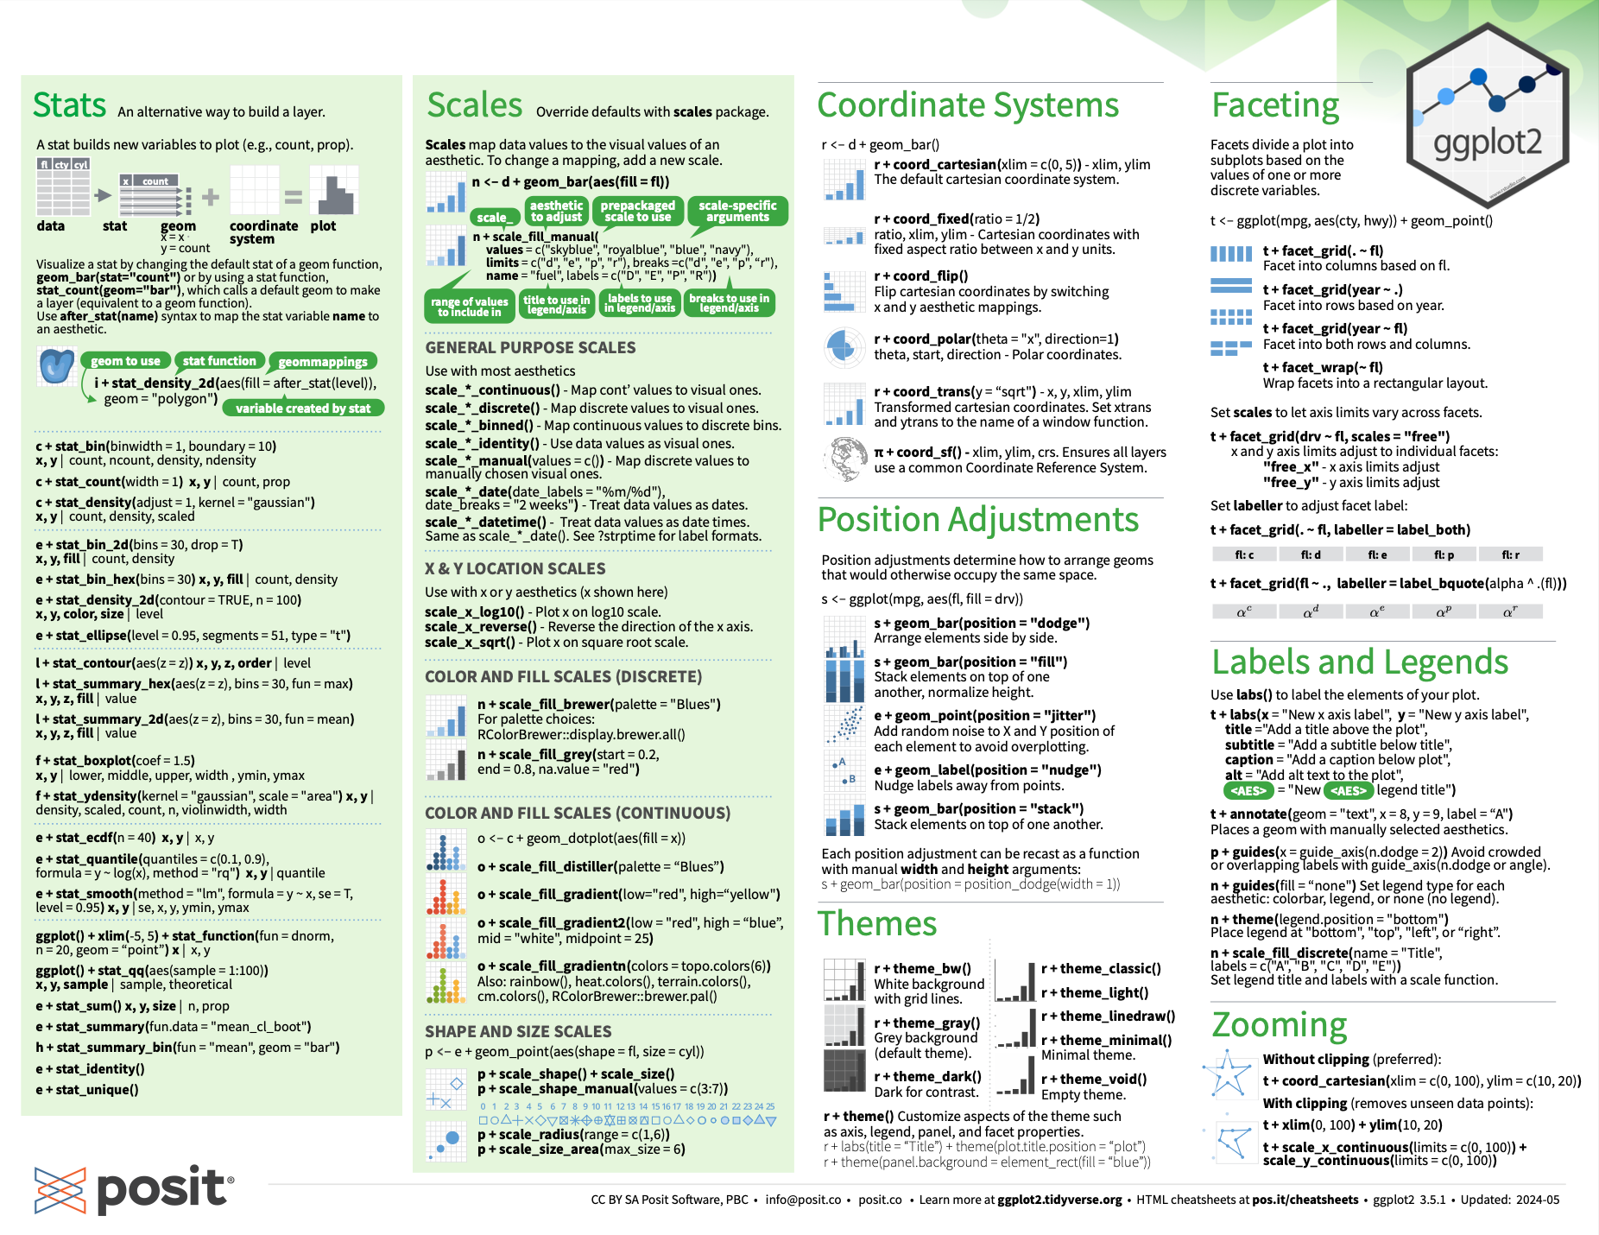

Slide 5
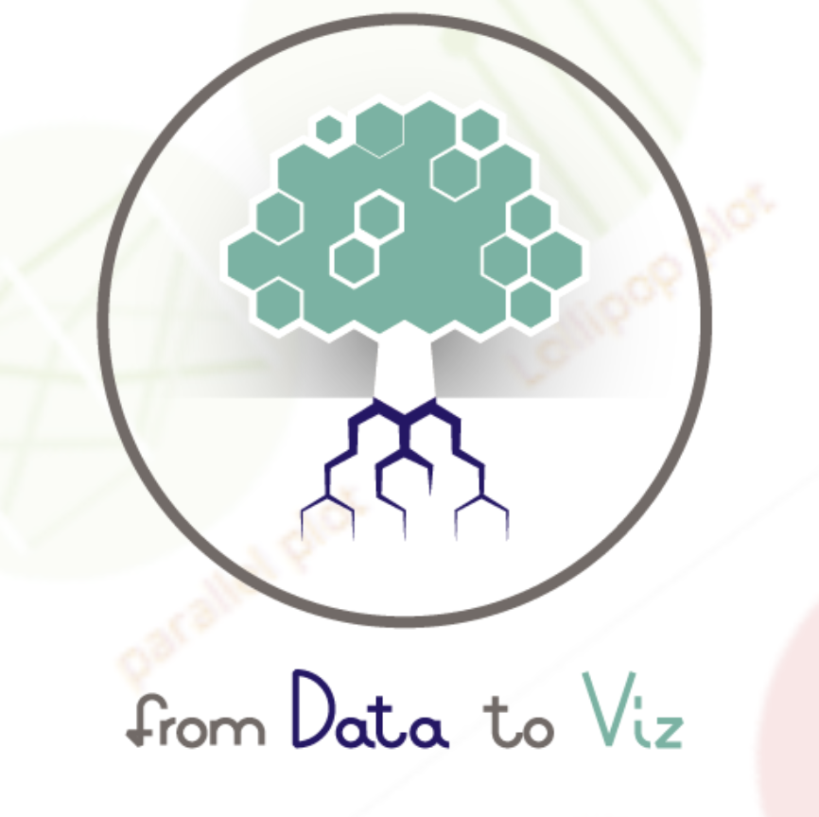
From data-to-viz
To get some graphical insights
https://www.data-to-viz.com/

Slide 6
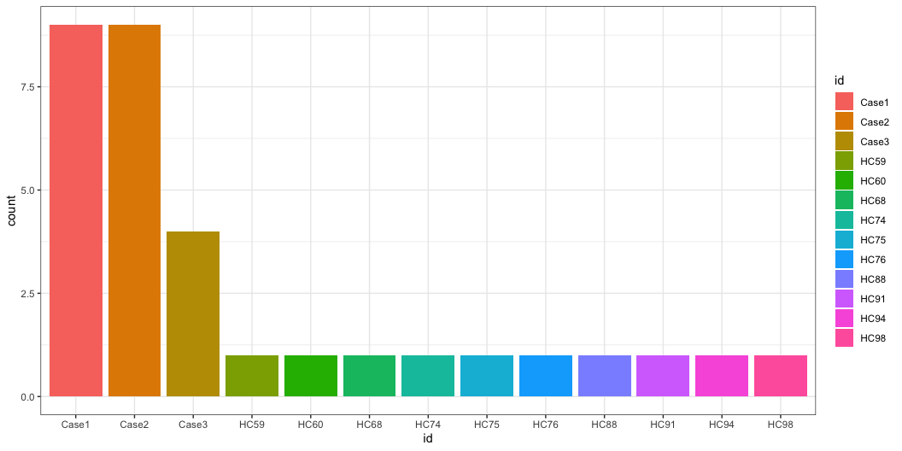
Barplot of the number of observations per subject
covid |> ggplot(aes(x = id, fill = id)) + geom_bar()

Slide 7
Barplot of the number of observations per subject
Use your favorite pipe
covid |>
ggplot(aes(x = id, fill = id)) +
geom_bar()
Aesthetic parameters
Geometry

Slide 8
Experimenting with ggplot2
Open the script called “ggplot2_experiment.R”: what does each individual command do?

Slide 9
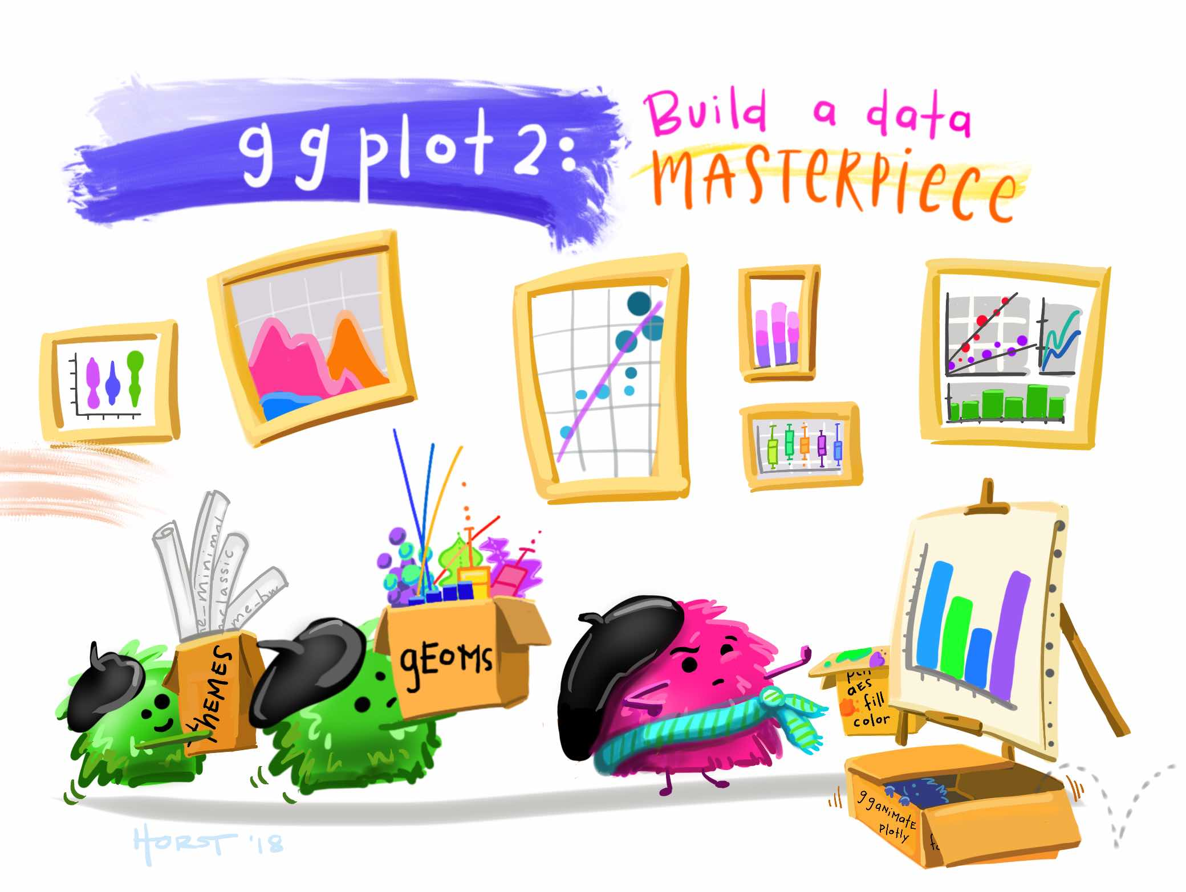
Artwork by @allison_horst

Slide 10
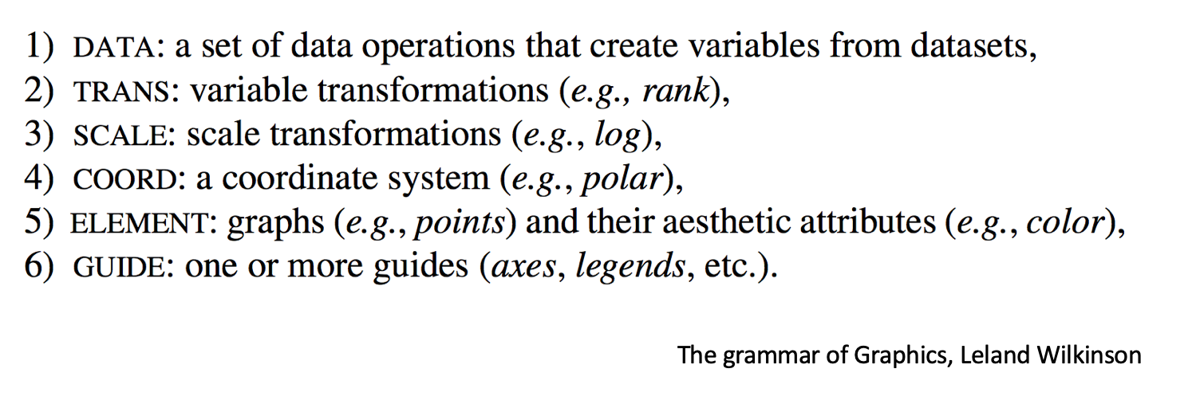
[G]rammar of [G]raphics

Slide 11

Implémentation dans ggplot2
Data | data | Dataset (data-frame or tibble) containing the data that needs to be drawn
Geometries | geom_ | Graphical objects used to represent the chosen data into shapes, colors, dots etc…
Aesthetics | aes() | Aesthetics parameters, meaning the type of graphical property that needs to be associated with a column of the dataset.
Scales | scale_ | Functions used to customize the transformation of values (from the dataset) into graphical objects. A scale function needs to be associated to an aesthetic parameter.

Slide 12
Exercise
Create a histogram of the expression of IFNG for
all subjects
healthy controls only

Slide 13
Conclusion: everything is customizable
Aesthetics: which columns of the dataset are transformed into graphical objects
Geometries: the graphical objects used to create the graph
Scales: how the values are transformed
Theme: general parameters

Slide 14
Exercise: aesthetic parameters
Fix the script “ggplot2_aesthetics.R”!

Slide 15
Exercise: be creative!
What do you want to plot from the COVID dataset?

Slide 16
Conclusion
Visualizing data is a complex and iterative process!
Know your limits, don’t forget your favorite tools, get inspiration.

