Slide 1
Introduction to R Markdown
Vincent Guillemot

Slide 2

Cheatsheet
rmarkdown.pdf

Slide 3
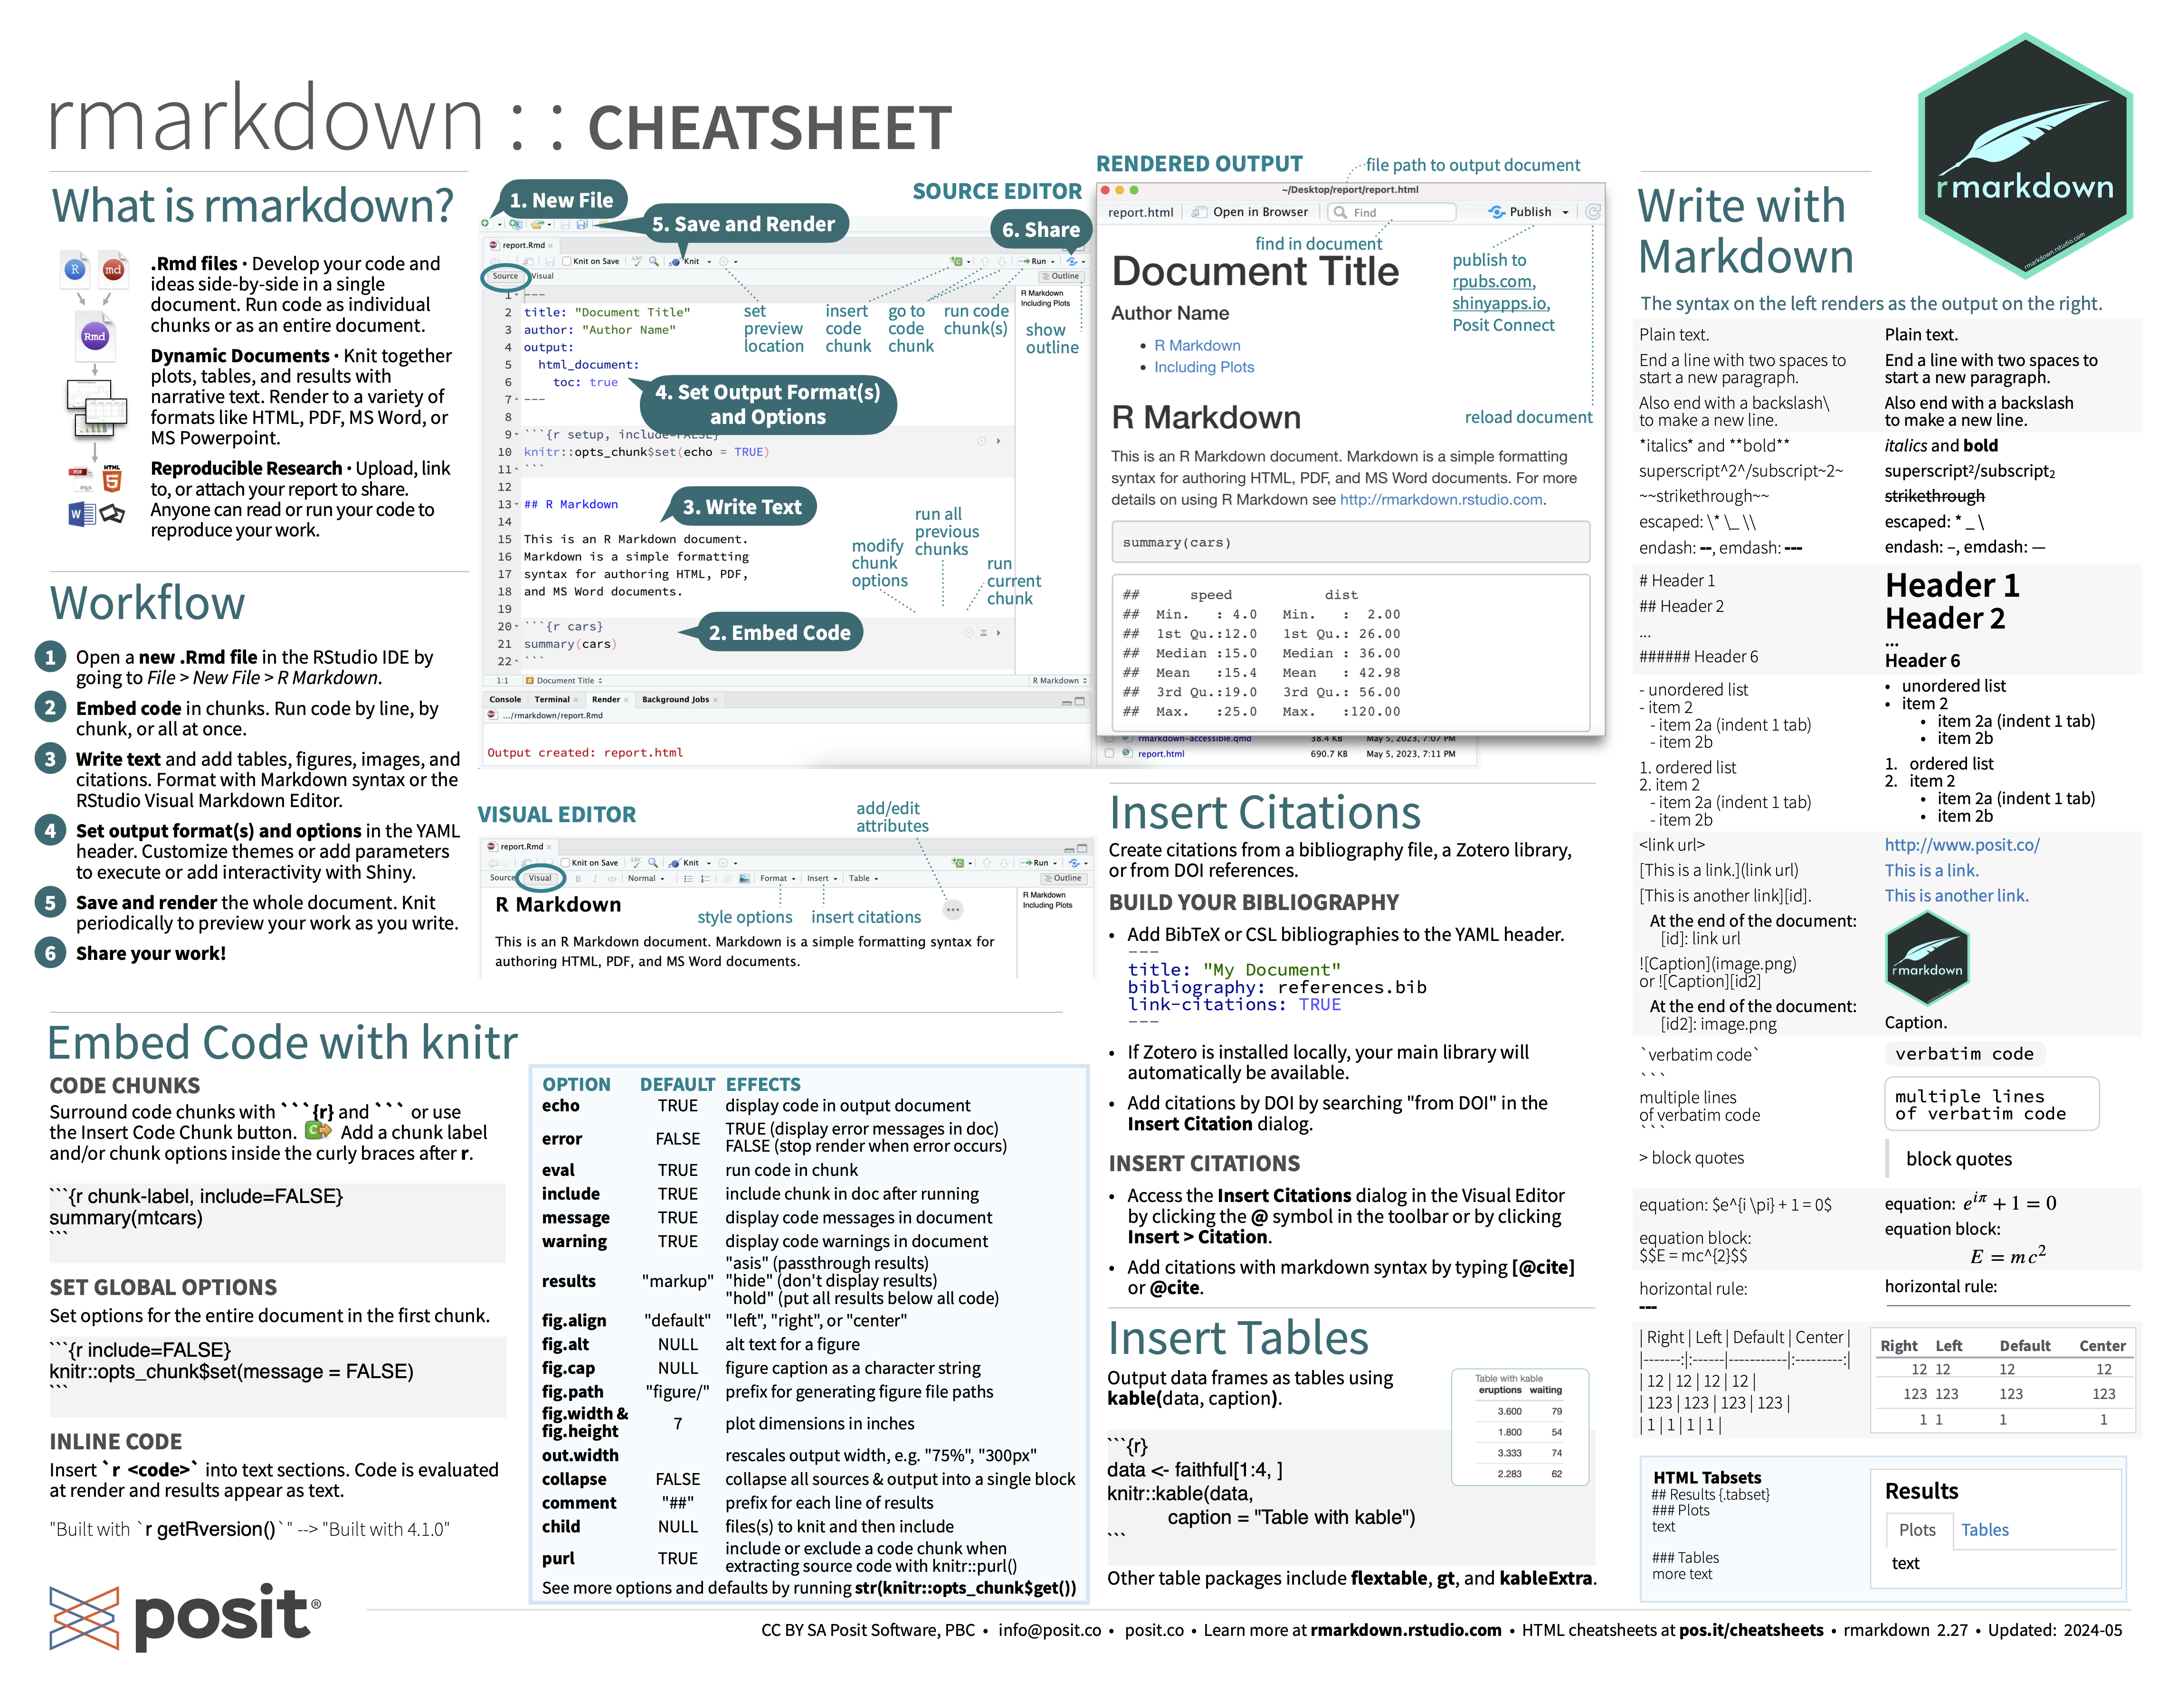

Slide 4
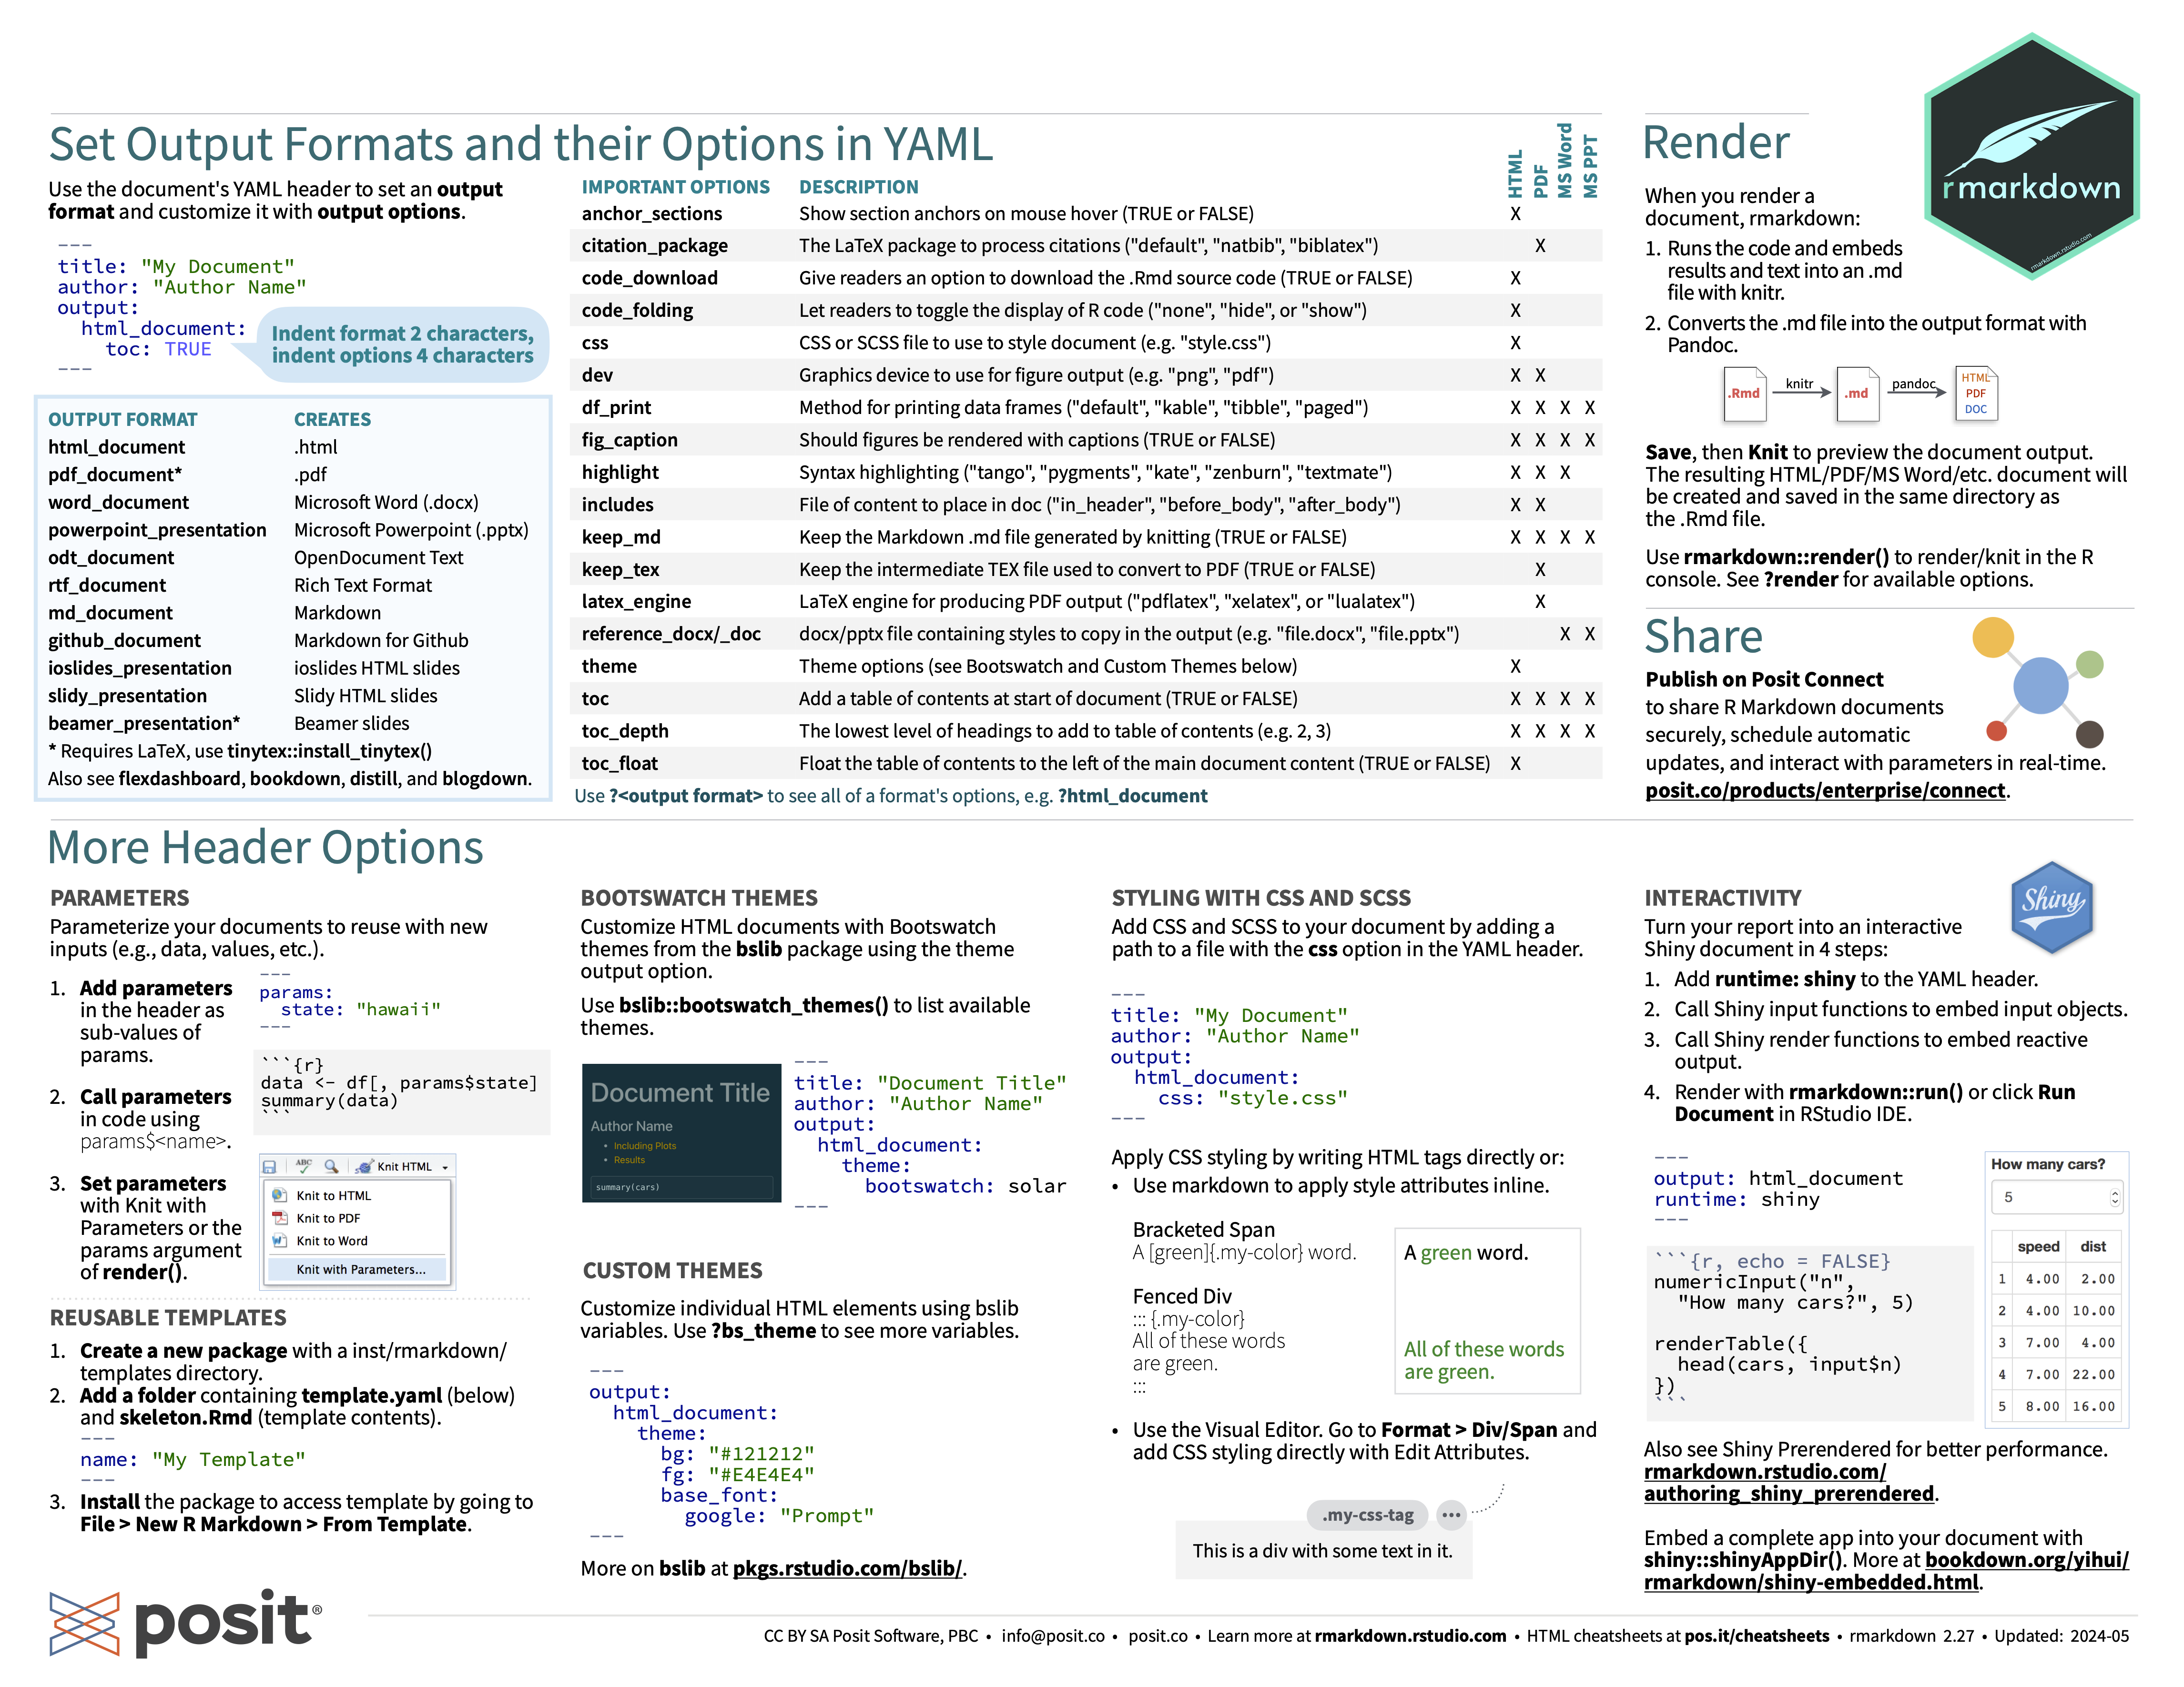

Slide 5
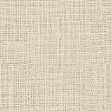

A mixture of tools and languages
WAOUH.HTML
R Markdown file
R
Markdown
Knitr
pandoc
YAML

Slide 6
Other features
PDF: LaTeX
Maths: LaTeX
Customized HTML documents: CSS (ou SCSS)
Diagrams: mermaid or GraphViz
Other high-level programming languages: Python, Julia, SQL
Other: bash, Rcpp (C++), Stan (statistiques bayésiennes),

Slide 7
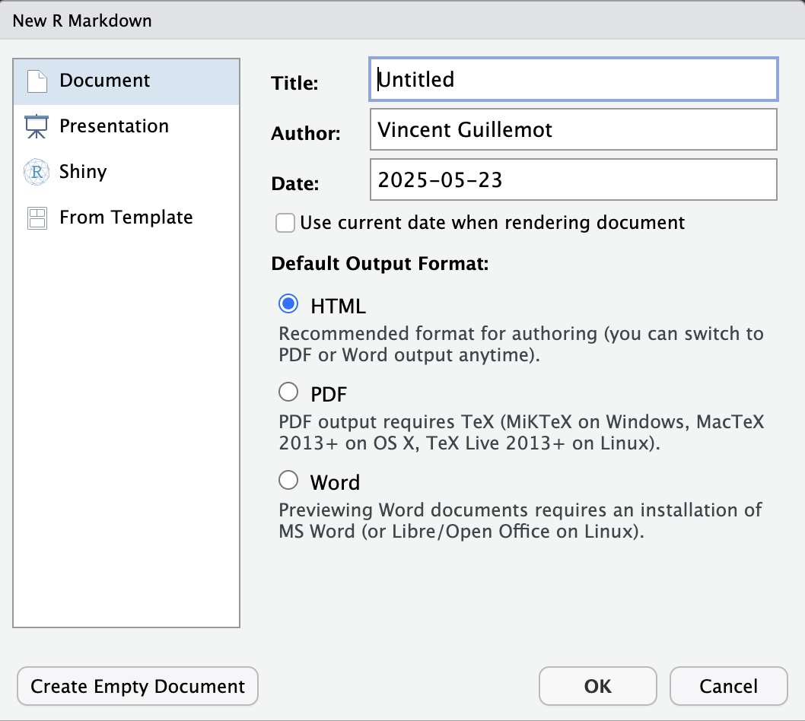

The default document
File > New File > R Markdown…
Procedure:
create a document,
change the default values,
change
headers,
text,
R code,
save document as an Rmd file.
Click on “Knit”

Slide 8
Exercise: modify the default document
Select « HTML » output format
Change title to “Document 1: title and text”
Change author
Change text:
Header to “Header”
Text to “I’m learning R Markdown!”
Save this file as “document1-simple.Rmd”
Compile by clicking on “Knit"

Slide 9
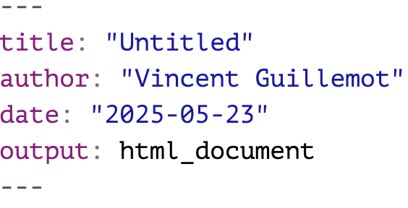
The structure of an R Markdown file
YAML header: title, author, date, etc.

Slide 10
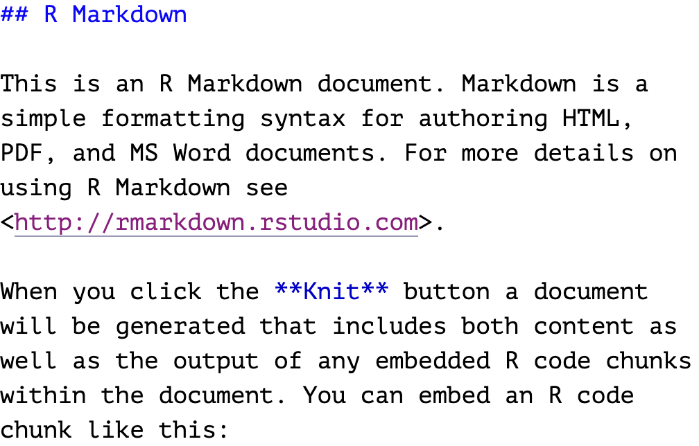
The structure of an R Markdown file
Text in Markdown

Slide 11
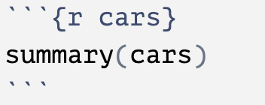
The structure of an R Markdown file
This chunk is called “cars”
R code in chunks
This is an R chunk
It contains this set of R commands

Slide 12
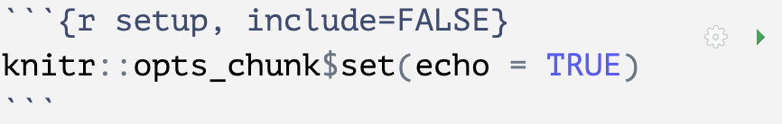
The structure of an R Markdown file
Its code is executed but nothing is shown on the output file
Setup chunk
This R chunk is called “setup”
It sets the values of chunk options for all the other chunks
All chunks have these little buttons, they are here to help you!

Slide 13

Exercise
Create an R Markdown document called « document2-justeAtitle.Rmd »
Compile it by clicking « Knit »
The result should look like this

Slide 14
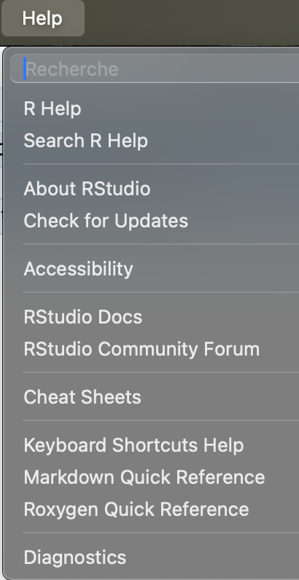
The “text” part is written in Markdown
It’s another language entirely… but intuitive!
Markdown Quick Reference
(…)
Emphasis
*italic* **bold**
_italic_ __bold__
Headers
# Header 1 ## Header 2 ### Header 3

Slide 15

Exercise
Create an R Markdown called “document3-just_blabla.Rmd” that will look like this:

Slide 16

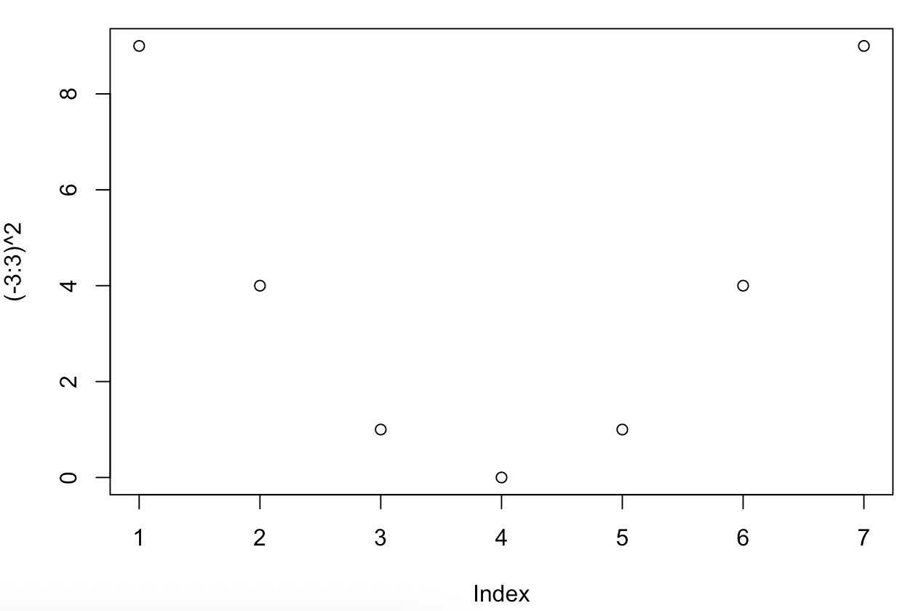
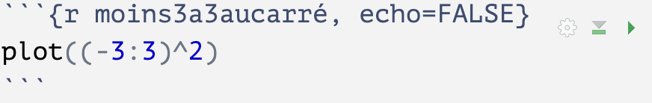

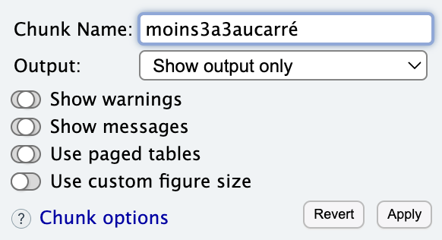
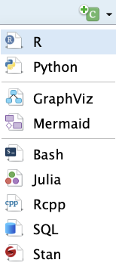

Chunks
Run the code inside this chunk
Add new chunk
Run all the previous chunks

Slide 17
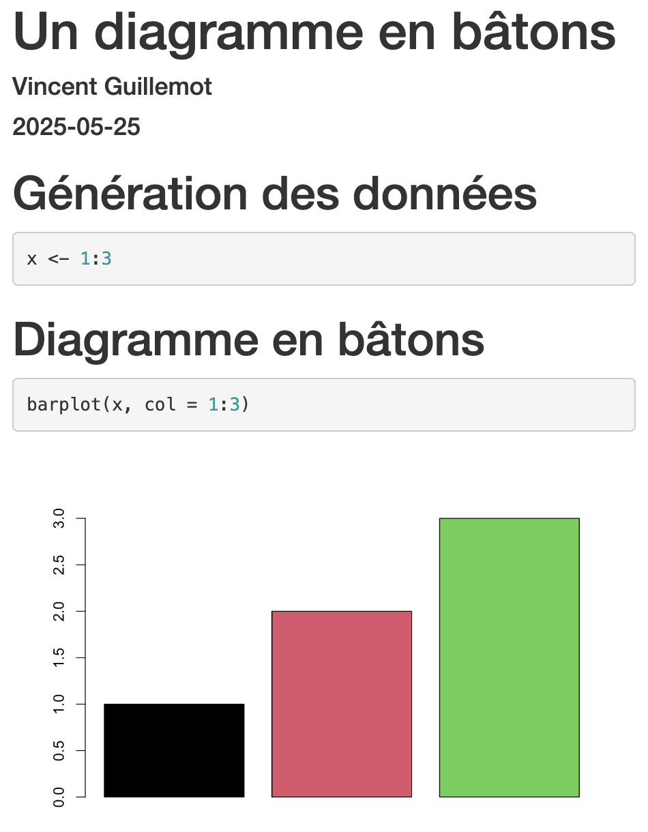
Exercise
Create an R Markdown document called « document4-complete.Rmd », with
a YAML header
Markdown text
Two R chunks
That will compile into the following HTML document ->

Slide 18
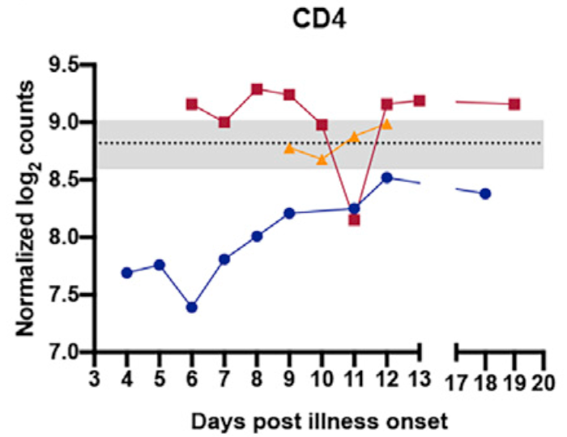
Final exercise: the first useful R Markdown document
Create an R Markdown document that will contain:
An R chunk to load the COVID dataset
An R chunk to show the expression of CD4 for all cases
A title, your name and the date
Some text
Work in groups

