Slide 1
Introduction to pathchwork
Vincent Guillemot

Slide 2
No cheatsheet
:’(

Slide 3
How pathchwork works
A set of operations to combine plots: imagine what adding, dividing, multiplying plots would mean!
:mind_blowing:
In practice:
“+” general operation (does a lot of stuff for you)
“/” stack plots on one another
“|” put plots next to each other
plot_layout(…) to control the layout
and more!!!! (e.g., “&”, “plot_annotation”)

Slide 4
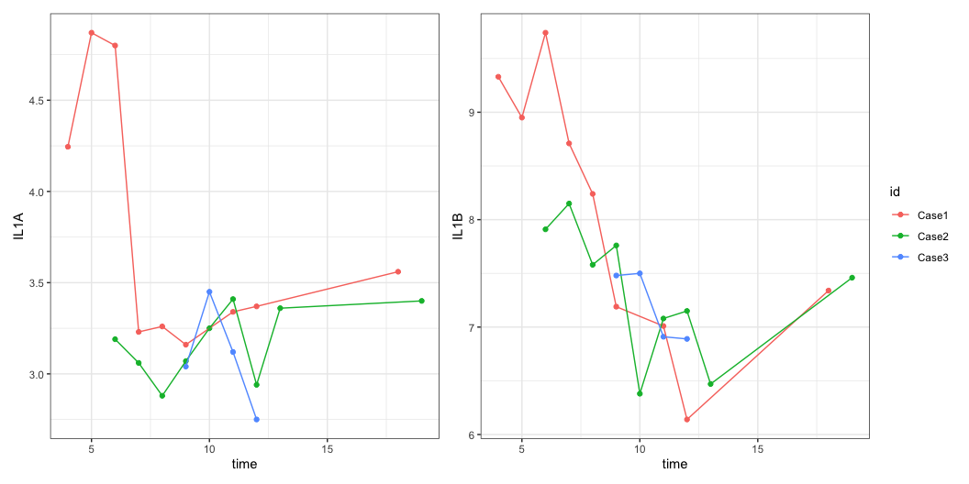
Example: IL1A and IL1B
il1a <- covid |> filter(status == "nCOV") |> ggplot(aes(x = time, y = IL1A, color = id)) + geom_point() + geom_line() il1b <- covid |> filter(status == "nCOV") |> ggplot(aes(x = time, y = IL1B, color = id)) + geom_point() + geom_line() (il1a | il1b ) + plot_layout(guides = "collect")

Slide 5
Exercise
Compose the panel B and C of figure 2 with patchwork, and then combine them together.

Slide 6
Group exercise
In groups, create a report with R Markdown with
a title, the authors names, and today’s date
chunks to load and pre-process the data
a text to shortly explain the data
a reproduction of Figure 2 using pheatmap, ggplot2 and patchwork
During the debrief, prepare an answer to the following questions:
What is missing compared to the original?
Are there choices that were made by the authors that you were able to understand and explain?
Was it difficult?

