Slide 1
Slides for Integration with code and equations

Slide 2
Parcimonie
random_sparsity <- function(coefs, nb) { out <- coefs out[sample(length(out, nb))] <- 0 return(out) }

Slide 3
SGCCA
res.sgcca <- rgcca( blocks = pHGG, sparsity = c(0.1, 0.1, 1), response = 3)

Slide 4
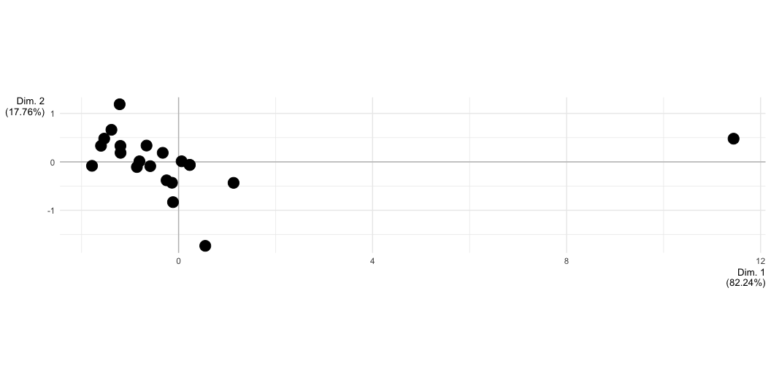
Outliers - one observation is isolated from the others

Slide 5
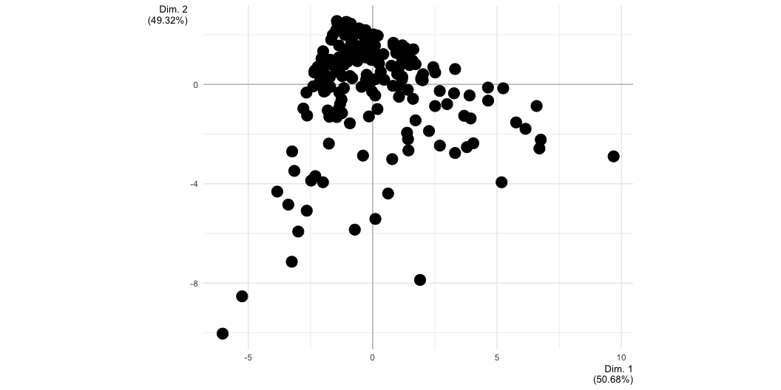
Outliers - carte très dissymétrique

Slide 6
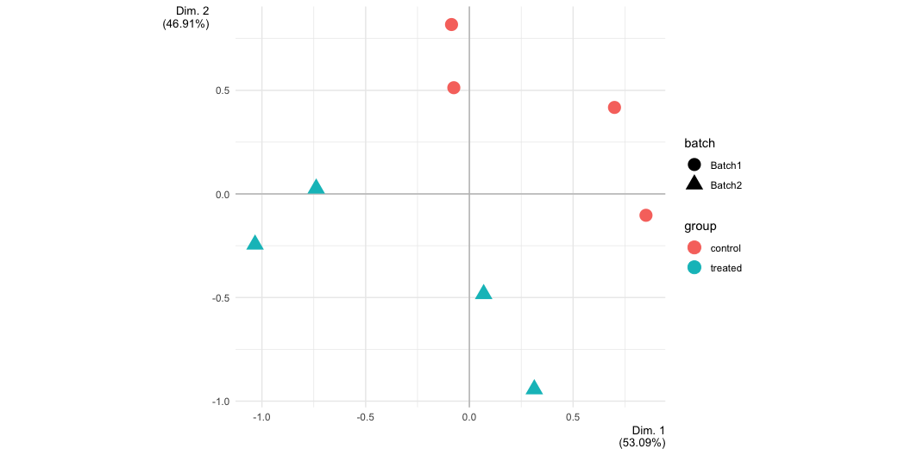
Outliers - confusion

Slide 7
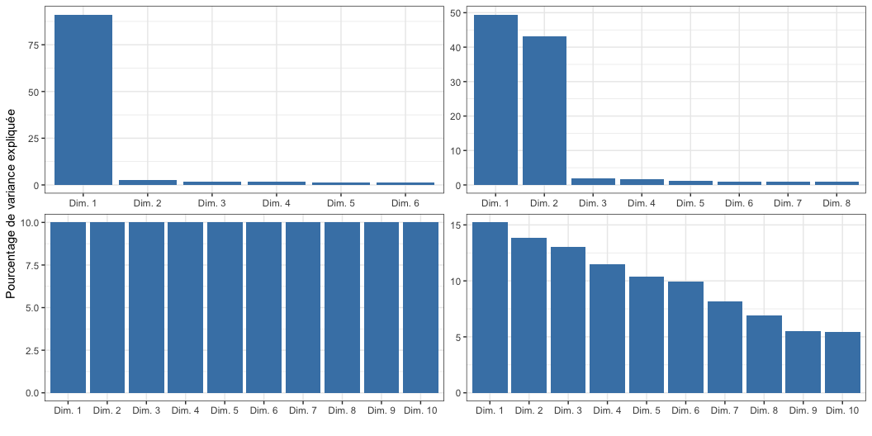
Sélection du nombre de composantes

Slide 8
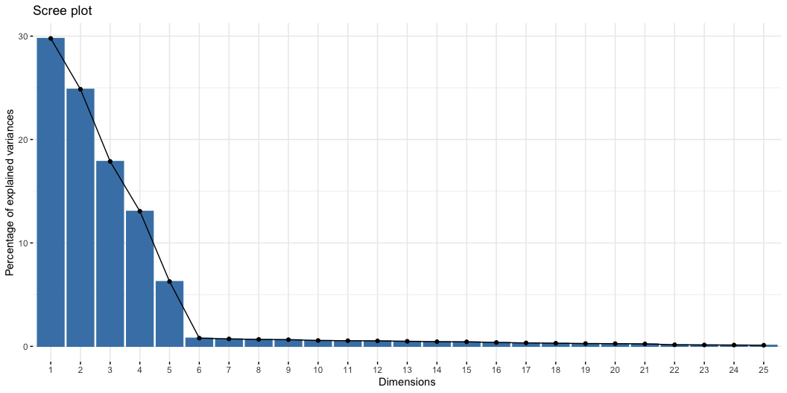
Elbow rule

Slide 9

Permutations rule

