Slide 1
Deploy shiny app on the web

Slide 2
The Rstudio documentation
https://shiny.rstudio.com/articles/deployment-web.html

Slide 3
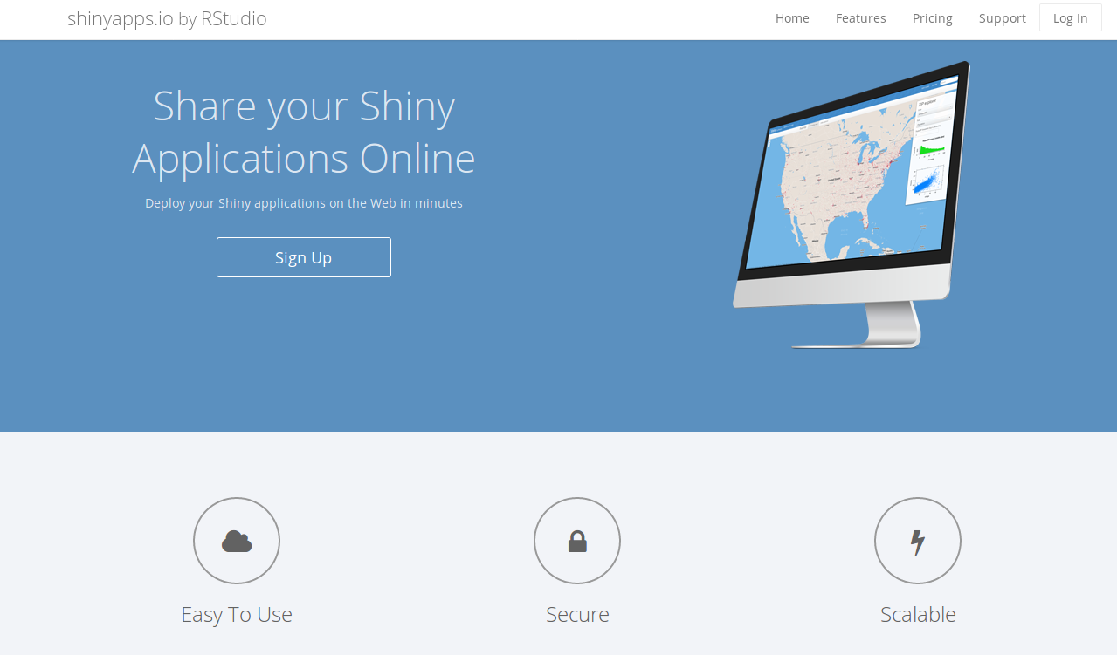

Slide 4
Shinyapps.io
first install rsconnect in Rstudio
install.packages('rsconnect')
Then create an account on shinyapp.io
https://www.shinyapps.io/

Slide 5
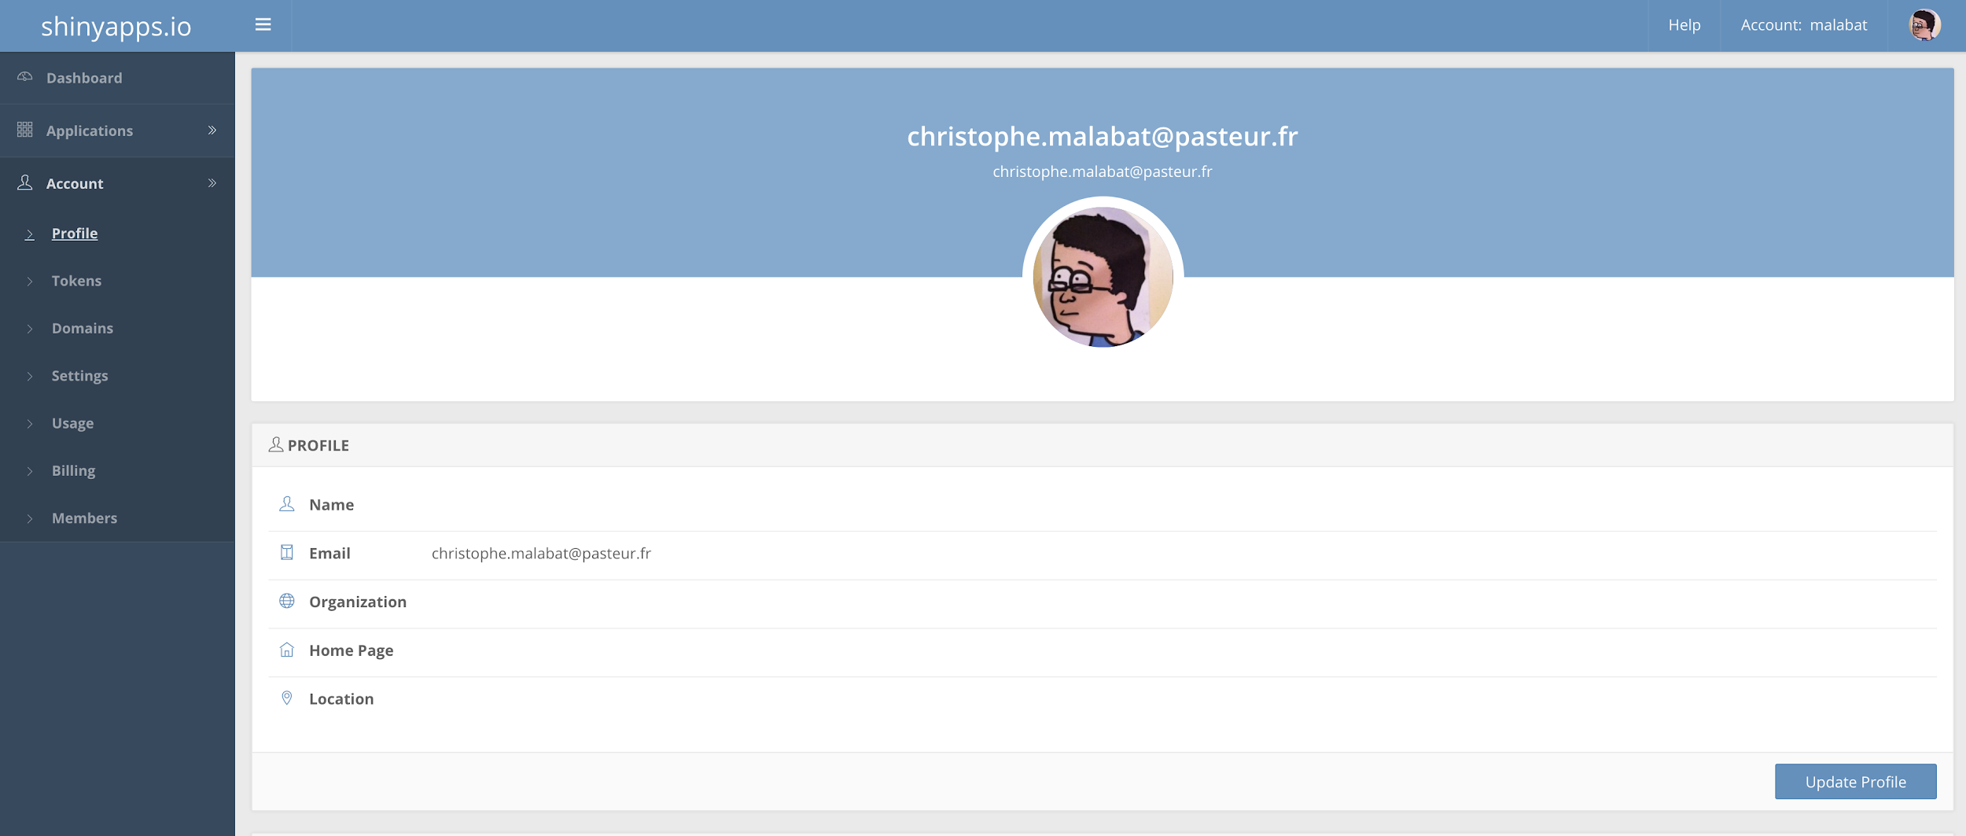

Slide 6
Shinyapps.io
Copy the token into Rstudio
rsconnect::setAccountInfo(name='malabat',
token='630DC388B2F1E7555A63681A5B847015',
secret='<SECRET>')
Don’t forget to show the ‘<SECRET>’ part before copying.

Slide 7
Shinyapps.io
Deploy the app
rsconnect::deployApp('path/to/your/app', account = ‘yourAccountName’)

Slide 8
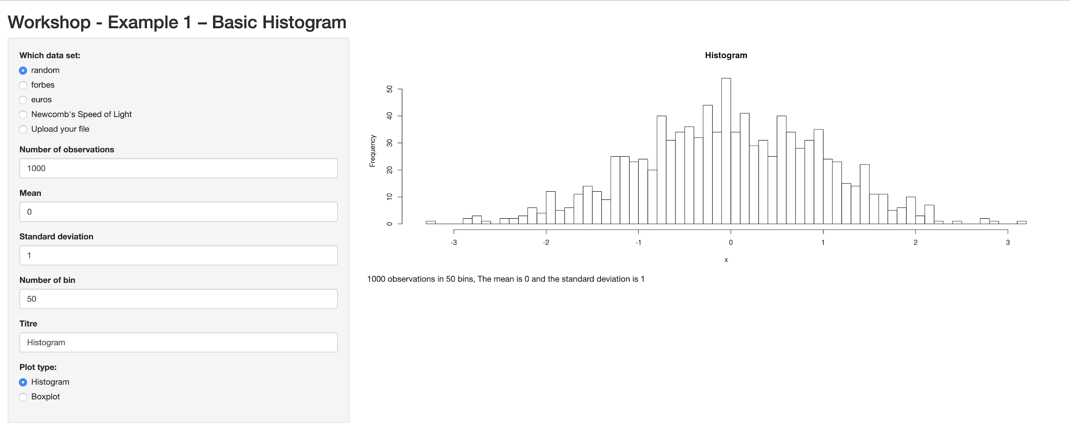
Shinyapps.io
The app is online :
https://malabat.shinyapps.io/shiny/

Slide 9
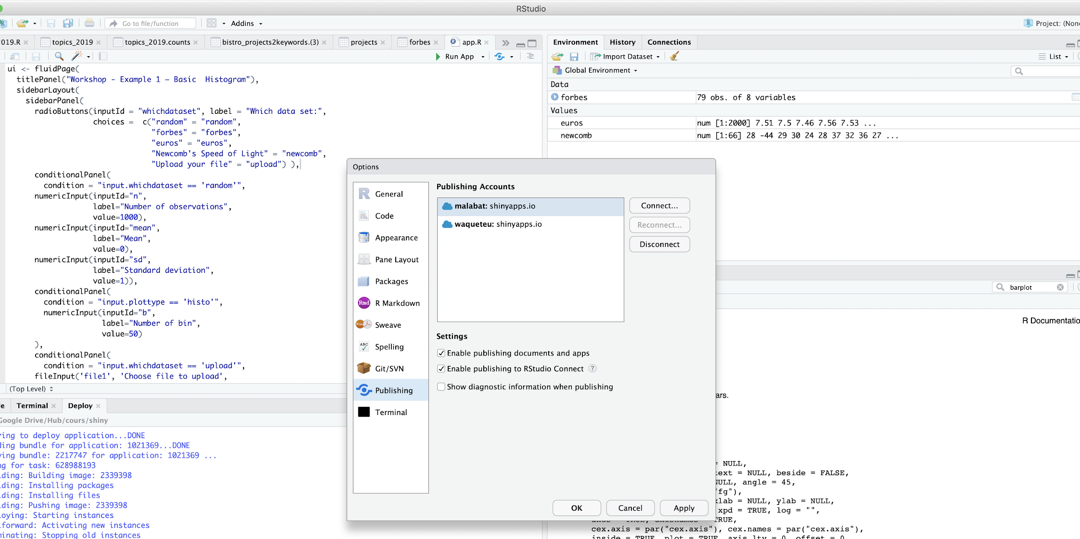
Shinyapps.io - Publish with Rstudio
After doing rsconnect, your account is configured into Rstudio - Go to publish menu for finding it

Slide 10
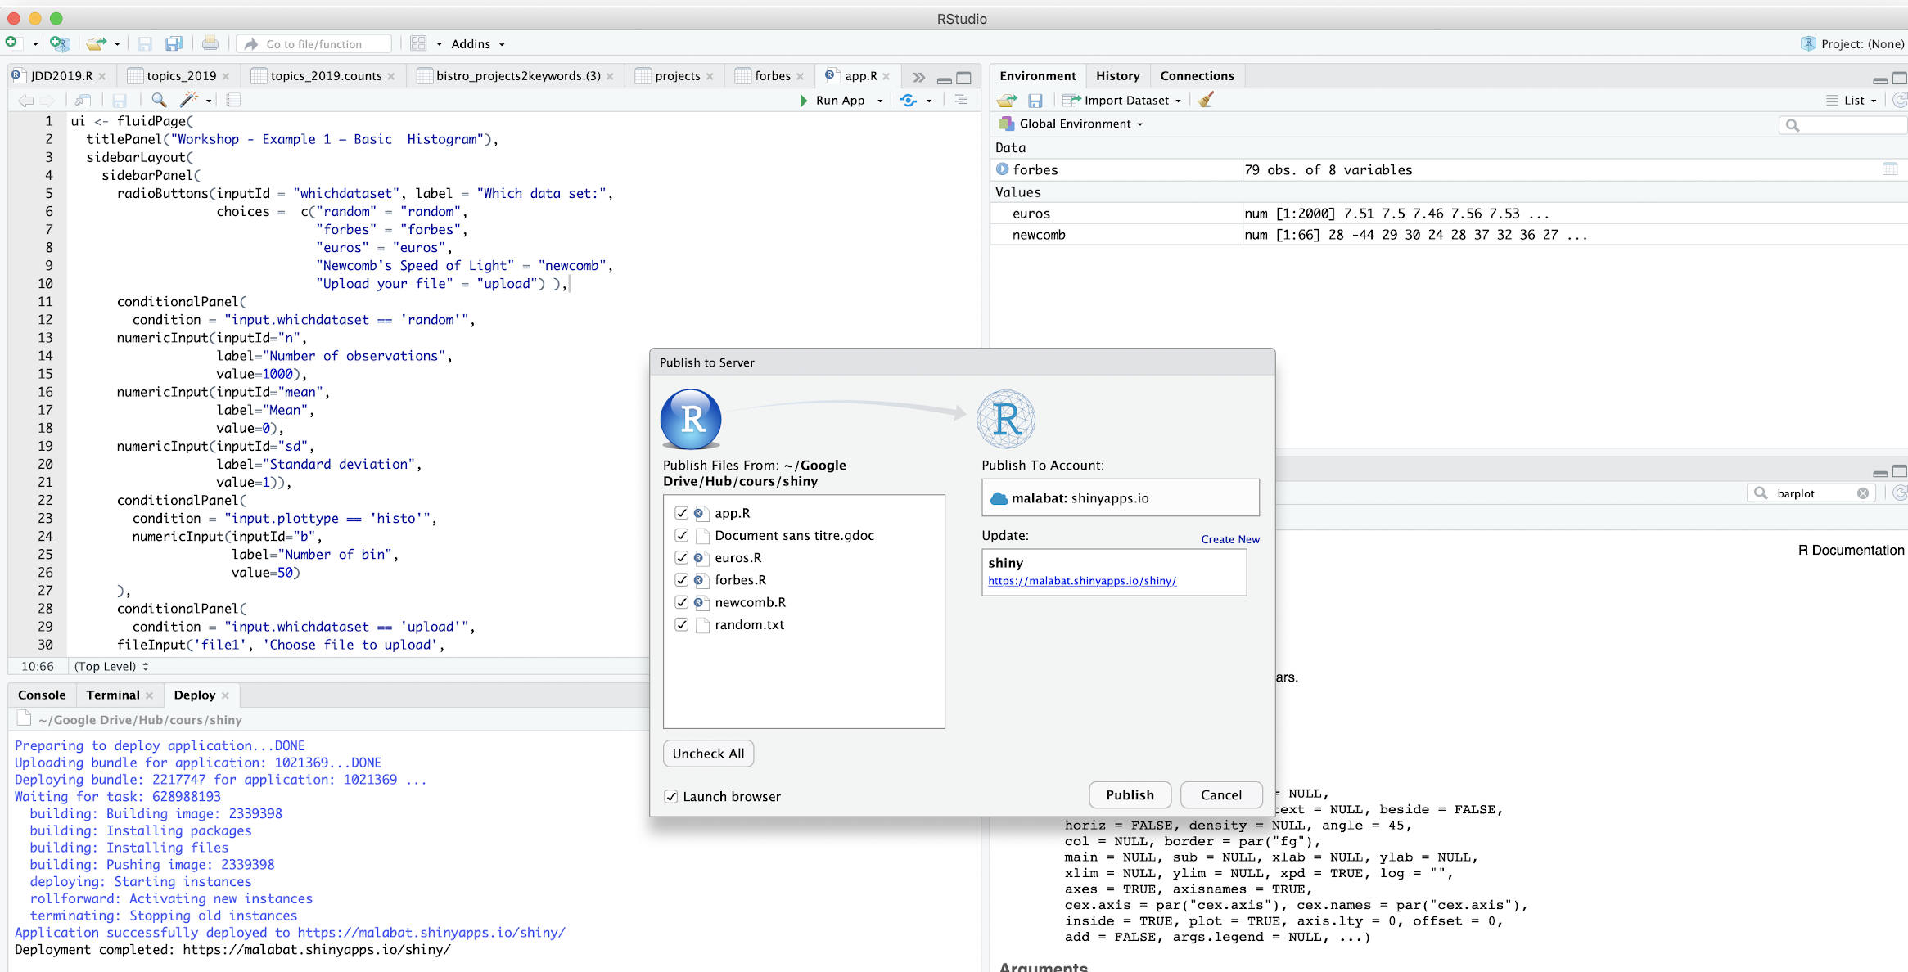
Shinyapps.io - Publish with Rstudio
Publish

Slide 11
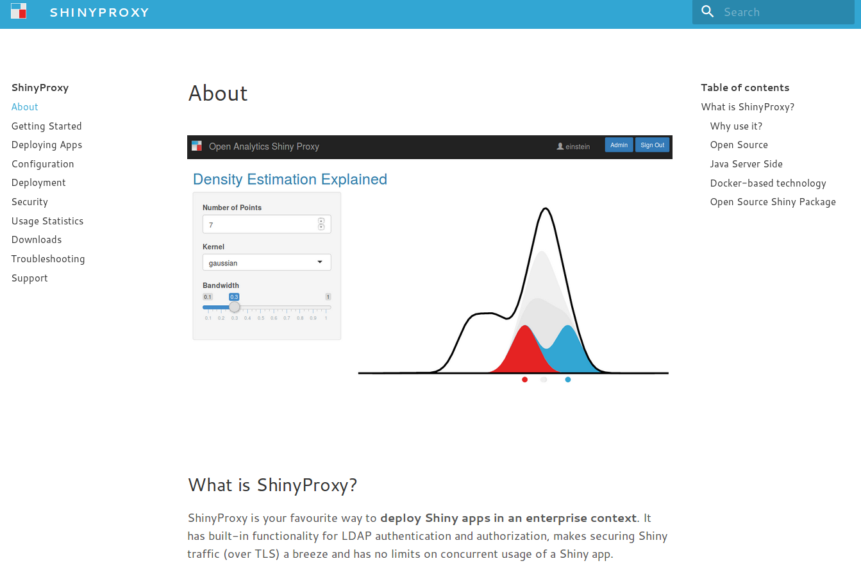
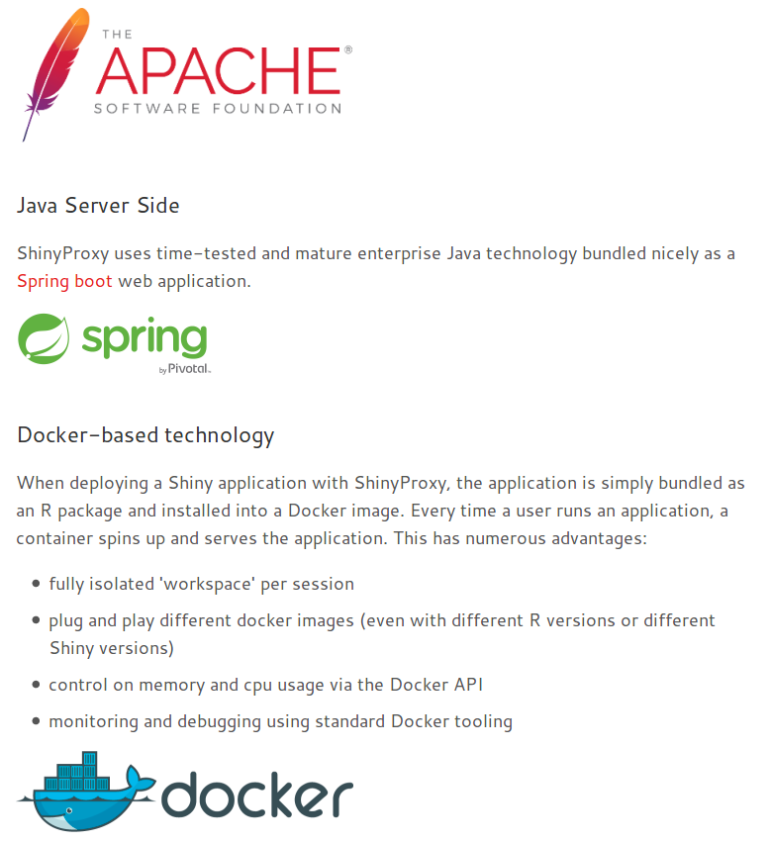

Slide 12
Shiny server & shiny server pro
Install shiny server
Install shiny R with apt-get for example
install shiny in R with install.packages()
sudo systemctl start shiny-server
scp path/to/my/app name@myserver:remotepath/to/my/app
Start shiny server
Copy the app files in a directory
Configure shiny-server.conf

Slide 13
the pros and cons
 | Infrastructure needed | Costs | Ease of installation | Skills needed for deployment
shinyapps.io | None needed | - free for 5 apps/25h usage - paying service for more important needs | No installation needed | No skills needed
shinyserver open source | ++ | free with limited capabilities 5000 €/year for full version | Installation relatively easy on ubuntu Maintenance easy for systems administrators | few skills in unix
shinyproxy | ++ | - free | Installation relativeley easy using docker but docker administration is not so easy | few skills in unix

Slide 14
Shinyapps.io
Troubleshootings
Error in lint(appDir, appFiles, appPrimaryDoc) :
Cancelling deployment: invalid project layout.
The project should have one of the following layouts:
1. 'shiny.R' and 'ui.R' in the application base directory,
2. 'shiny.R' and 'www/index.html' in the application base directory,
3. 'app.R' or a single-file Shiny .R file,
4. An R Markdown (.Rmd) document,
5. A static HTML (.html) or PDF (.pdf) document.
6. 'plumber.R' API description .R file
7. 'entrypoint.R' plumber startup script
8. A tensorflow saved model

Slide 15
Troubleshooting errors on installing rsconnect package
rsconnect packages depends on openssl and curl development packages.
Ubuntu:
If RCurl or openssl fail to install, make sure you have installed the dev packages of curl and openssl:
sudo apt-get install libssl-dev
sudo apt-get install libcurl4-openssl-dev

Slide 16
Troubleshooting errors on deployment
> rsconnect::deployApp("Shiny-SoSV/")
Preparing to deploy application...DONE
Uploading bundle for application: 1021372...Erreur :
* Application depends on package "ggsci" but it is not installed. Please resolve
before continuing.
* Application depends on package "shinyjs" but it is not installed. Please resolve
before continuing.
De plus : Warning messages:
1: In FUN(X[[i]], ...) :
Failed to infer source for package 'ggsci'; using latest available version on CRAN instead
2: In FUN(X[[i]], ...) :
Failed to infer source for package 'shinyjs'; using latest available version on CRAN instead
3: Unable to package DESCRIPTION files: Couldn't find DESCRIPTION file for ggsci
FIX: install missing packages
> install.packages(“ggsci”)
> install.packages("shinyjs")
> rsconnect::deployApp("Shiny-SoSV/")
Preparing to deploy application...DONE
Uploading bundle for application: 1021372...DONE
Deploying bundle: 2217728 for application: 1021372 ...
Waiting for task: 628985176
building: Parsing manifest
building: Building image: 2339381
building: Fetching packages
building: Building package: nlme
building: Building package: Matrix
building: Building package: mgcv
building: Installing packages
building: Installing files
building: Pushing image: 2339381
deploying: Starting instances
rollforward: Activating new instances
success: Stopping old instances
Application successfully deployed to https://jos4uke.shinyapps.io/shiny-sosv/

